Slide 1



PROPOSAL FOR STRATEGIC COLLABORATION IN LEARNING AND GRADUATE SKILLS ENHANCEMENT
Prepared for :
Prepared by :
Notes:
Font Type: Open Sans
Font Size: Proposal Title (60), Proposal Details (40)
Business unit & Client logo: Small size

Slide 2
TAF SALIHIN-UiTM is a collaborative effort between the Faculty of Accountancy UiTM and SALIHIN Chartered Accountants to materialise the national agenda of producing competent graduates and skillful and experienced lecturers.
This TAF SALIHIN-UiTM provides a unique and advanced learning and training field for accounting lecturers, students and the industry. This collaboration, also known as ‘industry coming to the university’, aims at providing better learning environment in a real-life industry setting for producing “thinking and enterprising accountants” relevant to industrial and national needs.

Slide 3
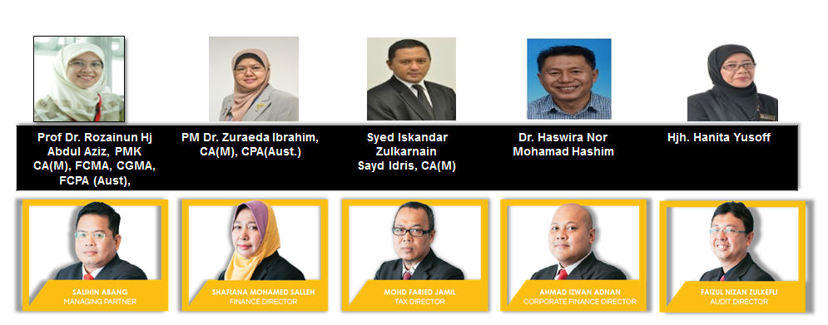
Joint Management Committee

Slide 4
1.0 Executive Summary
Enhancing learning experience with SPS
With the current shift towards efficient governance, the implementation of GST resulted in the requirement of further understanding of the tax structure in accounting. As one of the prestigious Professional Accountancy Centre in Malaysia, IPAC can lead the shift through utilization of professional prgramme as a practical tool in demonstrating tax structure in accounting.
This requires certified accounting software, developed with direct input from the customs department, the Salihin Premier Solution (SPS) will provide the competitive edge for IPAC to enhance the learning experience of its accounting students in gaining the practical understanding on GST implementations and its impacts in financial reports.
Notes:
Font Type: Open Sans
Font Size: Executive Summary Content (36)

Slide 5
Table of Content
1.0
Executive Summary 4
2.0
About Salihin Premier Solutions (SPS) 6
3.0
The Proposal 14
4.0
SPS Certificate Program 18
5.0
Contact Us 25
Notes:
Font Type: Open Sans Light
Font Size: Table of Content (44)
Attention: Please change the table of content and page numbering accordingly. Thank you very much ☺

Slide 6
About SPS
—
2.0 About Salihin Premier Solutions (“SPS”)
Notes:
Font Type: Open Sans (Bold)
Font Size: About Us (60)

Slide 7
ABOUT SPS
SALIHIN PREMIER SOLUTIONS BACKGROUND
The SALIHIN PREMIER SOLUTIONS also know as SPS SOFTWARE , the intelligent software in the world that can manage numerous aspects of financial accounting including Goods and Services Tax (GST) and Zakat calculation, customised specially for Small and Medium Enterprises (SMEs).
SPS SOFTWARE is an efficient and effective accounting software that accommodates changes affecting invoicing and billing system of the business process. The software is powered by the latest security features to secure data or information for optimal integrity and confidentiality. It is tailor made for small and medium industries by professional accountants.
The Zakat module makes SPS SOFTWARE the first comprehensive accounting software with Zakat solution. It will make it easier than ever for Muslim businesses, corporations and organizations to determine the amount payable as Zakat. With Zakat feature built in, it is simply the best accounting software yet.
Notes:
Font Type: Open Sans Light
Font Size: Content (36)
Content suggestion: Client and proposal background.

Slide 8
ABOUT SPS
Modules in SPS
Financial Module
Inventory Module
GST Module
Zakat Module
Waqf / Endowment Module
There are 5 main modules that makes the SPS Accounting software like no other’s.
Notes:
Font Type: Open Sans Light
Font Size: Content (36)
Content suggestion: Client and proposal background.

Slide 9
ABOUT SPS
Core Features
1
Easy To Use
With its user friendly interfaces, SPS requires minimum skill knowledge in accounting.
2
Predefined Accounting Chart
SPS comes with 19 industry standards predefined accounting chart and has flexibility to tailor according to business needs.
3
Biz Dashboard
Data updates are real-time for better business decision making.
4
Drill Down
Analysis and investigate from surface report drill down to the source of transaction.
5
Fully Responsive
Interactive and fully responsive for all devices and screen resolutions.
6
Regulate User Access
Provide the double layer security, all the right control of functionality to regulate the user accessibility to each module system. Can view by online anywhere and any places , and it is web based.
7
Multi Languages supported
SPS is ready to support latest business nature in multiple languages.
8
Super Search
Provides an integrated search engine that enabled users to find information related to transaction in the fastest and easiest way.
Ensure that an accurate record of activities or events is captured
Comprehensive Audit Trail
9
Notes:
Font Type: Open Sans Light
Font Size: Content (36)
Content suggestion: Client and proposal background.

Slide 10
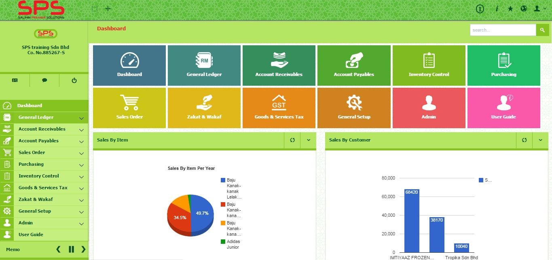
ABOUT SPS
SPS ACCOUNTING SOFTWARE REVIEW
Notes:
Font Type: Open Sans Light
Font Size: Content (36)
Content suggestion: Client and proposal background.

Slide 11
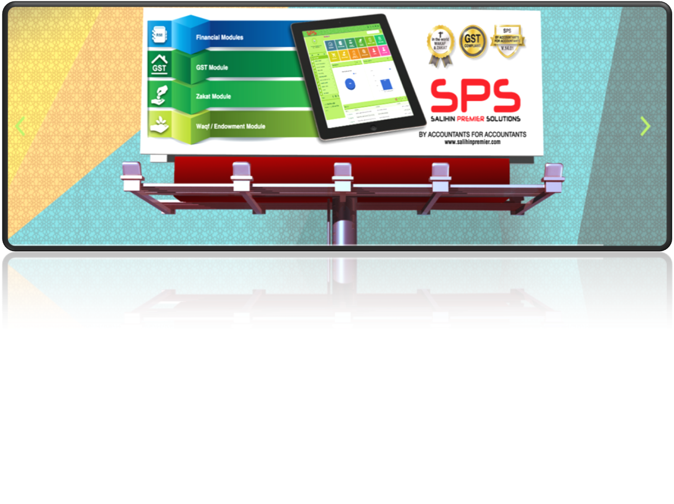
www.salihinpremier.com
Notes:
Font Type: Open Sans Light
Font Size: Content (36)
Content suggestion: Client and proposal background.

Slide 12
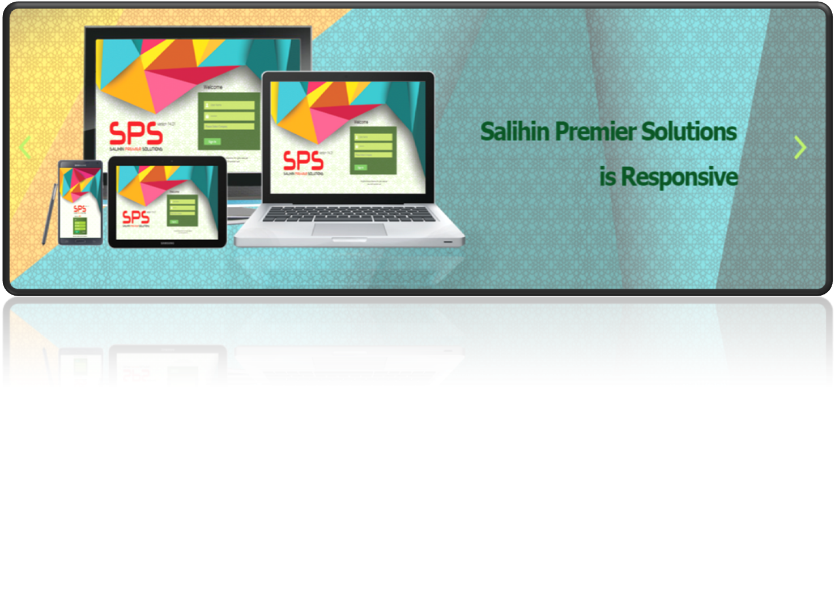
EASY ACCESS
Notes:
Font Type: Open Sans Light
Font Size: Content (36)
Content suggestion: Client and proposal background.

Slide 13
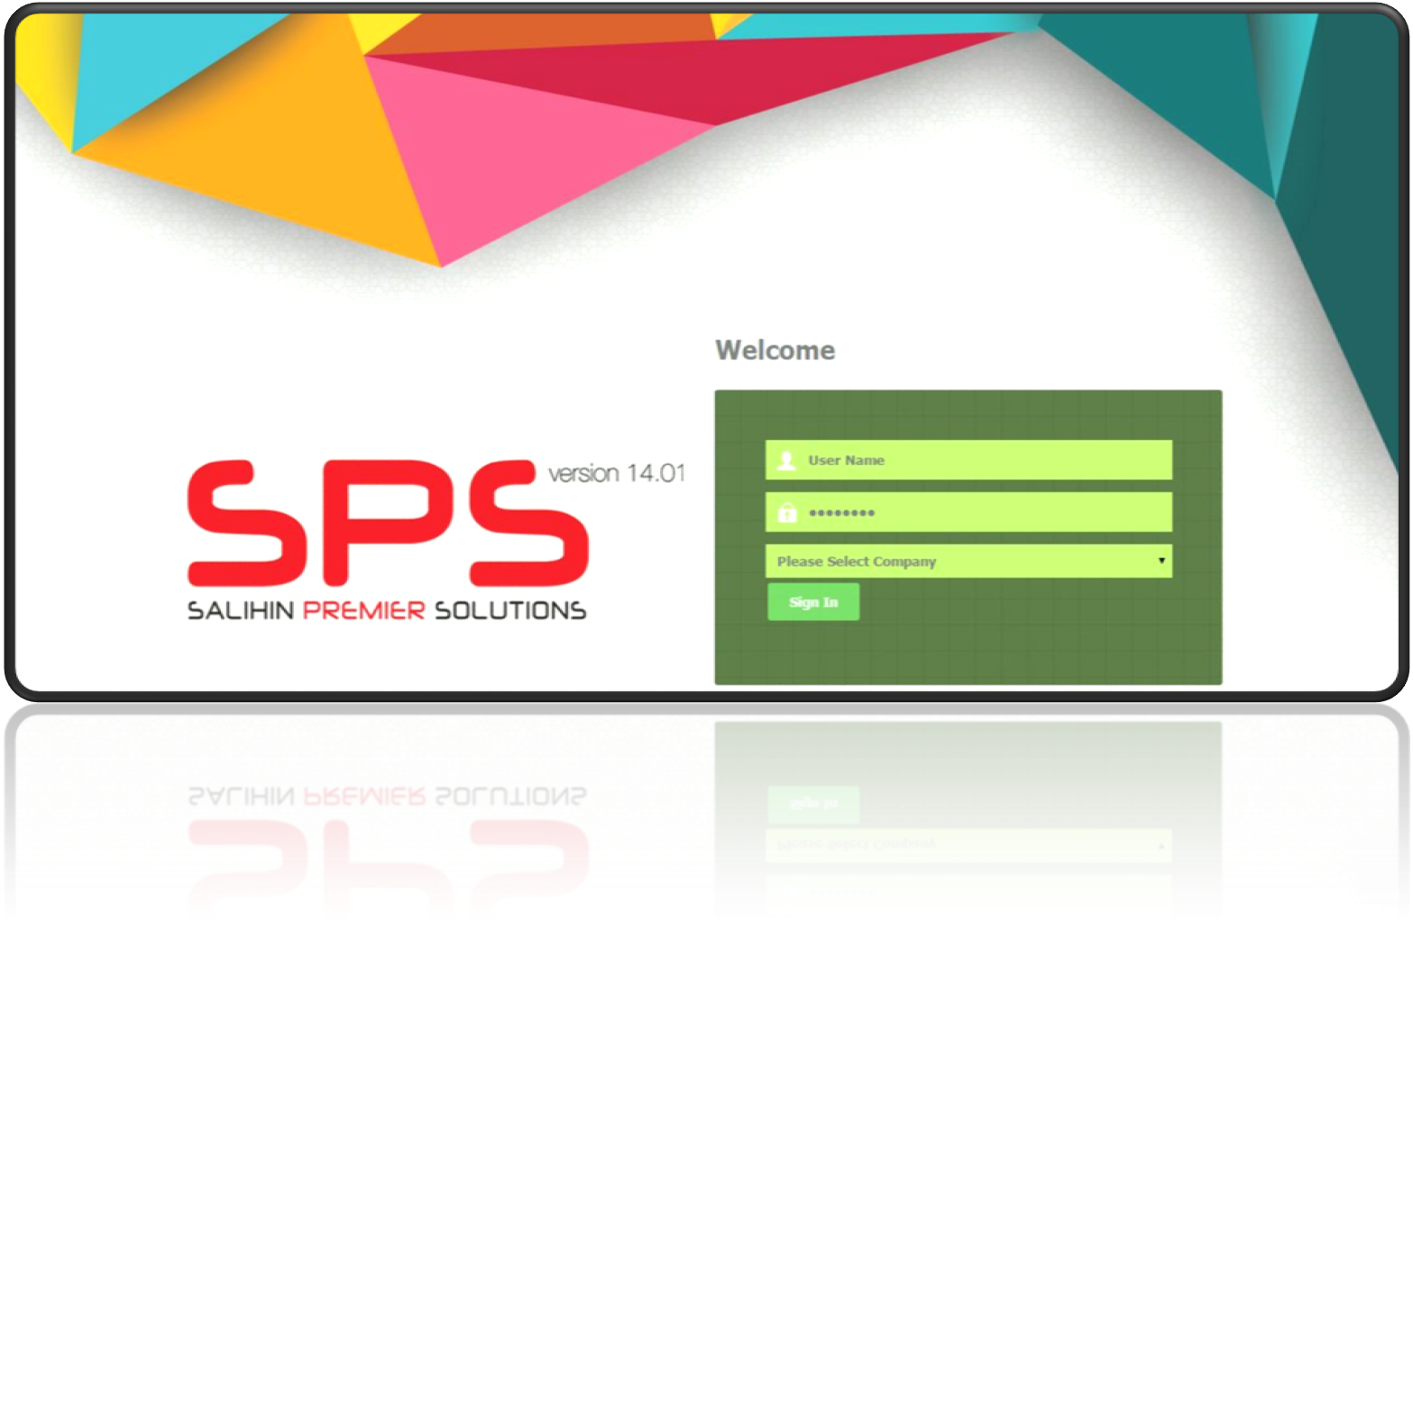
WEB-BASED LOGIN
Notes:
Font Type: Open Sans Light
Font Size: Content (36)
Content suggestion: Client and proposal background.

Slide 14
The Proposal
—
3.0 The Proposal
Notes:
Font Type: Open Sans (Bold)
Font Size: About Us (60)

Slide 15
THE PROPOSAL
VISION AND MISSION
Vision
To equip fresh graduate student from higher learning institution in Malaysia with high value added accounting software skill.
Build long lasting reputation and commitment through excellence.
Mission
Facilitate the expansion and integration of knowledge
Going beyond and influence changes towards improvement.
Provide solution that foster dedicated bonding between TAF SALIHIN-UiTM and IPAC
Notes:
Font Type: Open Sans Light
Font Size: Content (36)
Content suggestion: Client and proposal background.

Slide 16
THE PROPOSAL
OBJECTIVES OF THE PROPOSAL
CAPACITY BUILDING
SKILLS ENHANCEMENT
INDUSTRIAL
RELEVANCE
To equip IPAC graduate student with value added accounting software skills
To provide avenue for IPAC to enhance graduate skills and accreditations
To provide practical expertise and experience for IPAC in delivering courses relevant to current and future industrial practices.
Notes:
Font Type: Open Sans Light
Font Size: Content (36)
Content suggestion: Client and proposal background.

Slide 17
THE PROPOSAL
COLLABORATION MODEL
LECTURER / STUDENT
Commitment
Proactive participation
IPAC
Expand new coursework
programme
To provide gihg quality,
comprehensive educational
facilities.
Student engagement and
participation
Other support as and when
needed.
TAF SALIHIN UITM
SPS Training Provider and
Technical Support
Latest SPS as learning tools for
accounting students
Provide the professional
certified SPS certificate
Notes:
Font Type: Open Sans Light
Font Size: Content (36)
Content suggestion: Client and proposal background.

Slide 18
The Proposal
—
PROPOSAL FOR STRATEGIC COLLABORATION
IN LEARNING & GRADUATE SKILLS ENHANCEMENT
4.0 SPS Certificate Program
Notes:
Font Type: Open Sans & Open Sans Light
Font Size: The Proposal (60), Content (36)
Proposal Title’s Example (at the right-top of the red box) : Audit Proposal (For Audit Dept.) or GST Proposal (For GST Dept.)

Slide 19
PROGRAM OVERVIEW
SPS Training
SPS Training Module
Time | 9.00am to 4.30 pm
Duration | -1 ½ Days Workshop - ½ Day Exam
Exam period | 2 Hour
Venue | IPAC Computer Lab
Target Participant | Professional students
Speaker | TAF Salihin-UiTM trainers
Course Fee | RM 100 per student
Minimum Participation (per session) | 50 students
Course Materials | SPS Installer, User Manual, Stationery, SPS Certificate
Module | SPS overview Installation guides Setup process Sales Order Account Receivables | Purchasing Account Payables General Ledger Goods & Services Tax Zakat & Waqf Calculation
Notes:
Font Type: Open Sans Light
Font Size: Content (36)
Content suggestion: Client and proposal background.

Slide 20
PROGRAM BREAKDOWN
SPS Module Details
SPS Training Module Details
Day | Subjects
1 | SPS Overview Overview of SPS Product Overview on the SPS Interface (GUI) Setup Process COMPANY SETUP User Setup User Access Right Chart of Account System & General Setup Form Setup Financial Year Calendar General Ledger Financial Report Journal Entry? Posting Journal? Other Payment & Other Receive | Account Payables What is Account Payables? Supplier Setup How to create Direct Purchase Invoice? What is Purchase Debit Note & Purchase Credit Note? What is Supplier Payment Advice?
Notes:
Font Type: Open Sans Light
Font Size: Content (36)
Content suggestion: Client and proposal background.

Slide 21
PROGRAM BREAKDOWN
SPS Module Details
SPS Training Module Details
Day | Subjects
2 | Account Receivables What is Account Receivable? Customer Setup How to create Direct Sales Invoice What is Sales Invoice Copy? What is Debit & Credit Note? What is Customer Payment Received? Goods & Services Tax GST Setup – Tax Table, Tax Class, Tax Group, Tax Type, GST Preferences, GST Tax Mapping What is GAF File Process? What is Bad Debt Relief & Bad Debt Relief? GST Report, GST -03 & Relevant Report Zakat & Waqf Calculation | The exam consists of TWO (2) sections Objective questions 10 questions 1 mark per questions Total Mark: 10 Marks Section A (Subjective questions) Total Mark: 85 Marks Section B (Fill in the blank and Amendment) Total Mark: 5 Marks 2. Duration: 2 Hours 3. Venue: IPAC Computer Lab Exam Supervisor TAF Salihin-UiTM Trainers Marking TAF Salihin-UiTM Trainers
Notes:
Font Type: Open Sans Light
Font Size: Content (36)
Content suggestion: Client and proposal background.

Slide 22
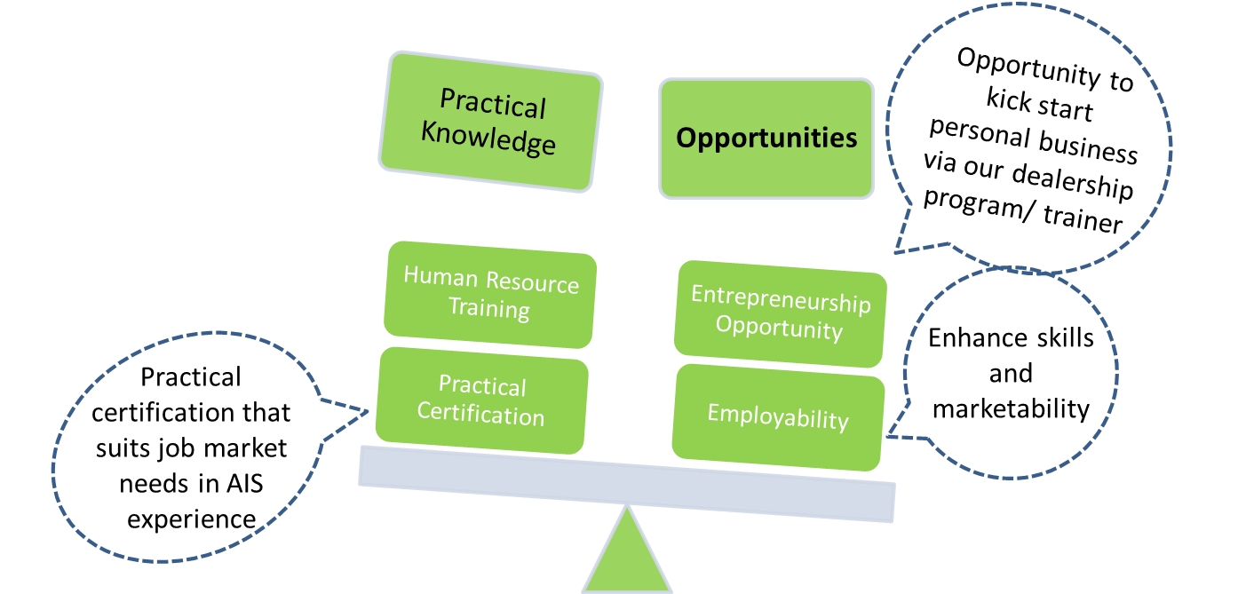
PROGRAM BENEFITS
Benefits of our course and its upskilling features
Notes:
Font Type: Open Sans Light
Font Size: Content (36)
Content suggestion: Client and proposal background.

Slide 23
RULES OF ENGAGEMENT
ROLES & RESPONSIBILITY
ROLES & RESPONSIBILY
IPAC | TAF SALIHIN-UiTM
Provision of teaching space & facilities IPAC shall provide the venues for the program Participation of students IPAC shall prioritize and ensure participation of students as one of its “upskilling” efforts for students Monitor and facilitate training program IPAC shall monitor and facilitate the program operations in terms of smooth operations and commencement Promotion and Marketing IPAC shall permit TAF SALIHIN-UiTM to use its registered name, branding and trademark for the purpose of marketing of the training program in the related marketing materials. | Setting up training program SALIHIN shall create two(2) days training that utilizes SPS for accounting, GST, Zakat and Wakaf complete with exam and certification. TAF SALIHIN-UiTM shall provide the trainer/presenter for the program The training program exam shall be supervised and marked by SALIHIN representatives. Training program materials and contents TAF SALIHIN-UiTM shall to the extent possible to make the training program relevant to the needs of IPAC for its accounting graduates. To achieve this, TAF SALIHIN-UiTM shall, wherever necessary and relevant, The academic standards of the modules offered shall be at par with current industry standards . Promotion & Marketing TAF SALIHIN-UiTM shall use its commercially efforts to promote the training program
Notes:
Font Type: Open Sans Light
Font Size: Content (36)
Content suggestion: Client and proposal background.

Slide 24

Product Comparisons
SPS vs Other Accounting Software
Notes:
Font Type: Open Sans Light
Font Size: Content (36)

Slide 25

5.0 Contact Us
Person Incharge : En. Zafiruddin Baharum
Aras 7, Fakulti Perakaunan ,
UiTM Cawangan Selangor ,
Kampus Puncak Alam,
42300 Bandar Puncak Alam
03-3258 7511
Follow us on social media
Notes:
Font Type: Open Sans Light
Font Size: Content (28)
Attention: You may add / edit this section.

Slide 26

www.salihin.com.my | www.salihinpremier.com
Careline: 1 300 88 5678
Notes:
Attention: Please don’t change any content here. Thank you very much ☺

