Slide 1



MICRO FINANCE ENTREPRENEURS (MFE) ANALYTIC
BY ACCOUNTING SOLUTIONS
PILOT PROPOSAL
Prepared for:
Prepared by:

Slide 2
TABLE OF CONTENT
Introduction of TAF-SALIHIN UiTM
Page 3 - 4
Proposal
Page 5 - 19
Execution Plan
Page 21 - 24
Web Interface
Page 25 - 26
Financial Consideration
Page 27 - 28

Slide 3
TAF-UiTM is a collaborative effort between the Faculty of Accountancy UiTM and SALIHIN Chartered Accountants to materialise the national agenda of producing competent graduates and skillful and experienced lecturers.
This TAF-UiTM provides a unique and advanced learning and training field for accounting lecturers, students and the industry. This collaboration, also known as ‘industry coming to the university’, aims at providing better learning environment in a real-life industry setting for producing “thinking and enterprising accountants” relevant to industrial and national needs.

Slide 4
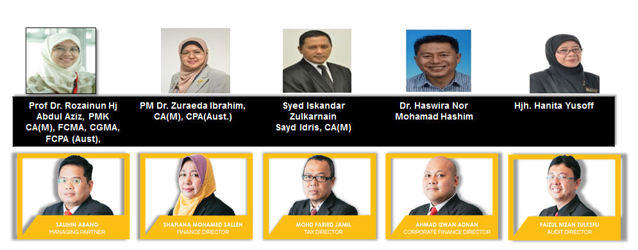
Joint Management Committee

Slide 5

Pilot proposal executive summary
The purpose of preparing this Pilot Project Proposal is to outline the parameters and the scope of work as anticipated from BSN to establish the workable action plan with regards to the Micro Finance Entrepreneurs (MFE) Analytic by SALIHIN’s Accounting Solution (SAS).
Hence, a pilot project is proposed by TAF-SALIHIN UiTM to justify the effectiveness of the “Micro Finance Entrepreneurs Analytic by Accounting Solutions Proposal”.
HELPDESK
SUPPORT
INDUSTRIES PARTICIPATION
SITE VISIT &
MONITORING
ACADEMIA PARTICIPATION
DATA ENTRY
STUDENT
TRAINING
SALIHIN ACCOUNTING SOLUTIONS (SAS)
5

Slide 6
Pilot Deliverables parameters
To establish the numbers of participants and the trainings plan for the Pilot Project.
To establish and develop the Project Execution Plan & Timeline with the tentative schedules for the proposed implementation intended at the proposed date, time & venues. This to be determined by BSN.
To outline the value added services availability as set forth by SALIHIN’s on the data entry & monitoring TAF-UiTM.
To established the detail content of the certification certificate for the successful participants.
To discuss and organize the “BSN MFE Award” for successful participating entrepreneurs in this pilot program.
To elaborate the Advertising & Promotions to create the programme awareness.
To proposed the reporting process and recording method for progress monitoring.

Slide 7
Pilot project – delivery plan
May 2018 –April 2019
Jul 2019
Mar 2018
Program Start
Site Selangor
BSN-MFE Award (optional)
Preparation & Planning of Project Execution Plan
2019
Issuance of Pilot project LOA & Contract Agreement
Advertising & Promotion
Report & Monitoring
Anticipated
Feb - Mar2018
Mar – April 2018
May 2019 –June 2019

Slide 8

Pilot project – proposed salient points
Proposed no. of MFE./ license
Proposed no. of MFE per Student
Total no. of site visit
1,000
10
1,000
Proposed Zones / Territories | Zone Selangor
Proposed MFE | 1,000
Proposed Duration | 1 Year
Hence, we anticipate to reasonably run the Micro Finance Entrepreneurs Analytic by Accounting Solutions Pilot Project evaluation process will last for at least 12 – 14 months inclusive pre-development period of at least 1-2 months. It comprises of setting up the SALIHIN Accounting Solutions (S.A.S) into the cloud based and students training.

Slide 9

What is sps?

Slide 10





Target audience
1,000 Micro
Entrepreneurs selected by BSN
100 Students selected by TAF-UiTM

Slide 11

Micro Finance Entrepreneurs Analytic framework
Micro
Sales turnover; < RM 300,000
OR
Employees; < 5

Slide 12
PROPOSED ROLE & RESPONSIBILITIES
BSN | MFE
Provide fund to MFE Identify and provide information of selected MFE to TAF-SALIHIN UiTM Acquire SPS software and provide to the selected MFE From time to time BSN consistently monitor MFE and give feedback (if any) to TAF-SALIHIN UiTM | Provide picture document taken from cash book provided on weekly basis to support center number. Provide accounting information to BSN MFE can seeks advice to any accounting matters form TAF-SALIHIN UiTM.

Slide 13
PROPOSED ROLE & RESPONSIBILITIES
SALIHIN | UiTM
Provide SPS accounting software Preview the financial statements on quarterly basis Analyze the accounting records and report on the performance of MFE to BSN semi-annually | Identify manpower (students or lecturers) to assist MFE to record business transactions. To provide standard format of Cash Book to MFE. The respective manpower will key in business transactions on weekly basis (1 day per week) TAF-UiTM and selected lecturers supervise the manpower Review monthly financial statements Site visit for 1,000 MFE business center.

Slide 14







Targeted deliverables
1,000
Software Licenses
100
Selected Students
1 State
Selangor
1 Year
Helpdesk Support
1,000
Expected Participations
10
Anticipated
Lecturers
Comprehensive Report
Analytical Report
BSN-MFE Award (Optional)

Slide 15


Commercial mileage
In the spirit of business collaboration between TAF-SALIHIN UiTM and BSN, we will support MFE in providing quality products and services with the highest degree of customer satisfaction. We believe the recognition BSN-MFE Award is essential and can be applied at additional cost.
BSN-MFE AWARD
Launch by BSN
Event
Organized & Managed by
TAF-SALIHIN UiTM
& BSN
Support By:

Slide 16


Road to success
Close monitor on entrepreneur business performance
Foster and empower Micro business
3U1i inline with MOHE’s aspiration

Slide 17

Student criteria
Diploma/ Degree Holder in Accounting
Certified SPS Trainer
CGPA > 3.0
Excellent in Public Speaking

Slide 18

Critical success factor
Support from BSN
1
5
1
Support from Entrepreneurs
2
Coordination from TAF-UiTM
3
4
2
SUPPORT FROM TECHNOLOGY
4
3
Content Solution Provider
5
We have long believed that, over the long term, no institution, idea, or effort of real consequence is ever successful on its own; the most impactful efforts are those approached collaboratively and achieved through close partnership.

Slide 19
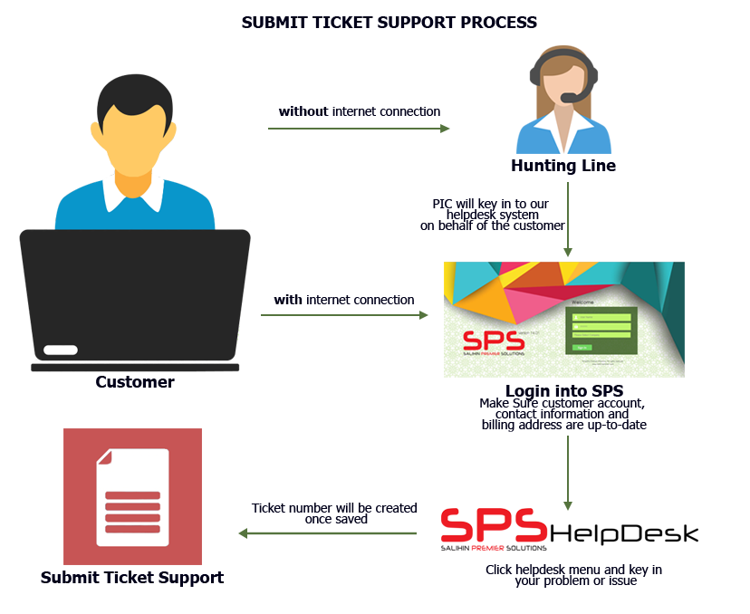
Helpdesk SUPPORT
Response time: Within 24 hours week days (Subject to availability).
Diagram below illustrates process of helpdesk business support.
Working Hours: 8.30am – 5.30pm

Slide 20

EXECUTION PLAN

Slide 21
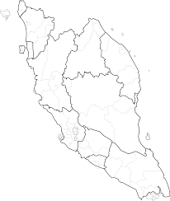
Proposed ZONING POSITION & ROAD MAPPING
Zone 1
Selangor
1,000 MFE

Slide 22
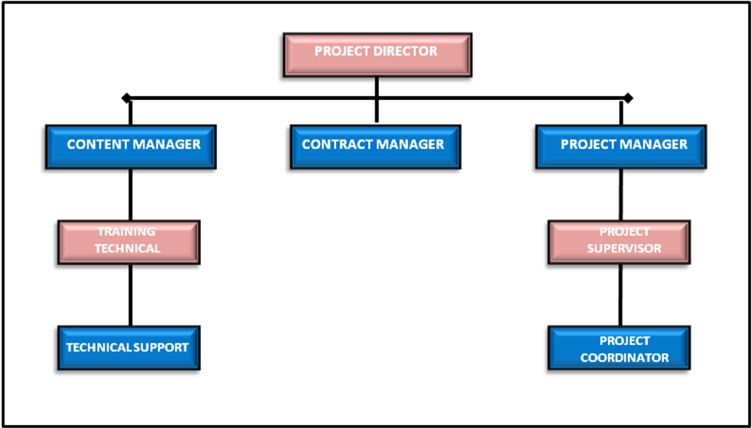
PROJECT MANAGEMENT TEAM
NOTE:
Total = 125 Pax
Management = 10
Executive = 10
Backroom Support = 5
Field Team= 100

Slide 23



Key MEETING & COORDINATION STRATEGY
Review the monthly practice statistics such as production, adjustments, collections, outstanding claims, unscheduled time units, production by provider, daily production averages, etc.
Review on timeline progress project
Review on weekly report
Discussion on any other matters related to MFE activities
Review on timeline progress project
Review on weekly report
Discussion on any other matters related to MFE activities
Review on deployment activities and problem arise
Discussion on project enhancement activities

Slide 24

REPORTING DELIVERABLES
ZONE
01
Selangor
Progress Report
Reporting consist of Weekly, Monthly, Quarterly & Yearly
(Participation, Activities, Other’s Report )

Slide 25
WEB INTERFACE

Slide 26
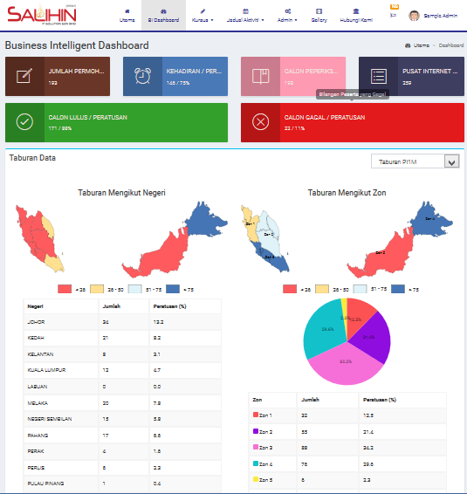
mfe business intelligence page

Slide 27
FINANCIAL CONSIDERATIONS

Slide 28
financial considerations
TOTAL INVESTMENT BY BSN/ MFE FOR PILOT PROJECT | RM 720,000.00
The financial considerations are includes an attractive value-for-money proposition to the BSN which includes:-
Installations, commissioning and maintenance of SPS-Lite Cash-Book Cloud Base software license for 1,000 participants (including SPS Entrepreneurs Web) inclusive of one (1) year software license.
Anticipated approximately 100 no. of students within 1 year.
Site visit for 1,000 Entrepreneurs business place.
Inclusive of one (1) year of free on-line support (helpdesk).
Inclusive certification and endorsement by SALIHIN’s partner in Teaching Accounting Firm (TAF)
Anticipated resources of:
  Management: Ten (10) persons.
  Coordinator: Five (5) persons.
  Students: One Hundred (100) persons.
  Helpdesk Support: Five (5) persons.
  Marketing: One (1) person.
  Social Media: One (1) Person.

Slide 29

www.salihin.com.my | www.salihinpremier.com
Careline: 1 300 88 5678
Aras 7, Fakulti Perakaunan ,
UiTM Cawangan Selangor ,
Kampus Puncak Alam,
42300 Bandar Puncak Alam
03-3258 7511
Notes:
Attention: Please don’t change any content here. Thank you very much ☺

Slide 30
APPENDIX

Slide 31

Briefing Session

Slide 32
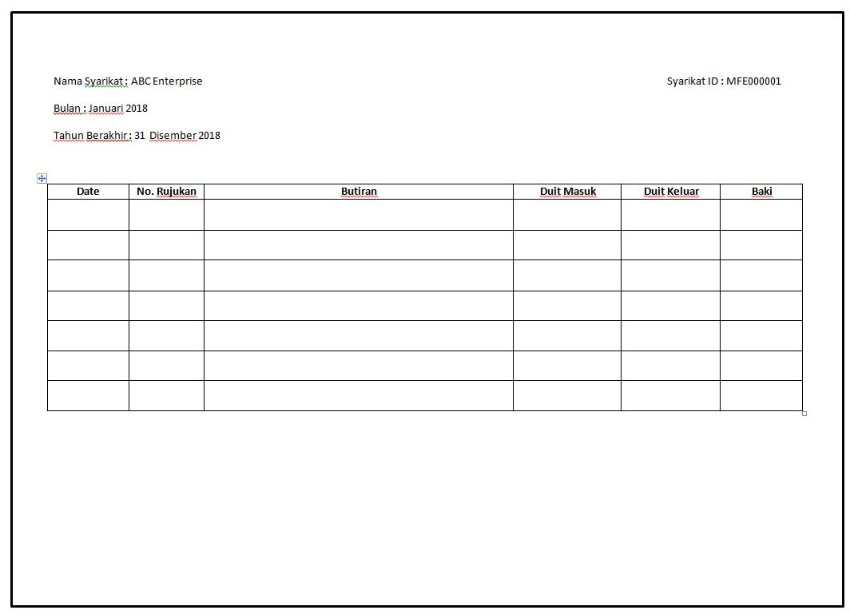
Example : Bookkeeping

Slide 33




Delivery of Information

Slide 34
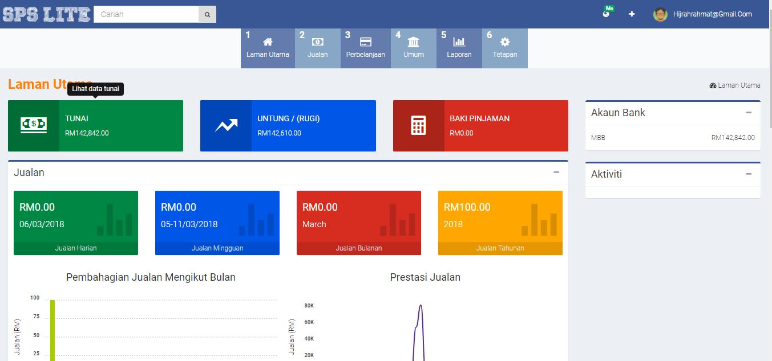
Example : SPS Lite Screen

Slide 35


Site Visit

