Slide 1



MICRO FINANCE ENTREPRENEURS (MFE) ANALYTICS
BY ACCOUNTING SOLUTIONS
PROPOSAL FOR A PILOT PROJECT
Prepared for:
Prepared by:

Slide 2
TABLE OF CONTENT
Introduction of Faculty of Accountancy
Page 3
Proposal
Page 4 - 17
Execution Plan
Page 18 - 23
Financial Consideration
Page 24 -25

Slide 3
The Faculty of Accountancy, being one of the earliest faculties in UiTM, has journeyed through more than 50 years and matured into a Faculty that has managed to make its presence greatly felt in the country. The Faculty’s commitments and efforts to discharge its responsibility towards nation building are well established. The Faculty does this by producing graduates who are skillful, market-relevant and ethically competent. To date, the Faculty is the number one and the biggest producer of Bumiputera accounting graduates.
In ensuring its graduates to always be on the top list of big, reputable accounting firms and multinational companies, the Faculty equip them not only with quality academic qualification, but continuously inculcate them with other strengths and values that build their characters. These strengths and values include the development of excellent interpersonal skills, possessing professional qualification recognised worldwide, acquiring both soft and hard skills relevant to the field and the practice of noble values and the promotion of positive attitude.

Slide 4

executive summary FOR Pilot PROJECT proposal
The purpose of preparing this proposal is to outline the parameters and the scope of works in order to establish a workable action plan with respect to knowledge enhancement and skills for Micro Finance Entrepreneurs (MFE) Analytics by using a suitable accounting solution.
HELPDESK
SUPPORT
ACADEMIA PARTICIPATION
STUDENTS PARTICIPATION
SITE VISIT &
MONITORING
INDUSTRIES PARTICIPATION
DATA ENTRY
STUDENTS
TRAINING
ACCOUNTING SOLUTIONS
4

Slide 5
Pilot parameters
Number of participants and the training plan.
Project Execution Plan & Timeline with tentative schedules (to be determined by BSN).
Listing of value-added services through availability for data entry & monitoring.
Advertising & Promotion to create the programme awareness.
Reporting, recording and monitoring process.
Certificate of Attendance and Skills for successful participants and an optional “BSN MFE Award”

Slide 6
TIME-LINE AND delivery plan
Sept 2018
Oct 2018 –March 2019
May 2019
Preparation & Planning of Project Execution Plan
Program Start
Site Selangor
BSN-MFE Award (optional)
2019
Issuance of Pilot project LOA & Contract Agreement
Advertising & Promotion
Reporting & Monitoring
Anticipated
Aug – Sept 2018
Sept-Oct 2018
March 2019 – April 2019

Slide 7

proposed TARGETS
Proposed no. of MFE./ license
Proposed no. of MFE per Student
Site visit (options):
  At random (10% of selected MFE), or
  10 MFE based on performance, or
  A day with all MFE
100
5
Proposed Zones / Territories | Zone Selangor
Proposed MFE | 100
Proposed Duration | 6 Months
Hence, we anticipate to reasonably run the Micro Finance Entrepreneurs Analytic by Accounting Solutions Pilot Project evaluation process will last for at least 6 – 8 months inclusive pre-development period of at least 1-2 months. It comprises of setting up the accounting solutions into the cloud based and students training.

Slide 8





Target PARTICIPANTS
100 Micro
Entrepreneurs selected by BSN
10 Academia selected
by the team
20 Students selected
by the team

Slide 9


Micro Finance Entrepreneurs AnalyticS framework
Micro
Sales turnover; < RM 300,000
OR
Employees; < 5

Slide 10
PROPOSED ROLES & RESPONSIBILITIES
BSN | MFE
Provide fund to MFE Identify and provide information of selected MFE to the team Acquire accounting software and provide to the selected MFE From time to time BSN consistently monitor MFE and give feedback (if any) to the team | Provide picture-document taken from cash book on weekly basis to support center number. Provide accounting information to BSN MFE can seek advice for any accounting matters from the team.

Slide 11
PROPOSED ROLE & RESPONSIBILITIES
Faculty of Accountancy, UiTM
Provide accounting software Provide standard format of Cash Book to MFE Preview the financial statements on quarterly basis Analyze the accounting records and report on the performance of MFE to BSN semi-annually | Identify manpower (students or lecturers) to assist MFE to record business transactions. The respective manpower will key in business transactions on weekly basis (1 day per week) The team and selected lecturers supervise the manpower Review monthly financial statements Site visit

Slide 12







Targeted deliverables
100
Software Licenses
20
Selected Students
1 State
Selangor
6 Months
Helpdesk Support
100
Expected Participations
10
Anticipated
Lecturers
Comprehensive Report
Executive Summary
BSN-MFE Award (Optional)

Slide 13


Commercial mileage
In the spirit of business collaboration between Faculty of Accountancy, UiTM and BSN, we will support MFE in providing quality products and services with the highest degree of customer satisfaction. We believe the recognition BSN-MFE Award is essential and can be applied at additional cost.
BSN-MFE AWARD
Launch by BSN
Event
Organized & Managed by
UiTM
& BSN
Support By:

Slide 14


Road to success
Close monitor on entrepreneur business performance
Foster and empower Micro business
3U1i inline with MOHE’s aspiration

Slide 15

Student criteria
Diploma/ Degree Holder in Accounting
Certified Software Trainee
CGPA > 2.50
Good communication skills

Slide 16

Critical success factor
Support from BSN
1
5
1
Support from Entrepreneurs
2
Coordination from THE TEAM
3
4
2
SUPPORT FROM TECHNOLOGY
4
3
Content Solution Provider
5
We have long believed that, over the long term, no institution, idea, or effort of real consequence is ever successful on its own; the most impactful efforts are those approached collaboratively and achieved through close partnership.

Slide 17
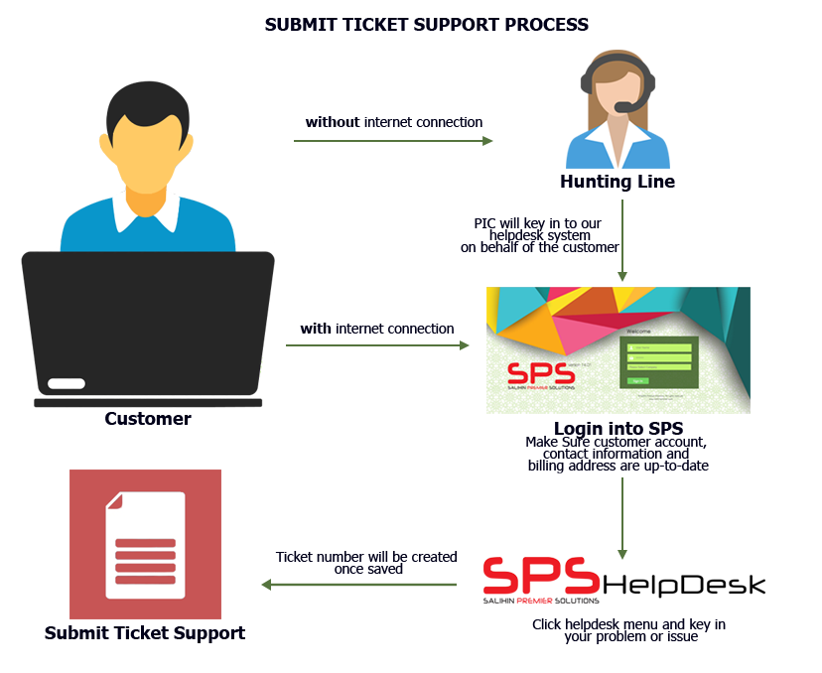

Helpdesk SUPPORT
Response time: Within 24 hours week days (Subject to availability).
Diagram below illustrates process of helpdesk business support.
Working Hours: 8.30am – 5.30pm

Slide 18
EXECUTION PLAN

Slide 19
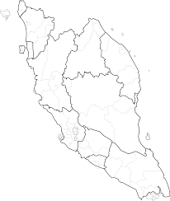
Proposed ZONING POSITION & ROAD MAPPING
Zone 1
Selangor
100 MFE

Slide 20
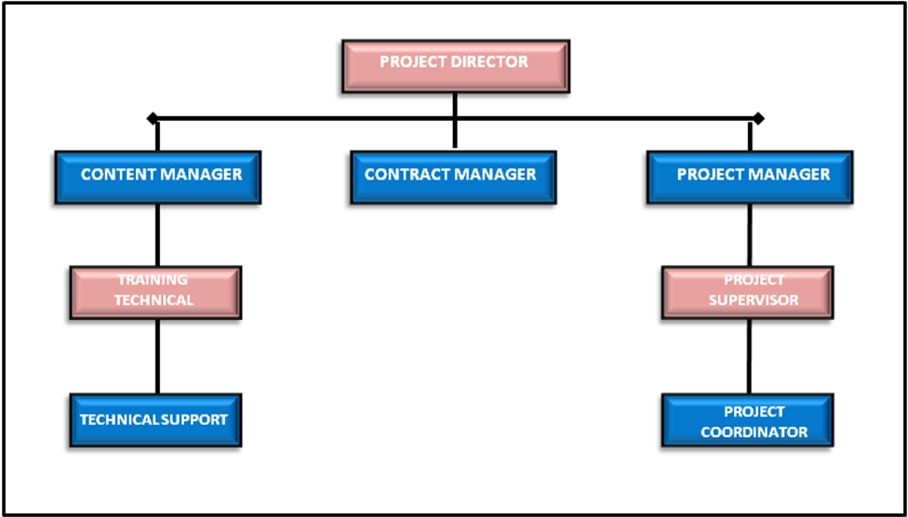
PROJECT MANAGEMENT TEAM
NOTE:
Total = 41 Pax
Management = 2
Executive = 6
Backroom Support = 3
Field Team= 30

Slide 21
PROJECT MANAGEMENT TEAM
Project Director
Nur Ashikin Ishak
Project Manager
Syed Iskandar Zulkarnain Sayd Idris
Content Manager
PM Dr. Zuraeda Ibrahim
Nor Syafinaz Shafee
Contract Manager
Noorlaila Ghazali
Zafiruddin Baharum

Slide 22



Key MEETING & COORDINATION STRATEGY
Review the monthly practice statistics such as production, adjustments, collections, outstanding claims, unscheduled time units, production by provider, daily production averages, etc.
EVERY 4 WEEKS
Review on timeline progress project
Review on weekly report
Discussion on any other matters related to MFE activities
Review on timeline progress project
Review on weekly report
Discussion on any other matters related to MFE activities
Review on deployment activities and problem arise
Discussion on project enhancement activities

Slide 23
REPORTING DELIVERABLES
ZONE
01
Selangor
Progress Report
Quarterly Reporting
(Participation, Activities, Other’s Report )

Slide 24
FINANCIAL CONSIDERATIONS

Slide 25
financial considerations
TOTAL INVESTMENT BY BSN/ MFE FOR PILOT PROJECT | RM48,000.00
The financial consideration include value-for-money proposition of the following:-
Installations, commissioning and maintenance of cloud based accounting software license for 100 participants inclusive of one (1) year software license.
Anticipated approximately 20 students within 6 months.
Site visit at MFE’s business premise.
Inclusive of six (6) months of free on-line support (helpdesk).
Inclusive certification and endorsement by project partner
Anticipated resources of:
  Management: Two (2) persons.
  Coordinator: Ten (10) persons.
  Students: Twenty (20) persons.
  Helpdesk Support: Three (3) persons.
  Marketing: One (1) person.
  Social Media: One (1) Person.

Slide 26
Faculty of Accountancy, Aras 1 & 2 Bangunan FPA, UiTM Selangor, Kampus Puncak Alam,
42300 Bandar Puncak Alam, Selangor, Malaysia
03-3258 7511/ 7501 / 7504 / 7426
Notes:
Attention: Please don’t change any content here. Thank you very much ☺

