Slide 1



PROPOSAL FOR STRATEGIC COLLABORATION IN LEARNING AND GRADUATE SKILLS ENHANCEMENT
PREPARED BY:
SUBMITTED TO:
Notes:
Font Type: Open Sans
Font Size: Proposal Title (60), Proposal Details (40)
Business unit & Client logo: Small size

Slide 2
1.0 Executive Summary
Enhancing learning experience with SPS
With the current shift towards efficient governance, the implementation of GST resulted in the requirement of further understanding of the tax structure in accounting. As one of the prestigious university in Malaysia, UNIKL can lead the shift through utilization of accounting information system(AIS) as a practical tool in demonstrating tax structure in accounting.
This requires certified accounting software, developed with direct input from the customs department, the Salihin Premier Solution (SPS) will provide the competitive edge for UNIKL to enhance the learning experience of its accounting students in gaining the practical understanding on GST implementations and its impacts in financial reports.
It can be implemented as a learning tool in Accounting Information System subject.
Notes:
Font Type: Open Sans
Font Size: Executive Summary Content (36)

Slide 3
Table of Content
1.0
Executive Summary 2
2.0
About Us 4
3.0
The Proposal 13
4.0
Contact Us 39
Notes:
Font Type: Open Sans Light
Font Size: Table of Content (44)
Attention: Please change the table of content and page numbering accordingly. Thank you very much ☺

Slide 4
About Us
—
SALIHIN
2.0 About Us
Key Management Team
Services
Salihin Premier Solutions (SPS)
Our Diverse Clients
Our Local & International Networks
Why SALIHIN?
Notes:
Font Type: Open Sans (Bold)
Font Size: About Us (60)

Slide 5



About Us
Founded in 2002, SALIHIN is a professional business consultancy firm specializing in Auditing and Assurance, Shariah Auditing, Taxation (Direct Tax and GST), Corporate Advisory, and Accounting and Business Management Software.
The past decade has witnessed our continuing effort in brand building through commitment to integrity, high quality and business excellence in providing exceptional end-to-end services.
From grass to grace, our endless effort did not go unnoticed when we are certified as MSC status, 1-Innocert and Enterprise 50 company. As we progress, we grow along with our valued clients, looking forward to a more mature business relationship.
We are certified by the Royal Malaysian Customs Department (RMCD as approved GST Trainer and by the Pembangunan Sumber Manusia Berhad (PSMB) as one of the approved trainers under Human Resources Development Fund (HRDF) which allows our clients to claim 100% training expenses.
Vision
To become the preferred national accountancy firm of Malaysia.
Mission
SALIHIN is dedicated to creating value by focusing on customer satisfaction and growth, excellent internal business process and superior human capital resource development.
Notes:
Attention: Please don’t change any content here. Thank you very much ☺

Slide 6
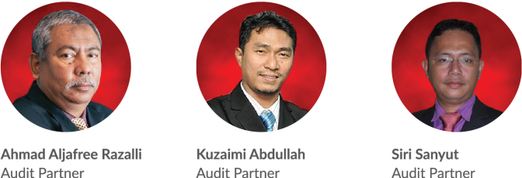
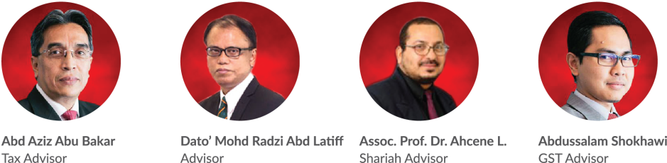
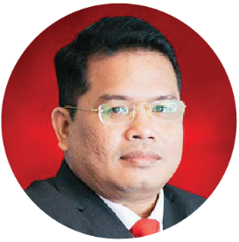
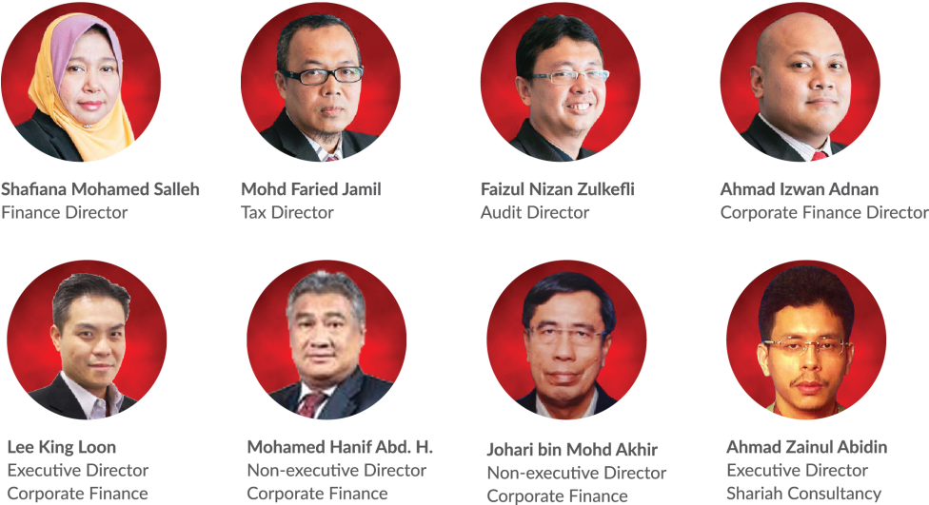
Key Management Team
Salihin Abang
Founder/Managing Partner/CEO
Notes:
Attention: Please don’t change any content here. Thank you very much ☺

Slide 7
Services
SALIHIN offers wide spectrum value for money services:
AUDIT & ASSURANCE
GST & BUSINESS
ACCOUNTING SOLUTION
GST ADVISORY
Statutory Financial Statement Audit
Review Engagements
Compilation Engagement
MPERS / MFRS Training
Agreed Upon Procedures
Preparation & Submission: GST-03
GST Accounting and Review for users of SPS
Preparation of Full Sets Accounts
Preparation of Management Account or Reports
Forensic Accounting
GST Strategic Planning
Cash Flow Planning & Pricing Strategy
GST Bad Debt Management
GST Record Keeping and Internal Control
GST Special Transaction
GST-IT Advisory
Transfer of Going Concern
GST Audit and Investigation
Advice on GST Ruling & Appeal
GST-03 Monthly Submission Review
Monitoring TAP System
GST Annual Adjustment
GST Training & Education Services
GST Accounting Software
DIRECT TAXATION
Mergers and Acquisition Tax Advisory
Corporate Tax Compliance and Planning
Transfer Pricing Advisory
Transfer Pricing Documentation
Tax Audit, Investigation & Appeal
International Tax Consulting
Real Property Gain Tax
Tax Accounting
Tax Risk Management
Notes:
Attention: Please don’t change any content here. Thank you very much ☺

Slide 8
Services (Cont.)
SALIHIN offers wide spectrum value for money services:
GOVERNANCE &
CORPORATE SECRETARIAL
IT CONSULTANCY
SHARIAH AUDIT & ADVISORY
Company Incorporation
Filing Annual Return
Updating Information
Certifying Company Documents
Striking Off Company
Legal Due Diligence
Registration with Relevant Government Agencies
Corporate Governance Advisory
Secretarial Due Diligence and Management
IT Audit & Due Diligence
IT Governance and Planning
IT Project Management
IT Risk Management & Strategy and Assessment
Business Intelligence
IT Sourcing/Outsourcing
Enterprise Resource Planning (ERP)
Software Development and Customisation
Islamic Banking Product Structuring
Islamic Securities: Sukuk Issuance & Structure
Islamic Fund, Wealth & Asset Management
Islamic Private Equity
Establishment of Islamic Bank
Zakat & Waqf Accounting Software (SPS)
Shariah Compliance Training Program
Shariah Training & Education
Shariah Research and Development
Shariah Review & Screening
Shariah Internal Audit
Shariah External Audit
Shariah Risk Management
Shariah Legal Advisory
Shariah Convernance & Supervision
Shariah Accounting
TRANSACTION & CORPORATE FINANCE
Internal Auditing
Enterprise Risk Management
Due Diligence
Business Valuation
Financial Statement Analysis
Raising Seed/Start-Up Capital
Agreed Upon Procedures
Management Buy-In(MBI)/Buy-Out(MBO)
Project and Infrastructure Finance
Pre and Post IPO Advisory
Raising and Restructuring of Debt
Governance and Compliance Advisory
Forensic Audit
Merges, Acquisition and Demergers
Notes:
Attention: Please don’t change any content here. Thank you very much ☺

Slide 9
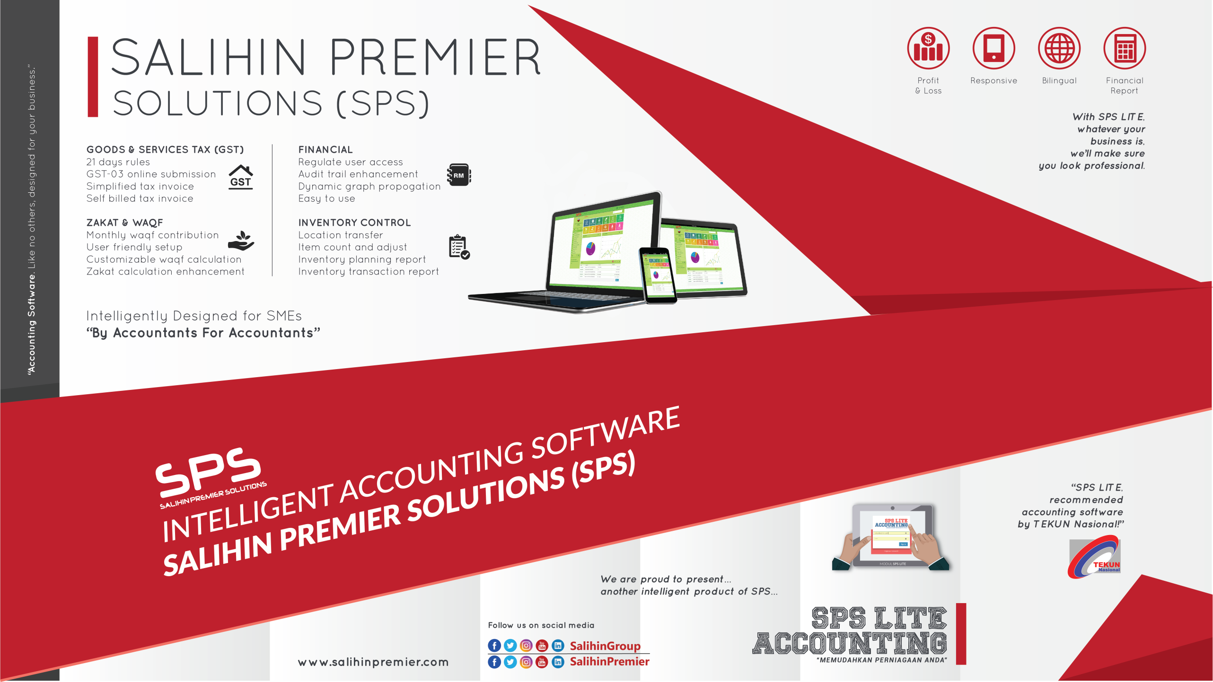
Notes:
Attention: Please don’t change any content here. Thank you very much ☺

Slide 10








































Our Diverse Clients
SALIHIN serves diverse clients including corporate companies, foundations / non-profit organisations, government bodies, government linked companies and educational institutions. Their diversity spans across different sectors of the economy.
Notes:
Attention: Please don’t change any content here. Thank you very much ☺

Slide 11



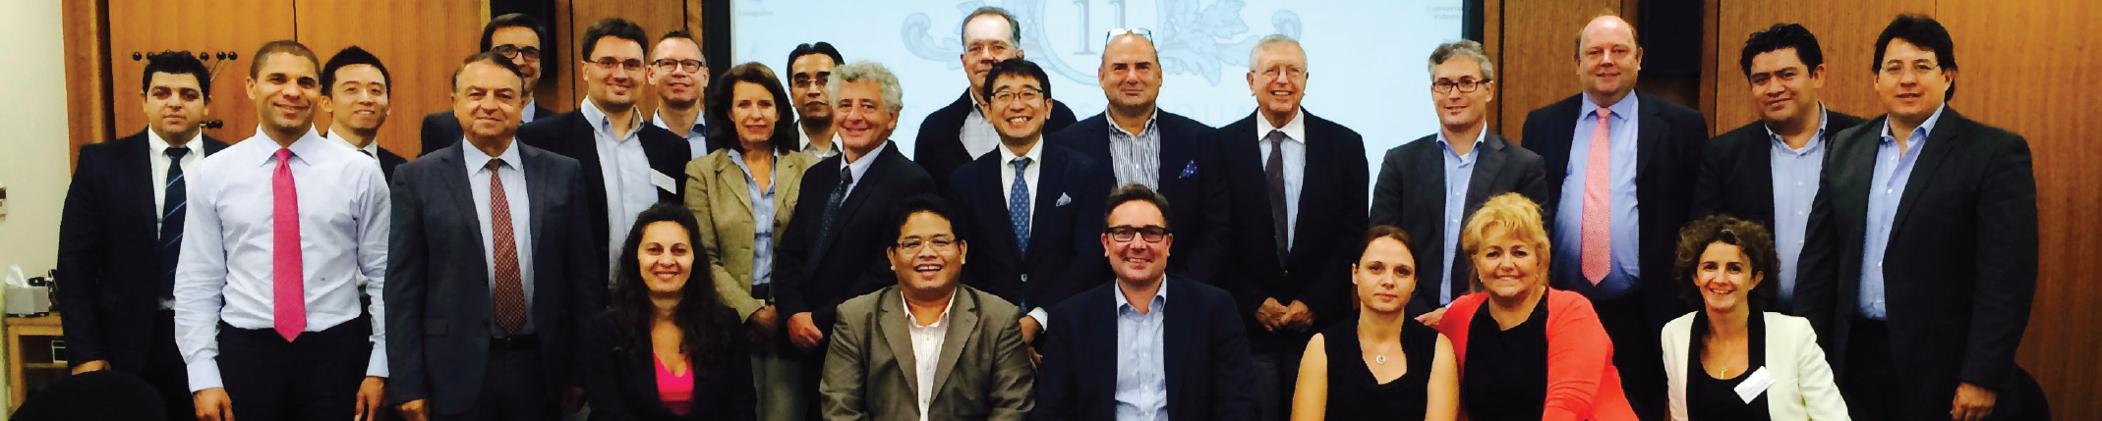
Our Local & International Networks
Buenos Aires
Mexico
Boston
Los Angeles
Miami
New York
San Francisco
Europe
Batu Caves
Johor Bahru
Kuching
Kuala Terengganu (TAF)
Vienna
Brussels
Limassol
Paris
Frankfurt
Milan
Rrome
Luxemborg
Bucharest
Moscow
Barcelona
Madrid
Lausanne
Rotterdam
London
Kyiv
SALIHIN is a member firm of i2an,
a reputable global network of accountants which have presence in America, Asia and Europe as well as all the international financial centres.
Asia
Shanghai
Hong Kong
Tokyo Kuala Lumpur
Singapore
Dubai
Sydney
New Delhi
Ramat Gan
Taiwan
America
Our Local Branches
Notes:
Attention: Please don’t change any content here. Thank you very much ☺

Slide 12
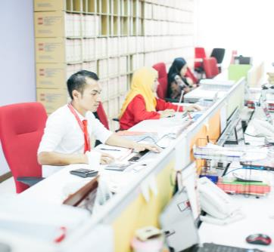

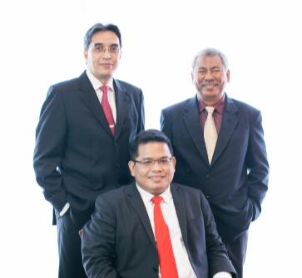

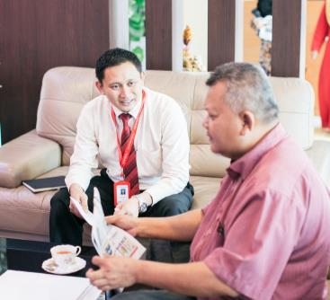
Why SALIHIN?
The following are key reasons why SALIHIN should be your firm’s preferred choice:
01.
Experienced Employees
We have the right ‘hands-on’ team with vast knowledge and relevant experience.
02.
Comprehensive Reports
We would be able to provide complete and comprehensive reports in tandem to your key areas of concern.
03.
Quality Service Delivery
Our Engagement Partner, Board of Advisors and Managers will be involved in closed co-operation for quality service delivery.
04.
Value for Money
We offer ‘value for money’ without compromising on the quality and timeliness of our services.
05.
Minimal Disruption
We will apply our considerable experience to ensure minimal disruption to clients’ daily operations.
Notes:
Attention: Please don’t change any content here. Thank you very much ☺

Slide 13
The Proposal
—
PROPOSAL FOR STRATEGIC COLLABORATION
IN LEARNING & GRADUATE SKILLS ENHANCEMENT
3.0 ABOUT SALIHIN PREMIER SOLUTIONS (SPS)
Notes:
Font Type: Open Sans & Open Sans Light
Font Size: The Proposal (60), Content (36)
Proposal Title’s Example (at the right-top of the red box) : Audit Proposal (For Audit Dept.) or GST Proposal (For GST Dept.)

Slide 14
ABOUT US
SALIHIN PREMIER SOLUTIONS BACKGROUND
The SALIHIN PREMIER SOLUTIONS also know as SPS SOFTWARE , the intelligent software in the world that can manage numerous aspects of financial accounting including Goods and Services Tax (GST) and Zakat calculation, customised specially for Small and Medium Enterprises (SMEs).
SPS SOFTWARE is an efficient and effective accounting software that accommodates changes affecting invoicing and billing system of the business process. The software is powered by the latest security features to secure data or information for optimal integrity and confidentiality. It is tailor made for small and medium industries by professional accountants.
The Zakat module makes SPS SOFTWARE the first comprehensive accounting software with Zakat solution. It will make it easier than ever for Muslim businesses, corporations and organizations to determine the amount payable as Zakat. With Zakat feature built in, it is simply the best accounting software yet.
Notes:
Font Type: Open Sans Light
Font Size: Content (36)
Content suggestion: Client and proposal background.

Slide 15
SPS
Modules in SPS
Financial Module
Inventory Module
GST Module
Zakat Module
Waqf / Endowment Module
There are 5 main modules that makes the SPS Accounting software like no other’s.
Notes:
Font Type: Open Sans Light
Font Size: Content (36)
Content suggestion: Client and proposal background.

Slide 16
SPS
Core Features
1
Easy To Use
With its user friendly interfaces, SPS requires minimum skill knowledge in accounting.
2
Predefined Accounting Chart
SPS comes with 19 industry standards predefined accounting chart and has flexibility to tailor according to business needs.
3
Biz Dashboard
Data updates are real-time for better business decision making.
4
Drill Down
Analysis and investigate from surface report drill down to the source of transaction.
5
Fully Responsive
Interactive and fully responsive for all devices and screen resolutions.
6
Regulate User Access
Provide the double layer security, all the right control of functionality to regulate the user accessibility to each module system. Can view by online anywhere and any places , and it is web based.
7
Multi Languages supported
SPS is ready to support latest business nature in multiple languages.
8
Super Search
Provides an integrated search engine that enabled users to find information related to transaction in the fastest and easiest way.
Ensure that an accurate record of activities or events is captured
Comprehensive Audit Trail
9
Notes:
Font Type: Open Sans Light
Font Size: Content (36)
Content suggestion: Client and proposal background.

Slide 17
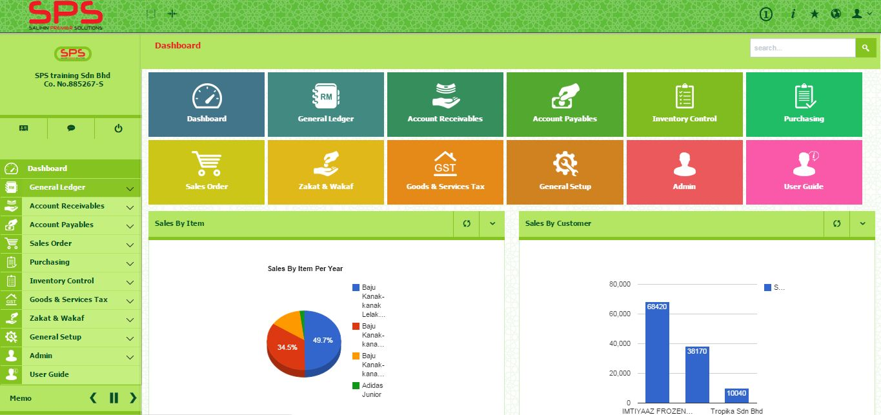
SPS
SPS ACCOUNTING SOFTWARE REVIEW
Notes:
Font Type: Open Sans Light
Font Size: Content (36)
Content suggestion: Client and proposal background.

Slide 18
THE PROPOSAL
VISION AND MISSION
Vision
To equip fresh graduate student from higher learning institution in Malaysia with high value added accounting software skill.
Build long lasting reputation and commitment through excellence.
Mission
Facilitate the expansion and integration of knowledge
Going beyond and influence changes towards improvement.
Provide solution that foster dedicated bonding between SALIHIN and UNITEN
Notes:
Font Type: Open Sans Light
Font Size: Content (36)
Content suggestion: Client and proposal background.

Slide 19
THE PROPOSAL
OBJECTIVES OF THE PROPOSAL
To strategically collaborate with UNIKL to equip and develop the students with skill sets required by the Industry in Malaysia. To this end, we are expecting the following :
  Multi skills for talent pool of UNIKL graduates with practical knowledge in accounting, accounting system, GST, Zakat and Waqf.
  Utilizing of SPS as comprehensive teaching and learning tools for accounting students.
  Expanding the scope of studying course in accounting management, accounting information system (AIS), business module and related subjects.
  Enhancing accounting graduates marketability with our SPS Certification.
  Building a good partnership between SALIHIN and UNIKL.
  Providing industry-ready entry-level talent from UNIKL for high-skilled jobs.
Notes:
Font Type: Open Sans Light
Font Size: Content (36)
Content suggestion: Client and proposal background.

Slide 20
THE PROPOSAL
COLLABORATION MODEL
National
Perspective
----------------------------------------------------------------------------------------------------------------------------------------------------
Industry
Perspective
----------------------------------------------------------------------------------------------------------------------------------------------------
Higher Learning
Institution
Perspective
----------------------------------------------------------------------------------------------------------------------------------------------------
Learning and
Growth Perspective
Productivity Strategy
Long-Term Human Capital Value
Growth Strategy
Improve Professional Skill
Increase Human Capital Utilization
Expand Opportunities
Enhance Human Resource Value
Industry Value Proposition
Employment
Quality
Availability
Selection
Functionality
Service
Partnership
Brand
Product/Services Attributes
Relationship
Image
Lecture Learning Processes | Tutorial and Assignment Processes | Industrial Training Processes | Professional Certificate Processes
SPS as the accounting software tools Train the Trainer Train the Student | Configuration Course work Assessment | Apply SPS into a real business Entrepreneur programme | Certified SPS Engineer Certified SPS Consultant Certified SPS Trainer
HUMAN CAPITAL
ORGANIZATION CAPITAL
( Culture , Leadership, Alignment, Teamwork)
Notes:
Font Type: Open Sans Light
Font Size: Content (36)
Content suggestion: Client and proposal background.

Slide 21
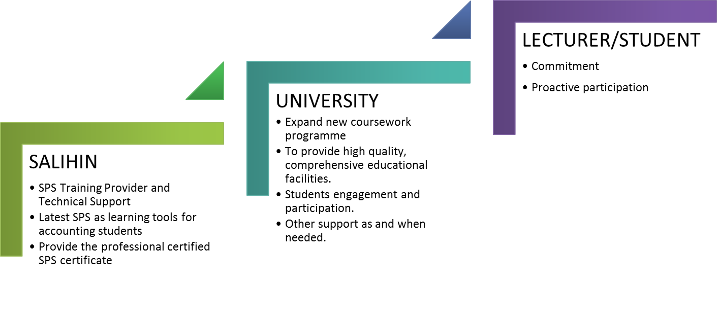
THE PROPOSAL
COLLABORATION MODEL
Notes:
Font Type: Open Sans Light
Font Size: Content (36)
Content suggestion: Client and proposal background.

Slide 22
The Proposal
—
PROPOSAL FOR STRATEGIC COLLABORATION
IN LEARNING & GRADUATE SKILLS ENHANCEMENT
4.0 Featuring SALIHIN Premier Solution
Notes:
Font Type: Open Sans & Open Sans Light
Font Size: The Proposal (60), Content (36)
Proposal Title’s Example (at the right-top of the red box) : Audit Proposal (For Audit Dept.) or GST Proposal (For GST Dept.)

Slide 23
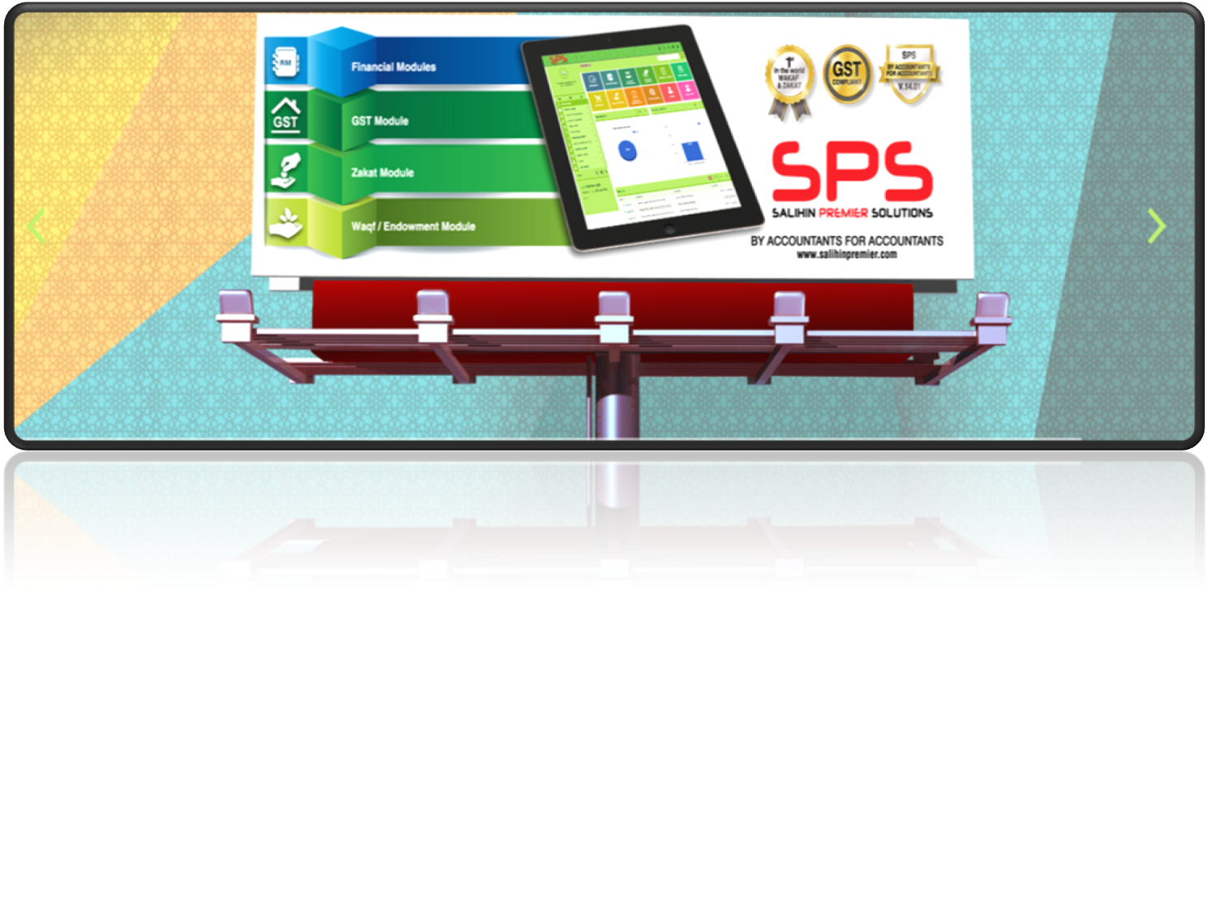
www.salihinpremier.com
Notes:
Font Type: Open Sans Light
Font Size: Content (36)
Content suggestion: Client and proposal background.

Slide 24
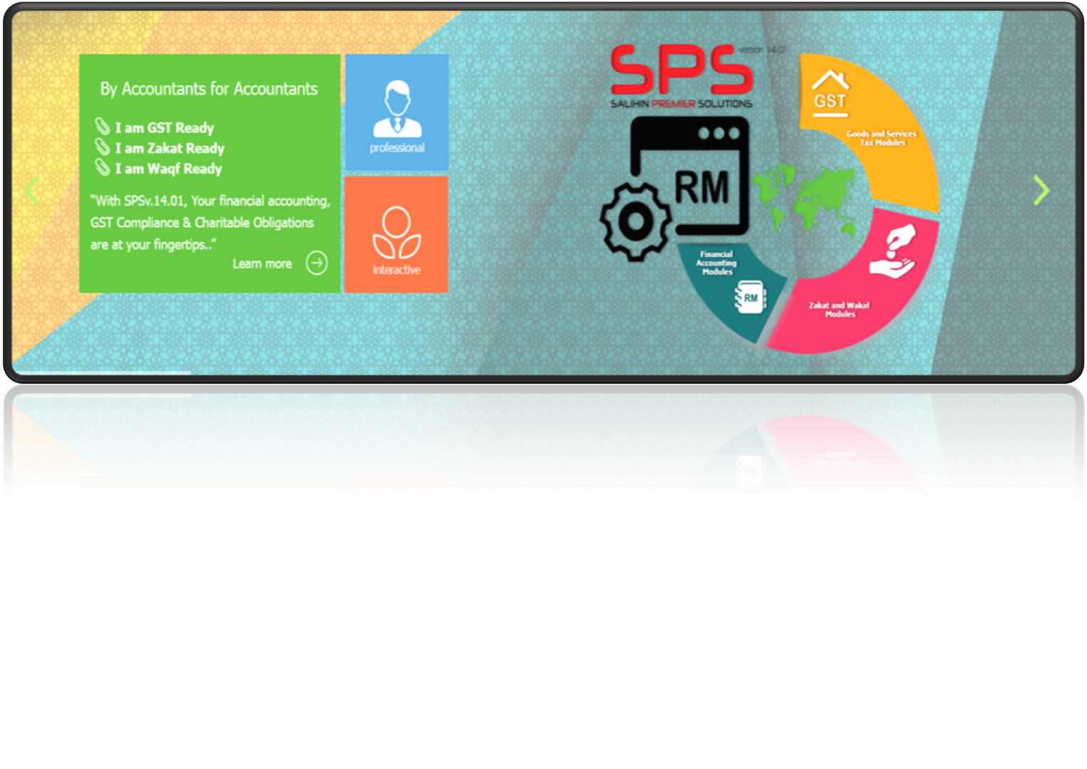
GST, ZAKAT & WAKAF MODULE
Notes:
Font Type: Open Sans Light
Font Size: Content (36)
Content suggestion: Client and proposal background.

Slide 25
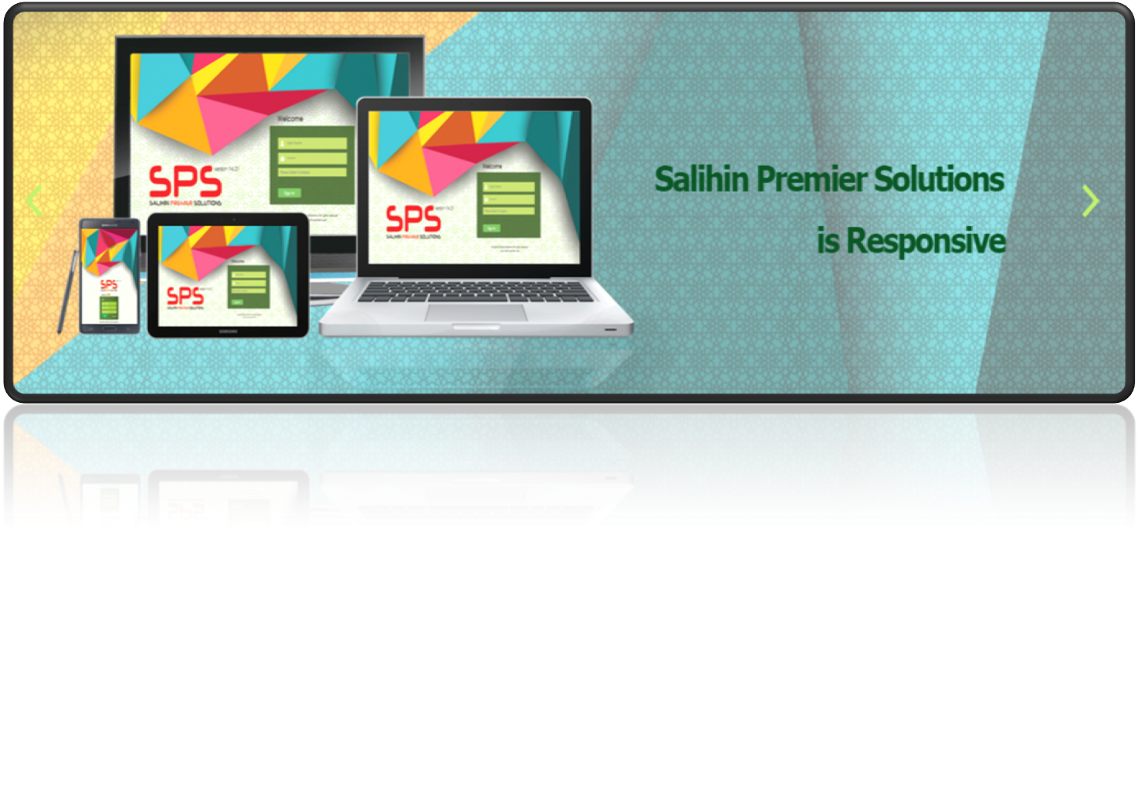
EASY ACCESS
Notes:
Font Type: Open Sans Light
Font Size: Content (36)
Content suggestion: Client and proposal background.

Slide 26
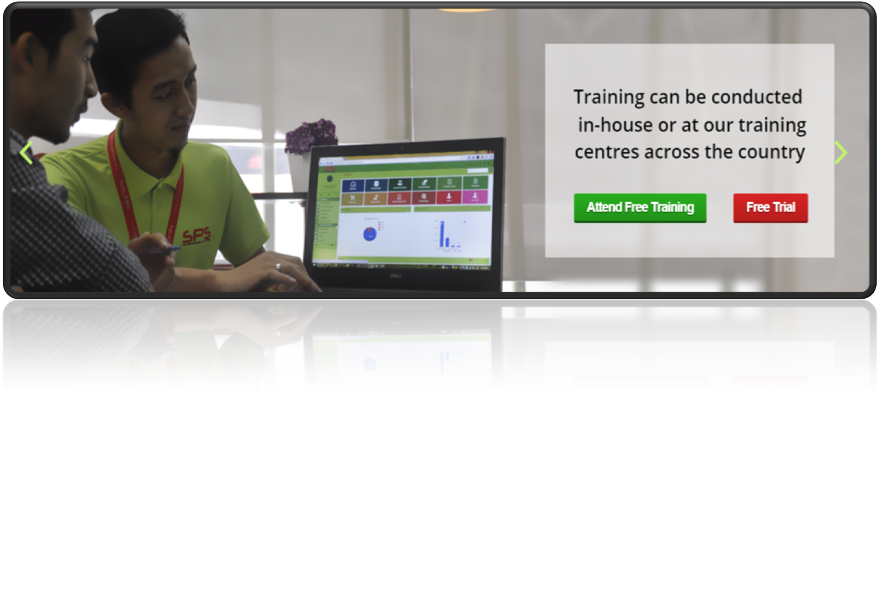
www.salihinpremier.com
Notes:
Font Type: Open Sans Light
Font Size: Content (36)
Content suggestion: Client and proposal background.

Slide 27
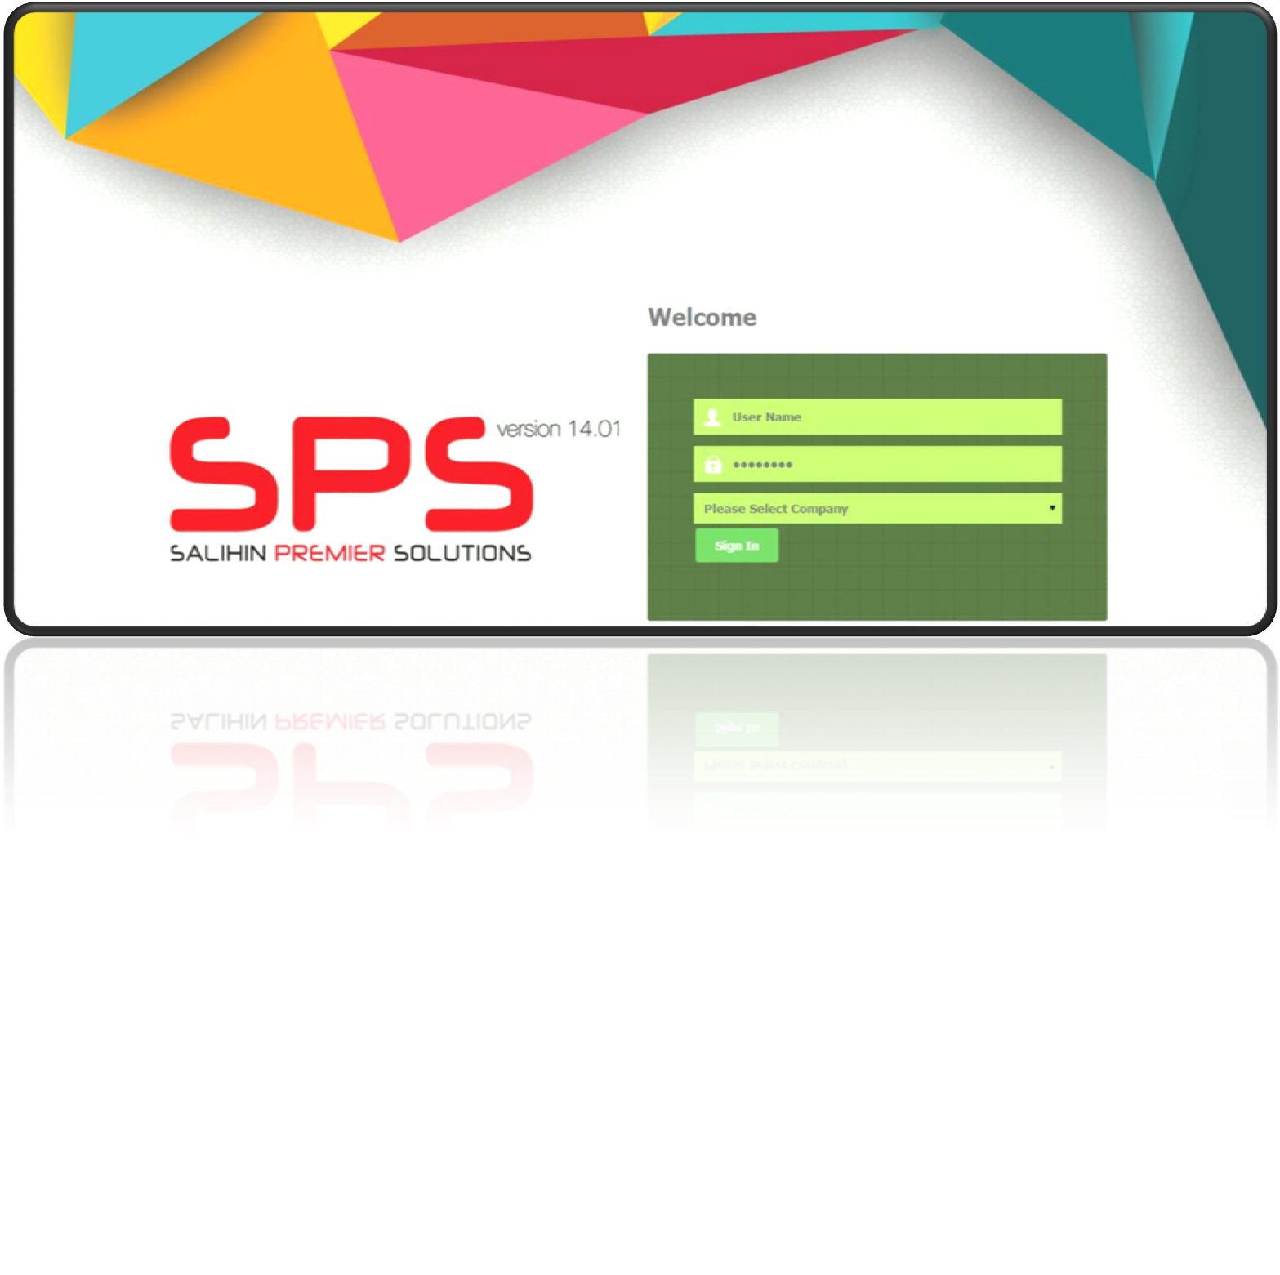
WEB-BASED LOGIN
Notes:
Font Type: Open Sans Light
Font Size: Content (36)
Content suggestion: Client and proposal background.

Slide 28
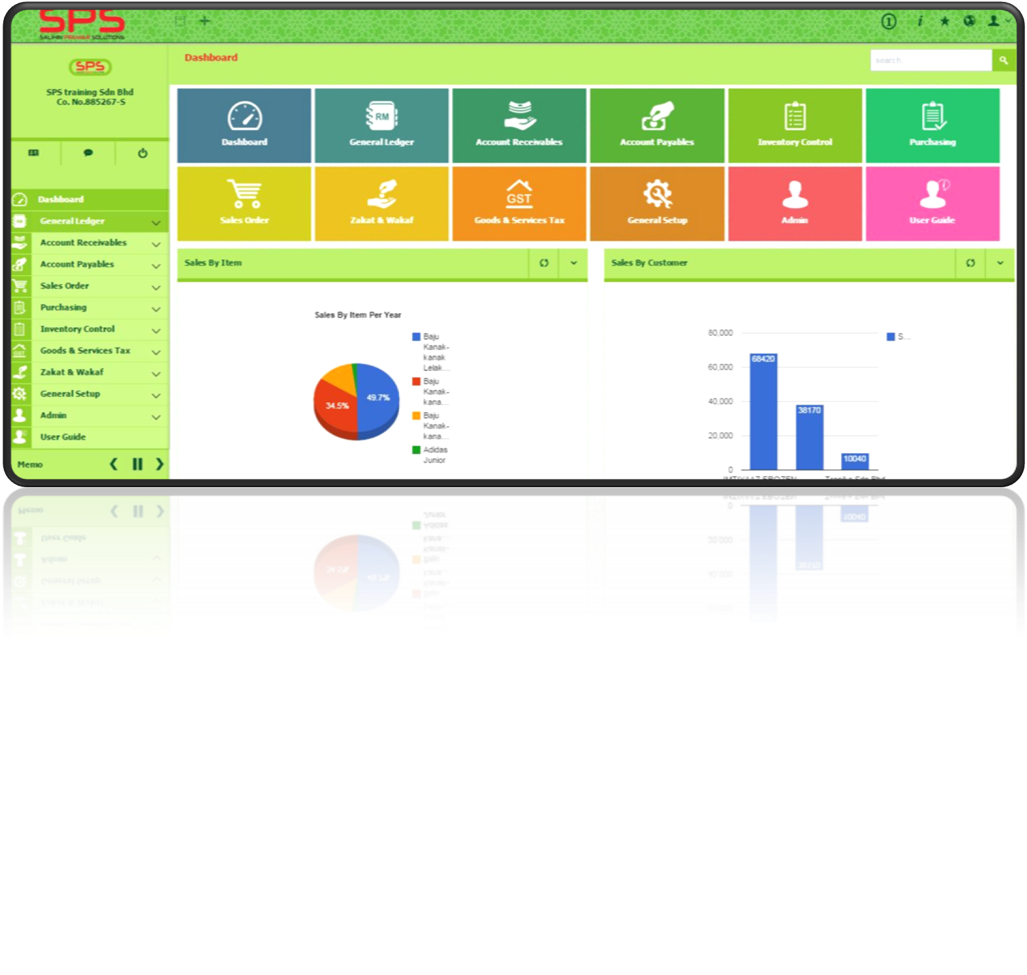
FRIENDLY INTERFACE
Notes:
Font Type: Open Sans Light
Font Size: Content (36)
Content suggestion: Client and proposal background.

Slide 29
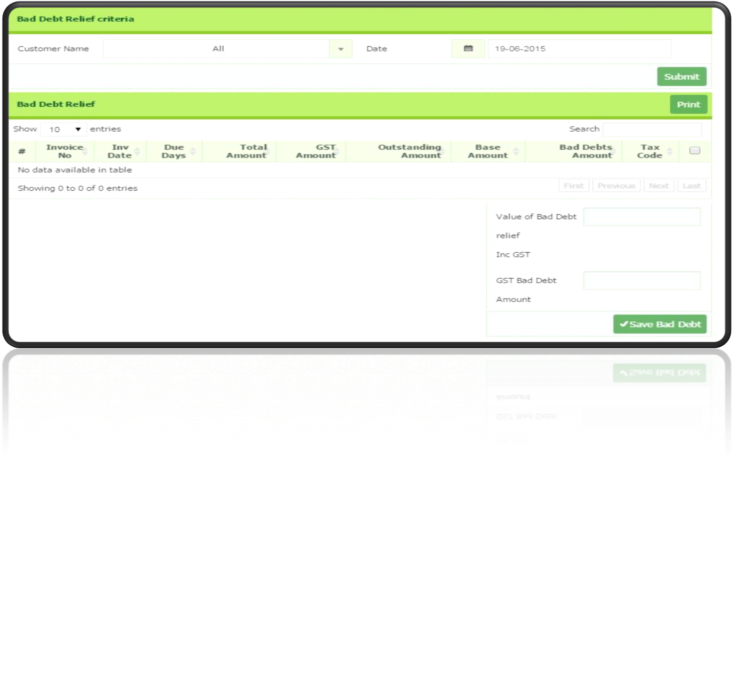
GST FEATURES
Notes:
Font Type: Open Sans Light
Font Size: Content (36)
Content suggestion: Client and proposal background.

Slide 30
The Proposal
—
PROPOSAL FOR STRATEGIC COLLABORATION
IN LEARNING & GRADUATE SKILLS ENHANCEMENT
5.0 SPS Certificate Program
Notes:
Font Type: Open Sans & Open Sans Light
Font Size: The Proposal (60), Content (36)
Proposal Title’s Example (at the right-top of the red box) : Audit Proposal (For Audit Dept.) or GST Proposal (For GST Dept.)

Slide 31
PROGRAM OVERVIEW
SPS Training
SPS Training Module
Time | 9.00am to 4.30 pm
Duration | -1 ½ Days Workshop - ½ Day Exam
Exam period | 2 Hour
Venue | UNIKL Computer Lab
Target Participant | Final Year Accounting Students
Speaker | SALIHIN trainers
Course Fee | RM 100 per student
Minimum Participation (per session) | 50 students
Course Materials | SPS Installer, User Manual, Stationery, SPS Certificate
Module | SPS overview Installation guides Setup process Sales Order Account Receivables | Purchasing Account Payables General Ledger Goods & Services Tax Zakat & Waqf Calculation
Notes:
Font Type: Open Sans Light
Font Size: Content (36)
Content suggestion: Client and proposal background.

Slide 32
PROGRAM BREAKDOWN
SPS Module Details
SPS Training Module Details
Day | Subjects
1 | SPS Overview Overview of SPS Product Overview on the SPS Interface (GUI) Installation Steps Setup Process COMPANY SETUP User Setup User Access Right Chart of Account System & General Setup Form Setup Fniancial Year Calendar INVENTORY | Sales Order What is Sales Order? Sales Price What is Sales Quotation? What is Sales Order? What is Delivery Order? Account Receivables What is Account Receivable? Customer Setup How to create Direct Sales Invoice What is Sales Invoice Copy? What is Debit & Credit Note? What is Customer Payment Received? What is Cash Sales?
Notes:
Font Type: Open Sans Light
Font Size: Content (36)
Content suggestion: Client and proposal background.

Slide 33
PROGRAM BREAKDOWN
SPS Module Details
SPS Training Module Details
Day | Subjects
2 | Purchasing What is Purchase Order? What is Purchase Receive? Account Payables What is Account Payables? Supplier Setup How to create Direct Purchase Invoice? What is Purchase Debit Note & Purchase Credit Note? What is Supplier Payment Advice? | General Ledger Financial Report Journal Entry? Posting Journal? Other Payment & Other Receive Goods & Services Tax GST Setup – Tax Table, Tax Class, Tax Group, Tax Type, GST Preferences, GST Tax Mapping What is GAF File Process? What is Bad Debt Relief & Bad Debt Relief? GST Report, GST -03 & Relevant Report Zakat & Waqf Calculation
Notes:
Font Type: Open Sans Light
Font Size: Content (36)
Content suggestion: Client and proposal background.

Slide 34
PROGRAM BREAKDOWN
SPS Module Details
SPS Training Module Details
Day | EXAM details
3 | The exam consists of TWO (2) sections Section A (objective questions) 10 questions 1 mark per questions Total Mark: 10 Marks Section B (Subjective questions) Four Subjective questions 22.5 mark per questions Total Mark: 90 Marks Section C (Fill in the blank and Amendment) Section D (Zakat & Waqif) 2. GST Exam | 3 Duration: 2 Hours Venue: UNIKL Computer Lab Exam Supervisor SALIHIN Trainers Marking SALIHIN Trainers
Notes:
Font Type: Open Sans Light
Font Size: Content (36)
Content suggestion: Client and proposal background.

Slide 35
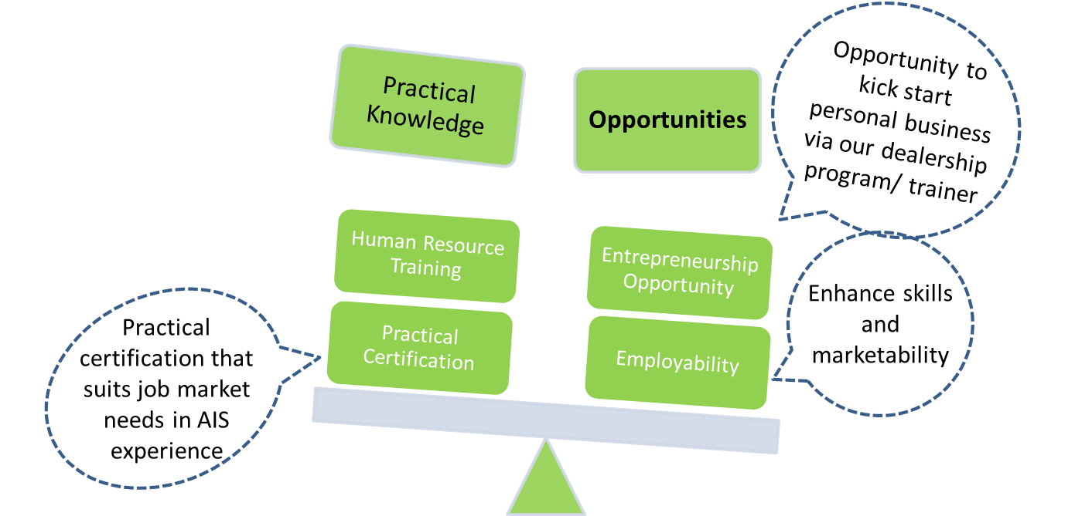
PROGRAM BENEFITS
Benefits of our course and its upskilling features
Notes:
Font Type: Open Sans Light
Font Size: Content (36)
Content suggestion: Client and proposal background.

Slide 36
RULES OF ENGAGEMENT
ROLES & RESPONSIBILITY
ROLES & RESPONSIBILY
UNIKL | SALIHIN
Provision of teaching space & facilities UNIKL shall provide the venues for the program Participation of students UNIKL shall prioritize and ensure participation of students as one of its “upskilling” efforts for students Monitor and facilitate training program UNIKL shall monitor and facilitate the program operations in terms of smooth operations and commencement Promotion and Marketing UNIKL shall permit SALIHIN to use its registered name, branding and trademark for the purpose of marketing of the training program in the related marketing materials. | Setting up one week training program SALIHIN shall create one week training module that utilizes SPS for accounting, GST, Zakat and Wakaf complete with exam and certification. SALIHIN shall provide the trainer/presenter for the program The training program exam shall be supervised and marked by SALIHIN representatives. Training program materials and contents SALIHIN shall to the extent possible to make the training program relevant to the needs of UNIKL for its accounting graduates. To achieve this, SALIHIN shall, wherever necessary and relevant, The academic standards of the modules offered shall be at par with current industry standards . Promotion & Marketing SALIHIN shall use its commercially efforts to promote the training program
Notes:
Font Type: Open Sans Light
Font Size: Content (36)
Content suggestion: Client and proposal background.

Slide 37
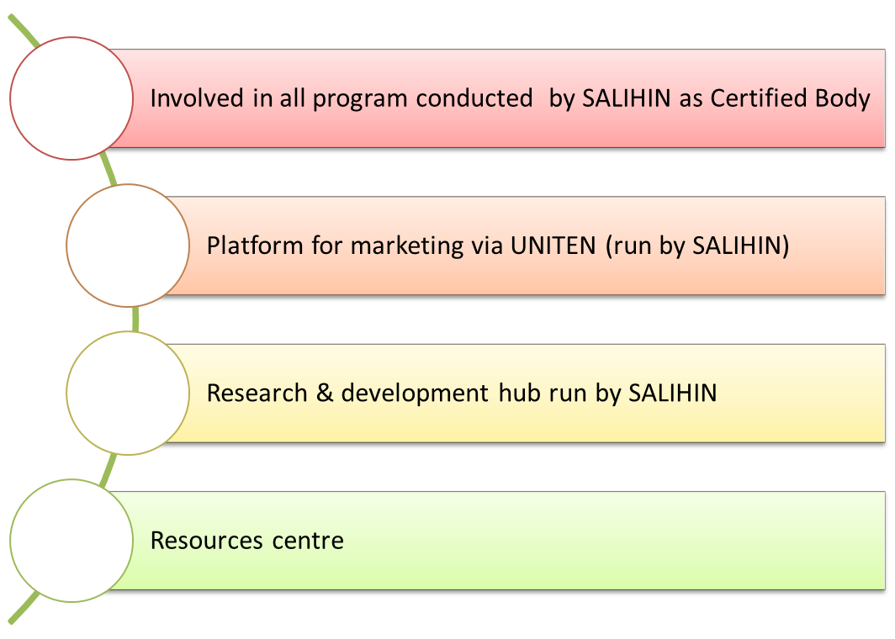
WAY FORWARD
Notes:
Font Type: Open Sans Light
Font Size: Content (36)
Content suggestion: Client and proposal background.

Slide 38
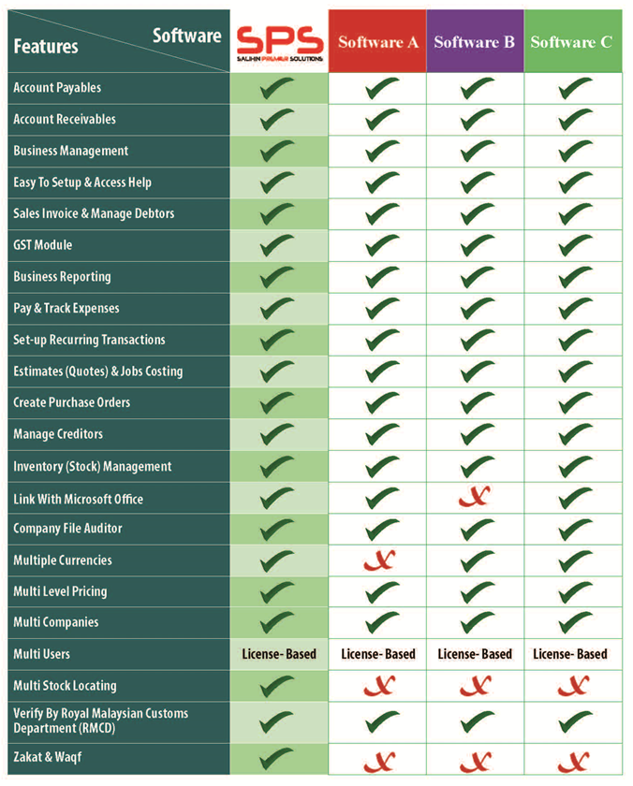
Product Comparisons
SPS vs Other Accounting Software
Notes:
Font Type: Open Sans Light
Font Size: Content (36)

Slide 39

6.0 Contact Us
Headquarters
—
555, Jalan Samudra Utara 1,
Taman Samudra,
68100 Batu Caves,
Selangor, Malaysia.
Tel: +603-6185 9970
Fax: +603-6184 2524
Email: info@salihin.com.my
Follow us on social media
Notes:
Font Type: Open Sans Light
Font Size: Content (28)
Attention: You may add / edit this section.

Slide 40
www.salihin.com.my | www.salihinpremier.com
Careline: 1 300 88 5678
Notes:
Attention: Please don’t change any content here. Thank you very much ☺

