Slide 1



SPS PROPOSAL FOR DIPLOMA STUDENT’S UP SKILLING PROGRAM
Prepared by:
Prepared for:

Slide 2
EXECUTIVE SUMMARY
Enhancing learning experience with SPS
With the current shift towards empowering national revenue via tax collection, the implementation of GST resulted in the requirement of further understanding of the tax structure in accounting. Thus, the education institution plays a fundamental role in prepare the new generations capabilities to undertake, understand and practice GST in daily business process.
As one of the prestigious university in Malaysia, UITM can lead the shift through utilization of accounting information system(AIS) as a practical tool in demonstrating tax structure in accounting.
This requires certified accounting software, developed with direct input from the customs department, the Salihin Premier Solution (SPS) will provide the competitive edge for UITM to enhance the learning experience of its accounting students in gaining the practical understanding on GST implementations and its impacts in financial reports.

Slide 3
PRODUCT SUMMARY
Salihin Premier Solutions
The SALIHIN PREMIER SOLUTIONS also know as SPS, the intelligent software in the world that can manage numerous aspects of financial accounting including Goods and Services Tax (GST) and Zakat calculation, customized specially for Small and Medium Enterprises (SMEs).
SPS is an efficient and effective accounting software that accommodates changes affecting invoicing and billing system of the business process. The software is powered by the latest security features to secure data or information for optimal integrity and confidentiality. It is tailor made for small and medium industries by professional accountants.
The Zakat module makes SPS the first comprehensive accounting software with Zakat solution. It will make it easier than ever for Muslim businesses, corporations and organizations to determine the amount payable as Zakat. With Zakat feature built in, it is simply the best accounting software yet.

Slide 4

SPS Background
The Main Modules
There is 5 main modules of SPS
Financial Module
Inventory Module
GST Module
Zakat Module
Waqf / Endowment Module

Slide 5

SPS Background
Function And Features
SPS
Predefined Accounting Chart
Default GST Setup
Biz Dashboard
Regulate User Access
GST-03 Online Submission
Dynamic Graph Propagation
Void Unconfirmed Transaction
Auto Notification of
any New Update
Zakat Calculation Enhancement
Simplified Tax Invoice
Auto Calculation Waqf
Self Billed Tax Invoice

Slide 6

Product Comparisons
SPS vs Other Accounting Software

Slide 7
THE PROPOSAL
Main Objective: Enhancing Graduates
CAPACITY BUILDING
SKILLS ENHANCEMENT
INDUSTRIAL
RELEVANCE
To equip UiTM graduate student with value added accounting software skills
To provide avenue for UiTM to enhance graduate skills and accreditations
To provide practical expertise and experience for UiTM in delivering courses relevant to current and future industrial practices.

Slide 8
THE PROPOSAL
SPS As Optional Learning Tool
SPS is used to support the curriculum based on self initiatives by student with the assistance from lecturers.
For better positioning of SPS, exam will be given as an optional (to test student understanding of each particular subject)
Exam, Marking & Certification will be provided by SALIHIN (For those who seat for exam).
Part of
Up Scaling
Not Bound to University Program
Does Not Require Senate Permission
SPS Student Manual & Installer
SPS as Optional Learning Tool
2 Hours Online Exam
Separate Session in Lab
SPS Certification
Lecturer’s Decision
Student’s Willingness
Monitoring & Marking By SALIHIN

Slide 9
THE PROPOSAL
Target Course/ Student
Diploma (No of Student: XXXX)
  Diploma in Accountancy -AC110
    Sg. Petani, Machang, Segamat, Tapah, Kota Samarahan, Jengka, Alor Gajah, Kota Kinabalu & Dungun

Slide 10
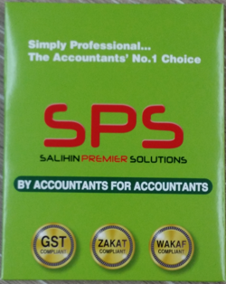
THE PROPOSAL
Proposed Pricing
Proposed pricing for UiTM Accounting Student:
  RM60.00 per pax.
Participated student will be provided with (Student Kits):
  SPS Student Installer/ Cloud-based ID access
  SPS Student Manual
  Seat for Examination

Slide 11
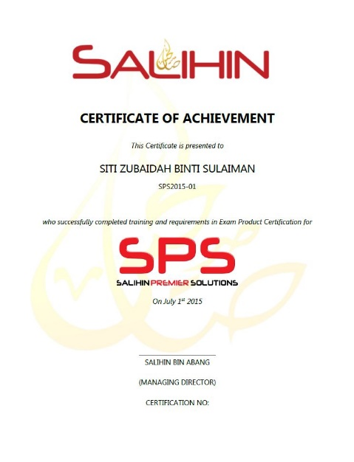
THE PROPOSAL
Expected Outcomes & Deliverables
At the end of the programme, we expected each graduates would be able to:
  Operate and utilize SPS Software (Install, configure & operate).
  Provide consultation & training on SPS.
SALIHIN deliverables to partipated graduates:
  SPS Certifications
    SPS Participation Certificate
    SPS Consultant Certificate
  1 Year Free SPS License
  1 Year Free SPS Support Service

Slide 12

CONTACT US
OFFICIAL ADDRESS & CONTACT PERSON
CORPORATE CENTRE:
TAF UITM
Faculty of Accountancy
Level 1 & 2, FPA Buildings
UiTM Selangor, Kampus Puncak Alam
42300 Bandar Puncak Alam
Selangor Darul Ehsan, Malaysia
Tel: +603-6185 9970
Fax: +603-6184 2524
CONSULTANT: IRA FAZIRA ROSLAN
EMAIL: irafazira@salihin.com.my
TAF UITM is Authorized Partner of SPS
Official Website : www.salihin.com.my
Customer Service : www.salihinpremier.com
E-mail : info@salihin.com.my
Careline : 1 300 88 5678

