Slide 1



PROPOSAL FOR INDEPENDENT SCRUTINEER SERVICE FOR EXTRAORDINARY GENEREL MEETING KUB MALAYSIA BERHAD
PREPARED BY:
SUBMITTED TO:
Notes:
Font Type: Open Sans
Font Size: Proposal Title (60), Proposal Details (40)
Business unit & Client logo: Small size

Slide 2
Executive Summary
Extraordinary General Meeting (“EGM”) of KUB MALAYSIA BERHAD (“KUB MALAYSIA”) will be held at Dewan Shah Alam 1, Ground Floor, Shah Alam Convention Centre, No.4, Jalan Perbadanan 14/9, 40000 Shah Alam, Selangor on Wednesday, 02 August 2017 at 8.00 a.m.
SALIHIN, therefore, is pleased to submit a proposal to serve as the Independent Scrutineer to KUB MALAYSIA during the above-mentioned EGM. We believe we can offer KUB MALAYSIA a quality service with the right team and experience.
This proposal outlines the services scope, expected timeline and proposed fee for the engagement.
Notes:
Font Type: Open Sans
Font Size: Executive Summary Content (36)

Slide 3
Table of Contents
10
About Us 4
1.0
2.0
The Proposal 12
3.0
Contact Us 19
Notes:
Font Type: Open Sans Light
Font Size: Table of Content (44)
Attention: Please change the table of content and page numbering accordingly. Thank you very much ☺

Slide 4
About Us
—
SALIHIN
1.0 About Us
About SALIHIN
Key Management Team
Services
Our Diverse Clients
Our Local and International Networks
Notes:
Font Type: Open Sans (Bold)
Font Size: About Us (60)

Slide 5
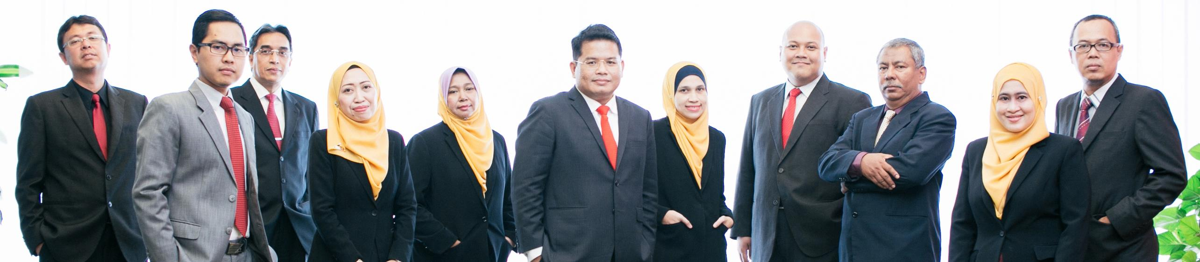


About
Founded in 2002, SALIHIN is the brand name of a group of independent and separate legal entities, deploying wide spectrum of capabilities to help clients see and tap opportunities in the areas of transaction and corporate finance, taxation (direct tax and GST), auditing and assurance, shariah auditing and advisory, corporate governance, IT consultancy and business accounting solution.
As one of the fastest growing home-nurtured and bumiputera firms, SALIHIN is having close to 200 competent professionals from different background with diverse thoughts, expertise and experience serving in 9 offices nationwide. In addition to relevant licenses/certifications for its capabilities, SALIHIN is having MSC Malaysia Status and 1-InnoCERT certification, Licensed Tax Agent and GST Tax Agent, Licensed Capital Market Services as well as Shariah Advisory by Securities Commission. SALIHIN is also a Registered Public Interest Entities Auditor by Audit Oversight Board (AOB), a Registered Auditor with PPK Accountants in the UK, an approved Cooperative Auditor with Suruhanjaya Koperasi Malaysia (SKM), an Approved Training Provider by Human Resources Development Fund (HRDF). Additionally, SALIHIN is a member of i2an, a global network of accountants based in Paris and has won Enterprise 50 (E50) Awards in 2010.
We have a proven track record credited to a sustained quality service delivery to our clients without compromising our professional integrity. SALIHIN continues to build on its successes. It became the first in the world to introduce Teaching Accountancy Firm (TAF) to bridge the gap between accountancy theory and practice.
Vision
To become the preferred national accountancy firm of Malaysia.
Mission
SALIHIN is dedicated to creating value by focusing on customer satisfaction and growth, excellent internal business process and superior human capital resource development.
Notes:
Attention: Please don’t change any content here. Thank you very much ☺

Slide 6
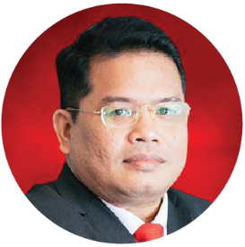
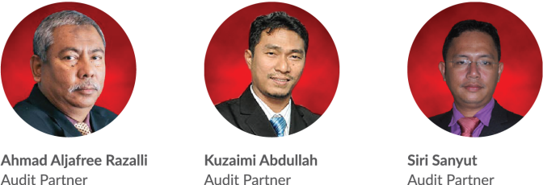
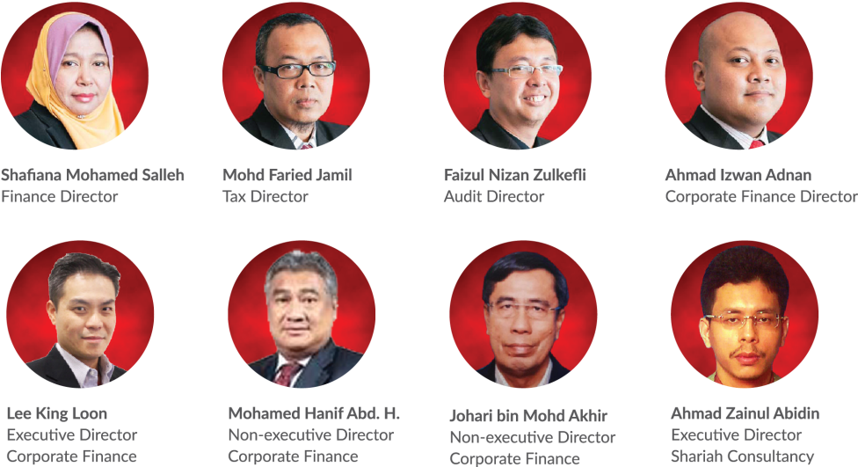
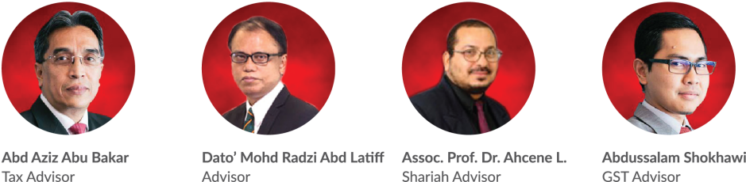
About Us
Key Management Team
Salihin Abang
Founder/Managing Partner/CEO
Notes:
Attention: Please don’t change any content here. Thank you very much ☺ Horizontal

Slide 7
About Us
Services
SALIHIN offers wide spectrum value for money services:
AUDIT & ASSURANCE
GST & BUSINESS
ACCOUNTING SOLUTION
GST ADVISORY
Statutory Financial Statement Audit
Review Engagements
Compilation Engagement
Agreed Upon Procedures
Preparation & Submission: GST-03
GST Accounting and Review for users of SPS
Preparation of Full Sets Accounts
Preparation of Management Account or Reports
Forensic Accounting
GST Strategic Planning
Cash Flow Planning & Pricing Strategy
GST Bad Debt Management
GST Record Keeping and Internal Control
GST Special Transaction
GST-IT Advisory
Transfer of Going Concern
GST Audit and Investigation
Advice on GST Ruling & Appeal
GST-03 Monthly Submission Review
Monitoring TAP System
GST Annual Adjustment
GST Training & Education Services
GST Accounting Software
DIRECT TAXATION
Mergers and Acquisition Tax Advisory
Corporate Tax Compliance and Planning
Transfer Pricing Advisory
Transfer Pricing Documentation
Tax Audit, Investigation & Appeal
International Tax Consulting
Real Property Gain Tax
Tax Accounting
Tax Risk Management
Notes:
Attention: Please don’t change any content here. Thank you very much ☺

Slide 8
About Us
Services (Cont.)
SALIHIN offers wide spectrum value for money services:
GOVERNANCE &
CORPORATE SECRETARIAL
IT CONSULTANCY
SHARIAH AUDIT & ADVISORY
Islamic Banking Product Structuring
Islamic Securities: Sukuk Issuance & Structure
Islamic Wealth Management Advisory
Islamic Private Equity Advisory
Establishment of Islamic Bank
Zakat & Waqf Accounting Software (SPS)
Shariah Compliance Training Program
Shariah Training & Education, Research & Development
Shariah Internal & External Audit, Review & Screening
Shariah Risk Management
Shariah Legal Advisory
Shariah Governance & Supervision
IT Audit & Due Diligence
IT Governance and Planning
IT Project Management
IT Risk Management
IT Strategy and Assessment
Business Intelligence
IT Sourcing/Outsourcing
Enterprise Resource Planning (ERP)
Software Development and Customisation
TRANSACTION & CORPORATE FINANCE
Internal & Forensic Auditing
Enterprise Risk Management
Due Diligence & Business Valuation
Financial Statement Analysis
Raising Seed/Start-Up Capital
Agreed Upon Procedures
Management Buy-In(MBI) / Buy-Out (MBO)
Project and Infrastructure Finance
Pre and Post IPO Advisory
Raising and Restructuring of Debt
Governance and Compliance Advisory
Merges, Acquisition and Demergers
Notes:
Attention: Please don’t change any content here. Thank you very much ☺

Slide 9

About Us
Services (Cont.)
Notes:
Attention: Please don’t change any content here. Thank you very much ☺

Slide 10








































About Us
Our Diverse Clients
SALIHIN serves diverse clients including corporate companies, foundations / non-profit organisations, government bodies, government linked companies and educational institutions. Their diversity spans across different sectors of the economy.
Notes:
Attention: Please don’t change any content here. Thank you very much ☺

Slide 11




About Us
Our Local and International Networks
Buenos Aires
Mexico
Boston
Los Angeles
Miami
New York
San Francisco
Europe
SALIHIN is a member firm of i2an,
a reputable global network of accountants which have presence in America, Asia and Europe as well as all the international financial centres.
MALAYSIA
Batu Caves
Johor Bahru
Kuching
Kuala Terengganu (TAF)
Vienna
Brussels
Limassol
Paris
Frankfurt
Milan
Rrome
Luxemborg
Bucharest
Moscow
Barcelona
Madrid
Lausanne
Rotterdam
London
Kyiv
Asia
Shanghai
Hong Kong
Tokyo Kuala Lumpur
Singapore
Dubai
Sydney
New Delhi
Ramat Gan
Taiwan
America
Our Local Branches
Notes:
Attention: Please don’t change any content here. Thank you very much ☺

Slide 12
The Proposal
—
Independence
Scrutineer
2.0 The Proposal
Introduction
Approach and Methodology
Professional Fee
Why SALIHIN?
Notes:
Font Type: Open Sans & Open Sans Light
Font Size: The Proposal (60), Content (36)
Proposal Title’s Example (at the right-top of the red box) : Audit Proposal (For Audit Dept.) or GST Proposal (For GST Dept.)

Slide 13
The Proposal
Introduction
We understand that KUB MALAYSIA BERHAD (“KUB MALAYSIA”) is an investment holding company listed on the Main Market of Bursa Malaysia, operating in the core business of Agro, Information & Communication Technology (ICT), Energy, Food, Property and Power Industries.
It is understood that KUB MALAYSIA intends to engage the services of SALIHIN (AF1426) for the independence scrutineer service for its Extraordinary General Meeting (“EGM”) which will be held at Dewan Shah Alam 1, Ground Floor, Shah Alam Convention Centre, No.4, Jalan Perbadanan 14/9, 40000 Shah Alam, Selangor on Wednesday, 02 August 2017 at 8.00 a.m.
We will carry out this engagement as KUB MALAYSIA’s independent scrutineer upon appointment.
Notes:
Font Type: Open Sans Light
Font Size: Content (36)
Content suggestion: Client and proposal background.

Slide 14
The Proposal
Approach and Methodology
At SALIHIN, we will stand by our people and we commit that we will provide KUB MALAYSIA with professionals that are qualified, well trained and well prepared to serve.
For the independent scrutineer service, the timeline, action plan and deliverable are outlined as below:
Timeline | Action Plan | Deliverable
Monday & Tuesday, 31 July & 01 August 2017 | To cross check and verify information keyed in the polling system with the shareholder/proxy forms | 6 officers to cross check and verify information keyed in the polling system with the shareholder/proxy forms.
Wednesday, 02 August 2017 | To observe and ensure the voters’ information are correct before the voting process; To observe and ensure all voters are using the system properly and orderly; To observe and ensure the voter turnout is same with the information in the system; To verify the report on the final election results; and To submit the final election results to the EGM secretariat. | 1 manager and 9 officers to observe and monitor the voting process.
The independent scrutineer service would be carried out by SALIHIN (AF1426).
Notes:
Font Type: Open Sans Light
Font Size: Content (36)
Please insert the details (in red) accordingly.

Slide 15
The Proposal
Professional Fee
  The philosophy of SALIHIN is to provide the maximum in client service and individual staff capabilities at the minimum cost, which can be achieved within the highest professional standards and competence levels.
Our fees are based on the complexities of the assignment, the level of staff and experience required and the time committed on the assignment by our staff as well as the level of skills and responsibilities involved to complete the work.
Engagement | Total Fee
Independent Scrutineer Service for Extraordinary General Meeting for KUB Malaysia Berhad To cross check and verify information keyed in the polling system with the shareholder/proxy forms. To observe and monitor the voting process during the Extraordinary General Meeting: 1 Manager 9 Officers | RM1,500.00 RM1,000.00 RM5,400.00
GRAND TOTAL | RM7,900.00
Notes:
Font Type: Open Sans
Font Size: Engagement’s content (36)
Attention: You may add additional row/slide depending on your needs.
In the case of progress fee, you may use this phrase: *The fees are based on deliverables at each stage of advisory work.

Slide 16
The Proposal
Professional Fee (Cont.)
Terms and conditions
The fees are subject to 6% GST and out of pocket expenses such as logistic and travelling, telecommunication charges and other expenses which will be charged to you at cost.
Should there be any additional work that would cause our billing to be significantly higher than the above estimate or should you at later stage indicate that you wish to add or change the scope of our agreed work or include other modules which will incur additional time cost on our part, we will be pleased to discuss with you and obtain your prior agreement on the revised amount on the addition/variation of the scope of work. Our fees shall be payable irrespective of the outcome of the transaction.
Payment terms (negotiable):
20% down payment before commencing of work
80% balance payment after completion of work
Invoiced amounts must be paid within 30 days from the invoice date.
Notes:
Font Type: Open Sans
Font Size: Term & conditions (36)
Please edit accordingly (red font)

Slide 17



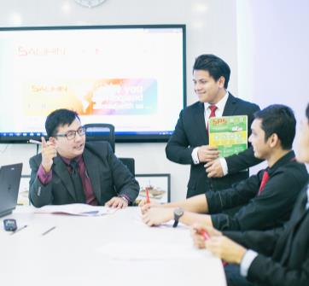

The Proposal
WHY SALIHIN?
The following are key reasons why SALIHIN should be your firm’s preferred choice:
01.
Experienced Employees
We have the right ‘hands-on’ team with vast knowledge and relevant experience.
02.
Comprehensive Reports
We would be able to provide complete and comprehensive reports in tandem to your key areas of concern.
03.
Quality Service Delivery
Our Engagement Partner, Board of Advisors and Managers will be involved in closed co-operation for quality service delivery.
04.
Value for Money
We offer ‘value for money’ without compromising on the quality and timeliness of our services.
05.
Minimal Disruption
We will apply our considerable experience to ensure minimal disruption to clients’ daily operations.
Notes:
Attention: Please don’t change any content here. Thank you very much ☺

Slide 18
The Proposal
WHY SALIHIN? (Cont.)
The following are key reasons why SALIHIN should be your firm’s preferred choice:
Commitment
Our mission emphasizes responsive personal attention to help you fulfill your mission and achieve your goals. Our team works with you in an integrated fashion, and we are committed to:
Performing the work within a timeframe mutually agreed upon between KUB MALAYSIA and SALIHIN.
Timely, prompt and responsive attention. We encourage the entire client service team to act proactively.
A strategic, organized approach to engagement management.
A job done efficiently and at a commensurate price — with minimal disruption to your staff and/or office procedures.
Philosophy
We hold ourselves accountable to a very high standard of behavior. We always focus on doing the right thing regardless of how it “sells”. Our accountability philosophy has been the cornerstone of SALIHIN, it has guided our growth for over 15 years and will continue to guide future growth and practice.
Notes:
Attention: Please change the name of the co accordingly.

Slide 19
Contact Us
Primary Contact Person
Name : En. Faizul Nizan Zulkefli
Designation : Audit Director
Contact No : 012-251 2304
Email : faizul@salihin.com.my
Selangor
—
Headquarters
555, Jalan Samudra Utara,
Taman Samudra,
68100 Batu Caves,
Selangor Darul Ehsan.
Tel: +603-6185 9970 (Hunting Line)
Fax: +603-6184 2524
Email: info@salihin.com.my
Sarawak
—
Lot 506, Floor Section 1,
KTLD Jalan Kulas Tengah,
93400 Kuching, Sarawak.
Tel: +6082-240 378
Fax: +6082-240 359
Email: salihinkuching@salihin.com.my
Johor
—
No. 17-02, Jalan Kolam Air 1,
Taman Nong Chik Heights,
80100 Johor Bahru,
Johor Darul Takzim.
Tel: +607-207 1728
Fax: +607-207 1729
Email: info@salihin.com.my
Terengganu (TAF)
—
School of Maritime Business & Management,
Universiti Malaysia Terengganu (UMT),
21030 Kuala Terengganu,
Terengganu Darul Iman.
Tel: +609-668 3674
Fax: +609-668 3498
Email: taf.umt@salihin.com.my
Notes:
Please insert primary contact person accordingly.

Slide 20

www.salihin.com.my | www.salihinpremier.com
Careline: 1 300 88 5678
Follow us on social media
Notes:
Attention: Please don’t change any content here. Thank you very much ☺

