Slide 1
Symphony Share Registrars Sdn. Bhd.
E-polling System
1

Slide 2
e-Polling System - Introduction
A paperless and fully electronic voting system.
Internally developed in 2012.
Previewed by Securities Commission and Bursa Malaysia official in 2013.
1st share registrar to launch an e-Polling system in Malaysia.
Application Review for application functionality and security controls conducted by Deloitte Enterprise Risk Services Sdn. Bhd.

Slide 3
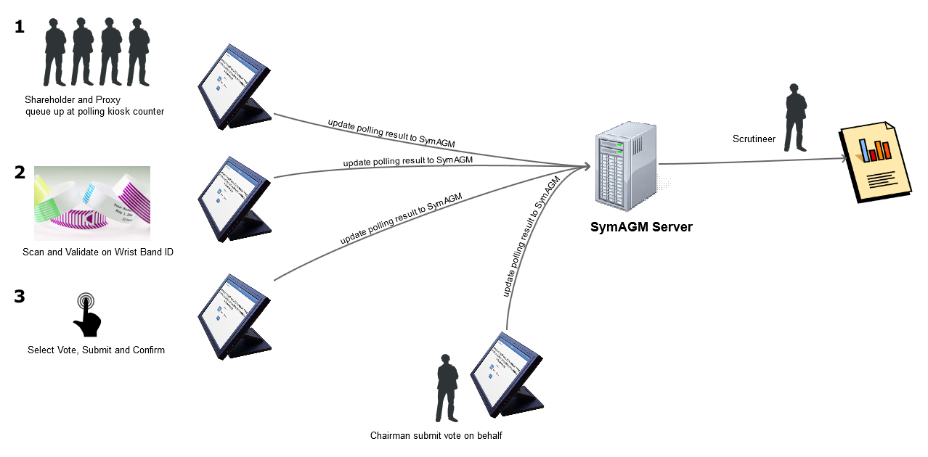
e-Polling Overview

Slide 4
e-Polling – Tested Clientele
MEETING DATE | CLIENT NAME | LOCATION | SCRUTINEERS'
15-Jun-15 | IHH HEALTHCARE BERHAD | HILTON HOTEL KL SENTRAL | KPMG
06-Nov-15 | SYMPHONY HOUSE BERHAD | THE SAUJANA HOTEL | KPMG
25-Nov-15 | MMC CORPORATION BERHAD | HOTEL ISTANA | KPMG
18-Apr-16 | CIMB GROUP HOLDINGS BERHAD | SIME DARBY CONVENTION CENTRE | KPMG
19-Apr-16 | MISC BERHAD | MANDARIN ORIENTAL HOTEL | SYMPHONY CORPORATEHOUSE
26-Apr-16 | DUTCH LADY MILK INDUSTRIES BERHAD | HOTEL ARMADA | SYMPHONY CORPORATEHOUSE
06-May-16 | HIAP TECK VENTURE BERHAD | SETIA CITY CONVENTION CENTRE | SYMPHONY CORPORATEHOUSE
10-May-16 | TALIWORKS CORPORATION BERHAD | ONE WORLD HOTEL | DELOITTE
26-May-16 | K & N KENANGA HOLDINGS BERHAD | THE ROYALE CHULAN K.LUMPUR | SYMPHONY CORPORATEHOUSE
27-May-16 | IHH HEALTHCARAE BHD | CONNEXION @ NEXUS | KPMG
31-May-16 | MALAYSIAN RESOURCES CORPORATION BERHAD | ONE WORLD HOTEL | SYMPHONY CORPORATEHOUSE
01-Jun-16 | RANHILL HOLDINGS BERHAD | INTERCONTINENTAL K LUMPUR | SYMPHONY CORPORATEHOUSE
01-Jun-16 | FELDA GLOBAL VENTURES HOLDINGS BERHAD | MENARA FELDA | SYMPHONY CORPORATEHOUSE
24-Jun-16 | RHB CAPITAL BERHAD | THE ROYALE CHULAN K.LUMPUR | PRICEWATERHOUSECOOPERS
26-Jul-16 | SAPURAKENCANA PETROLEUM BERHAD | SAPURA@MINES | MEGA CORPORATE
27-Jul-16 | DATASONIC GROUP BERHAD | THE EVERLY PUTRAJAYA HOTEL | BOARDROOM
28-Jul-16 | DRB HICOM BERHAD | HOLIDAY IN KUALA LUMPUR | EY
28-Jul-16 | AMFIRST REAL ESTATE INVESTMENT TRUST | BERJAYA TIMES SQUARE HOTEL KUALA LUMPUR | SYMPHONY CORPORATEHOUSE
28-Jul-16 | K & N KENANGA HOLDINGS BERHAD | THE ROYALE CHULAN K.LUMPUR | SYMPHONY CORPORATEHOUSE

Slide 5
E-Polling - Process illustrations
5

Slide 6
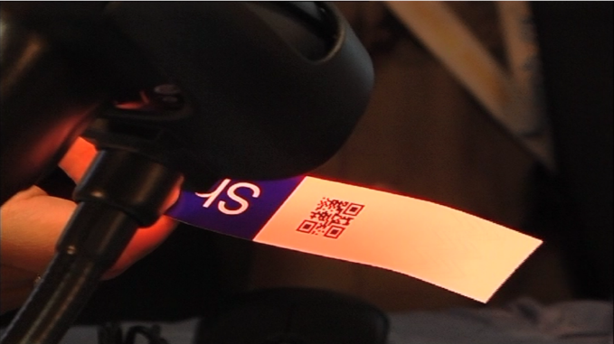
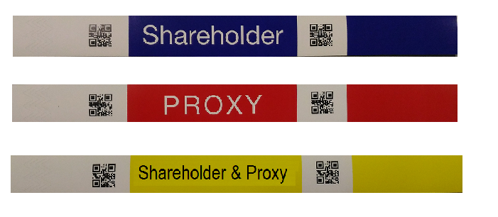
e-Polling Barcoded Wristbands
The barcode wristbands distributed during AGM/EGM registration
6
Notes:
6
Check why recurring high vs F07 while client dropped

Slide 7
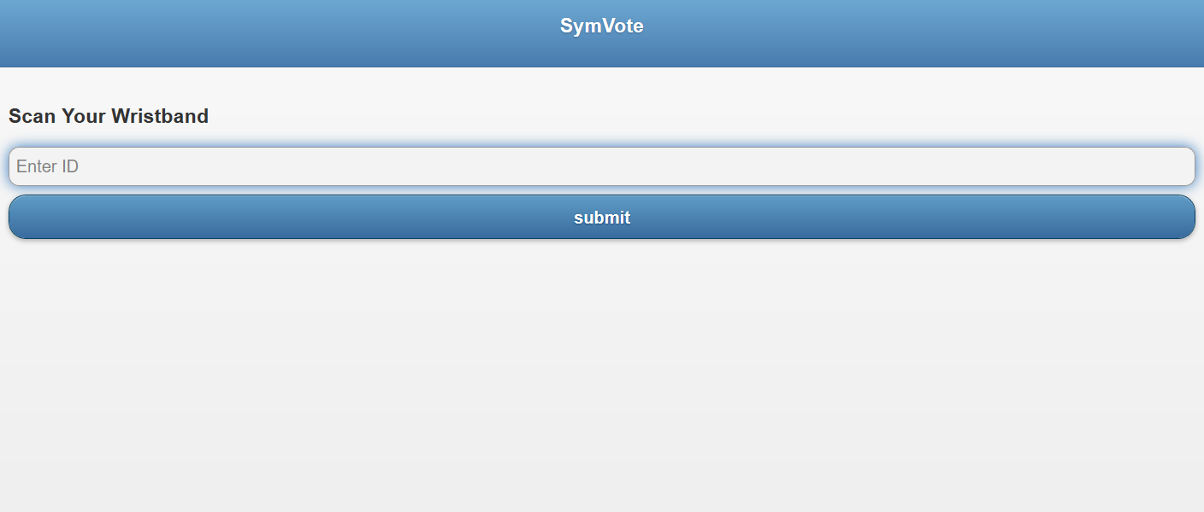
e-Polling Scanners
INSTRUCTION TO SCAN YOUR BARCODED WRISTBAND
7
Notes:
7
Check why recurring high vs F07 while client dropped

Slide 8
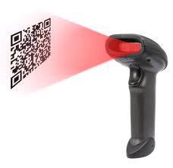
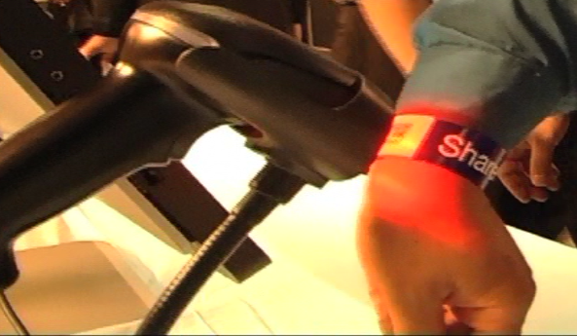
e-Polling – Touchscreen Instructions No.1
SCAN YOUR BARCODED WRISTBAND TO THE BARCODE READER
8
Notes:
8
Check why recurring high vs F07 while client dropped

Slide 9
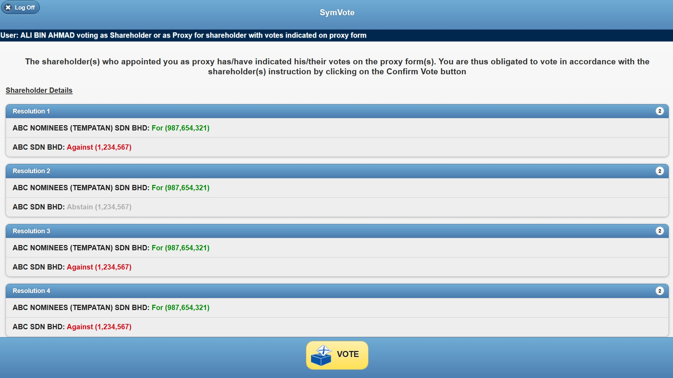
e-Polling – Touchscreen Instructions No.2
PROXYHOLDERS WITH VOTES INDICATED – TO PRESS THE “VOTE” BUTTON
9
Notes:
9
Check why recurring high vs F07 while client dropped

Slide 10
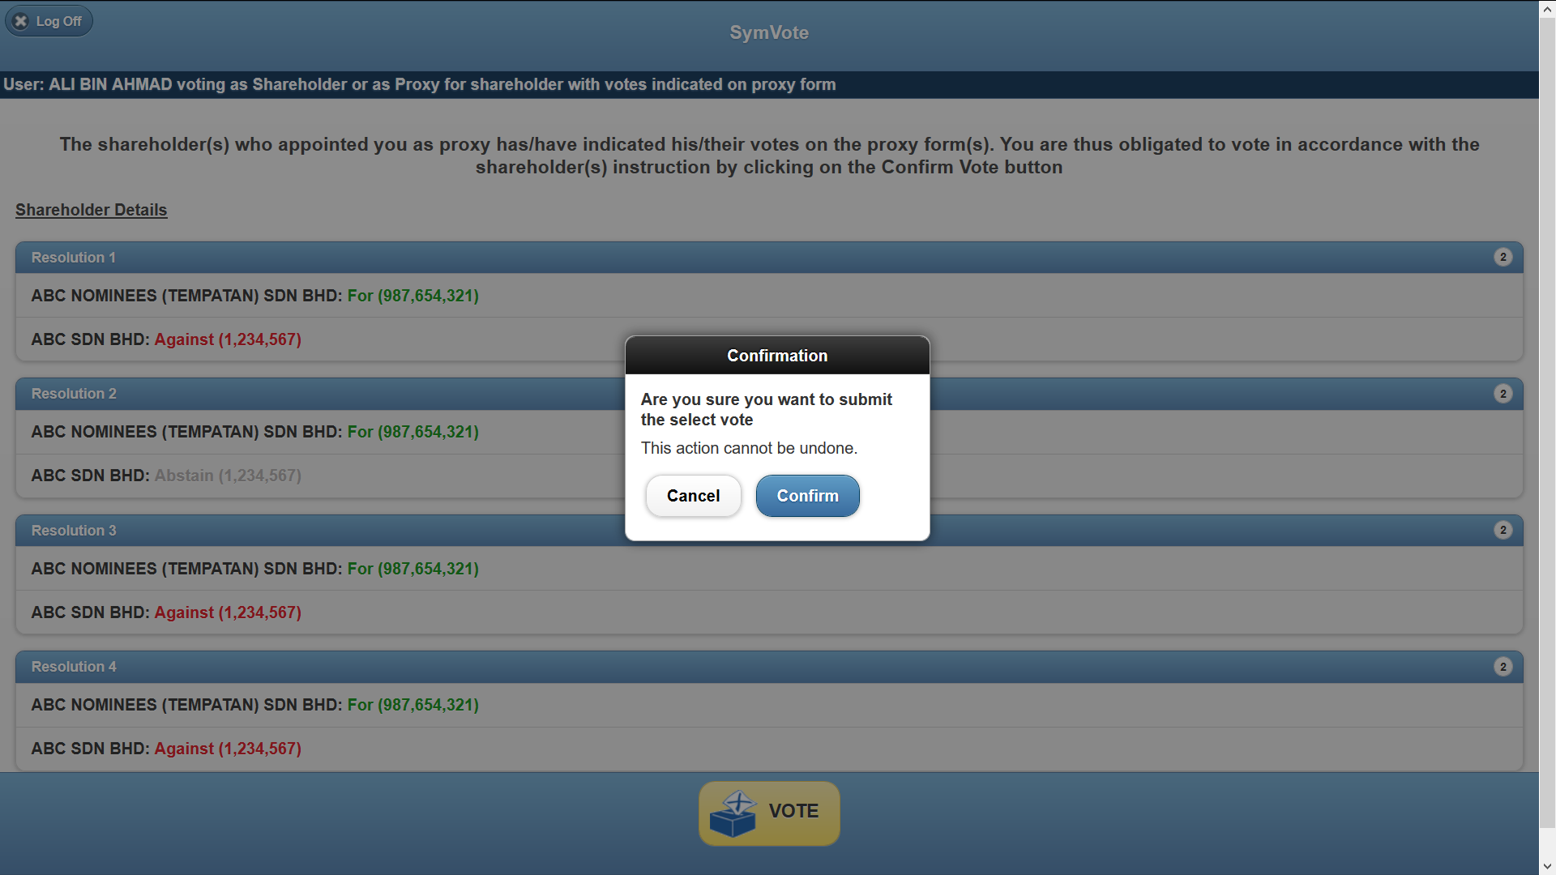
e-Polling – Touchscreen Instructions No.3
“CONFIRM” YOUR VOTE
10
Notes:
10
Check why recurring high vs F07 while client dropped

Slide 11
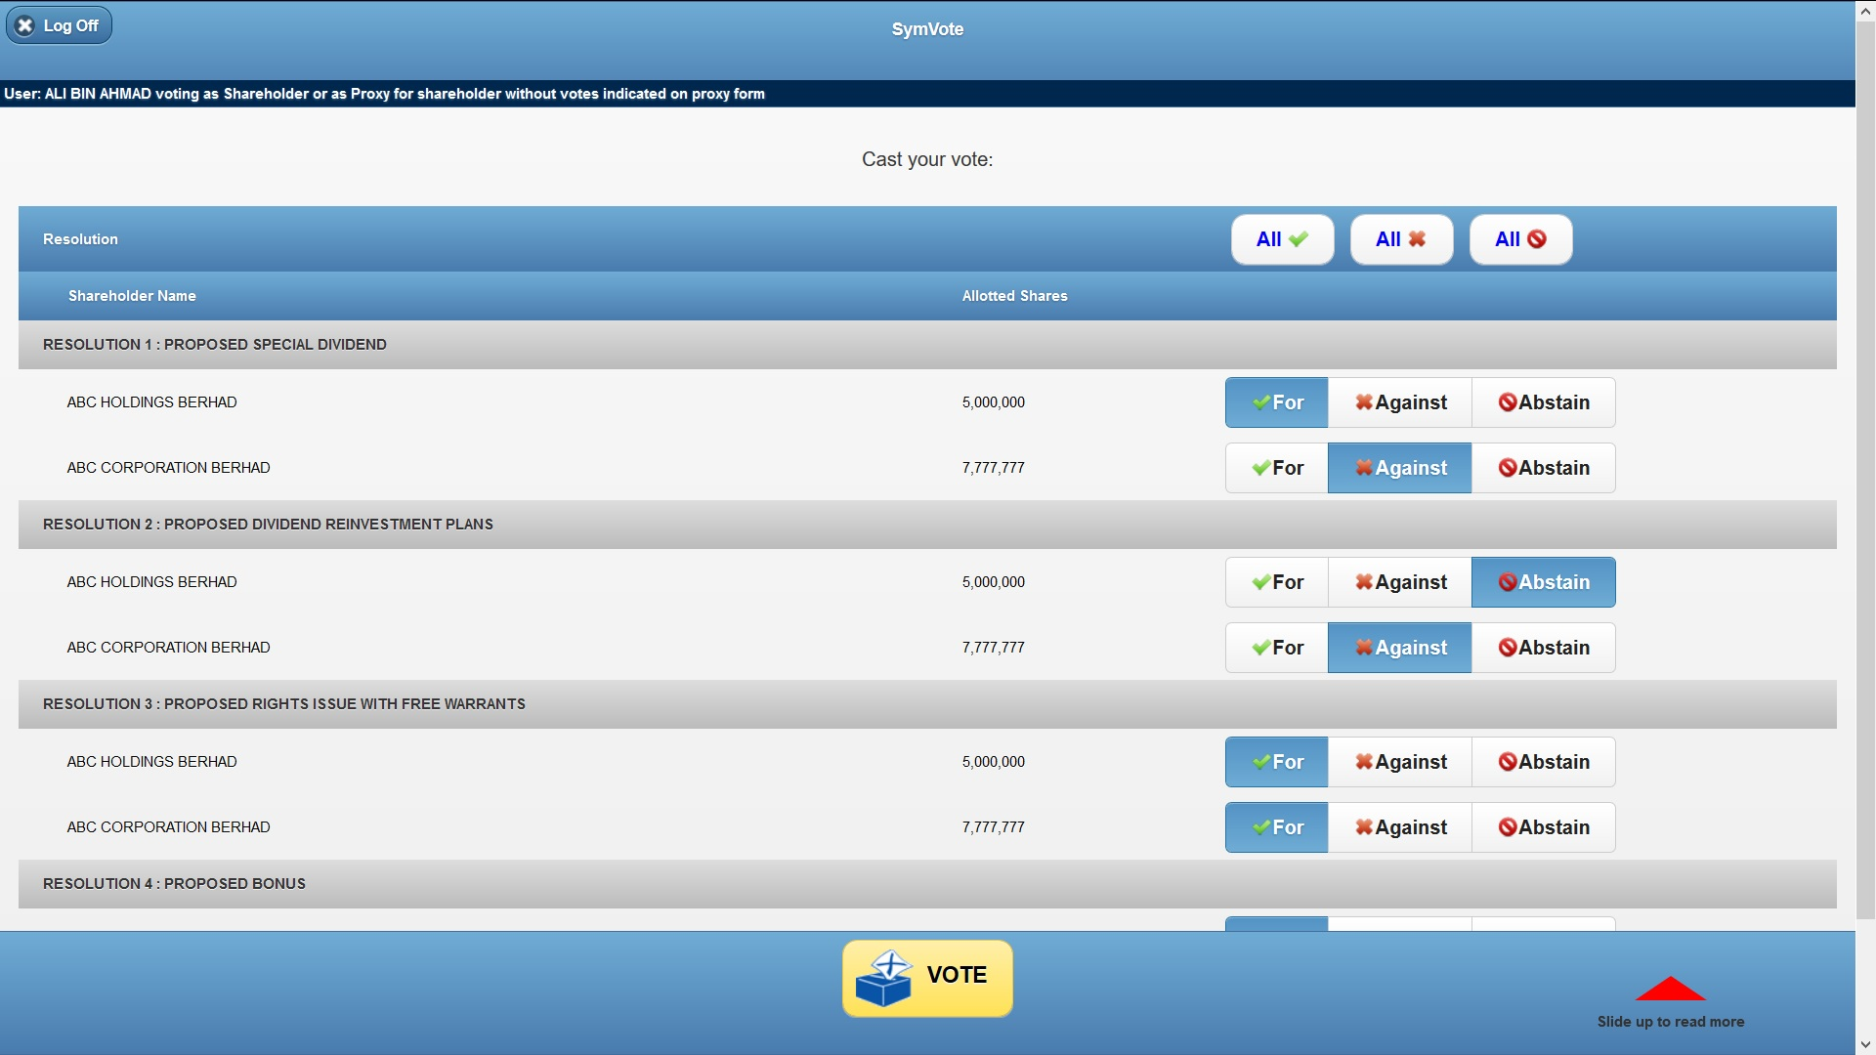
e-Polling – Touchscreen Instructions No.4
SHAREHOLDERS OR PROXYHOLDERS WITH NO VOTES INDICATED
- VOTE “FOR”, “AGAINST” OR “ABSTAIN” ON THE RESOLUTION SHOWN ON SCREEN, THEN PRESS “VOTE” BUTTON
11
Notes:
11
Check why recurring high vs F07 while client dropped

Slide 12
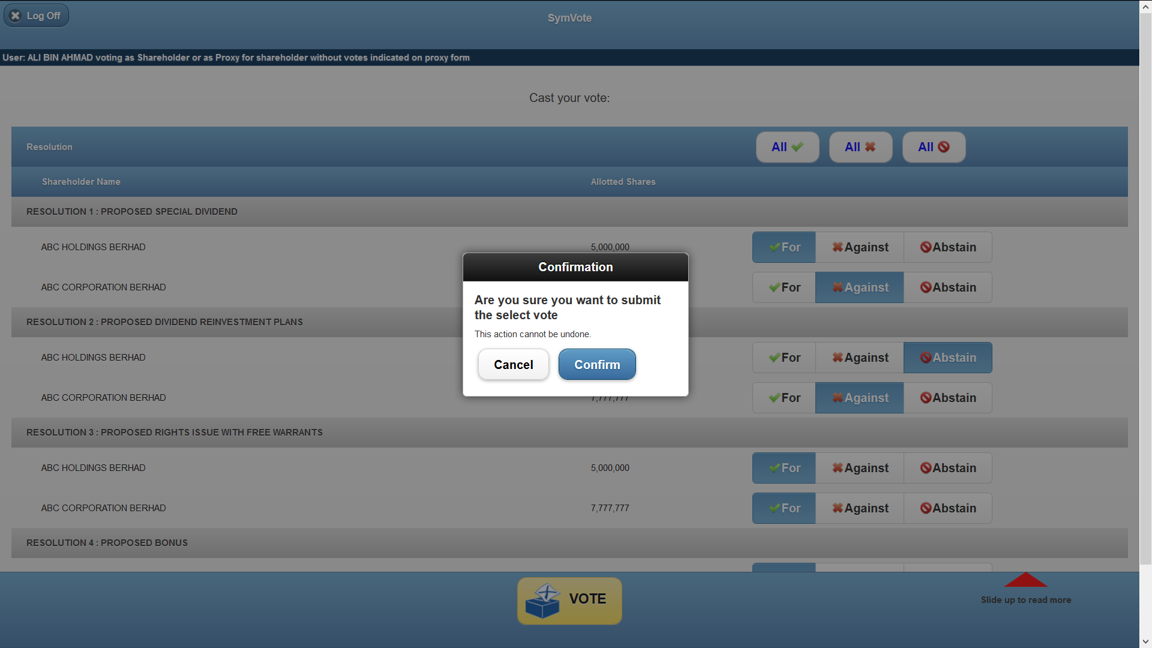
e-Polling – Touchscreen Instructions No.5
“CONFIRM” YOUR VOTE
12
Notes:
12
Check why recurring high vs F07 while client dropped

Slide 13
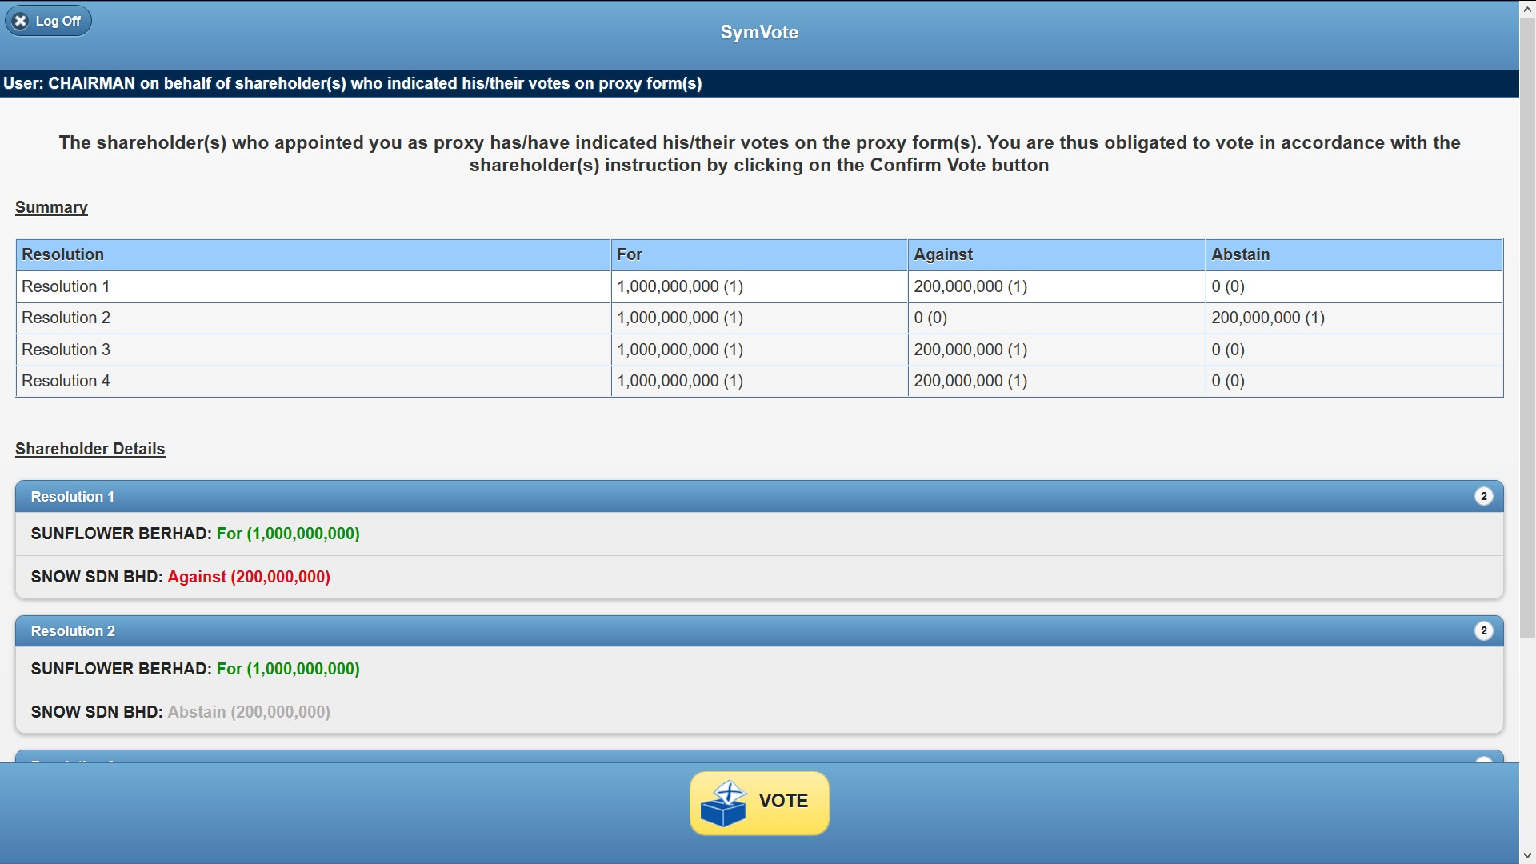
e-Polling – Touchscreen Instructions No.6
CHAIRMAN/FAILING WHICH WITH VOTES INDICATED – TO PRESS THE “VOTE” BUTTON
13
Notes:
13
Check why recurring high vs F07 while client dropped

Slide 14
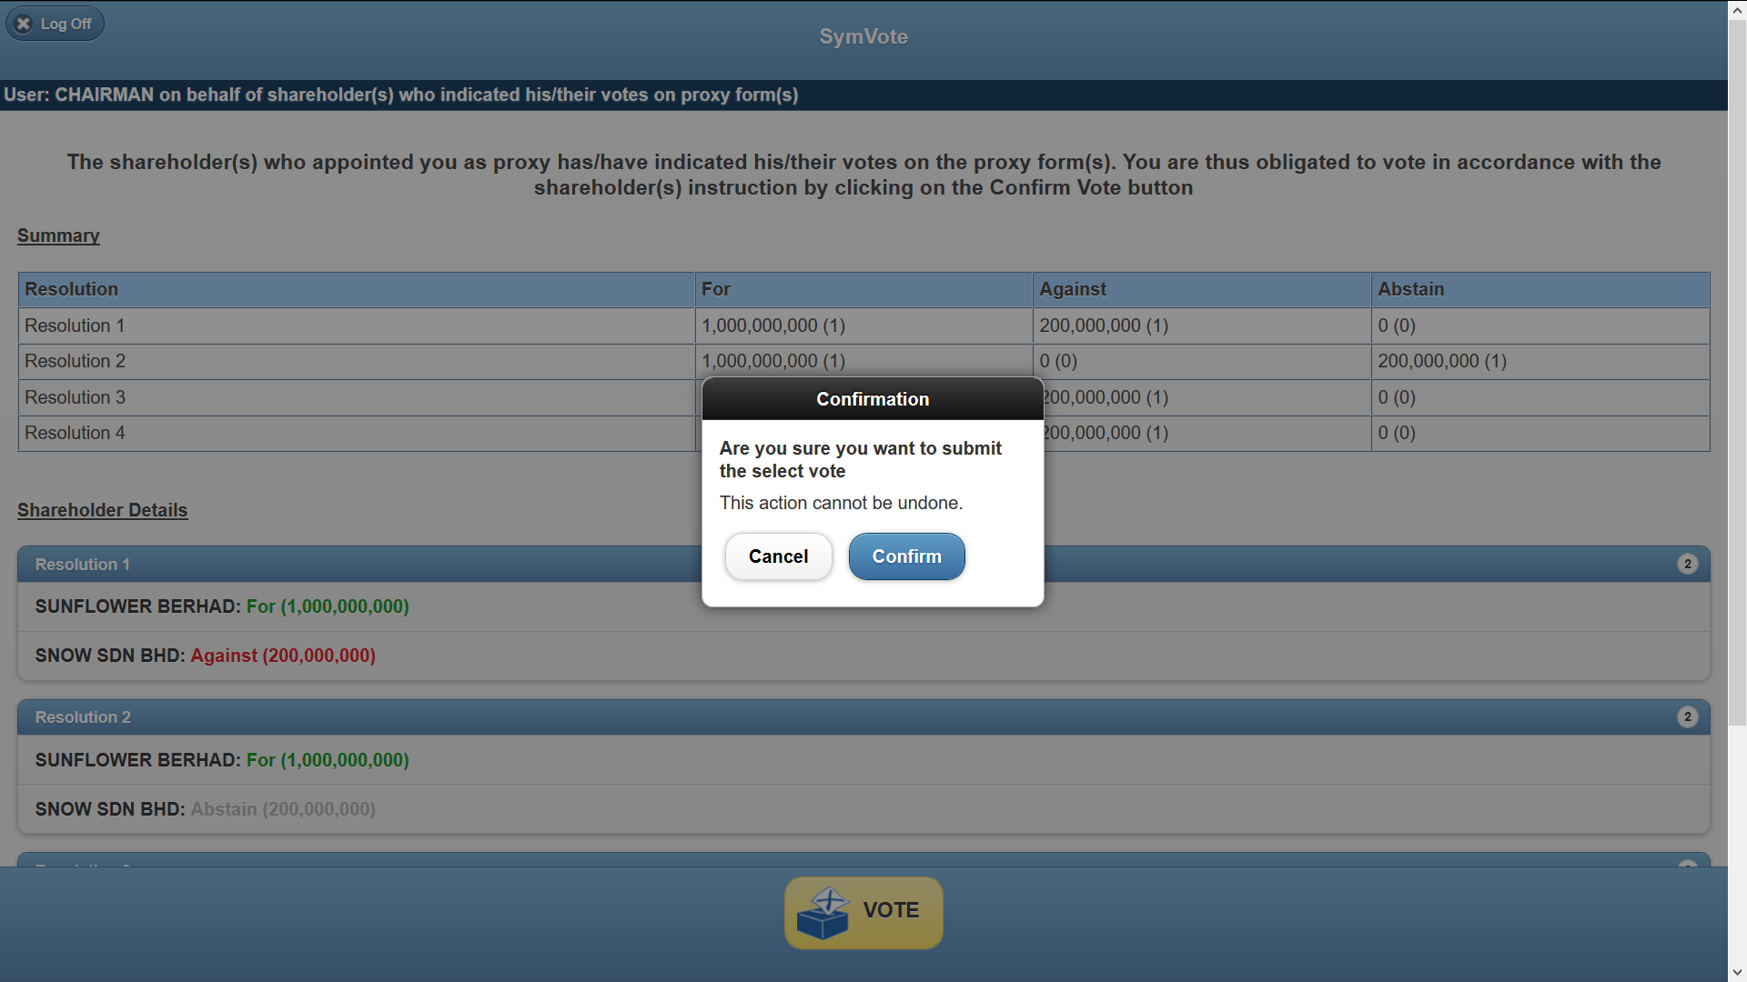
e-Polling – Touchscreen Instructions No.7
“CONFIRM” YOUR VOTE
14
Notes:
14
Check why recurring high vs F07 while client dropped

Slide 15
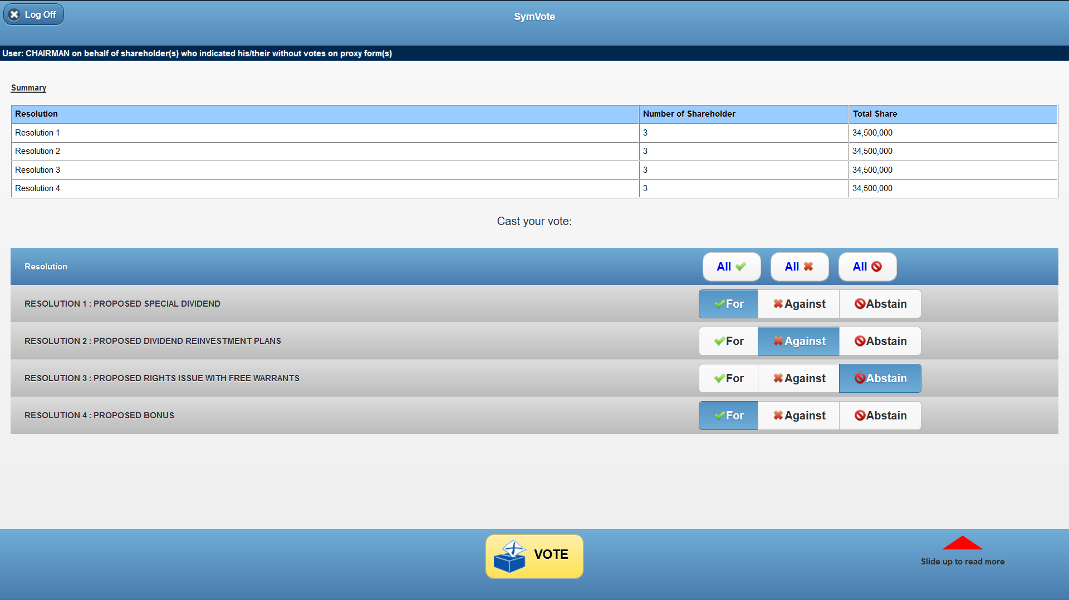
e-Polling – Touchscreen Instructions No.8
CHAIRMAN/FAILING WHICH WITH NO VOTES INDICATED
- VOTE “FOR”, “AGAINST” OR “ABSTAIN” ON THE RESOLUTION SHOWN ON SCREEN, THEN PRESS “VOTE” BUTTON
15
Notes:
15
Check why recurring high vs F07 while client dropped

Slide 16
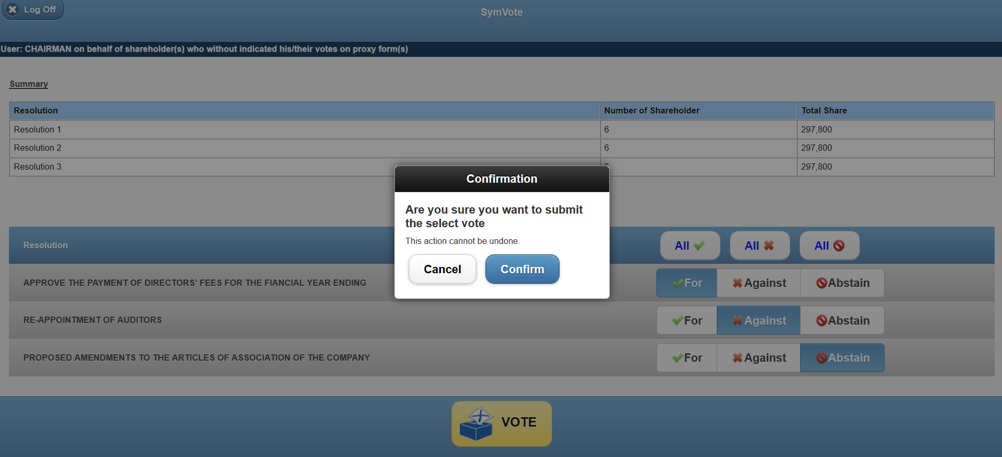
e-Polling – Touchscreen Instructions No.9
“CONFIRM” YOUR VOTE
16
Notes:
16
Check why recurring high vs F07 while client dropped

Slide 17
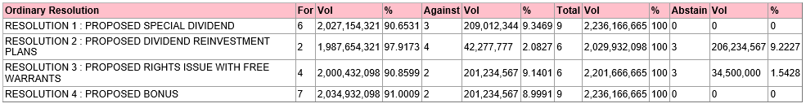
Polling Results

Slide 18
THANK YOU
Q&A Session
18

