Slide 1
SPSLite
CashBook
*Memudahkan Perniagaan Anda

Slide 2
Dengan SPSLite CashBook:
Pengurusan kewangan anda makin mudah
Kawalan aliran tunai perniagaan anda terjamin
Keyakinan pelabur, bank, pembekal dan pelanggan makin tinggi
Menjimatkan masa dan tenaga
Mengurangkan kos
SPSLite
CashBook
*Memudahkan Perniagaan Anda
Disyorkan untuk Usahawan Mikro & Sederhana
HARGA LANGGANAN
RM100
Langganan 3 Bulan
RM300
Langganan Setahun
Mudah, Praktikal dan Mesra Pengguna
untuk urusan perniagaan anda.
SPSLite, perisian simpankira yang disyorkan oleh TEKUN Nasional

Slide 3
SALIHIN merupakan Rakan Strategik Perisian Perakaunan TEKUN Corporation Sdn. Bhd.
Trial http://www.salihin.noip.me/demo.spslite.my
Rekod Perbelanjaan
Rekod Pinjaman
Laporan Kewangan
Business Intelligence Dashboard
Rekod Jualan
Paparan Mesra Pengguna
PC/ HP/ Tablet
Dwi Bahasa
Paparan Skrin SPSLite
Borang
Alamat

Slide 4
SPS
Salihin Premier Solutions
BY ACCOUNTANT FOR ACCOUNTANT
WWW.SALIHINPREMIER.COM
Accounting Software Tailored to SME’s

Slide 5
MODULES
FINANCIAL MODULE
INVENTORY MODULE
GST MODULE
ZAKAT MODULE
WAQF MODULE
Boost Productivity
Comprehensive
Financial Report
Pre-Define
Account
Chart
SPS
Salihin Premier Solutions
BY ACCOUNTANT FOR ACCOUNTANT
WWW.SALIHINPREMIER.COM
Accounting Software Tailored to SME’s
SUBSCRIPTION FEE
RM300
QUARTERLY SUBSCRIPTION
RM1,000
YEARLY SUBSCRIPTION
User Access Control
Fully Responsive
Comprehensive
Audit Trail
Mudah, Praktikal dan Mesra Pengguna
untuk urusan perniagaan anda.
SPSLite, perisian simpankira yang disyorkan oleh TEKUN Nasional

Slide 6
SPS Logo
SME’s Acccounting Software Recommended by TekunCorp
FREE TRIAL Sign Up at http://demo.salihinpremier.com/demo/login
GST 03
Multi Users /Companies
Comprehensive Financial Report
Dynamic Web Propagation
Customer’s
Statement
Fully Responsive PC/ HP/ Tablet
Bi-Language
Paparan Skrin SPS
Borang
Alamat

Slide 7
Salihin WebLite
Dynamic Website for SME’s

Slide 8

Easy to Manage
Arsenal to Create Business Website
Simple
SUBSCRIPTION FEE
RM100
YEARLY SUBSCRIPTION
Salihin WebLite
Dynamic Website for SME’s
D.I.Y
Friendly
Fully Responsive
Designed for Non-IT Background
Your small business will gain credibility and better presence by having a website with us
Salihin WebLite, recommended website platform by TEKUN Nasional

Slide 9
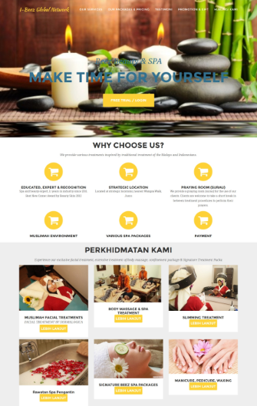
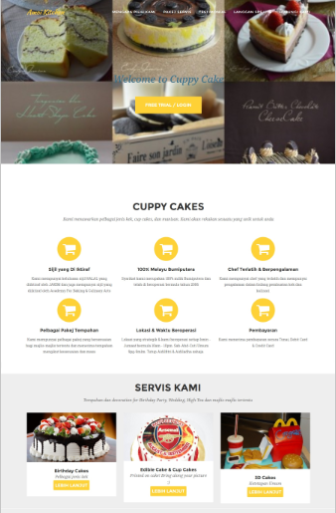
Salihin WebLite
SME’s CloudBased Website Recommended by TekunCorp
FREE TRIAL Sign Up at http://demo.salihinpremier.com/demo/login
Borang
Alamat

