Slide 1

SPS
SALIHIN PREMIER SOLUTIONS
BY ACCOUNTANTS FOR ACCOUNTANTS

Slide 2
  SPS SOFTWARE TRAINING
TIME | PROGRAMME
08.45 am – 09.00 am | Registration
09.00 am – 10.30 am | Installation/Setup Process
10.30 am – 11.00 am | Break
11.00 am – 01.00 pm | Account Payables/Receivables
01.00 pm – 02.00 pm | Lunch
02.00 pm – 04.00 pm | General Ledger/Report/GST
04.00 pm – 04.30 pm | Q & A / Closing

Slide 3
  TOPIC
INSTALLATION
SETUP PROCESS
  COMPANY SETUP
  INVENTORY SETUP
ACCOUNT PAYABLES
ACCOUNT RECEIVABLES
GENERAL LEDGER
REPORT
GST

Slide 4
  SPS MODULE
GENERAL LEDGER
ACCOUNT RECEIVABLES
ACCOUNT PAYABLES
SALES ORDER
PURCHASING
INVENTORY CONTROL
GOODS & SERVICE TAX
ZAKAT & WAKAF
GENERAL SETUP
ADMIN

Slide 5
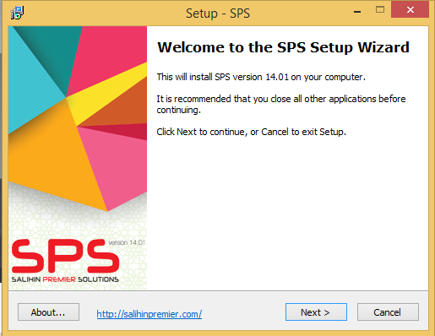
  INSTALLATION
STEP 1: Welcome to the SPS Setup Wizard. This installer will install the SPS Version 14.01 on your computer. It is recommended that you close all the other applications before continuing. Click Next to continue, or Cancel to exit the installation setup.

Slide 6
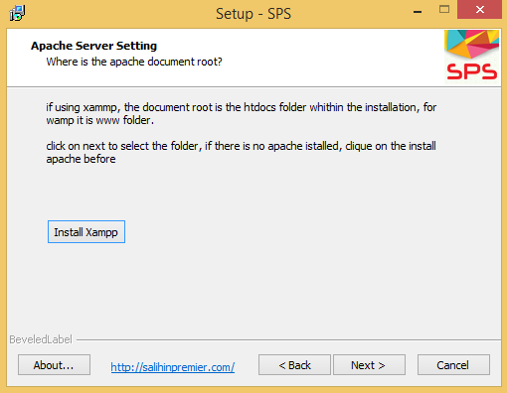
  INSTALLATION
STEP 2: Please make sure the XAMPP is installed or your web server is functioning. In case you already have Xampp, click Next to continue, otherwise click on Install Xampp then wait until Xampp installation is complete.

Slide 7
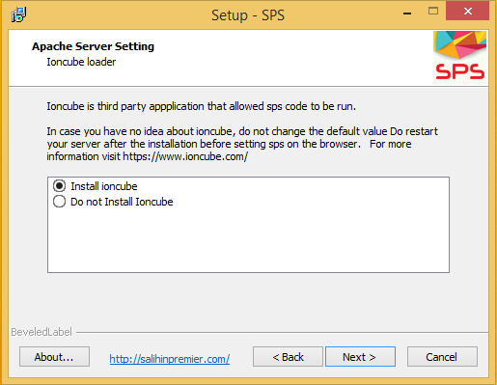
  INSTALLATION
STEP 3: Please make sure you install ioncube. Click Next button.

Slide 8
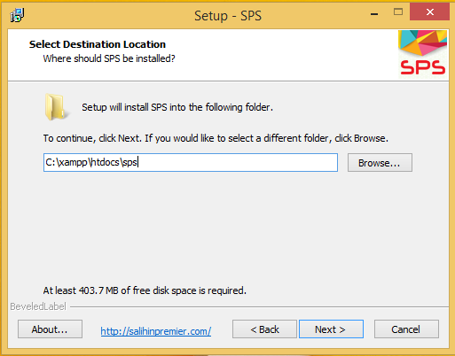
  INSTALLATION
STEP 4: Before you continue, please select the destination which must be the web document root of your server (htdocs for Xampp), stored folder location.
To continue, click Next. If you would rename the folder name, then click Browse.

Slide 9
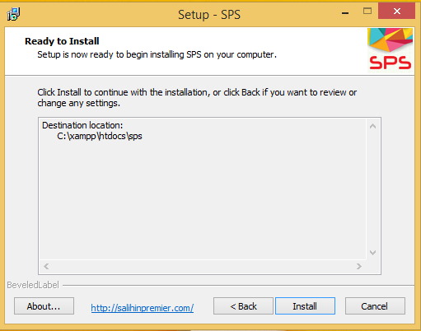
  INSTALLATION
STEP 5: Click Install to continue with the installation, or click Back if you want to review or change any settings.

Slide 10
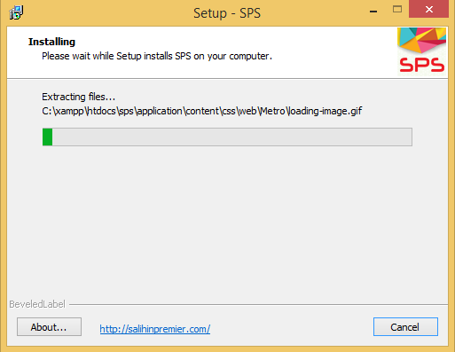
  INSTALLATION
STEP 6: Please wait while Setup installs SPS on your computer.

Slide 11
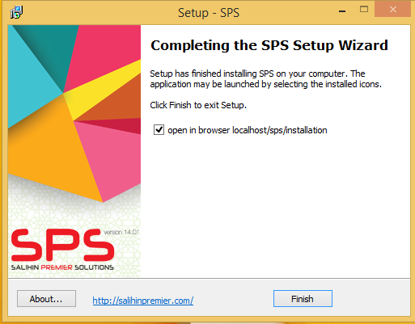
  INSTALLATION
STEP 7: Congratulation! Setup has finished installing SPS on your computer. Please make sure that you RESTART your XAMPP before you tick the open in browser localhost/sps/installation option. Click Finish to exit Setup.
NOTE
If you have renamed the sps folder, once the browser opens, replace “sps” with the name you have used previously.
In case you encounter the following error, do restart your server then refresh your browser.
Site error: the file C:\xampp\htdocs\sps\application\controllers\installation.php requires the ionCube PHP Loader ioncube_loader_win_5.6.dll to be installed by the website operator. If you are the website operator please use the ionCube Loader Wizard to assist with installation.

Slide 12
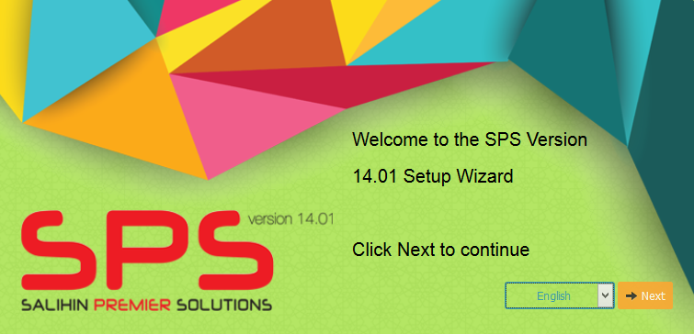
  INSTALLATION
STEP 8: Type localhost/sps/installation. You will see the Welcome to the SPS Version 14.01 Setup Wizard. Click Next to continue.
NOTE : If you have renamed the sps folder, once the browser opens, replace “sps” with the name you have used previously.
.

Slide 13
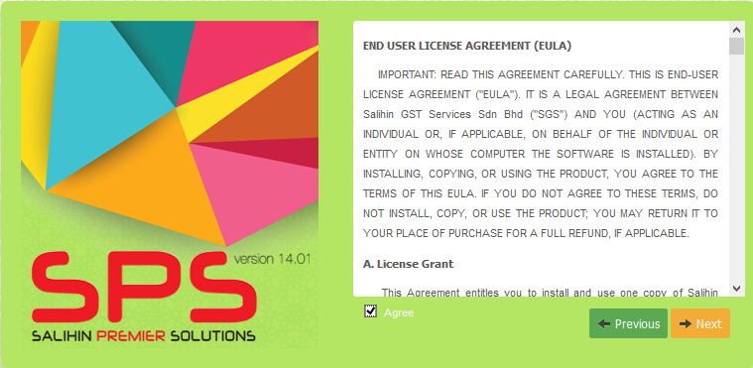
  INSTALLATION
STEP 9: To continue, you have to accept the software license agreement by clicking the box. If you do not agree with the license agreement, the Next button will be disabled.

Slide 14
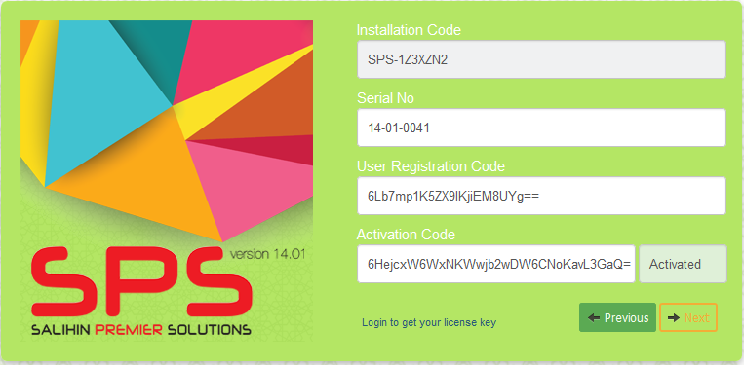
  INSTALLATION
STEP 10: Click on Login to get your license (open in a browser demo.salihinpremier.com/ss-ss/customerlogin). You need to enter your Serial No. located at your SPS Pack. Copy and paste the User Registration Code and Activation Code. Click Validate button. (Please refer to Appendix 1)
Note: Make sure there is no SPACE when you copy and paste. IF it fails to validate, please contact your Dealer.
.

Slide 15
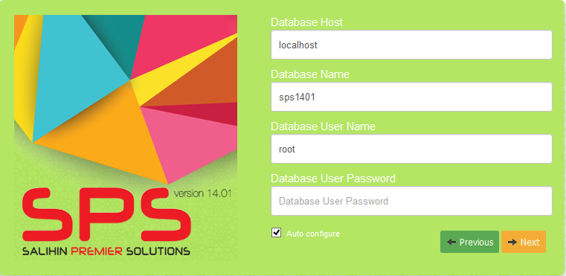
  INSTALLATION
STEP 11: After successful activation , you have to setup your database. Please make sure that your Database Host, Database Name and Username are correct.
.

Slide 16
  INSTALLATION
Note:
If you want to change the database setting, click the Auto configure box.
If you are setup sharing networking of SPS, please make sure you enter the IP Number of your main server. Otherwise you can use as localhost.
You are encouraged not to rename Database Name.
Enter your Database User Name. (By default is root).
Enter your Database User Password. (By default, there is no password).
Click Next to continue.
.

Slide 17
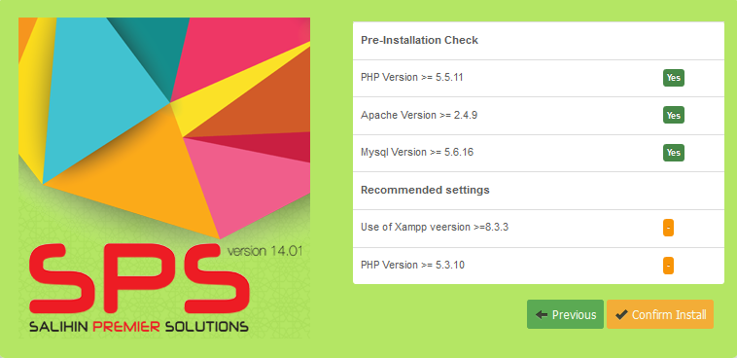
  INSTALLATION
STEP 12: Check the Pre-Installation. Click Confirm Install button to continue

Slide 18
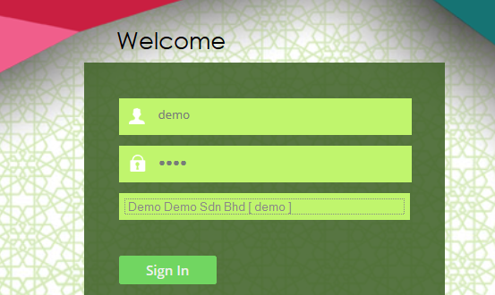
  INSTALLATION
STEP 13: Once finished, you will see this interface. Here, you will enter the following details:
Username : demo
Password : demo
Company : Demo Demo Sdn Bhd [demo]

Slide 19
  INSTALLATION
After Signing In, you are already in the main page of SPS Accounting Interface. Refer to the internal user guide on how to use SPS to manage your business.
Appendix 1: How to get customer installation details
Open in a browser demo.salihinpremier.com/ss-ss/customerlogin
Enter the username and password to login.
Click the SPS Serial No. link. Then you will be directed to License page.
Dealer and Customer can configure the license.
Enter the Installation Code and click the Update button.
Once updated, the system will generate the Activation Code.
Note: Make sure that there is no SPACE when pasting into the installation field.

Slide 20
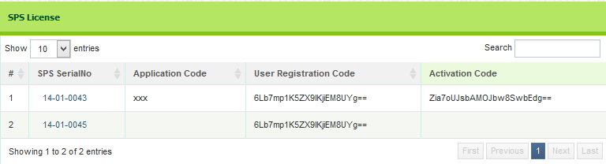
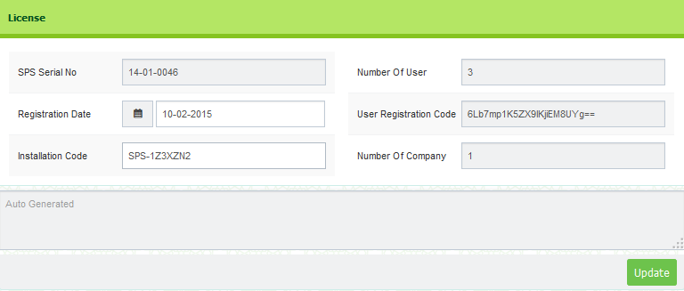
  INSTALLATION

Slide 21
  INSTALLATION VERSION II

Slide 22
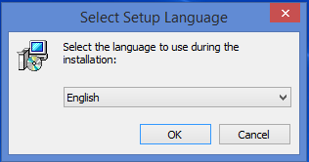
  INSTALLATION VERSION II
STEP 1: First of all, please insert or plug-in your SPS thumb drive into your machine. Select the language that you prefer to use during the installation.

Slide 23
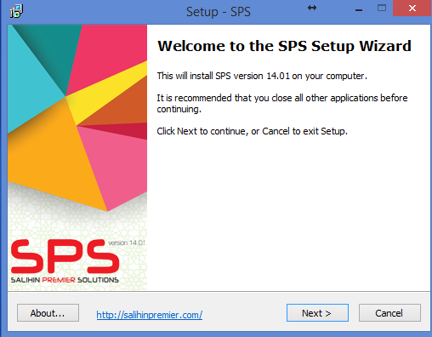
  INSTALLATION VERSION II
STEP 2: Welcome to the SPS Setup Wizard. This installer will install the SPS Version 14.01 on your computer. It is recommended that you close all the other applications before continuing. Click Next to continue, or Cancel to exit the installation setup.

Slide 24
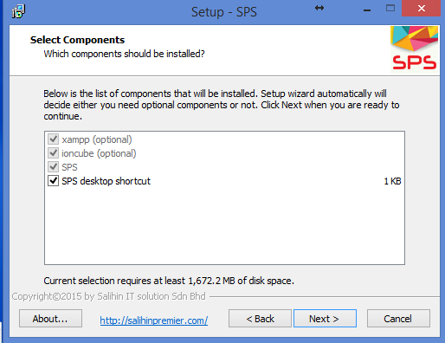
  INSTALLATION VERSION II
STEP 3: In this part, the list of component will be installed automatically. Then, click Next button.

Slide 25
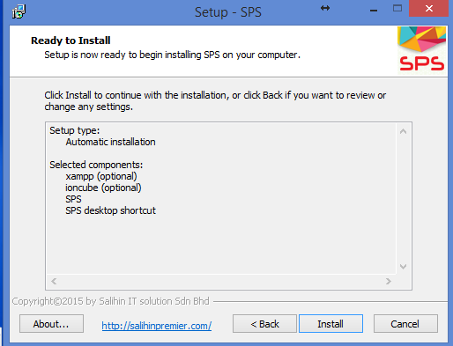
  INSTALLATION VERSION II
STEP 4: Click Install button to continue with the installation, or click Back button if you want to review or change any settings.

Slide 26
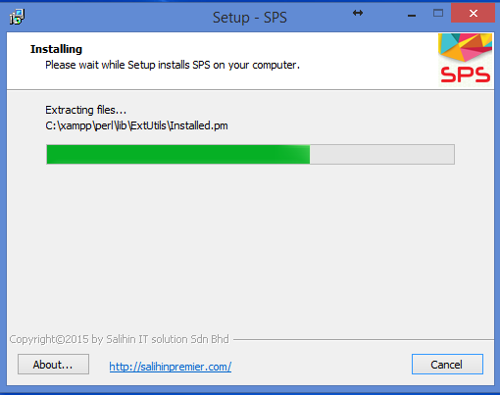
  INSTALLATION VERSION II
STEP 5: Please wait while Setup installs SPS on your computer.

Slide 27
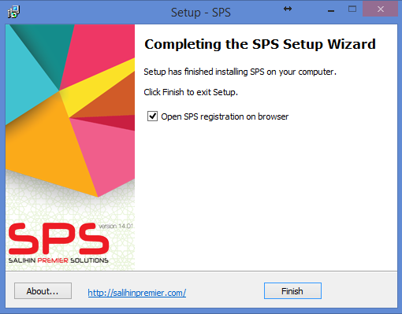
  INSTALLATION VERSION II
STEP 6: Congratulation! Setup has finished installing SPS on your computer. Please make sure that you RESTART your XAMPP before you tick the open in browser localhost/sps/installation option. Click Finish to exit Setup.

Slide 28
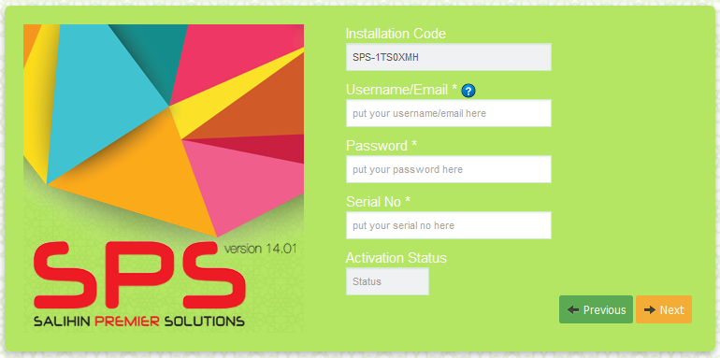
  INSTALLATION VERSION II
STEP 7: Check your email, we have send username/email and password. You need to enter this User Name/email, password and your Serial No that locate at your SPS Packaging. Click Next button.
Note: Make sure there is no SPACE when you copy and paste. IF you are failed to validate, please contact your Dealer.

Slide 29
  SETTING UP

Slide 30
  COMPANY SETUP
Company Setup
User Setup
User Right Setup
Log Out
Chart of Account Setup
System &General Setup
Financial Year Calender
Log in with New user ID & Company

Slide 31
  COMPANY SETUP
Employee Setup
Agent Setup
Master Setup
Term Setup
Bank Setup

Slide 32
  INVENTORY SETUP
Item category
Item Type
Item Setup
Location Master
Unit of Measures

Slide 33
  ACCOUNT PAYABLES
PURCHASING
Optional
PURCHASE PRICING
SUPPLIER LIST
PURCHASE ORDER
PURCHASE ORDER CONFIRM
Good Received Note (GRN)
PURCHASE RECEIVE
PURCHASE RECEIVE CONFIRM
INVENTORY
REPORTING
Inventory Control
  Inventory list
Statement of Financial Position
  Trade Payable
POSTING JOURNAL
Decrease Stock (purchase return)
Increase Stock
(additional purchase)
DEBIT NOTE
CREDIT NOTE
ACCOUNT PAYABLE
PURCHASE INVOICE CONFIRM
PURCHASE INVOICE
Trade Payable
POSTING JOURNAL
(Auto create GRN)
DIRECT PURCHASE INVOICE
PURCHASE INVOICE CONFIRM

Slide 34
  ACCOUNT RECEIVABLES
SALES ORDER
Optional
SALES PRICE
SALES QUOTATION
SALES ORDER
Delivery Order
(DO)
DELIVERY ORDER
DELIVERY ORDER CONFIRM
INVENTORY
REPORTING
Inventory Control
  Inventory list
Statement of Financial Position
  Trade Receivable
POSTING JOURNAL
Decrease Stock (additional sales)
Increase Stock
(sales return)
DEBIT NOTE
CREDIT NOTE
ACCOUNT RECEIVABLES
SALES INVOICE CONFIRM
SALES INVOICE
Trade Receivable
POSTING JOURNAL
(Auto create DO)
DIRECT SALES INVOICE
SALES INVOICE CONFIRM

