Slide 1



PROPOSAL FOR STRATEGIC COLLABORATION
IN LEARNING & GRADUATE SKILLS ENHANCEMENT
Prepared for:
Prepared by:

Slide 2
EXECUTIVE SUMMARY
Enhancing learning experience with SPS
With the current shift towards efficient governance, the implementation of GST resulted in the requirement of further understanding of the tax structure in accounting. As one of the prestigious university in Malaysia, UMT can lead the shift through utilization of accounting information system(AIS) as a practical tool in demonstrating tax structure in accounting.
This requires certified accounting software, developed with direct input from the customs department, the Salihin Premier Solution (SPS) will provide the competitive edge for UMT to enhance the learning experience of its accounting students in gaining the practical understanding on GST implementations and its impacts in financial reports.
It can be implemented as a learning tool in Accounting Information System subject.

Slide 3
THE PROPOSAL
Main Objective: Enhancing Graduates
CAPACITY BUILDING
SKILLS ENHANCEMENT
INDUSTRIAL
RELEVANCE
To equip UMT graduate student with value added accounting software skills
To provide avenue for UMT to enhance graduate skills and accreditations
To provide practical expertise and experience for UMT in delivering courses relevant to current and future industrial practices.

Slide 4
THE PROPOSAL
SPS As Optional Learning Tool
SPS is used to support the curriculum based on self initiatives by student with the assistance from lecturers.
For better positioning of SPS, exam will be given as an optional (to test student understanding of each particular subject)
Exam, Marking & Certification will be provided by SALIHIN (For those who seat for exam).
Part of
Up Skilling
Program
Not Bound to University Program
Does Not Require Senate Permission
SPS Student Manual & Installer
SPS as Optional Learning Tool
2 Hours Online Exam
Separate Session in Lab
SPS Certification
Lecturer’s Decision
Student’s Willingness
Monitoring & Marking By SALIHIN

Slide 5
THE PROPOSAL
Proposed Modules - Summary
SPS Modules | Setup & Operate Admin & General Setup Module Setup General Ledger Module Setup Account Receivables Module Setup Account Payables Module Setup & Operate Sales Order Module Setup and Operate Purchasing Module Setup & Operate Inventory Control Module Setup & Operate GST Module Setup & Operate Zakat & Waqf Modules

Slide 6
THE PROPOSAL
Proposed Modules - Details
Setup & Operate General Setup Module
  How to setup a company
  How to setup employee
  How to setup agent
  How to setup master code
  How to setup project
  How to setup terms
  How to setup bank
  How to setup ship to (location)
  How to setup a graph
Setup & Operate Admin Module
  How to add/edit & authorization of access for each user
  How to search & produce log report
  How to perform a backup
  How to upgrade license & version

Slide 7
THE PROPOSAL
Proposed Modules - Details
Setup General Ledger Module
  How to setup financial year, chart of account, opening balance & other sub modules
  How to perform transaction
  How to generate and produce report
4. Setup Account Receivables Module
  How to setup customers
  How to setup historical customer invoice
  How to perform sales transaction
  How to generate & produce report
5. Setup Account Payables Module
  How to setup supplier
  How to setup historical supplier invoice
  How to perform purchases transaction
  How to generate & produce report

Slide 8
THE PROPOSAL
Proposed Modules - Details
6. Setup & Operate Sales Order Module
  How to setup sales price
  How to perform sales quotation & delivery order
  How to generate & produce report
Setup and Operate Purchasing Module
  How to setup purchase price & supplier lists
  How to perform purchase order & purchase receive
  How to generate & produce report
Setup & Operate Inventory Control Module
  How to setup inventory items
  How to perform location transfer & stock take
  How to generate & produce report

Slide 9
THE PROPOSAL
Proposed Modules - Details
Setup & Operate GST Module
  How to setup GST requirement
  How to perform GST transaction
  How to generate & produce GST report
  How to generate & submit GST-03
Setup & Operate Zakat & Waqf Modules
  How to setup zakat nisab & centre
  How to setup waqf & waqf centre
  How to perform zakat calculation
  How to perform waqf calculation
  How to generate & produce zakat & waqf report

Slide 10
THE PROPOSAL
Target Market
Main Target
  Final Year Student of (GE02 Sarjana Muda Perakaunan)
  Others Final Year Student (Whom interested in upskilling process)

Slide 11

THE PROPOSAL
Proposed Pricing
Proposed pricing for UMT Accounting Student:
  RM55.00 per pax.
Participated student will be provided with (Student Kits):
  SPS Student Installer/ Cloud-based ID access
  SPS Student Manual
  CD Interactive

Slide 12
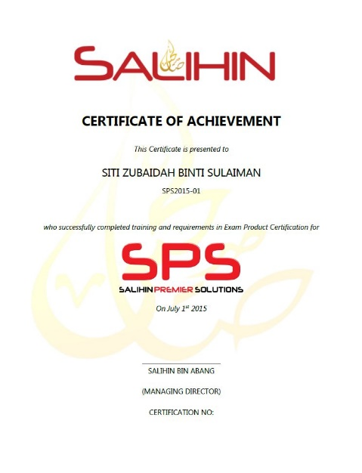
THE PROPOSAL
Expected Outcomes & Deliverables
At the end of the programme, we expected each graduates would be able to:
  Operate and utilize SPS Software (Install, configure & operate).
  Provide consultation & training on SPS.
SALIHIN deliverables to partipated graduates:
  SPS Certifications
    SPS Participation Certificate
    SPS Certified Engineer Certificate
    SPS Consultant Certificate
  1 Year Free SPS License
  1 Year Free SPS Support Service

Slide 13
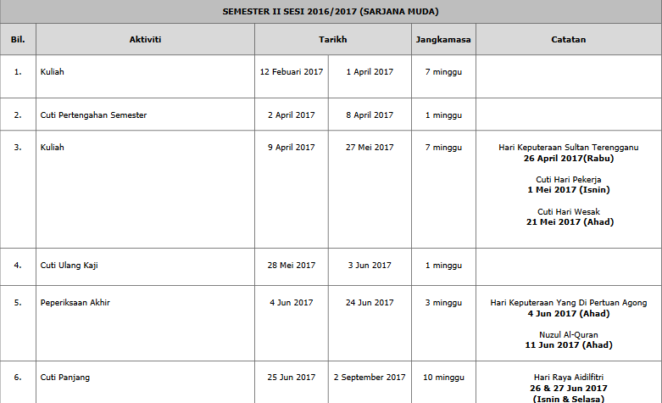
THE PROPOSAL
UMT Academic Calendar
Week before study week start

Slide 14

THE PROPOSAL
Proposed Teaching Method
OPTION 1:
  SALIHIN teach student directly (without participation from lecturers)
    Revenue will be shared between SALIHIN and TAF
OPTION 2:
  Lecturers teach student directly (without participation from SALIHIN)
    SALIHIN will provide trainings to interested/ participated lecturers
    Revenue from the training 100% goes to UMT
    UMT pay SALIHIN for the accounting software only
    Revenue of accounting software will be shared between SALIHIN and TAF

Slide 15
THE PROPOSAL
Proposed Implementation Plan
1st Quarter 2017
MOU signing
Train the trainer
Finalize course syllabus
SPS kit installation
User manual & documentation preparation
1st Quarter 2017
ToT Kick off
  April 2017
Pilot program kick off
  May 2017
4th Quarter 2017
Program kick off
  Oct 2017

Slide 16
THE PROPOSAL
Roles & Responsibility
UMT | SALIHIN
To fully utilized SPS as main teaching tools / software. | To provide education version software
Provide facilities i.e classes & computer lab | Train the trainer (Lecturers) On site (2 -3 Days) In house (30 Days)
Provide trainers/ lecturers | Provide user manual (text book), exam , scoring, marking & certification.
Assist SALIHIN to promote SPS to students | Provide full support & hotline no
UMT to allow SALIHIN to use UMT brand, image recognition in promotional and advertising purposes | Assist UMT in develop new course syllabus.
Expand new coursework program (where applicable)

Slide 17
SPS Background
Salihin Premier Solutions
The SALIHIN PREMIER SOLUTIONS also know as SPS, the intelligent software in the world that can manage numerous aspects of financial accounting including Goods and Services Tax (GST) and Zakat calculation, customized specially for Small and Medium Enterprises (SMEs).
SPS is an efficient and effective accounting software that accommodates changes affecting invoicing and billing system of the business process. The software is powered by the latest security features to secure data or information for optimal integrity and confidentiality. It is tailor made for small and medium industries by professional accountants.
The Zakat module makes SPS the first comprehensive accounting software with Zakat solution. It will make it easier than ever for Muslim businesses, corporations and organizations to determine the amount payable as Zakat. With Zakat feature built in, it is simply the best accounting software yet.

Slide 18
SPS Background
The Main Modules
There is 5 main modules of SPS
Financial Module
Inventory Module
GST Module
Zakat Module
Waqf / Endowment Module

Slide 19

SPS Background
Function And Features
SPS
Predefined Accounting Chart
Default GST Setup
Biz Dashboard
Regulate User Access
GST-03 Online Submission
Dynamic Graph Propagation
Void Unconfirmed Transaction
Auto Notification of
any New Update
Zakat Calculation Enhancement
Simplified Tax Invoice
Auto Calculation Wakaf
Self Billed Tax Invoice

Slide 20

Product Comparisons
SPS vs Other Accounting Software

Slide 21










Client Tele
SPS Client

Slide 22

SPS Background
Future Developments
POS System
Fixed Asset Management
Payroll System
CRM System
Cash Book System

Slide 23

CONTACT US
OFFICIAL ADDRESS & CONTACT PERSON
CORPORATE CENTRE:
555, Jalan samudra Utara 1,
Taman Samudra,
68100 Batu Caves,
Selangor Darul Ehsan.
Tel: +603 6185 9970 (Hunting Line)
Fax: +603 6184 2524
CONSULTANT: WAN MOHD ISKANDAR B. WAN OMAR
EMAIL: wanmohdiskandar@salihin.com.my
Mobile: +6010 401 4180
Official Website : www.salihin.com.my
Customer Service : www.salihinpremier.com
E-mail : info@salihin.com.my
Careline : 1 300 88 5678

Slide 24




PI1M COMMUNITY CONTENT ENHANCEMENT
BY ACCOUNTING SOLUTIONS
Prepared for:
Prepared by:

Slide 25
TABLE OF CONTENT
Project Executive Summary
Page 3-10
SPS Training Module
Page 11
Continuous Learning
Page 25
SPS Business Support
Page 30
Hardware, Infrastructure & Maintenance
Page 34
Execution Plan
Page 42
Proposed Project Coordination
Page 51
Web Interface
Page 62
Timelines
Page 69
Marketing & Promotion Strategy
Page 73
Financial Project Consideration
Page 81

Slide 26

PI1M COMMUNITY CONTENT ENHANCEMENT
BY ACCOUNTING SOLUTIONS
To Request TAF-UMT Endorsement
for Syllabus Program

Slide 27

introduction
SALIHIN and its business partner intent to install SPS Accounting Software in PI1M. As part of the empowering processes, we are seeking UMT-TAF to endorse the teaching program and the syllabus for this project.
SITS Training Program is part of Salihin IT Solution Sdn. Bhd. (SITS) 5 Years Pi1M Content Empowerment Proposal to PI1M.
Pusat Internet 1 Malaysia (PI1M) is one of the earliest initiative under Universal Service Provision (USP), the first PI1M was built in 2007. It is an initiative to bring positive social and economic impact to the community in underserved areas.
All PI1M centres are equipped with 20 units of computer and the centre provides basic internet access as well as ICT-related trainings that are conducted by full-time Manager and Assistant Manager.
Focus of PI1M expanded from 2013 onwards to include the underserved groups in urban areas. PI1Ms in urban areas are built in low-cost housing areas such as at the People’s Housing Project (PPR) and the Government’s Support Staff housing areas.

Slide 28



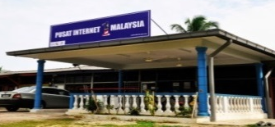













Community content enhancement framework
Rural Community
500,000 TEKUN Nasional Micro Entrepreneurs
300,000 AIM Micro Entrepreneurs
15,000 Co-operatives i.e Micro Co-Operatives
500 PKK Nationwide
400 Fishermen’s Association Nationwide
PI1M “Accounting Technician”
New Job Creation
Potential accounts to be served via PI1M

Slide 29




Targeted deliverables
1,200
PI1M Accounting Technician
3 Modules
2 Days Training +
½ Day Revision +
½ Day Exam
Dedicated Team Will Conduct Training to Assigned Zone.
Zone 1
  Perak, Kedah, Penang, Perlis
Zone 2
  Selangor, Kuala Lumpur, Malacca, N. Sembilan, Johor
Zone 3
  Kelantan, Terengganu, Pahang
Zone 4
  Sarawak
Zone 5
  Sabah
30,000
Expected Participations
1,600
Targeted
Training Sessions

Slide 30





Road to success
Further Studies via SPS Webinar & Online Learning
Program
Kickstart
“PI1M Accounting Technician”
Business
SPS Job Matching Platform
Start
Own
Career
Pathways

Slide 31

SPS TRAINING MODULE

Slide 32
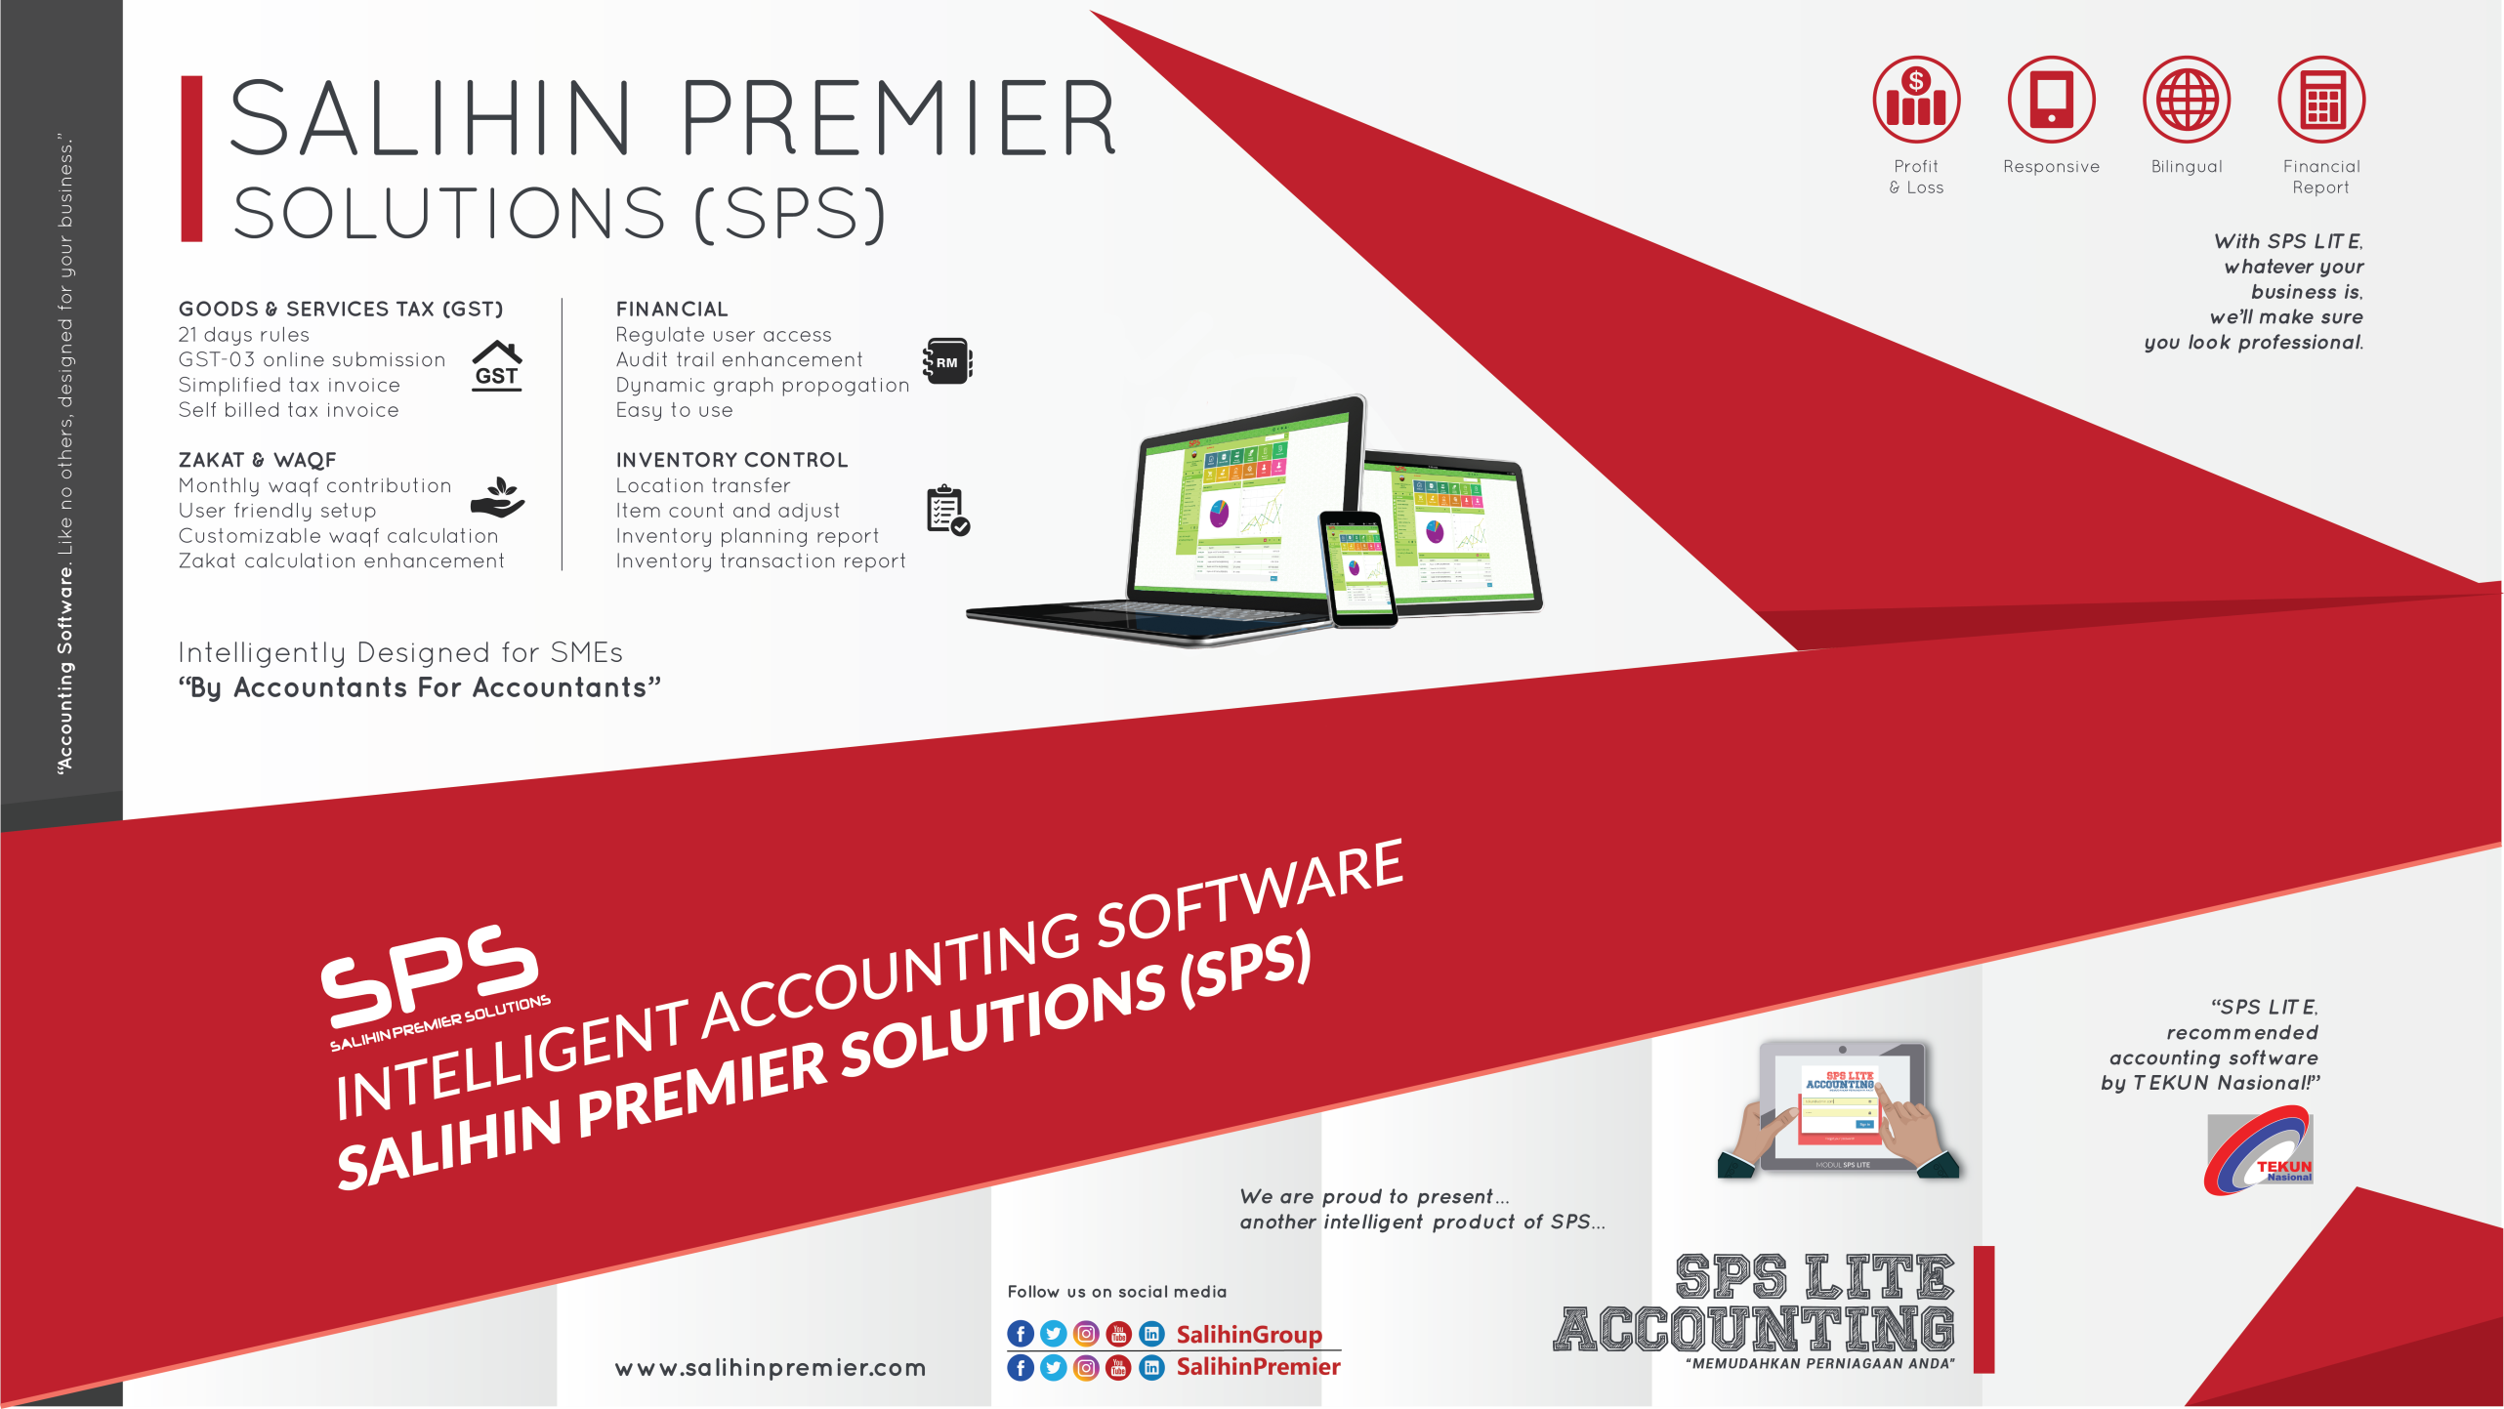
What is sps?
Equip PI1M Centre with comprehensive SOFTWARE & FREE TRAININGS of high value added accounting software.
Groom & nurture a FINANCIAL, MANAGEMENT & BUSINESS SOUND entrepreneurs in underserved areas.
Increase PI1M BUSINESS RELEVANCY to its respective communities.

Slide 33








Target audience
Small & Micro
Entrepreneurs
PRE-REQUISITE
PC Literate
SRP/ PMR Holder
Minimum 10-20 Pax
Registered with PI1M
Women Entrepreneurs
Single Parent
Part-Time Housewife
Student
Under Graduate Student
Graduates
SPM Leavers
Unemployed
Others

Slide 34
SITS training & Certification
To nurture local economies and bring about greater shared prosperity and social change to underserved communities
SITS Training Program is part of Salihin IT Solution Sdn. Bhd. (SITS) 5 Years Pi1M Content Empowerment Proposal
01
Catalyze underserved growth
Communities
Transformation
02
Closing
Skills
Gaps
Bridging skills and knowledge gap
Accelerate
Rate of
Change
03
Economy
vs Education
Demand
Bringing industries close to communities

Slide 35

SITS continuous learning
NO. | TRAINING MODULES | METHOD OF TRAINING | SYLLABUS
DAY 1 | Basic Accounting & Business Documentation | Class Room Online Seminar (Webinar) Online Training Video & Tutorial Online Training Material Online Test & Examinations | Objective: To Maintain Systematic Records of Business Transaction in Order to Generate Various Report. Company Setup User Setup User Access Right Chart of Account System & General Setup Form Setup Financial Year Calendar
 | SPSLite Training & Basic/ Advance SPSLite Website Training
DAY 2 | SPS Training
DAY 3 | Revision Examination
Anticipated Class Room Training for 600 PI1M Min 10-20 Participation Per Training 3 Modules (SPS, SPSLite & SPSWeb) 2 Days Training + 1 Day Exam 5 Years Continuous Learning

Slide 36

Trainer criteria
Diploma/ Degree Holder in Accounting or Business Management
Certified SPS Trainer
Minimal 2 Years Working Experience
Excellent in Public Speaking

Slide 37
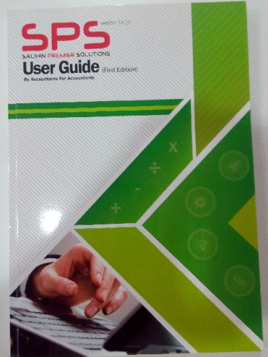
SITS Training kits
Softwares Access
SPS, SPSLite & SPS Entrepreneur Web
01
02
Training Hand Out & Stationery
Manual
SPS, SPSLite & SPS Entrepreneur Web
03

Slide 38
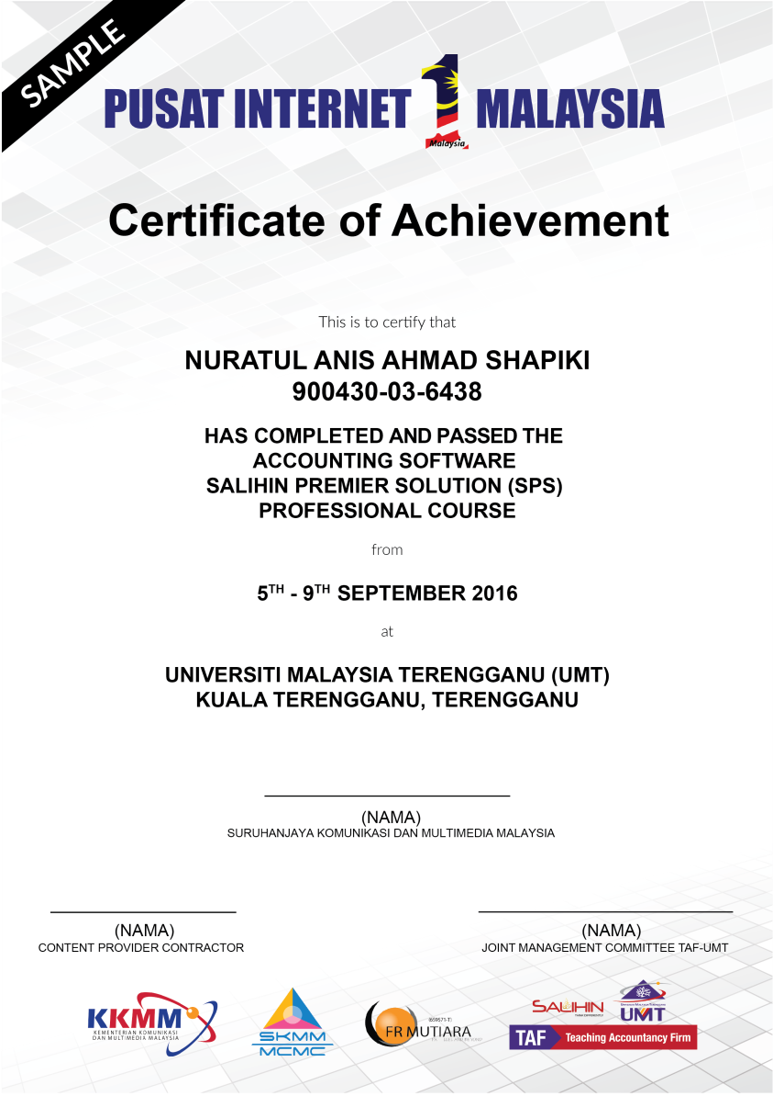

SITS certification

Slide 39

ACKNOWLEDGEMENT DAY
Anticipated Quarterly Event
Anticipated 1,000++ Graduates
Event Organized & Managed by SITS
Launch by KKMM & SKMM

