Slide 1
SALIHIN PREMIER SOLUTIONS (SPS)
BY ACCOUNTANTS FOR ACCOUNTANTS

Slide 2
ZAKAT

Slide 3
CONDITIONS OF ZAKAT BUSINESS ASSETS
Only Muslim needs to pay zakat
Complete Ownership
Assets Must be for business purposes
Valuation
Must have complete haul
Nisab (Minimum Amount)
Zakat Rate
Zakat is payable only on Muslim share of the business wealth. Where a company is owned by Muslim and non-Muslim, the zakat is chargeable on the Muslim’s percentage share of the business assets.
A substance together with benefits. The ownership must be complete. The owner(s) must have complete ownership over the property especially the power to dispose.
Property acquired with the intent and purpose of the trade is zakatable. Assets acquired for business purposes and the assets must be used in business activities. Thus, fixed assets are not zakatable unless they are sold as part of main trading activities.
Items for zakat must be valued at their market selling prices, i.e. cash equivalent value, NOT historical cost.
Haul is the fiscal period of zakat based on Islamic lunar calendar. However, businesses may follow their financial calendar.
Nisab is the amount exceeding amount which zakat becomes payable. For business working capital, the nisab is the monetary equivalent of 85 grams of gold. The nisab is determined and published by the Majlis Agama Islam of each state.
The zakat rate for the Islamic calendar is 2.5%. However, if the company is using its financial year, the rate is 2.5775%.

Slide 4
ZAKAT CALCULATION METHOD
There are two main methods of zakat calculation, the Capital Growth Method and the Working Capital Method. Thus, the current version of SPS uses the working capital approach.
Working Capital = Current Assets minus Current Liabilities
Zakat on Working Capital = Working Capital +/- Adjustment x% Muslim Share x 2.5775%
Adjustments:
These are adjustments needed in the current assets and current liabilities.
  Items Deducted from Current Assets (-):
  Items that are not Zakat obligated
  Items such as interest, gambling and liquor are to be excluded from the zakat calculations because they are items or products that are non-permissible i.e. ‘haram’.
  Limited Ownership
  Water, telephone, electrical and its similar kinds of deposit shall be deducted as it does not comply with the requirements of full rights.
Loan Receivable
The money on loan to a borrower is based on the characteristics of full ownership that has been transferred to the borrower. The borrower then possesses the full right and freedom to exploit and manage the loaned financial resources for his own interest and gain. Thus the borrower is obligated to perform Zakat on the amount of money loaned and NOT the Company.
No items are to be paid Zakat for, twice.
The dividend income that has already been deducted for Zakat may be zakat exempted.
Current Assets must be productive
Bad Debts, expired stocks and depreciation that is permanent are exempted.

Slide 5
ZAKAT CALCULATION METHOD
Charitable Funds
Charitable funds such as khairat and education funds in current assets may be exempted from Zakat. Nevertheless, charitable funds that are business in nature such as a Qardhul Hassan loan, the amount exempted from Zakat is the principal value while funds that are charitable in nature such as donations and khairat, only the balance amount is exempted.
Inventory / Stock category
Only the end product is subjected to Zakat. Raw materials or any work-in-progress items are exempted from Zakat.
Items Added to Current Assets (+):
All contributions, donations and alms made by any of the business entity at the end of financial year (the last quarter) shall be added again (with the assumption that the donations made will not affect the company’s liquidity) into the current assets. This is because any amount channeled for charitable purposes, are still obligatory to Zakat unless the source is from a charitable fund.
Items Added to Current Liabilities (+):
According to Imam Shafie, there are no debt requirements that pre-determine on whether the assets are qualified for the nisab or not. Imam Shafii’s opinion is that financial loans (not commercial liabilities) do not affect the obligations of Zakat.
  Thus, adjustments only involve those items that are not deductible such as:
  Those not in the form of business operations such as financial loans and the classifications of scheduled refinance.
  Dividends payable
  Overdraft
  Financial / Capital Lease
  To qualify for nisab, the current liabilities that can be deducted are those operational in nature that includes:
  Trade creditors
  Operating payables such as salaries, electrical and phone bills etc
  Taxes based on current assessment
[Current Assets - Current Liabilities] * x % Shares owned by Muslim x 2.5%

Slide 6
BASIC ZAKAT SETUP
GENERAL SETUP
COMPANY SETUP
LIST
COMPANY MASTER
ZAKAT & WAKAF
MUSLIM SHARE (%)
Notes:
Auto generate installation code

Slide 7
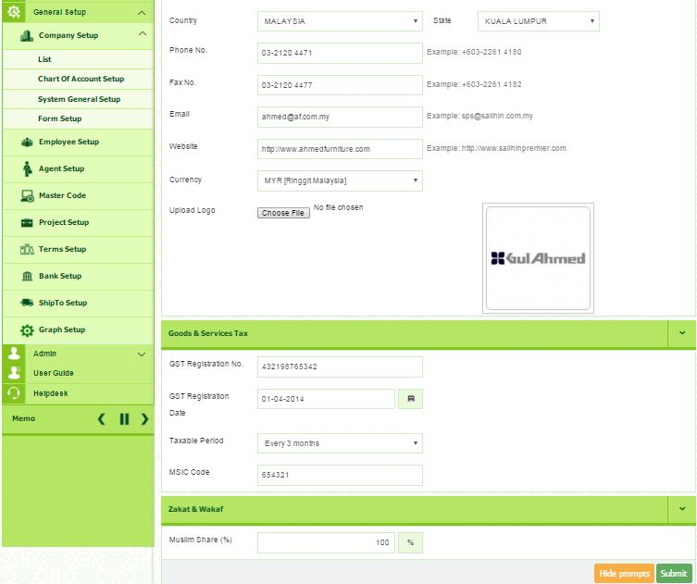
BASIC ZAKAT SETUP
1
2
3
4
Figure 1: Zakat Setup

Slide 8
ZAKAT SETUP
ZAKAT & WAKAF
SETUP
ZAKAT NISAB/CENTRE

Slide 9
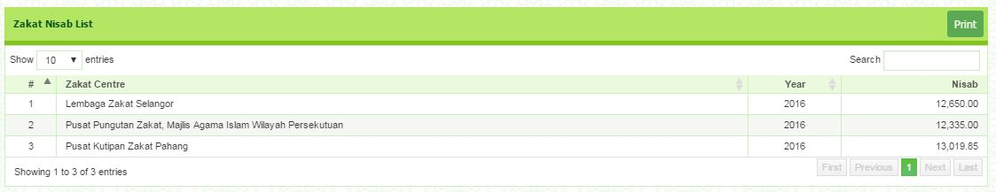
ZAKAT SETUP
Figure 7: Zakat Nisab List Report

Slide 10
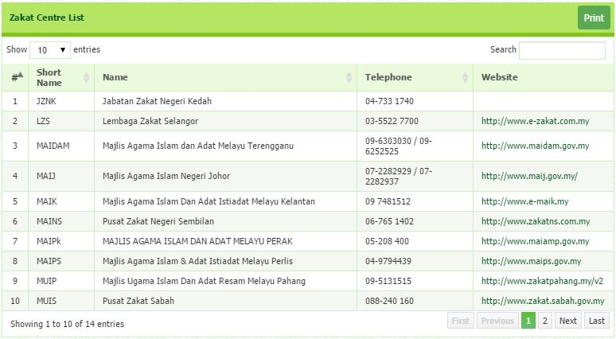
ZAKAT SETUP
Figure 8: Zakat Centre List Report

Slide 11
ZAKAT TRANSACTION
ZAKAT & WAKAF
ZAKAT CALCULATION
TRANSACTION

Slide 12
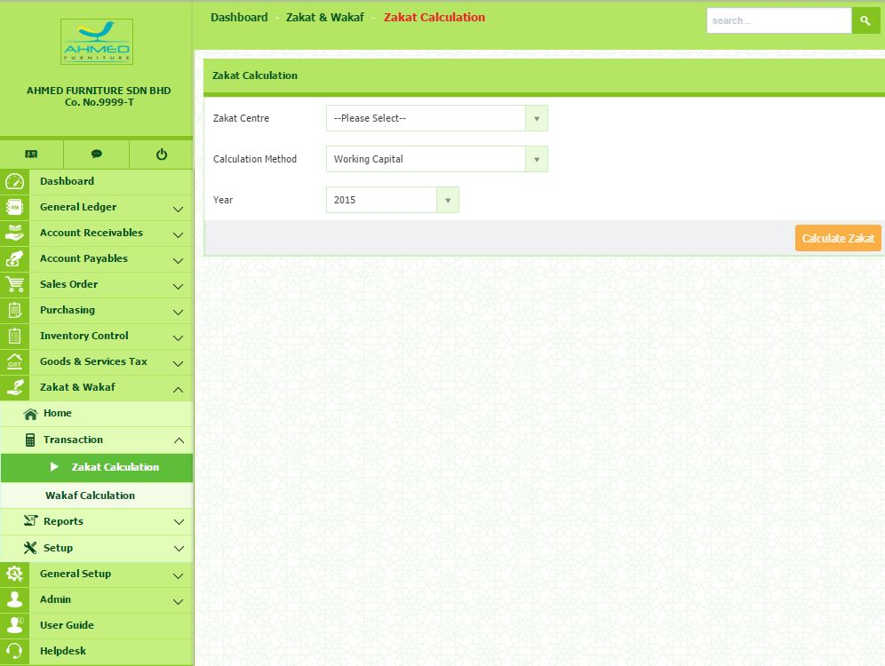
ZAKAT TRANSACTION
Figure 2: Zakat Transaction

Slide 13
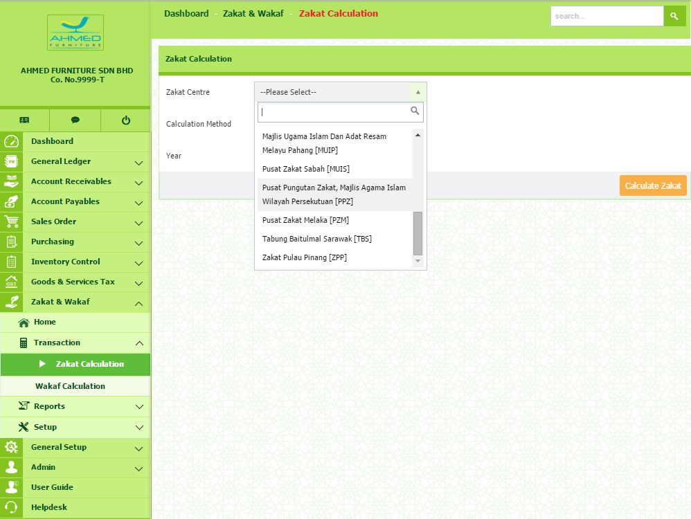
ZAKAT TRANSACTION
Figure 3: List Of Zakat Centre

Slide 14
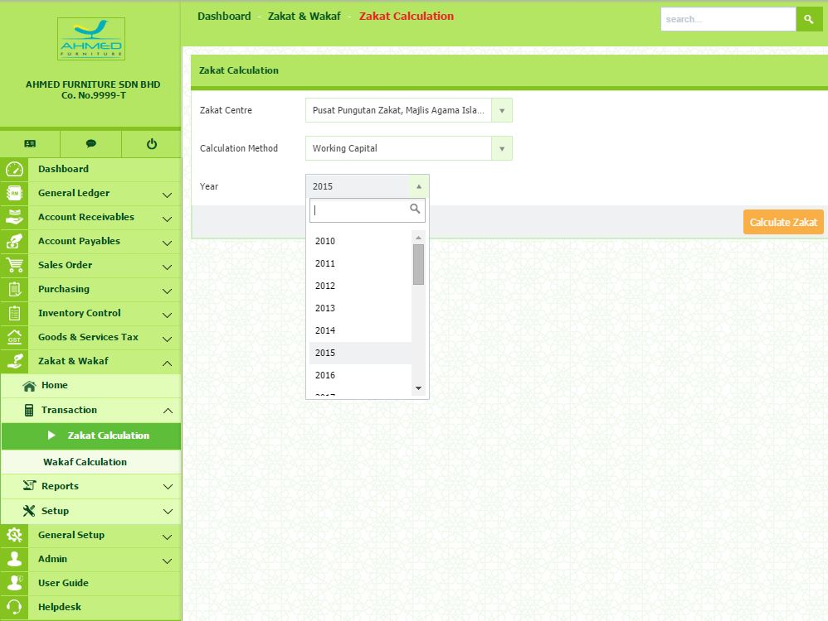
ZAKAT TRANSACTION
Figure 4: List Of Year

Slide 15
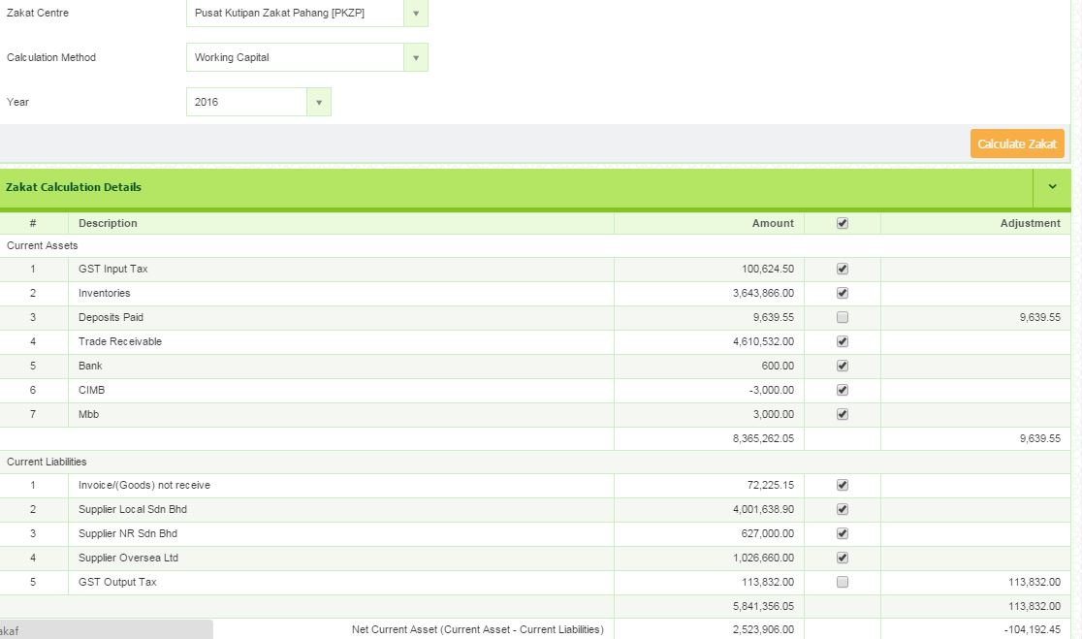
ZAKAT TRANSACTION
Figure 5: Zakat Calculation Details

Slide 16
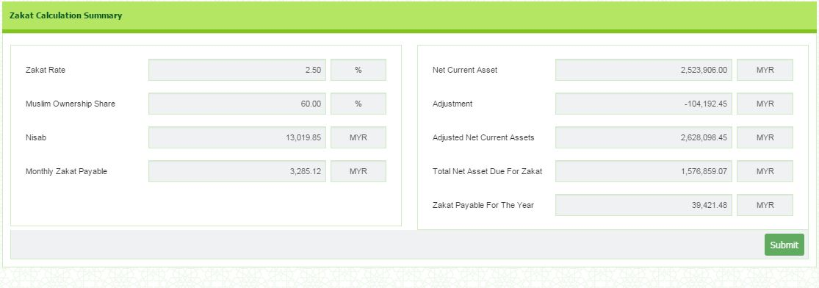
ZAKAT TRANSACTION
Figure 6: Zakat Calculation Summary

Slide 17
ZAKAT REPORT
ZAKAT & WAKAF
REPORT
ZAKAT SUMMARY

Slide 18
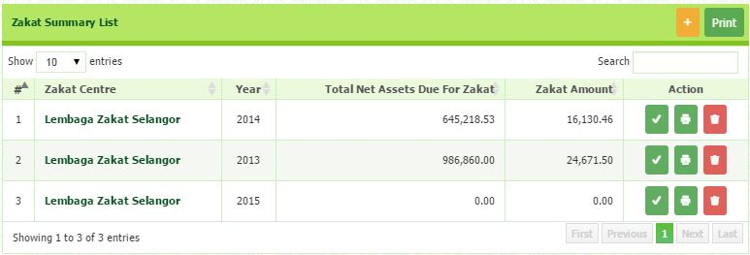
ZAKAT REPORT
Figure 9: Zakat Summary List Report

Slide 19
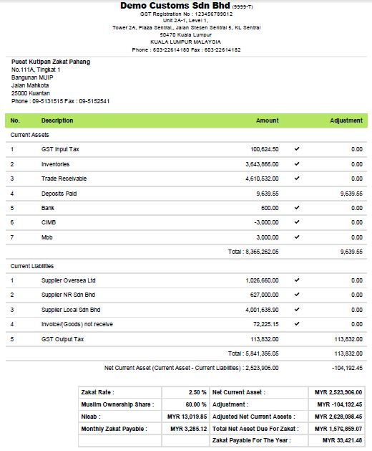
ZAKAT REPORT

Slide 20

CONTACT US
CORPORATE CENTRE:
KL Sentral Office
Unit 2A-1, Level 1
Tower 2A, Plaza Sentral
Jalan Stesen Sentral 5
KL Sentral
50470, Kuala Lumpur
Tel: +603 2261 4180
Fax: +603 2261 4182
CONSULTANT: FARHANA BT ZAHARI
EMAIL: farhana@salihin.com.my
Official Website : www.salihin.com.my
Customer Service : www.salihinpremier.com
E-mail : sales@salihinpremier.com
Careline : 1 300 88 5678

Slide 21

Official Website : www.salihin.com.my
Customer Service : www.salihinpremier.com
E-mail : sales@salihinpremier.com

