Slide 1


ZAKAT ASSESSMENT
CERTIFICATION COURSE
Knowledge Sharing: Zakat Software
Salihin Premier Solutions (SPS)
Presenter : SALIHIN ABANG
Venue : College of Business Management and Accounting
Universiti Tenaga Nasional
Sultan Haji Ahmad Shah Campus, Pahang
Date : Friday, February 19, 2016

Slide 2
Outline
Introduction
Business Zakat Computation
Issues and Challenges
The Way Forward
Salihin Premier Solution

Slide 3
Introduction- About Us
Salihin Consulting Group is an approved zakat agent for both Majlis Agama Islam Selangor and Wilayah Persekutuan (Federal Territory).
Roles as business zakat agent:
  Advising clients on zakat matters: zakat computation
  Zakat planning :-
    Utilization of 2.5% rebate from aggregate income for corporate tax
    Determination of haul
    Synchronization of zakat payment with business cashflow
  Reminding clients to fulfill their 3rd Pillars of Islam
  Collecting zakat from businesses on behalf of the Majlis.

Slide 4
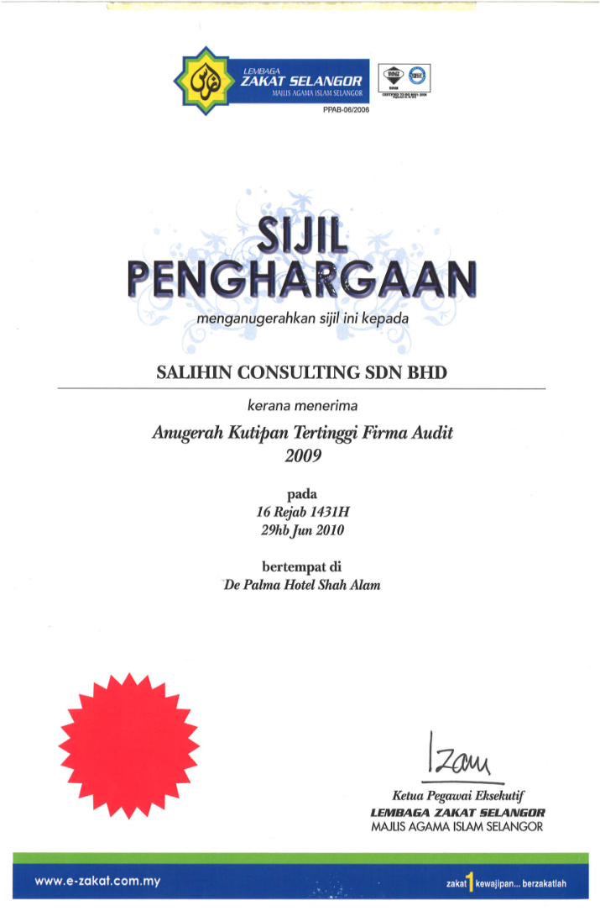

Introduction- Awards
Highest Zakat Collector
2009-2011

Slide 5
Business Zakat Computation
Currently there are 3 methods of computing business zakat;
  Incomplete record (for small businesses)
  Working capital
  Capital growth.
Most often the last 2 methods are used since most businesses have their accounting records.
However, there are significant issues and challenges to consider.

Slide 6
Issues and Challenges-
Zakat Computation
Zakat Determination valuation
Difficulty in Determining Ownership Proportion
Adjustments for Tax Planning/Minimisation
Time constraint impacting compliance
No system/zakat software, except SPS.
Notes:
The Capital Growth Method relies on accounts prepared based on historical costs (fixed assets) instead of the desired current values.
management account is usually not ready to warrant timely determination of zakat
Insufficient information to determine full ownership of assets of the company
Adjustments for Tax Planning/Minimisation
Tax payers are unwilling to pay higher tax, higher tendency for accounts adjustment
Low zakat payable amount
Time constraint impacting compliance
Inputting data as per the formula of the Majlis
Getting the right zakat agents/accountants
Payers lack knowledge on zakat determination, need assistance

Slide 7
Issues and Challenges-
Zakat Payment & Collection
Low religious morale
Low knowledge and education
Low incentive in inhibiting compliance
Payment of business zakat often exceeds the haul year
No enforcement
Notes:
Low incentive in inhibiting compliance
Businesses tend to ignore zakat as the rebate given by IRBM is only 2.5% from aggregate income
Payment of business zakat often exceeds the haul year
management account is usually not ready yet
No enforcement
No compulsion for zakat return submission
No punishment nor penalty for zakat evasion
No zakat audit and investigation

Slide 8
The Way Forward:-
Provide facilitation tool - SPS
Salihin Premier Solutions (SPS)
  Zakat calculation made easier
  It is now a mouse click
  Standardized zakat calculation method –
    Working capital method – applicable to all states and businesses.
  All zakat institutions and details addresses embedded
  Easy zakat adjustment
  Auto-journal posting
  Zakat Statement/Report
  Comprehensive user guide
  Education and Training

Slide 9
The Way Forward:-
Zakat Audit & Investigation
Lessons from Saudi Arabia
  Zakatable companies are required to file their zakat returns to the Department of Zakat & Income Tax (“DZIT”) during the first month of the year following the zakat year.
  The DZIT will then review or audit data filed by the companies and will inform the zakatpayer (companies) of the amount zakat payable.
  A zakatpayer may object the amount of zakat within 15 days of the receipt date by a registered-mailed memorandum stating reasons for objection
  Otherwise, zakatpayer loses the right to object and is required to pay the amount as stated in the received notice.
Zakat By-Law, Ministerial Resolution number 393, dated 6/8/1370 H (corresponding to 13/5/1950).

Slide 10
The Way Forward:-
Zakat Audit & Investigation
Lessons from Saudi Arabia
  An example is the case of Al Rajhi Bank
  The zakat assessments for the years through 1997 have been finalized with the Department of Zakat & Income Tax (“DZIT”). The DZIT issued assessments for the years 1998 through 2006, which were appealed by the Bank.
  The Bank submitted the zakat assessment for the years from 2007 till 2010 and paid the zakat due accordingly. The DZIT did not yet issue the final zakat assessments for these years.
  (Al Rajhi Bank, Annual Report 2011, Note 22)

Slide 11
The Way Forward:-
Zakat Audit & Investigation
Lessons from Saudi Arabia
  An example is the case of Abdullah Abdul Mohsin Al-Khodary Sons Company:- civil engineering, oil and gas, railway, bridges, etc.
  The Zakat assessments have been agreed with the Department of Zakat and Income Tax (DZIT) up to 2004. The assessments for the years 2005 to 2009 have not yet been raised.
  (Abdullah Abdul Mohsin Al-Khodary Sons Company, Annual Report 2011, Note 22)

Slide 12
The Way Forward:-
Enforcement
Lessons from Saudi Arabia- penalties for zakat evasion
  Maximum penalties
    Freezing of company accounts
    Owners ban from travel
  Lesser penalties
    Suspension of government transactions with the company
    Company cannot bid for government project
    Company cannot collect money owed by the government
    Company will not be issued work visas
    Company cannot renew business license
    http://www.saudigazette.com.sa

Slide 13
The Way Forward:-
Enforcement
Zakat evaders in MALAYSIA should be penalize/punished
For instance in Selangor;
  The Majlis should exercise its power to create penalties and provide punishments for matters in relation to the collection and delivery of all proceeds of zakat and fitrah.
  (S.87, Enactment No. 1, Administration Of The Religion Of Islam (State Of Selangor) Enactment 2003)
  IRB
    Zakat should be treated in a similar way as tax

Slide 14
The Way Forward:-
Others
Move Towards fair/current value accounting
Encourage proper book-keeping
Zakat incentives
  business zakat payment should be given 100%/full rebate instead of the 2.5% on the aggregate income or
  the rebate be increased to 10% of aggregate income
Back Duty Zakat: for zakat recovery
Awareness of zakat as the 3rd Pillar of Islam needs to be more aggressive and productive

Slide 15
Contact
Thank You
555, Jalan Samudra Utara 1, Taman Samudra, 68100 Batu Caves, Selangor
Tel: +603 6185 9970 Fax: +603 6184 2524
Email: info@salihin.com.my W: www.salihin.com.my

