Slide 1





MARA’s Entrepreneurs Big Data
Pre-Implementation Proposal
Utilizing SPS Total Solutions
PREPARED BY:
SUBMITTED TO:
Notes:
Font Type: Open Sans
Font Size: Proposal Title (60), Proposal Details (40)
Business unit & Client logo: Small size

Slide 2
Executive Summary
The world now has CHANGE
The business has emerged rapidly to new era (Mobile lifestyle/ IoT/ Big Data)
Bumi SME are way behind other’s races in all aspect.
They need holistic support from government (MARA).
SME Highlights
Bumi SME
Bumi SME Hiccups
Support Needed
Considered as the economy backbone
Comprising over 98% of total establishments
Contributing to over 65% of employment
Contributing as over 50% of the gross domestic product.
27.6% of total SME establishment
90.7 % are micro enterprise
Less resources
Less knowledge/ hands –on skills
No access to pertinent business insights
Competitive Market
Fund Raising Issues
Skills Resources Issues
Competition from New Players
Support from Government
Better Access for Fund Raising & Financing
Technology Support
Centralized Coordination Centre for SME Business Insights
Centralized SME Training Bodies/ Coordinator
Notes:
Please insert primary contact person accordingly.

Slide 3
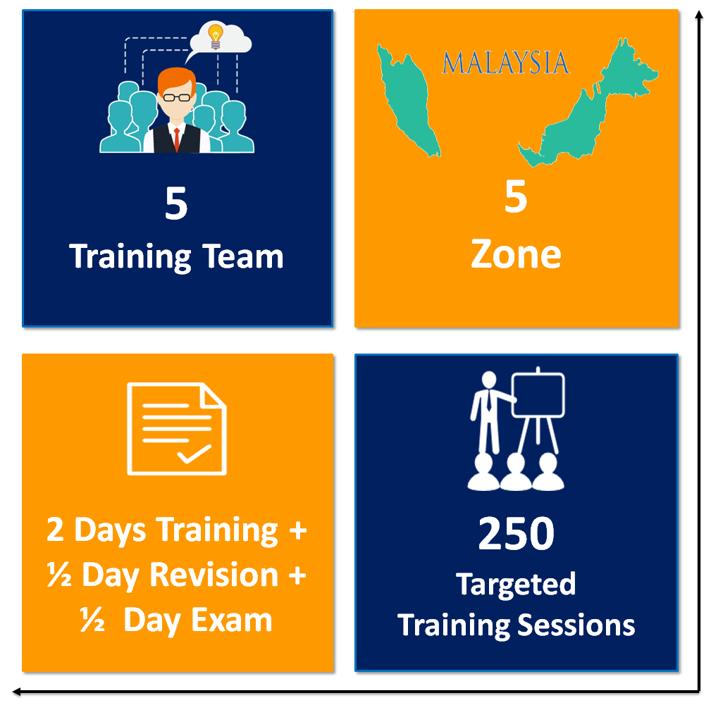

What We Offer?
The full scale of applied accounting training nationwide
Equipped with industry grade accounting and book keeping software
Supported by long term engagement and monitoring service
Assisted with pertinent business insights and big data analytics
MARA Entrepreneurs Awards Event
with
Media Coverage in Major Malay Newspaper (Schedule and Timetable – TBD)
5 Years FREE Access to SALIHIN
E-Learning Platform
Webinar
Online Tutorial
Online Training
Online Exam
Online Support
5,000 SALIHIN Certifications & Accreditations
-Endorsed by Reputable Bodies-UMT TAF, UITM TAF
UNIKL TAF, UPM TAF
250 @ 3 Days Training Sessions in
2 years
(5 Zones)
5,000 SALIHIN Accounting License for 5 Years
Notes:
Please insert primary contact person accordingly.

Slide 4
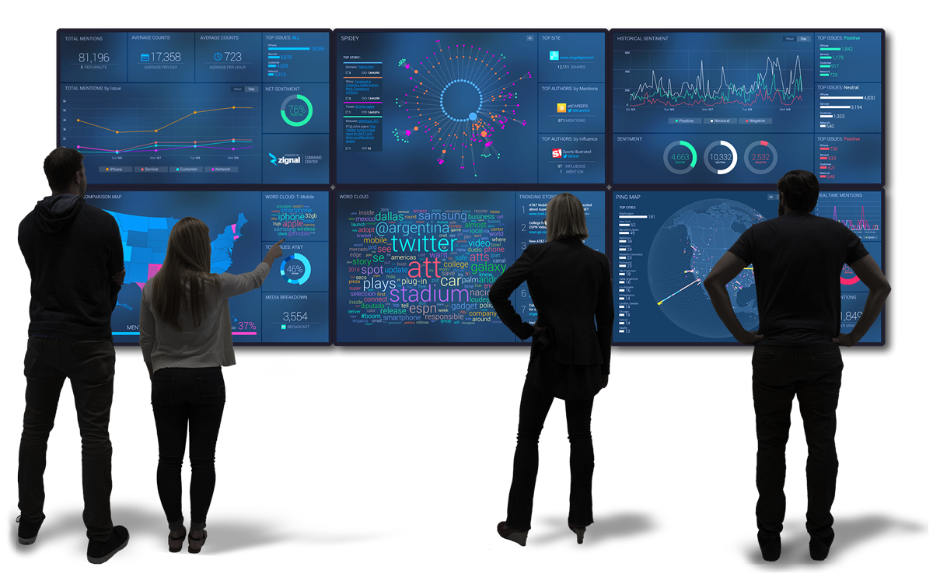
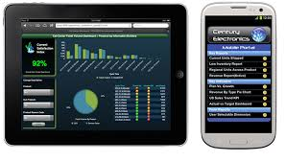
Entrepreneurs Business Intelligent Centre
Centre of Excellence for SME Financial Management Services.
Bird Eye View (360 Deg) of Entrepreneur Financial Portfolio and Business Performance
Better support for Entrepreneur Decision Making and Advisory
More Agile Product and Service Delivery with potential to highly Innovative Services/Product.
DESCRIPTIVE
ANALYTICS
PREDICTIVE ANALYTICS
PRESCRIPTIVE ANALYTICS
Notes:
Please insert primary contact person accordingly.

Slide 5
Leveraging Hyper Trend
CLOUD
Iaas
Saas
Education aaS
Big Data
Economic Performance
Productivity
Govt Income
Implementing Bumiputra Agenda
Social Media
Sales Marketing
Crowd Sourcing
Consumerization (Market Creation)
Mobility
Core Medium
Productivity Tools – MARA
Internal Communication
Economic, Social and Education
Global Market
Sustainability
Notes:
Please insert primary contact person accordingly.

Slide 6
Intelligent Enterprise:
Huge data, smarter systems—better business.
For years, software’s expanding capabilities were geared primarily toward helping employees make better and faster decisions.
Amid the influx of data—along with advances in processing power, analytics and cognitive technology—software intelligence is helping automobiles, thermostats and other everyday things recognize, “think” and respond accordingly.
To fully capture the power and potential of software intelligence, visionary companies will find new ways to get smart software out of the lab and into as many practical scenarios as possible. Only then will their software be able to spur innovation and raise the operating-performance bar across the organization.
Notes:
Please insert primary contact person accordingly.

Slide 7

Workforce Reimagined:
Collaboration at the intersection of humans and machines.
As the digital revolution gains momentum, humans and machines must do more together. Successful businesses will embrace both as critical team members.
Advances in robotics enable machines to not only communicate with humans, but also work side-by-side with them. It’s a division of labor that plays to strengths of both.
Human and machine
each on their own
won’t be enough to drive businesses in the coming decades.
Tomorrow’s leading enterprises will be those that know how to meld the two effectively.
Notes:
Please insert primary contact person accordingly.

Slide 8









Benefit to KKLW & MARA
GTP KPI
5
Comply with Bumiputera Agenda as set out in Government Transformation Program
NBOS KPI
4
Active participations and support from industries
(UMT/ UiTM/ UniKL/ UPM TAF)
TECHNOLOGY
ADOPTION
3
New technology adoption as outlined in TN50
EMPLOYMENT
OPPORTUNITIES
2
New employment and job creation for Bumiputera’s graduates, mostly in rural area
BUSINESS
EMPOWERMENT
1
Foster and empower Bumi SME business via good financial governance and best business practice.
Notes:
Please insert primary contact person accordingly.

Slide 9
PROPOSED COLLABORATION BETWEEN MIMOS AND SALIHIN
Register as Technology Recipient
MIMOS
Fund / Grant SPS System
Propose to MARA / TEKUN / AIM
Provided Free Training / Data Analytic / Big Data using SPS & Big data technology
Become SME Bloomberg
Revenue Stream
1. SME Bloomberg Terminal
Target Market
1. Financial Institutions
2. Non-Financial Institutions
3. Public Interest Entities
4. Non Public Interest Entities
Marketing Channel
1. MARA / TEKUN / AIM
2. SME Corp etc.
3. Financial Institutions
4. Suruhanjaya Syarikat M’sia

Slide 10

www.salihin.com.my | www.salihinpremier.com
Careline: 1 300 88 5678
Notes:
Attention: Please don’t change any content here. Thank you very much ☺

