Slide 1


AWARENESS TRAINING
©2017 SALIHIN GST Services. All Rights Reserved.

Slide 2
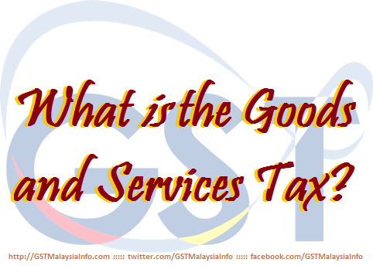
  AGENDA
INTRODUCTION OF GST IN MALAYSIA
WHAT IS GST?
BASIC CONCEPT AND GST MODEL
GST REGISTRATION

Slide 3

INTRODUCTION OF GST IN MALAYSIA

Slide 4



  WHAT IS GST?
  WHAT IS GST ?
What is
Goods and Services Tax

Slide 5
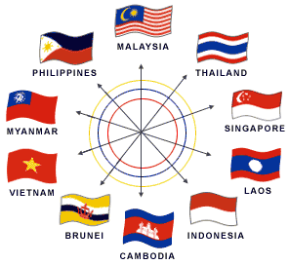
  GST/VAT IN ASEAN COUNTRIES
Country | Year of Implementation | Initial Rate(%) | Current Rate(%)
Indonesia | 1984 | 10 | 10
Thailand | 1992 | 7 | 7
Singapore | 1994 | 3 | 7
Filipina | 1998 | 10 | 12
Cambodia | 1999 | 10 | 10
Vietnam | 1999 | 10 | 10
Laos | 2009 | 10 | 10

Slide 6
WHAT IS GST?

Slide 7


  WHAT IS GST?
  A BROAD-BASED consumption tax in the form of value added tax
  MULTI STAGE TAX based on net value at each stage of business transaction up to the retail stage of distribution
  Also known as VALUE ADDED TAX (VAT) in certain countries
  Tax on final consumption – THE CONSUMER
  GST incurred on inputs is allowed as a credit to the registrant - OFFSET AGAINST OUTPUT TAX

Slide 8


  TYPE OF SUPPLY (GOODS OR SERVICES)
6%
0%
GST
GST
Standard Rated Supply
TAXABLE
SUPPLY
Zero Rated Supply
Exempt Supply
NON-
TAXABLE
SUPPLY
Out of Scope

Slide 9


  SCOPE OF GST / TEST OF GST
  GST is charged on
    The taxable supply of goods and services
    Made by a taxable person
    In the course or furtherance of business
    In Malaysia
  GST is charged on imported goods

Slide 10
BASIC CONCEPTS AND PROPOSED GST MODEL

Slide 11

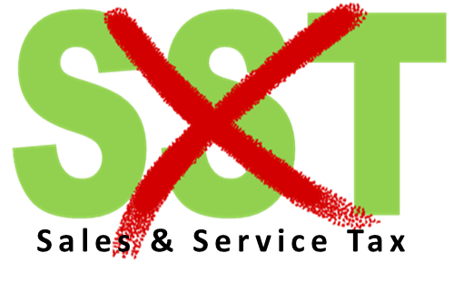
  ABOLISHMENT OF SST
Current Tax System
Effective on
1st April 2015
5%, 6%, 10%, 20%
& specific rate
6%
GST is a REPLACEMENT TAX

Slide 12
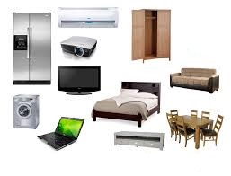
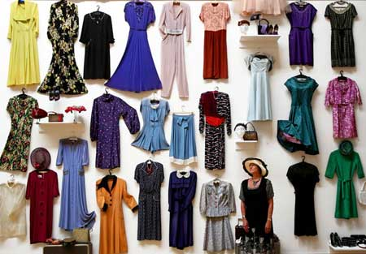
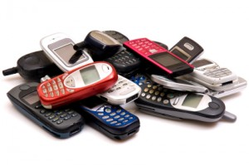



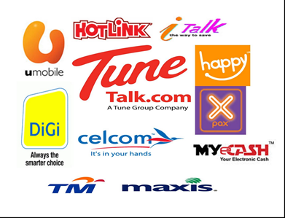
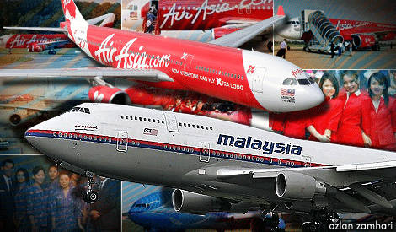
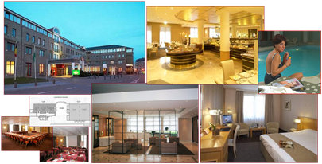
  GST MODEL - STANDARD RATED
6%
Standard rate

Slide 13



  GST MODEL - ZERO RATED
Water usage to domestic users
Export
First 300 units of electricity to domestic users
Excludes distilled water, de-ionised water, oxygenised water and mineral water.
Exported Goods and Services
Supply of first 300 units of electricity to domestic user (Current Tariff : RM 77)
0%

Slide 14
  GST MODEL - EXEMPTED
SUPPLY OF GOODS DETERMINED AS AN EXEMPT SUPPLY
Any building or premises being used for residential purposed, designed or adapted for use or intended to be used as dwelling (excluding hotel, inn, boarding house or similar establishment sleeping accommodation)
Any supply of investment precious metal.
Eg: gold, silver, platinum, gold coin, silver coin (excluding collector coin)
Any land intended to be used for residential or agricultural or general use
- including parking facilities
- agriculture – does not include land for hunting and fishing activities.
**General use : burial ground, playground, religious building
**Similar establishment: premises provided with sleeping accommodation, with or without lodging or facilities for the preparation of foods for use of visitor or travellers.
14

Slide 15
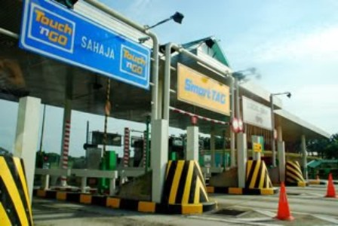
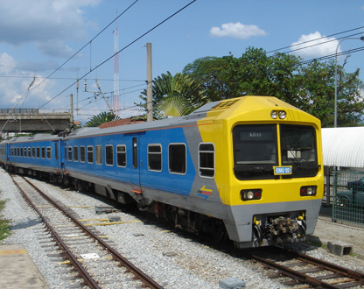
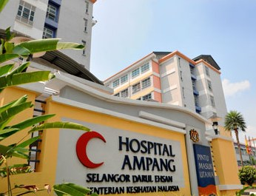
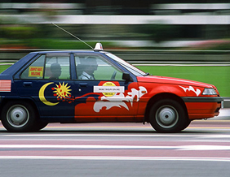
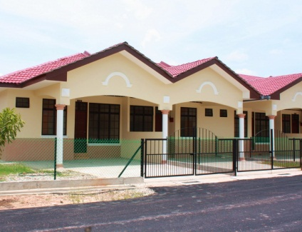
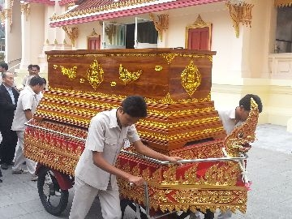
  GST MODEL - EXEMPTED
SUPPLY OF SERVICES DETERMINED AS AN EXEMPT SUPPLY
Public Transportation
Land For Residential, Agriculture And General Use
Highway and Toll Bridge
Funeral, Burial and Cremation Services
Healthcare Services
Education Services
Financial Services
Child Care Services
15

Slide 16
  PROPOSED GST MODEL
  GOVERNMENT SUPPLY
 | FEDERAL GOVERNMENT & STATE GOVERNMENT | LOCAL AUTHORITY & STATUTORY BODIES
OUT OF SCOPE | All supplies by Federal & State Government | Supplies made in the regulatory and enforcement (R&E) Functions e.g. assessment rate collection, issuance of license, penalty
SUBJECT TO GST | Supplies that have been directed by Minister in the GST (Government Taxable Supply Order) e.g. supply made by RTM, Prison Department | Non R&E functions, i.e. business activities e.g. Rental facilities

Slide 17
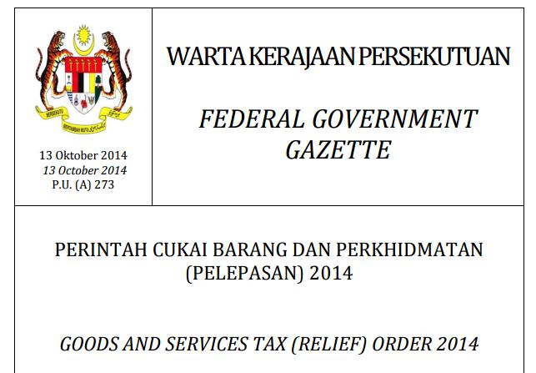
  PROPOSED GST MODEL
  RELIEF
http://gst.customs.gov.my/en/rg/Pages/re_odr.aspx

Slide 18
  GST MECHANISM
INPUT TAX
OUTPUT TAX
ACQUISITION
SUPPLY
PURCHASES
SALES
PAYMENT
INCOME

Slide 19
  GST MECHANISM (CONTD)
INPUT
OUTPUT
Goods
Raw Materials
Seller
Rental
Services
Telephone
GST on Input
= Input Tax
Claim
Input Tax
GST on Output
= Output Tax

Slide 20
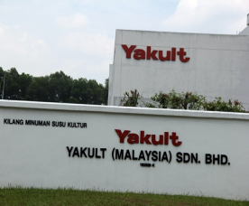
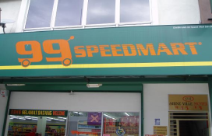
  HOW GST WORKS ?
  STANDARD RATED (CONTD)
Manufacturer
Tax Remitted to Government
Price :RM100
GST:RM6.00
Output Tax =
RM 6.00
Wholesaler
Output Tax = RM 7.50
Input Tax = RM 6.00
Price :RM125
GST:RM7.50
RM 1.50
Retailer
Output Tax = RM 9.00
Input Tax = RM 7.50
Price :RM150
GST:RM9.00
RM 1.50
Consumer
Total amount remitted to Custom:
= RM 9.00
GST 6%

Slide 21



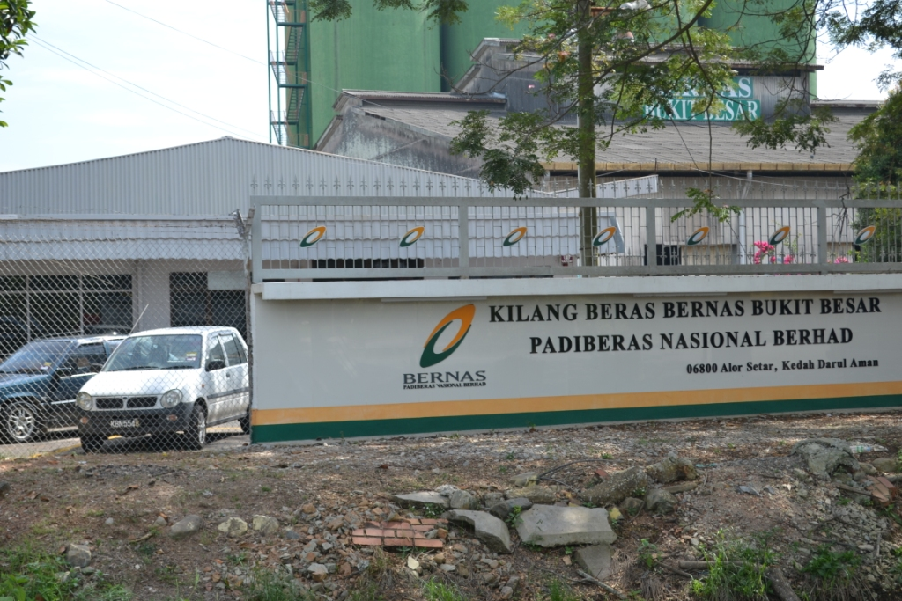
  HOW GST WORKS ?
  ZERO RATED (CONTD)
0%
0%
0%
Manufacturer
(Beras Bernas)
WHOLESALER
(Syarikat Faiza Sdn Bhd)
Retailer
(99 Speedmart)
Consumer
Value Added Activity
Purchase Cost: RM100
GST* : RM0
Purchase Price:RM100
Selling Price: RM125
GST : RM0
Total Selling Price: RM125
Added Value: RM25
(+ GST : No GST )
No GST will be paid to Customs
*Note: claim input tax

Slide 22
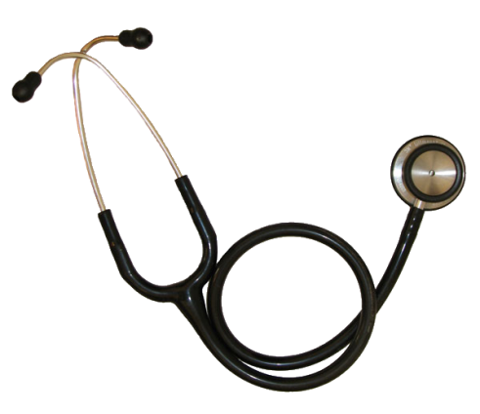


  HOW GST WORKS?
  EXEMPTED (CONTD)
Private Hospital
Supplier
Consumer
Value Added Activity
Purchase Cost: RM100
GST : RM6
Purchase Price:RM106
Selling Price: RM131
GST : RM0
Total Selling Price: RM131
Added Value: RM25
(+ GST : No GST )

Slide 23
GST REGISTRATION

Slide 24


GST REGISTRATION
Business
Non-Business
Taxable Supply
Non-Taxable Supply
Taxable Turnover exceed RM500,000
Taxable Turnover RM500,000 and below
Mandatory
Voluntary
Liable to notify within 28 days

Slide 25

MANDATORY REGISTRATION

Slide 26


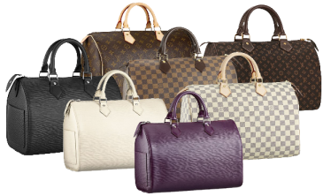

GST REGISTRATION
MANDATORY REGISTRATION
Carrying on a business in
Malaysia
The ‘PERSON’ should notify to register within 28 days from the end of taxable period
Makes taxable supplies
Taxable turnover exceed RM 500,000

Slide 27

GST REGISTRATION
MANDATORY REGISTRATION
Notification of liability & registration :
To apply for registration 28 days from end of the month where taxable turnover exceeds or expect to exceed RM 500,000
Effective date of registration will be on the 1st day of the following month after the 28th day period
Registration of GST
DATE EXCEEDS RM500K : 10 DECEMBER 2017
REISTRATION DATE : 20 DECEMBER 2017
GST STARTED : 01 FEBRUARY 2018

Slide 28
SCOPE OF SUPPLY
(THE DETERMINATION OF THRESHOLD)
Method of assessment :
Historical Method
Value of taxable supplies in current month and previous consecutive 11 month is more than RM 500,000
Future Method
Value of taxable supplies in current month and 11 months to the future is EXPECTED more than RM 500,000

Slide 29

VOLUNTARY REGISTRATION

Slide 30

VOLUNTARY REGISTRATION
(SECTION 24)
Business which do not liable for mandatory registration may register voluntarily if it satisfies any of these criteria:
Makes taxable supplies
VOLUNTEER!
Intends to make taxable supplies
Makes supplies outside Malaysia, which would be taxable if made in Malaysia
*Note: Business must remain registered for a period at least 2 years!
Intends to makes supplies outside Malaysia, which would be taxable if made in Malaysia

Slide 31

VOLUNTARY REGISTRATION
(SECTION 24)
Why business chooses for voluntary registration?
To recover input tax for start-up costs
To attract potential clients (GST input cannot be claimed if the invoice is issued by non-registered person)
To prepare for mandatory registration
To avoid giving the impression of small business operation

Slide 32
EXEMPTED FROM REGISTRATION

Slide 33

EXEMPTED FROM REGISTRATION
(Section 32)
Who is NOT required to register?
Any person who is:
Making exempt supply; or
Making out of scope supply
  Making supply in Designated Area for example in Labuan, Langkawi and Tioman

Slide 34
EXEMPTED FROM REGISTRATION
(Section 32)
Any person who makes or intends to make a taxable supplies can apply to be exempted from registration
The exempted person shall notify in writing when there is changes in his nature of supply within 30 days on which it occurred.

Slide 35

TYPE OF REGISTRATION

Slide 36

GST REGISTRATION
TYPE OF REGISTRATION
Partnership
Single Taxable Person
Branch / Division
Single Entity
Joint Venture
Group of Companies
Sole proprietorship
TOGC
Societies /
Club

Slide 37
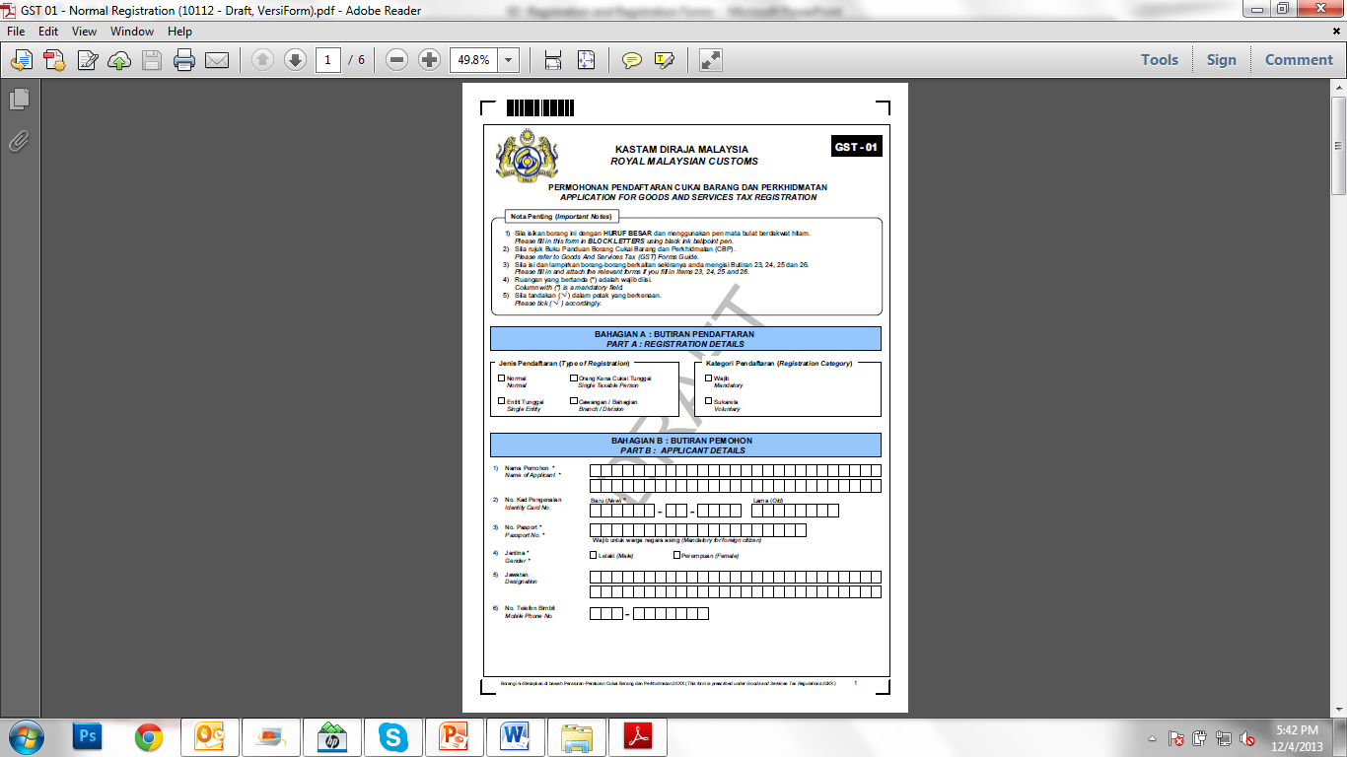
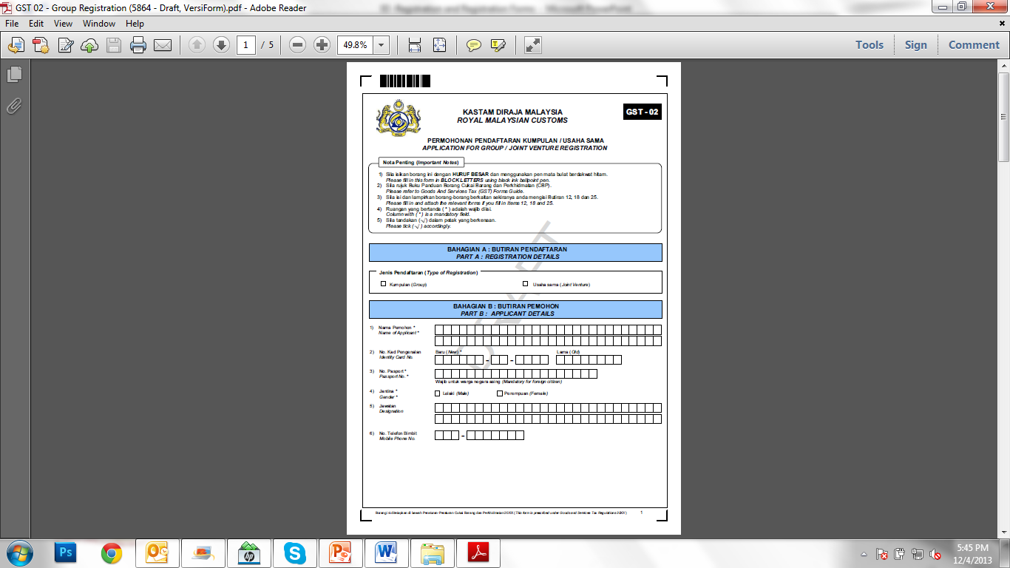
REGISTRATION FORM
FORM GST -01 & GST-02

Slide 38
EMPLOYEE BENEFITS

Slide 39

  EMPLOYEE BENEFITS
What do Employee Benefits mean?
Employee benefits include any right, privilege, service or facility provided free of charge to employees
Examples
Goods given free of charge to employees, interest free loan, leave passage, provision of accommodation and provision of transport

Slide 40

  EMPLOYEE BENEFITS
All goods provided free to the employees:
  subject to GST (subject to gift rule of RM 500) except those exempted,
  blocked input tax and zero rated goods
  ITC claimable
  Value of employee benefits (goods) given to be based on open market value

Slide 41
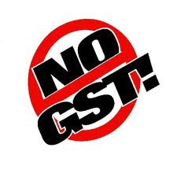
  EMPLOYEE BENEFITS
Services supplied free
Not a supply
No GST
Input tax is CLAIMABLE
41

Slide 42

  EMPLOYEE BENEFITS
Gift rule
Goods worth not more than RM 500 given free to the same person in the same year
Not a supply
Not subject to GST
Input tax is CLAIMABLE
[Provision – subparagraph 4(2)(a) of the First Schedule, GST Act]

Slide 43
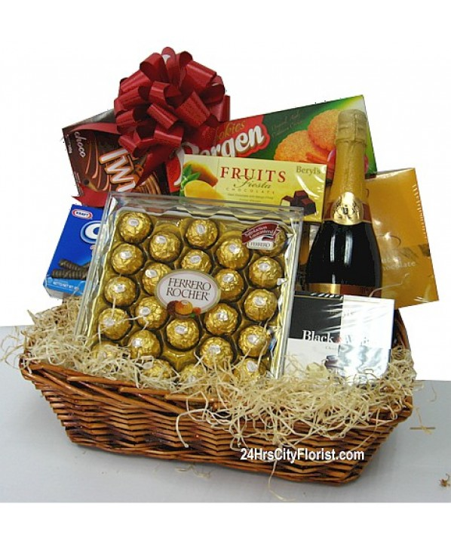

  EMPLOYEE BENEFITS
Example 1
Company A purchased 15 hampers for his employees worth RM200/hamper
Every employee will get one hamper FOC
No need to account for output tax
Input tax on 15 hampers
= RM 180.00 (6% x RM 3,000) is CLAIMABLE

Slide 44

  EMPLOYEE BENEFIT
  CHARGING OUTPUT TAX
No. | Employee Benefit | Charging Output Tax
 |  | YES | NO
1. | Services provided free to employees
2. | Services provided free to a connected person
3. | Gift given to same person in the same years, if more than RM500.00.
4. | Non-registered person given free goods to employees, the value of goods is more than RM500.00.
5. | Business goods used for non-business purposes
6. | Gift given to same person in the same years, if less than RM500 .00
7. | Given gift to employee but in monetary
8. | Goods given free as stated in the contract of employee

Slide 45

ACCOUNTING FOR GST

Slide 46
  AGENDA
TAX INVOICE
DEBIT NOTE & CREDIT NOTE
BAD DEBT
RECORD KEEPING
GST CODE & GST-03
GST TAX RETURN

Slide 47
TAX INVOICE

Slide 48



  OUTPUT TAX
  SCOPE AND CHARGE
Taxable supplies
Deemed supplies
  Disposal of business assets
  Private use of business asset
  Imported services
  Good sold in satisfactory of a debt
  Payment not paid to taxable person for purchases
  made after 6 month
  Gift costing more than RM500
GST charged on:

Slide 49
  OUTPUT TAX
  SCOPE AND CHARGE
Supplies which may not be subject to GST
Cash donation or grants where a person does not get benefits
Compensation or liquidated damages
Distribution, dividend, loan repayments or capital injection
Transfer of going concern
Contribution of pension, provident or social security fund
Supplies by any society or similar organisation
Supplies excluded from input tax credit

Slide 50

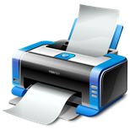

  GST TAX INVOICE
  DIAGRAM
Tax Invoice
Hard Copy
Electronic
Must be issued within 21 days
Full
Simplified
Self-billed
(Full or Simplified)
Pre-determined format
If amount payable including GST lower than RM 500
Price is unknown by supplier during transaction
Recipient and supplier are both registered
Supplier agreed no tax invoice will be issued by him
A copy of tax invoice should be provided to supplier
UPON DG’s APPROVAL!

Slide 51
  GST TAX INVOICE
  ITEMS
No. | Items | Full Tax Invoice | Simplified Tax Invoice
1 | The words “tax invoice” in a prominent place
2 | Serially tax invoice number
3 | Date of issuance of the invoice
4 | Name, address and identification number of the supplier
5 | Name and address of the person to whom the goods or services are supplied
6 | A description sufficient to identify the goods or services supplied
7 | For each description, the quantity of the goods or the extent of the services and the amount payable, excluding tax
8 | Any discount offered
9 | The total amount payable excluding tax, the rate of tax and the total tax chargeable shown as a separate amount
10 | The total amount payable including the total tax chargeable

Slide 52
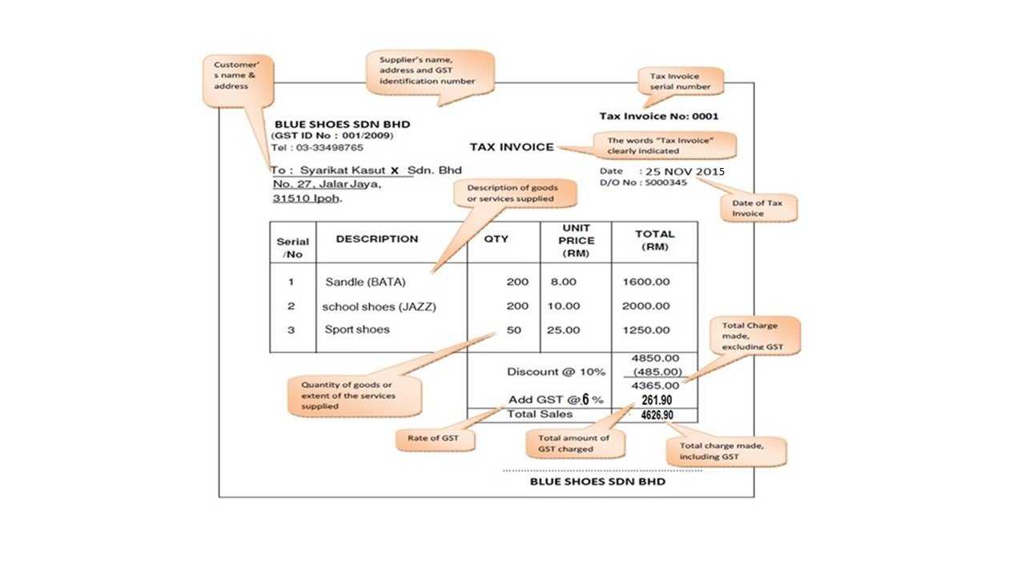
  GST TAX INVOICE
  FULL TAX INVOICE - SAMPLE

Slide 53
  GST TAX INVOICE
  SIMPLIFIED TAX INVOICE – SAMPLE
Supplier’s name, address and GST identification number
BESAR MALL SDN. BHD.
NO 3, Ampang Point Centre,
Jalan Gembira, 41100 Ampang,
Selangor.
(GST ID No : 346722220102)
Tel : 03-33498654
Tax Inv No : A00295
Date : 15.4.2015
Serialised “Tax Invoice” number
Date of Tax Invoice
Description | Total (RM)
3 in 1 coffee Ali | 15.65
Rounding Adj. | 0.05
TOTAL | *15.70
Description of goods or services supplied
Total amount payable including GST
The words “Price Payable includes GST amount and rate of tax” clearly indicated
* Price payable includes GST RM0.89 @ 6%

Slide 54

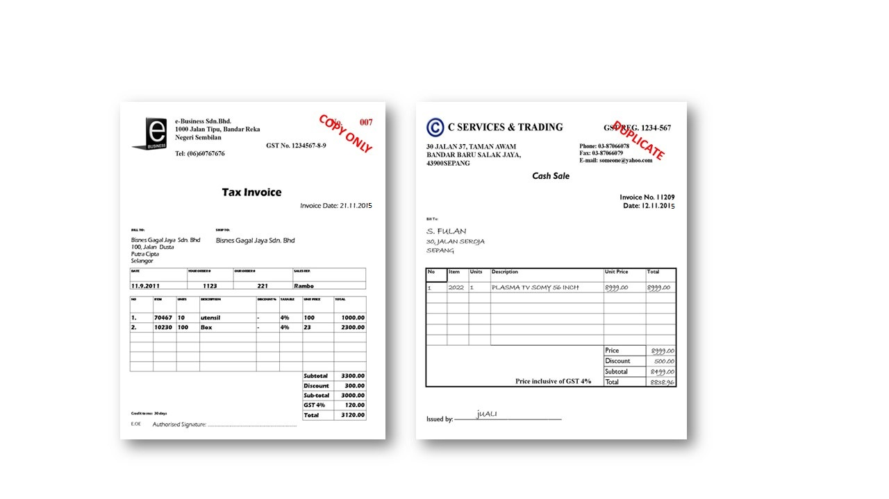
  GST TAX INVOICE
  LOST/MISPLACED TAX INVOICE - SAMPLE
What if user lost/the tax invoice?
request for replacement copy
marked as “COPY ONLY” or “DUPLICATE”

Slide 55
  GST TAX INVOICE
  FOREIGN CURRENCY
Invoice in Foreign Currency
Particulars in foreign currency need to be converted into RM using the open market rate of exchange for GST purposes included:
Amount payable before GST
Total GST chargeable
Total amount payable
In the case of importation, taxable person can use the exchange rate published by Customs

Slide 56
ENTITLEMENT INPUT TAX

Slide 57
  INPUT TAX CREDIT
  ENTITLEMENT TO CLAIM INPUT TAX
Entitlement to claim input tax
Input tax has been incurred
Input tax is allowable
Taxable person
Goods or services acquired in the furtherance of business
Goods and services made in Malaysia or supply made outside Malaysia which would taxable supply if made in Malaysia

Slide 58


  INPUT TAX CREDIT
  CLAIMING INPUT TAX
To be able for claiming Input Tax, taxable person MUST hold valid documents;
Tax Invoice
Custom No. 1 - Imported Goods
Custom No. 9 - Goods removed from
bonded warehouse
Documents on imported services

Slide 59
  INPUT TAX CREDIT
  CLAIMING INPUT TAX (CONTD.)
Input tax can be claimed on supplies bought or received regardless if the supplies:
Paid on credit
Cannot be sold through the taxable period (no matching of input-
output)
Claim can be made within the period of 6 years from the date GST return is made

Slide 60

  INPUT TAX CREDIT
  ALLOWABLE INPUT TAX
Allowable on taxable supplies:
Standard rated or zero rated supplies
Disregarded supplies
Within group
Within or between designated areas (Langkawi, Labuan etc)
Made in warehouse
Allowable on supplies made outside Malaysia which would be taxable supplies if made in Malaysia
Allowable on any other prescribed supply (Fixed Input Tax Recovery)

Slide 61
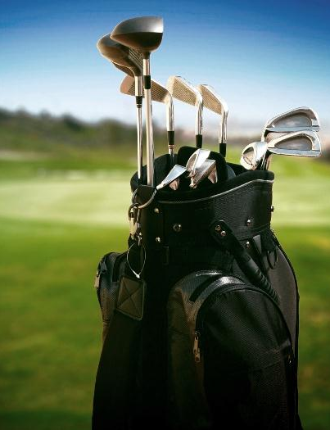


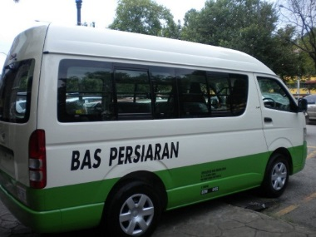
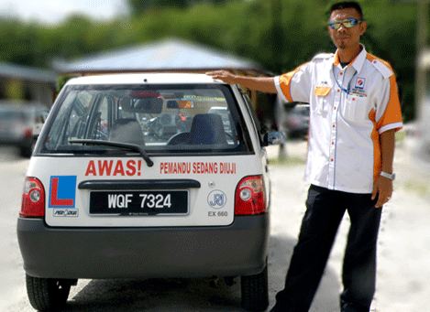
  INPUT TAX CREDIT
  BLOCKED INPUT TAX
Blocked supplies:
Passenger motor cars including hiring of car
Family benefits
Club subscription fee
Medical and personal accident insurance
Medical expenses
Entertainment expenses for family members and potential clients

Slide 62
DEBIT NOTE, CREDIT NOTE & GST BAD DEBTS
62

Slide 63
ISSUANCE OF DEBIT AND CREDIT NOTE
63

Slide 64


DEBIT AND CREDIT NOTE
CONTENTS
Debit Note and Credit Note must contains:
1) Words “Credit Note” or “Debit Note” in a prominent place
2) Serial Number and date of issue
3) Name, address and GST identification number of the supplier
4) Name and address of customer
5) Reason of issuance
6) Description of goods or services
7) Quantity and amount of each supply
8) Total amount excluding GST
9) Rate and amount of GST
10) Number and date of the original tax invoice
64

Slide 65
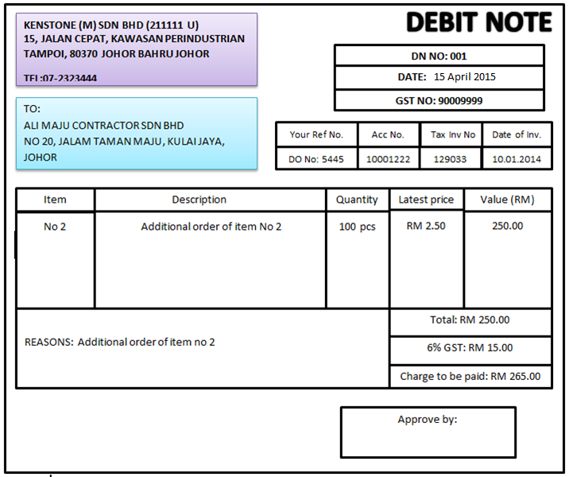
DEBIT NOTE
SAMPLE OF DEBIT NOTE
65

Slide 66
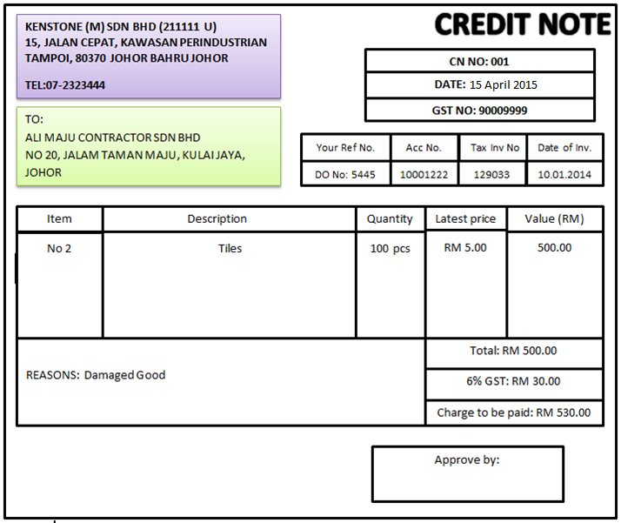
CREDIT NOTE
SAMPLE OF CREDIT NOTE

Slide 67
BAD DEBT
67

Slide 68
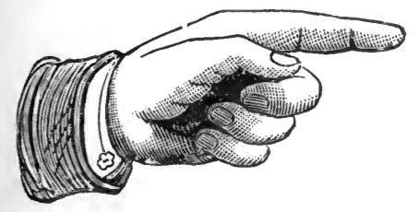
BAD DEBT
  Adjustments need to be made on the following situations:
    Bad debt due to non-payment
    Bad debt due to insolvency
    Recovery of payment with regards to bad debt
68

Slide 69

BAD DEBT RELIEF
ELIGIBILITY
A taxable person is entitled to a relief for bad debt on the whole or any part of the tax paid by him in respect of a taxable supply if:
  GST has been paid
  No payment has been received in 6 months from the date of supply
  The debtor has become insolvent before the period of 6 month has elapsed
  Sufficient efforts have been made by him to recover the debt.
69

Slide 70
BAD DEBT RELIEF
FORMULA
The seller has not received any payment
Claim for the whole of the tax paid
Seller received part payment for taxable supply
Claim for an amount calculated accordance to this formula
$$\frac{A1}{B}×C$$
Where A1 is payment not received for the taxable supply;
B is consideration for the taxable supply; and
C is the tax due and payable on the taxable supply.
70

Slide 71
BAD DEBT RELIEF
ADJUSTMENT – EXAMPLE
MONTHLY TAXABLE PERIOD
Invoice issued at 10th January 2016. The sixth month expires at the end of Jun and the bad debt relief must be claimed immediately in July monthly taxable period.
1
2
3
4
5
6
7
10/1/16
February
March
April
May
June
(expired)
July
(claim)

Slide 72


ADJUSTMENT-BAD DEBT
If company fails to pay GST after six month from date of supply :
If he has claimed input tax on that supply :
Pay back the input tax by accounting an amount equal to the input tax as his output tax.
Account the output tax in his taxable period immediately after six month period
72

Slide 73
RECORD KEEPING

Slide 74
  RECORD KEEPING
  LIABILITY TO KEEP RECORDS
The records MUST be:
in Bahasa Malaysia or English Language
kept in possession for a period not less than 7 years
made available upon request
readily accessible and convertible into writing if it is electronic
records
*Section 36

Slide 75

  RECORDS KEEPING
  TYPES OF BUSINESS RECORDS
Business Entity Records
SSM Records – Form A, B, C, 8, 9, 24, 49 and etc.
Business Transactions Records
Tax Invoices, invoices, receipts
Debit note, credit note
Delivery order, purchase order
Bank statement, slip, voucher etc
Contract, agreement
Accounting Records
(Hard Copy)
Financial statement
Account payable, receivable, GL, fixed asset register and etc
Taxation Records
Custom forms – K1, K2 and etc
Inland revenue declaration forms
GST adjustment working sheet
GST – GST returns, payment slips and receipts
Electronic
Accounting software manual
Audit trail
.GAF file
Others

Slide 76

  RECORDS KEEPING
  FAIL TO KEEP RECORDS
“Any person, who contravenes Sec. 36, commits an offence and shall, on conviction, be liable to a fine not exceeding RM 50,000 or imprisonment for a term not exceed 3 years; or both”

Slide 77
ACCOUNTING BASIS

Slide 78
  ACCOUNTING BASIS
  INVOICE BASIS
Invoice
Basis
Accounting
Basis
Payment
Basis
Invoice Basis
Generally, EVERY taxable person shall account for GST on an invoice basis
Under invoice basis, a taxable person shall:
Account for output tax on the date in which tax becomes due (time of
supply);
Claim input tax on the date in which he holds a valid tax invoice

Slide 79
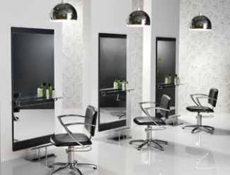
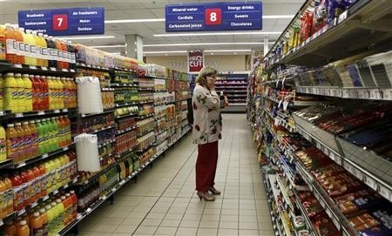
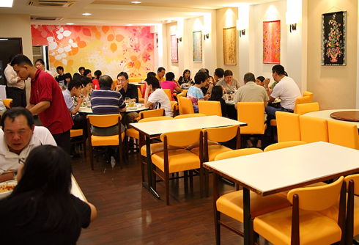
  RECORD KEEPING
  LIMITATION OF PAYMENT BASIS
Payment basis is NOT applicable for professional services
Applicable ONLY to:
PPublic body
Certain group of registered person who due to the nature of business and the nature of the accounting system employed by that person, is appropriate to account for the tax payable on a payment basis
Example: Retailers, grocery shops, hair salons and restaurant operators
Must get approval and under payment basis is effective for a period of 3 years only and is subject to renewal by the Director General.

Slide 80
GST TAX CODE & GST-03

Slide 81

GST TAX CODE
AGENDA
    GST TAX CODE FOR PURCHASE
    GST TAX CODE FOR SUPPLY
    GST - 03

Slide 82
GST TAX CODE FOR PURCHASE

Slide 83
GST TAX CODE FOR PURCHASE
Tax Type | Description | Tax Code | Tax Rate | Description | Ref. no. modul system GST | GST-03 Field
GST | Goods And Services Tax (Malaysia) | TX | 6% | Purchases with GST incurred at 6% and directly attributable to taxable supplies. | 1,2,4,5,7 | 6a, 6b
GST | Goods And Services Tax (Malaysia) | IM | 6% | Import of goods with GST incurred. | 3 | 6a, 6b
GST | Goods And Services Tax (Malaysia) | IS | 0% | Imports under special scheme with no GST incurred (e.g. Approved Trader Scheme, ATMS Scheme). | 12,13 | 14, 15

Slide 84
GST TAX CODE FOR PURCHASE
Tax Type | Description | Tax Code | Tax Rate | Description | Ref. no. modul system GST | GST-03 Field
GST | Goods And Services Tax (Malaysia) | BL | 6 % | Purchases with GST incurred but not claimable (Disallowance of Input Tax) (e.g. medical expenses for staff). | 14
GST | Goods And Services Tax (Malaysia) | NR | 0% | Purchase from non GST-registered supplier with no GST incurred. | 15
GST | Goods And Services Tax (Malaysia) | ZP | 0% | Purchase from GST-registered supplier with no GST incurred. (e.g. supplier provides transportation of goods that qualify as international services). | 16, 19

Slide 85
GST TAX CODE FOR PURCHASE
Tax Type | Description | Tax Code | Tax Rate | Description | Ref. no. modul system GST | GST-03 Field
GST | Goods And Services Tax (Malaysia) | EP | 0% | Purchases exempted from GST. E.g. purchase of residential property or financial services | 18,20
GST | Goods And Services Tax (Malaysia) | OP | 0% | Purchase transactions which is out of the scope of GST legislation (e.g. purchase of goods overseas). | 17,21,22
GST | Goods And Services Tax (Malaysia) | TX-E43 | 6% | Purchase with GST incurred directly attributable to incidental exempt supplies. | 6 | 6a, 6b

Slide 86
GST TAX CODE FOR PURCHASE
Tax Type | Description | Tax Code | Tax Rate | Description | Ref. no. modul system GST | GST-03 Field
GST* | Goods And Services Tax (Malaysia) | TX-N43 | 6% | Purchase with GST incurred directly attributable to non-incidental exempt supplies. | 20
GST* | Goods And Services Tax (Malaysia) | TX-RE | 6% | Purchase with GST incurred that is not directly attributable to taxable or exempt supplies. | 20 | 6a, 6b (taxable only)
GST | Goods And Services Tax (Malaysia) | GP | 0% | Purchase transactions which disregarded under GST legislation (e.g. purchase within GST group registration). | 22

Slide 87
GST TAX CODE FOR PURCHASE
Tax Type | Description | Tax Code | Tax Rate | Description | Ref. no. modul system GST | GST-03 Field
GST | Goods And Services Tax (Malaysia) | AJP | 6% | Any adjustment made to Input Tax e.g.: Bad Debt Relief, Debit Note & other input tax adjustment. | 8,9,10 | 6b only
*Applicable to GST-registered businesses that makes both taxable and exempt supplies. For more information, please refer to GST guide "Partially Exempt Traders and Input Tax Recovery" available at http://gst.customs.gov.my

Slide 88
GST TAX CODE FOR SUPPLY

Slide 89
GST TAX CODE FOR SUPPLY
Tax Type | Description | Tax Code | Tax Rate | Description | Ref. no. modul system GST | GST-03 Field
GST | Goods And Services Tax (Malaysia) | SR | 6% | Standard-rated supplies with GST Charged. | 1,2,3,8 | 5a, 5b
GST | Goods And Services Tax (Malaysia) | ZRL | 0% | Local supply of zero rated supplies. | 11 | 10
GST | Goods And Services Tax (Malaysia) | ZRE | 0% | Exportation of goods or services which are subject to zero rated supplies. | 12 | 11
GST | Goods And Services Tax (Malaysia) | ES43 | 0% | Incidental Exempt supplies. | 15 | 12

Slide 90
GST TAX CODE FOR SUPPLY
Tax Type | Description | Tax Code | Tax Rate | Description | Ref. no. modul system GST | GST-03 Field
GST | Goods And Services Tax (Malaysia) | DS | 6% | Deemed supplies (e.g. transfer or disposal of business assets without consideration). | 7 | 5a, 5b
GST | Goods And Services Tax (Malaysia) | OS | 0% | Out-of-scope supplies. | 17,18
GST | Goods And Services Tax (Malaysia) | ES | 0% | Exempt supplies under GST. | 15,16 | 12
GST | Goods And Services Tax (Malaysia) | RS | 0% | Relief supply under GST. | 13 | 13

Slide 91
GST TAX CODE FOR SUPPLY
Tax Type | Description | Tax Code | Tax Rate | Description | Ref. no. modul system GST | GST-03 Field
GST | Goods And Services Tax (Malaysia) | GS | 0% | Disregarded supplies. | 14
GST | Goods And Services Tax (Malaysia) | AJS | 6% | Any adjustment made to Output Tax e.g.: Longer period adjustment, Bad Debt recover, outstanding invoice > 6 months& other output tax adjustments. | 4,5,6,9 | 5b only
Notes: The tax codes listed are recommendations to allow proper classifications of typical purchase and sales scenarios encountered by GST-registered businesses for the purpose of GST. The list is not intended to be prescriptive nor comprehensive.

Slide 92
GST - 03

Slide 93
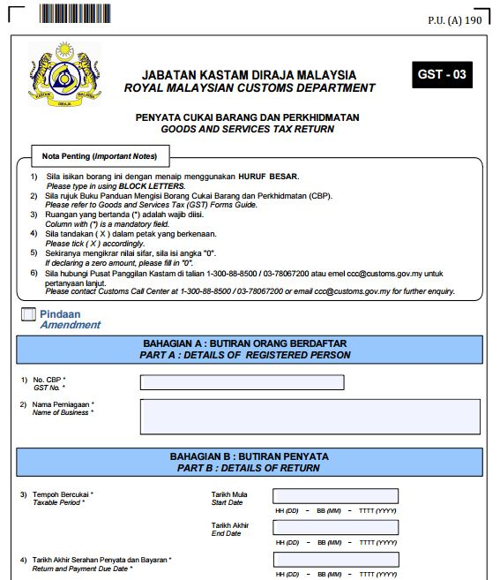
GST - 03
GST Number
Name of Business
Start Date : etc, 1 August 2015
End Date : etc, 31 August 2015
Due Date : etc, 30 Sept 2015

Slide 94
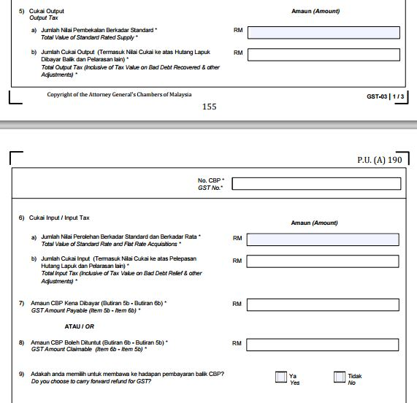
GST - 03
SR, DS
SR, DS, AJS
TX, TX-CG IM, TX-E43
TX, TX-CG, IM, TX-E43 , TX-RE, AJP
5b – 6b (Payable)
6b – 5b (Claimable)

Slide 95
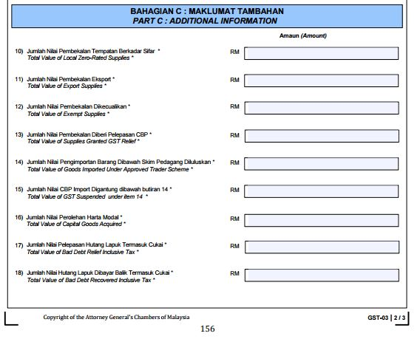
GST - 03
ZRL
ZRE
ES43 , ES
RS
IS
6% OF ITEM 14
TX-CG
AJP
AJS

Slide 96
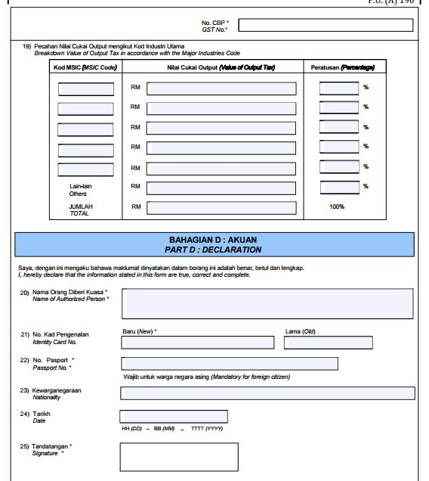
GST - 03
MSIC CODE
GST OUTPUT

Slide 97
GST TAX RETURN

Slide 98
  GST TAX RETURN PERIOD
Every taxable person will be assigned a taxable period which will end on the last day of the month of any calendar year unless a varied taxable period has been assigned
e.g. end on 31st January, 28th February, 31st March, …….
The category of a taxable period will depend on the amount of annual sales
Category | Taxable Supply | Taxable Period
A | RM 5 million and above | Monthly
B | Less than RM 5 million | Quarterly

Slide 99
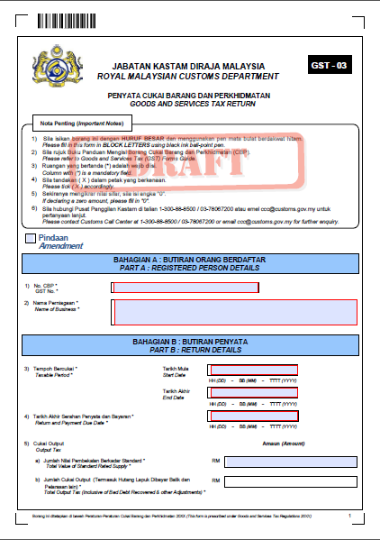

  GST TAX RETURN PERIOD
  FILING TAX RETURN
  GST returns and payment must be submitted not later than the last day of the following month of the taxable period
  Electronic filing is encouraged

Slide 100
  GST TAX RETURN PERIOD
  MONTHLY TAXABLE PERIOD
When to submit GST return
Monthly taxable period
Last date of submission :
DEC
JAN
FEB
MAC
31 Jan
28 Feb
31 Mac
Submission Date

Slide 101
  GST TAX RETURN PERIOD
  QUARTERLY TAXABLE PERIOD
When to submit GST return
      Quarterly taxable period
Last date of submission :
January - March
April - June
JAN
FEB
MAC
APR
MAY
JUN
JUL
30 April
31 July
Submission Date

Slide 102

  SUBMISSION OF GST-03
  GST FILING
There is two ways to filing a return GST-03:
Option 1 By log on into tax payer assess point (TAP) portal which is
https://gst.customs.gov.my/TAP/
Option 2 By doing manually
102

Slide 103
  SUBMISSION OF GST-03
  GST FILING – USING TAP PORTAL
1. Fill in email address and password. Click ‘Login’.
2. Click ‘GST No.’ in Account ID (My Account).
3. Click the link ‘File now’ for the required return. Click ‘Next’.
4. Complete all required information and click ‘Submit’
5. Click ‘Print Acknowledgement Receipt’ and keep for future reference.
6. Return has been successfully submitted. Click ‘Print’ to print the return.
103

Slide 104
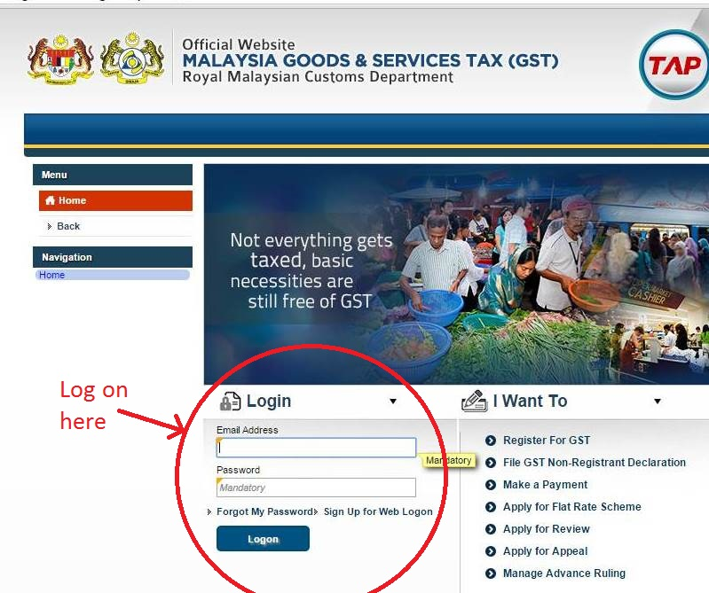
  SUBMISSION OF GST-03
  GST FILING – USING TAP PORTAL
104

Slide 105
  SUBMISSION OF GST-03
  GST FILING – MANUAL SUBMISSION
1. Click (Legislation & Guides)
2. Select menu (GST Forms)
3.Select No.5 (GST-03) and click download the form and save
4.Type in GST-03 form using BLOCK LETTERS. Complete part A, part B, part C and Part D
5. Once complete, the form must be printed
6. Put it in an envelope and post it to ‘Ketua Pengarah Kastam Malaysia’
105

Slide 106
  SUBMISSION OF GST-03
  GST FILING
  GST returns and payment must be submitted not later than the last day of the following month of the taxable period
  Electronic filing is encouraged
106

Slide 107

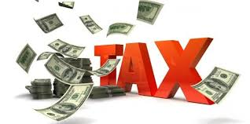
PAYMENT OF GST

Slide 108
  PAYMENT OF GST
  GST PAYMENT
WHEN TO MAKE PAYMENT
If your output tax exceeds the input tax, the difference shall be remitted to the Government together with the GST returns not later than the last day of the following month after the end of taxable period.
HOW TO MAKE PAYMENT
1) Online payments through banks and internet facilities
2) Payment via cheque/bank draft/money order must be made payable to 'Ketua
Pengarah Kastam Malaysia' and mail to Ketua Pengarah Kastam Malaysia
108

Slide 109
  PAYMENT OF GST
  GST PAYMENT – STEPS BY STEPS
1. To make payment directly after submission of return, click ‘Make a Payment’
2. Choose type of payment. Click ‘Continue Payment’ and click ‘Continue’
3. Payment confirmation screen will be displayed. Click ‘Proceed’ and ‘Proceed Anyway’
4. Payment details screen will be displayed. Choose the required bank. Click ‘Agree and Continue’.
5. Internet banking screen will be displayed. Please key in the bank account number and pin number then click ‘OK’.
8. Successful transaction screen will be displayed. Click ‘Continue’ to complete the process.
6. Authorization screen will be displayed. Click ‘OK’.
7. Payment details screen will be displayed. Click ‘Click here to complete your transaction’.
9. Print the Acknowledgement Receipt for future reference.
109

Slide 110

  PAYMENT OF GST
  GST PAYMENT
1. Open TAP main homepage. Click ‘Make a Payment’ under “I want To’ option.
2. Click ‘Make a Payment’ and Choose 'Payment for a Return that has been filed‘.
3. If there is media information, key in the media number. If not, key in GST No./ Account ID.
4. Complete the process till the end. Click ‘Print the Acknowledgement Receipt’. Keep for future reference.
110

Slide 111
  PAYMENT OF GST
  GST PAYMENT
1. Fill in Email Address and Password. Click ‘Login’.
2. Click 'Make a Payment' under 'I Want To' option.
3. Choose 'Pay a Filed Return'. Choose mode of payment. Choose taxable period for the required month.
4. Complete the process till the end. Click ‘Print Acknowledgement Receipt’. Keep for future reference.
111

Slide 112
  PAYMENT OF GST
  PENALTY ON LATE PAYMENT
In accordance with amendments made to Section 41 of the Goods and Services Tax Act 2014, with effect from 1/1/2016 failure to pay the amount of goods and services tax to be paid within the period specified will be penalized. Imposition of penalties will start for the taxable period for which tax payments are due and payable on 31/1/2016.
112

Slide 113
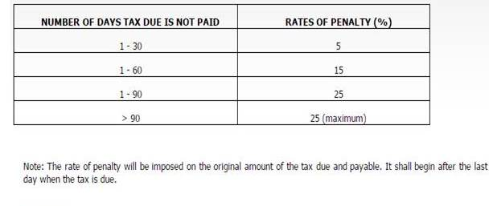
  PAYMENT OF GST
  PENALTY ON LATE PAYMENT
CALCULATION OF PENALTY
The calculation of the penalty will be based on the number of the days the tax due is not paid as per the table below :
113

Slide 114
  PAYMENT OF GST
  PENALTY ON LATE PAYMENT
Situation : Due date 31/1/2016
Tax payable RM 10,000
29/2/2016
Penalty 5% x RM 10,000
Total tax + penalty = RM 10,500
31/3/2016
Penalty 15% x RM10,000
Total tax + penalty = RM 11,500
30/4/2016
Penalty 25% x RM 10,000
Total tax + penalty = RM 12,500
114

Slide 115

  PAYMENT OF GST
  PENALTY ON LATE PAYMENT
Failure to register
Any deficiency on the net tax payable
No GST return is made
A GST return is submitted without payment or a lesser payment
Any refund paid to which there is no proper entitlement
115

Slide 116
  PAYMENT OF GST
  PENALTY ON LATE PAYMENT
Section 88 of the GST Act
Any person who —
(a) makes an incorrect return by omitting from the return any information;
(b) understates any output tax or overstates any input tax in a return; or
(c) gives any incorrect information in relation to any matter affecting his own
liability to tax or the liability to tax of any other person,
Fine not exceeding RM50,000 or imprisonment not exceeding 3 years or BOTH; and
Penalty equal to the GST undercharged
116

Slide 117
  PAYMENT OF GST
  PENALTY ON LATE PAYMENT
Section 89 of the GST Act
For the 1st offence, fine not less than 10 times and not more than 20 times the amount of tax or imprisonment not exceeding 5 years or BOTH; and
For 2nd offence or subsequent offence, fine not less than 20 times and not more than 40 times the amount of tax and imprisonment not exceeding 7 years or BOTH:
  Provided that where the amount of tax cannot be ascertained, the person shall be liable to a fine of not less than RM 50,000 and not more than RM 500,000 or to imprisonment not exceeding 7 years or BOTH.
117

Slide 118
  PAYMENT OF GST
  PENALTY ON LATE PAYMENT
Section 89 of the GST Act
  Any person who assists in, or advises with respect to, the preparation of any return where the return results in an understatement of the liability for tax of another person shall, unless he satisfies the court that the assistance or advice was given with reasonable care, commits an offence and shall, on conviction, be liable to a fine of not less than RM 2,000 and not more than RM 20,000 or imprisonment not exceeding 3 years or BOTH.
118

Slide 119

TAX PAYER ACCESS POINT

Slide 120
  TAXPAYER ACCESS POINT (TAP)
WHAT IS TAP
TAP is an easy and convenient way for taxpayer to deal with Royal Malaysia Custom Department (RMCD) regarding Good and Service Tax
Registered Taxpayer
Non-Registered Taxpayer
Agent
Tax Agent
Agency
Public
WHO CAN ASSESS TAP
HOW TO ASSESS TAP
Good Service Tax Portal (www.gst.customs.gov.my)
120

Slide 121
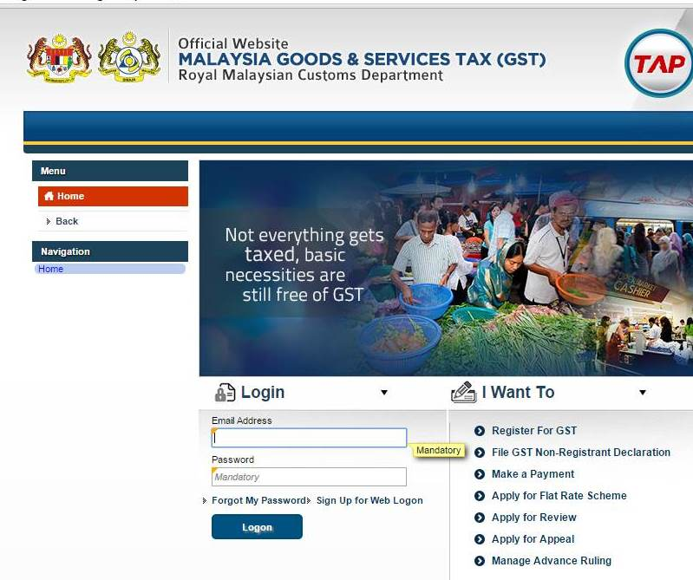
  TAXPAYER ACCESS POINT (TAP)
121

Slide 122
  TAXPAYER ACCESS POINT (TAP)
FUNCTIONS OF TAP
GST Registration
Online update of contact information and names and addresses
View account summaries and transaction lists
File returns online
Make payments and link to a payment portal to make other types of payments
Check refund status
Grant your account representative (accountant, bookkeeper, etc.) third-party access to use TAP on your behalf
122

Slide 123

T
H
A
N
K
Y
O
U
www.salihin.com.my | www.mysalihin.com
1 300 88 5678
Copyright Controlled 2014 @ SALIHIN

