Slide 1



FILING
Presenter : MOHD AFIQ BIN MOHAMAD RADZUAN
Venue : KERIS SAKTI
Date : 19 & 20 Disember 2018
PREPARED BY:
SUBMITTED TO:
Notes:
Font Type: Open Sans
Font Size: Proposal Title (60), Proposal Details (40)
Business unit & Client logo: Small size

Slide 2
CONTENT
WHAT IS FILING – DEFINITION
WHAT TYPES OF FILES TO MAINTAIN FOR BASIC OPERATION
DETAILS OF A BASIC FILE
IMPORTANCE OF FILING SYSTEM IN BUSINESS SUCCESS

Slide 3
FILING AND FILING SYSTEM
Filing is the activity of putting documents, electronic information, etc. into files
Filing system is the way that documents and files are organized, on a computer or in an office

Slide 4
WHAT TYPES OF FILES TO MAINTAIN FOR BASIC OPERATION
Bank Statement
Customer / Clients / Sales
Cash Book / Petty Cash
Salary Schedule
Loans / Hire Purchase/ Contracts
Tax / Statutory / Legal

Slide 5
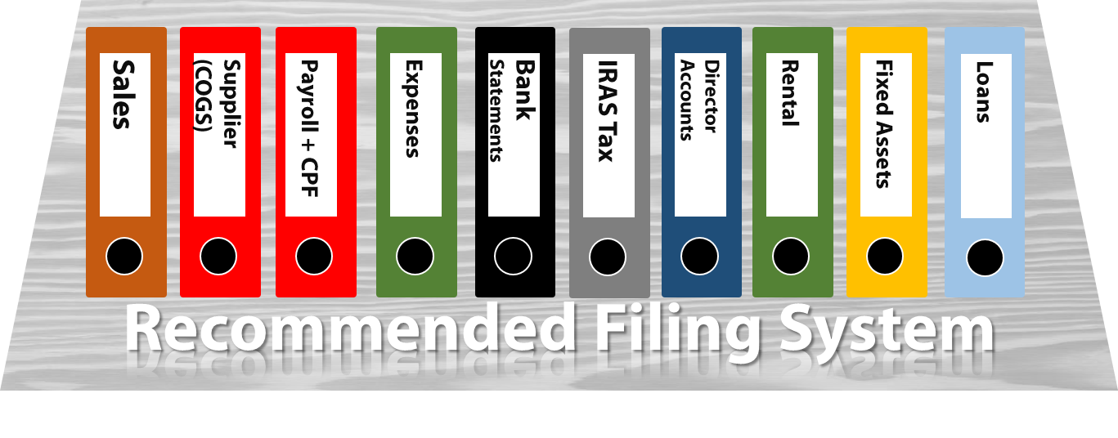
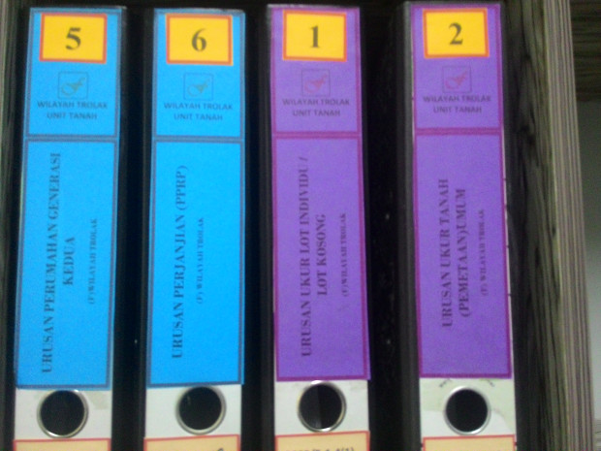

Slide 6
DETAILS OF A BASIC FILE
COMPANY’S NAME
FILE NUMBER
FILE NAME
MONTH/YEAR
OTHER PARTICULARS
LIST OF DOCUMENTS IN THE RESPECTIVE FILE

Slide 7
IMPORTANCE OF FILING SYSTEM IN BUSINESS SUCCESS
SAVE TIME
KEEP TRACK OF DAILY/MONTHLY/YEARLY BUSINESS OPERATIONS
PREVENT FRAUD
PREVENT ERROR
MONTHLY AND DAILY BUDGETING
AUDIT PURPOSES
TAX PURPOSES
PROPER 7 YEARS FILING

Slide 8

Contact Us
Headquarters
—
555, Jalan Samudra Utara 1,
Taman Samudra,
68100 Batu Caves,
Selangor, Malaysia.
Tel: +603-6185 9970
Fax: +603-6184 2524
Email: info@salihin.com.my
Follow us on social media
Notes:
Font Type: Open Sans Light
Font Size: Content (28)
Attention: You may add / edit this section.

Slide 9
www.salihin.com.my | www.salihinpremier.com
Careline: 1 300 88 5678
Notes:
Attention: Please don’t change any content here. Thank you very much ☺

