Slide 1





Rural Entrepreneurship Financial Literacy
Empowerment Proposal
By
SPS Accounting Solutions
PREPARED BY:
SUBMITTED TO:
Notes:
Font Type: Open Sans
Font Size: Proposal Title (60), Proposal Details (40)
Business unit & Client logo: Small size

Slide 2
1.0 Executive Summary
Aligned with the Kementerian Kemajuan Luar Bandar & Wilayah (KKLW) agenda in transforming the rural economy landscape and cultivate the entrepreneurships in the underserved area, SALIHIN aims to become the main catalyst by leveraging on our accounting solutions expertise to respective entrepreneurs under KKLW stewardship.
SALIHIN believe financials literacy plays a vital roles in any business, mainly for the start ups companies with the limited capital or funding. By understanding the proper flows of financial aspects in daily business activities, it will help them to properly manage their business cash flow. At the same time, they would be able to extract various information's for the benefits of the business continuity i.e main suppliers, main customers, main products, main cost etc.
In this proposal, we have details out our plan, who are the target user, what type of training provided, how we would help ministry to accomplish in setting a new benchmark of entrepreneurship for the rural business communities nationwide.
Notes:
Font Type: Open Sans
Font Size: Executive Summary Content (36)

Slide 3
Table of Contents
1.0
Executive Summary 2
2.0
About Us 4
3.0
The Proposal 12
4.0
Contact Us 24
Notes:
Font Type: Open Sans Light
Font Size: Table of Content (44)
Attention: Please change the table of content and page numbering accordingly. Thank you very much ☺

Slide 4
1.0 About Us
About Us
—
SALIHIN
1.0 About Us
Key Management Team
About Us
  Services
  Our Diverse Clients
Local & International Networks
Notes:
Font Type: Open Sans (Bold)
Font Size: About Us (60)

Slide 5



About Us
Founded in 2002, SALIHIN is the brand name of a group of independent and separate legal entities, deploying wide spectrum of capabilities to help clients see and tap opportunities in the areas of transaction and corporate finance, taxation (direct tax and GST), auditing and assurance, shariah auditing and advisory, corporate governance, IT consultancy and business accounting solution.
As one of the fastest growing home-nurtured and bumiputera firms, SALIHIN is having close to 200 competent professionals from different background with diverse thoughts, expertise and experience serving in 9 offices nationwide. In addition to relevant licenses/certifications for its capabilities, SALIHIN is having MSC Malaysia Status and 1-InnoCERT certification, Licensed Tax Agent and GST Tax Agent, Licensed Capital Market Services as well as Shariah Advisory by Securities Commission. SALIHIN is also a Registered Public Interest Entities Auditor by Audit Oversight Board (AOB), a Registered Auditor with PPK Accountants in the UK, an approved Cooperative Auditor with Suruhanjaya Koperasi Malaysia (SKM), an Approved Training Provider by Human Resources Development Fund (HRDF). Additionally, SALIHIN is a member of i2an, a global network of accountants based in Paris and has won Enterprise 50 (E50) Awards in 2010.
We have a proven track record credited to a sustained quality service delivery to our clients without compromising our professional integrity. SALIHIN continues to build on its successes. It became the first in the world to introduce Teaching Accountancy Firm (TAF) to bridge the gap between accountancy theory and practice.
Vision
To become the preferred national accountancy firm of Malaysia.
Mission
SALIHIN is dedicated to creating value by focusing on customer satisfaction and growth, excellent internal business process and superior human capital resource development.
Notes:
Attention: Please don’t change any content here. Thank you very much ☺

Slide 6
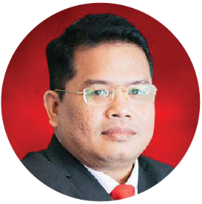
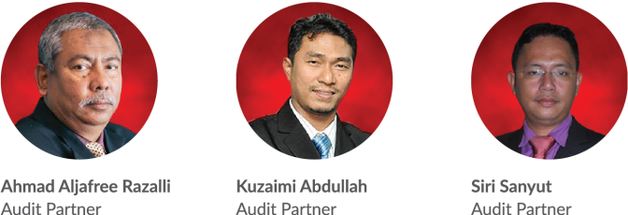
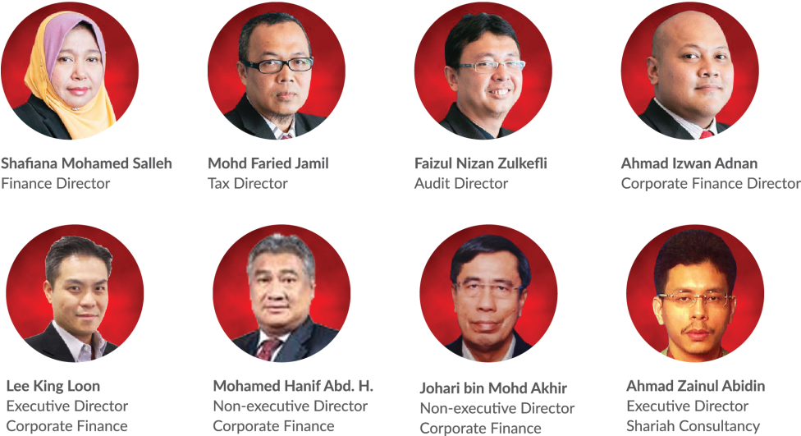
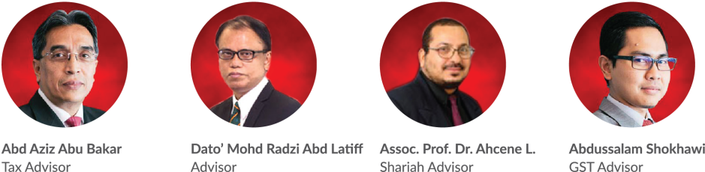
About Us
Key Management Team
Salihin Abang
Founder/Managing Partner/CEO
Notes:
Attention: Please don’t change any content here. Thank you very much ☺

Slide 7
About Us
Services
SALIHIN offers wide spectrum value for money services:
AUDIT & ASSURANCE
GST & BUSINESS
ACCOUNTING SOLUTION
GST ADVISORY
Statutory Financial Statement Audit
Review Engagements
Compilation Engagement
MPERS / MFRS Training
Agreed Upon Procedures
Preparation & Submission: GST-03
GST Accounting and Review for users of SPS
Preparation of Full Sets Accounts
Preparation of Management Account or Reports
Forensic Accounting
GST Strategic Planning
Cash Flow Planning & Pricing Strategy
GST Bad Debt Management
GST Record Keeping and Internal Control
GST Special Transaction
GST-IT Advisory
Transfer of Going Concern
GST Audit and Investigation
Advice on GST Ruling & Appeal
GST-03 Monthly Submission Review
Monitoring TAP System
GST Annual Adjustment
GST Training & Education Services
GST Accounting Software
DIRECT TAXATION
Mergers and Acquisition Tax Advisory
Corporate Tax Compliance and Planning
Transfer Pricing Advisory
Transfer Pricing Documentation
Tax Audit, Investigation & Appeal
International Tax Consulting
Real Property Gain Tax
Tax Accounting
Tax Risk Management
Notes:
Attention: Please don’t change any content here. Thank you very much ☺

Slide 8
About Us
Services (Cont.)
SALIHIN offers wide spectrum value for money services:
GOVERNANCE &
CORPORATE SECRETARIAL
IT CONSULTANCY
SHARIAH AUDIT & ADVISORY
Islamic Banking Product Structuring
Islamic Securities: Sukuk Issuance & Structure
Islamic Wealth Management Advisory
Islamic Private Equity Advisory
Establishment of Islamic Bank
Zakat & Waqf Accounting Software (SPS)
Shariah Compliance Training Program
Shariah Training & Education, Research & Development
Shariah Internal & External Audit, Review & Screening
Shariah Risk Management
Shariah Legal Advisory
Shariah Governance & Supervision
IT Audit & Due Diligence
IT Governance and Planning
IT Project Management
IT Risk Management
IT Strategy and Assessment
Business Intelligence
IT Sourcing/Outsourcing
Enterprise Resource Planning (ERP)
Software Development and Customization
TRANSACTION & CORPORATE FINANCE
Internal & Forensic Auditing
Enterprise Risk Management
Due Diligence & Business Valuation
Financial Statement Analysis
Raising Seed/Start-Up Capital
Agreed Upon Procedures
Management Buy-In(MBI) / Buy-Out (MBO)
Project and Infrastructure Finance
Pre and Post IPO Advisory
Raising and Restructuring of Debt
Governance and Compliance Advisory
Merges, Acquisition and Demergers
Notes:
Attention: Please don’t change any content here. Thank you very much ☺

Slide 9

About Us
Services (Cont.)
Notes:
Attention: Please don’t change any content here. Thank you very much ☺

Slide 10








































About Us
Our Diverse Clients
SALIHIN serves diverse clients including corporate companies, foundations / non-profit organisations, government bodies, government linked companies and educational institutions. Their diversity spans across different sectors of the economy.
Notes:
Attention: Please don’t change any content here. Thank you very much ☺

Slide 11



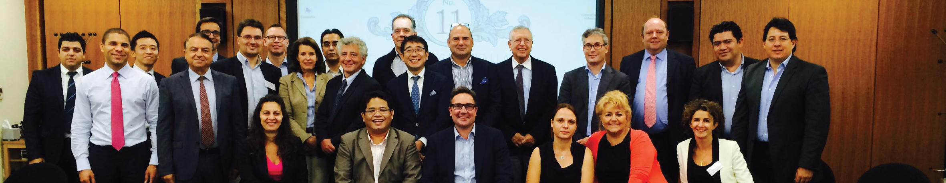
About Us
Our Local & International Networks
Buenos Aires
Mexico
Boston
Los Angeles
Miami
New York
San Francisco
Europe
MALAYSIA
Batu Caves
Johor Bahru
Kuching
Kuala Terengganu (TAF)
SALIHIN is a member firm of i2an,
a reputable global network of accountants which have presence in America, Asia and Europe as well as all the international financial centres.
Vienna
Brussels
Limassol
Paris
Frankfurt
Milan
Rrome
Luxemborg
Bucharest
Moscow
Barcelona
Madrid
Lausanne
Rotterdam
London
Kyiv
Asia
Shanghai
Hong Kong
Tokyo Kuala Lumpur
Singapore
Dubai
Sydney
New Delhi
Ramat Gan
Taiwan
America
Our Local Branches
Notes:
Attention: Please don’t change any content here. Thank you very much ☺

Slide 12
The Proposal
—
Rural Entrepreneur’s Financial Literacy Empowerment Proposal
2.0 The Proposal
SME Highlights
SME Contributions
Where Bumiputera SME Stand Now
Engagement Understanding
Objectives
Scope of Work
Approach & Methodology
Time Frame & Deliverables
Professional Fee
Engagement Team Leadership
Why SALIHIN?
Notes:
Font Type: Open Sans & Open Sans Light
Font Size: The Proposal (60), Content (36)
Proposal Title’s Example (at the right-top of the red box) : Audit Proposal (For Audit Dept.) or GST Proposal (For GST Dept.)

Slide 13
The Proposal
Malaysia’s SME Highlights
According to SME International Malaysia (2013):
Some advanced economies have succeeded because small and medium enterprises form a fundamental part of the economies
SMEs comprising over 98% of total establishments
SMEs contributing to over 65% of employment
SMEs contributing as over 50% of the gross domestic product.
SMEs contributions to GDP increased by 32.7% in 2013
SMEs in Malaysia
Is considered as the backbone of the economy
Reference: Business and Management Horizons ISSN 2326-0297 2014, Vol. 2, No. 2
Ref. SME Annual Report/ Laporan Tahunan PKS 2012/13
Notes:
Font Type: Open Sans Light
Font Size: Content (36)
Content suggestion: Client and proposal background.

Slide 14
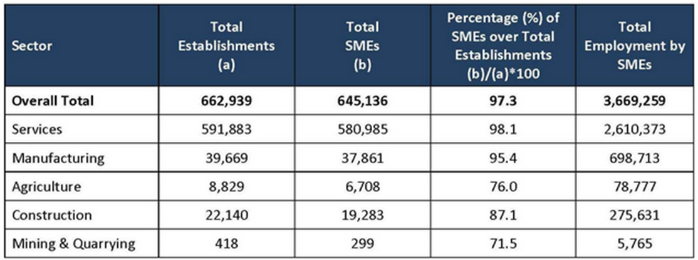
The Proposal
SME’s Contributions
SME ‘s
IS ONE OF THE MOST IMPORTANT SECTOR CONTRIBUTING OF:
97% OF FIRMS
22% OF LABOUR
33% OF GDP
Source: SME Corporation Malaysia
Notes:
Font Type: Open Sans Light
Font Size: Content (36)
Content suggestion: Client and proposal background.

Slide 15




The Proposal
Where Bumiputera SME Stand Now?
Business Operational Barriers faced By Bumiputera SME
Type of Support Required From Governments
COMPETITIVE MARKET
"Involvement of Bumiputera entrepreneurs in economy is still low in number. According to information update from Securities Commission Malaysia in 2014, there are 283,200 companies or 27.6% from 1,026,100 companies that are registered are Bumiputera companies. According to the Incorporation Census and Enterprise 2005, there are altogether 241,281 or 37.4% from 645,136 small and medium enterprises are owned by Bumiputera. From the total amount of the Bumiputera small and medium enterprises, 218,930 or 90.7 % are micro enterprise."
TAX INCENTIVES
FUND RAISING ISSUUES
BETTER ACCESS FOR FUND RAISING & FINANCING
SKILLED RESOURCES ISSUES
TECHNOLOGY SUPPORT
COMPETITION FROM NEW PLAYERS
CENTRALIZED COORDINATION CENTRE FOR SME’S BUSINESS INSIGHTS
SUPPORT FROM GOVERNMENT
CENTRALIZED SME TRAINING BODIES/ CUSTODIAN
Household Income Distributions by Ethnicity in Malaysia 2014
Household Income Distributions by Ethnicity in Malaysia 2012
Research by Bank Negara Malaysia
Research By UiTM
Research By Department of Statistic (DOSM)
Notes:
Font Type: Open Sans Light
Font Size: Content (36)
Content suggestion: Client and proposal background.

Slide 16
The Proposal
Insights from Industries
The Association of Chartered Certified Accountants Review
Small businesses with well-developed finance teams achieve faster, more sustainable growth for longer and can attract investment to help them develop
The role of the accountant in SME setting goes well beyond the basics of bookkeeping. Their role is vital at different stages of an SME’s development. Credit providers, supply chain partners and other stakeholders need a wealth of information from the finance team of an SME. For some investors, the information they require changes after investment to focus on other aspects of the business, such as agreed milestones
SMEs in Malaysia have to embrace the change that is taking place not just in Malaysia, but across the globe. They need to embrace new technologies and innovation
SOLID ACCOUNTING TEAM TO ENHANCE THEIR BUSINESS GROWTH AND SUSTAINABILITY
Talent management
Adoption of technology
Social media marketing
Increase competitiveness & embrace innovation
Reference: Shares Investment Malaysia. May 2013 Edition
Notes:
Font Type: Open Sans Light
Font Size: Content (36)
Content suggestion: Client and proposal background.

Slide 17


The Proposal
Proposal Objectives
250 training sessions
Learn proper business documentation
5 dedicated team to 5 region
Presentable & robust financial report
Intensive & focus oriented
Cultivate best business practice
1,000 potential new job creation via KKLW entrepreneurship empowerment program
Engagement with industries i.e TAF
MOA business networking engagement
Better business insights a, strategies and future planning
SALIHIN aim to collaborate with KKLW in equip and empower KKLW’s Entrepreneurs with proper business training and exposure through Special Facilitation Fund Scheme via below subject matter :
SALIHIN Premier Solutions (SPS) Accounting Information System
SPSLite Book Keeping Cloud System
Business Documentations and Financial Literacy Training
Since this 3 areas in embedded in one single name, which is SALIHIN PREMIER SOLUTIONS or SPS, therefore we will address SPS as the main tool throughout this proposal to KKLW.
Notes:
Font Type: Open Sans Light
Font Size: Content (36)

Slide 18













The Proposal
Target Participant
SME & Micro
Entrepreneurs
Food Truck Operator
Online Business
Program Usahawan MARA
Program Usahawan KEJORA
Program Usahawan KEMAS
Program Usahawan KEDA
Program Usahawan JAKOA
Program Usahawan KESEDAR
Program Usahawan KETENGAH
Program Usahawan RISDA
Program Usahawan FELCRA
PRE-REQUISITE
PC Literate
Private Limited/ Enterprise
Registered with KKLW
Women Entrepreneurs
Single Parent
5,000 Entrepreneurs Nationwide
Notes:
Font Type: Open Sans Light
Font Size: Content (36)

Slide 19


The Proposal
Coverage Scope
The edge of SPS Training Program is it prepares KKLW’s entreprenures to have a forte in the good financial management practices by leveraging technology adoption via SPS & SPSLite.
KKLW through it’s facilitation fund will nurture and groom a group of new rural and underserved entrepreneurs to have clear and sound knowledge in financial and GST, preparing them to fit in new business regulations, limitations and financial aspect thus enables them to generate new revenue stream to the country indirectly and foster employment opportunities amongs local bumiputera graduates.
Real Business Case Studies
Basic Business Documentations
Examination & Certifications
Notes:
Font Type: Open Sans Light
Font Size: Content (36)

Slide 20

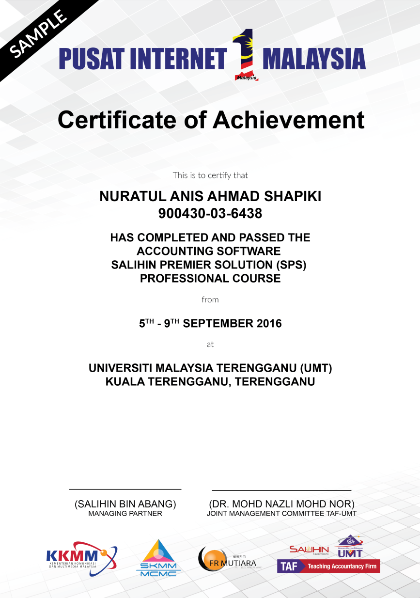

The Proposal
SPS Training And Certifications
Salihin’s Training & Certification Program entail an aggressive educational program that tests the level of competence in the principles and practices of proper business documentation and Financial Management
The Certification will only be issued to participants whom passed the exam, while others will be issued the participation certificates.
These principles and practices are closely monitor by our TAF Partners.
Notes:
Font Type: Open Sans Light
Font Size: Content (36)
Please insert the details (in red) accordingly.

Slide 21
The Proposal
SPS Training Modules & Syllabus
DAY | TRAINING MODULES | METHOD OF TRAINING | SYLLABUS
1. | Basic Business Documentation | Class Room | Basic of business documents Components of business documents Quotation, Invoice, Delivery Order, Payment Vouchers
 | SPSLite | Class Room | Basic accounting concepts Objective of book keepings How to operate SPSLite How to produce basic financial report
2. | SPS Accounting | Class Room | Company Setup, User Setup, User Access Right Chart of Account General Setup & Financial Year Calendar SPS Full Set (Sales, Account receivables, Other payment, GST & Financial Report Modules)
3. | Revision | Class Room | Basic Documentations, SPSLite & SPS Full Accounting.
 | Online Examination | Class Room | Basic Documentations, SPSLite & SPS Full Accounting.
Notes:
Font Type: Open Sans Light
Font Size: Content (36)
Please insert the details (in red) accordingly.

Slide 22

The Proposal
Continuous Learning
SPS Continuous Learning Platform provide KKLW’s entrepreneurs a learning opportunities & continuous upskilling opportunities.
  It consists of a short, free, high quality, self-directed, support focused functions and activities for KKLW’s entrepreneurs to go for an extra miles in SPS Product Offerings as well as professional and personal development.
  Courses are developed by SPS subject matter experts and participation academician from our TAF participating universities.
  The Learning platform is made available at all times for all KKLW’s entrepreneurs.
The 3 days education/ training program it’s not perceived only as 3 days training program, but it is essentially a 3 days fundamental training program + 5 years of continuous learning.
Online
Seminar
Online
Training
Online
Tutorial
Online
Exam
Online
Support
Notes:
Font Type: Open Sans Light
Font Size: Content (36)
Please insert the details (in red) accordingly.

Slide 23
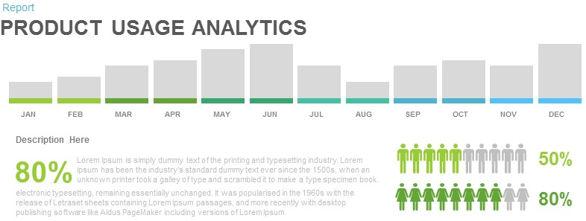
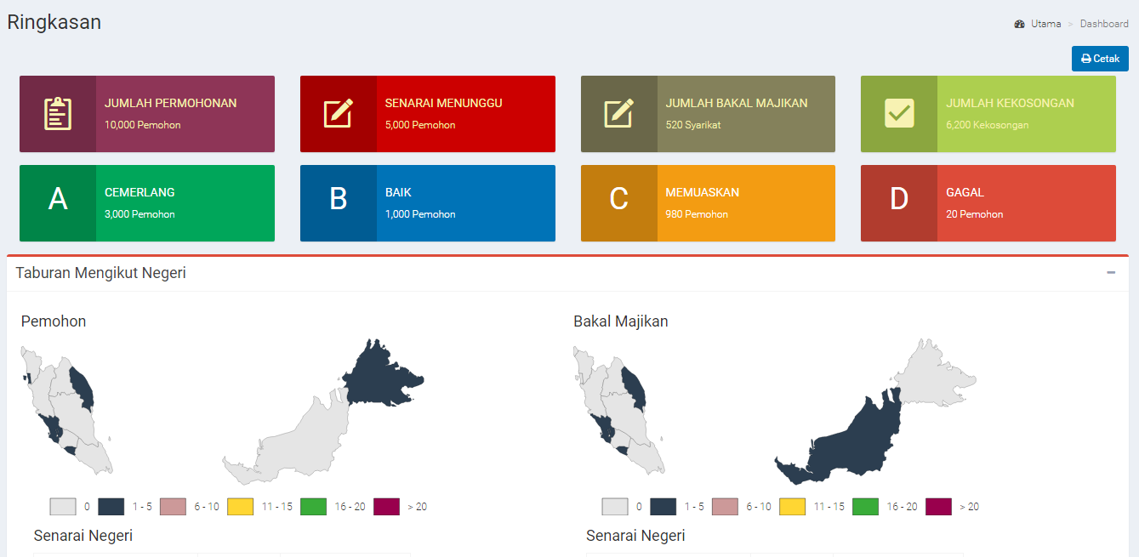
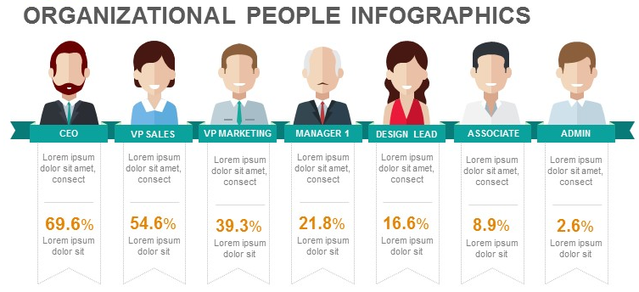
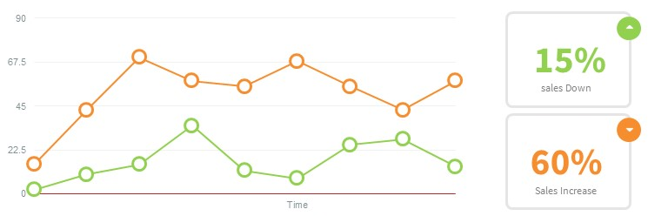
The Proposal
Big Data and Intelligence Dashboard
SAMPLE
SAMPLE
SALIHIN will provide to KKLLW Big Data and intelligence information as part of deliverables scope to ensure the success of the program and to patronized entrepreneurs better by understand the pertinent information.
Notes:
Font Type: Open Sans Light
Font Size: Content (36)

Slide 24





The Proposal
Commercial Mileage
In the spirit of business collaboration between SALIHIN and KKLW, we will support KKLW by introducing event that would give additional value and embrace entrepreneurship’s spirit amongst the rural communities.
KKLW BUSINESS AWARD
Joint program between
KKLW – SALIHIN
KKLW is required to share the success stories of business & entrepreneurs on monthly basis in Utusan/ Sinar Harian. (subject to negotiations terms & conditions between us and respective parties).
SALIHIN will do the selection of the SME award winner lists based on good financial management & governance, audit & financial report and KKLW’s internal criteria.
An event will be held to celebrate the winners.
Award will be sponsored by SALIHIN.
SALIHIN will sponsor the 1st year event and entrepreneurs segment in Utusan/ Sinar Harian.
Support By:
Notes:
Font Type: Open Sans Light
Font Size: Content (36)

Slide 25

The Proposal
SALIHIN Deliverables
KKLW Entrepreneurs Awards Event
with
Media Coverage in Major Malay Newspaper (Schedule and Timetable – TBD)
5 Years FREE Access to SPS E-Learning Platform
Webinar
Online Tutorial
Online Training
Online Exam
Online Support
5,000 SPS Certifications & Accreditations
-Endorsed by Reputable Bodies-TAF.
250 @ 3 Days Training Sessions in 2 years
(5 Zones)
5,000 SPS Accounting License for 5 Years
Notes:
Font Type: Open Sans Light
Font Size: Content (36)

Slide 26

The Proposal
Expected Improvement
Market Indication
IT Adoption Rate
Business Transaction
Demand & Supply
Market Positioning
Better Business Presence
Strategic Decision
Business Collaboration
Financial Literate
Growth & Expansion
Industries Relevancy
Business Performance
Market & Product Trends
Real Data
Proactive Action
Holistic Approach
Focused
Reporting
Training
Consultations
Monitoring
Notes:
Font Type: Open Sans Light
Font Size: Content (36)

Slide 27









The Proposal
Benefit to KKLW
GTP KPI
5
Comply with Bumiputera Agenda as set out in Government Transformation Program Agenda
NBOS KPI
4
Active participations and support from industries
(UMT/ UiTM/ UniKL TAF)
TECHNOLOGY
ADOPTION
3
New technology adoption as outlined in TN50
EMPLOYMENT
OPPORTUNITIES
2
New employment and job creation for Bumiputera’s graduates, mostly in rural area
BUSINESS
EMPOWERMENT
1
Foster and empower business in rural area via good financial governance and best business practice.
Notes:
Font Type: Open Sans Light
Font Size: Content (36)

Slide 28

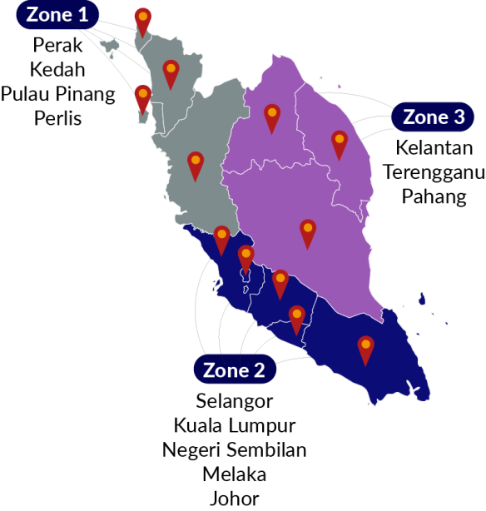

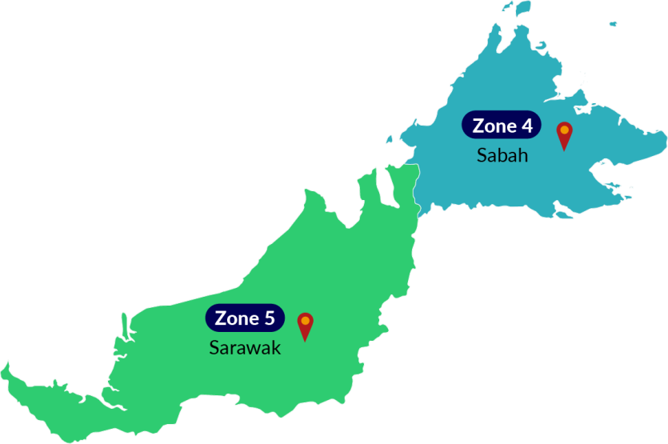



The Proposal
Training Zoning And Mapping
5
Training Team
5
Zone
2 Days Training +
½ Day Revision +
½ Day Exam
250
Targeted
Training Sessions
5
Training Team
(3 Pax per team)
Notes:
Font Type: Open Sans Light
Font Size: Content (36)

Slide 29






The Proposal
Expected Outcome
5,0000
Software License
1,000
New Employment Creation
Big Data
Analysis & Insights
Proper
Financial Account
Foster
Business Networking
Reshape
Bumi Entrepreneurs
NBOS
Anticipated Approach
GTP
Empowerment Agent
TAF Certification Endorsement
PI1M SME Award
Manual
SPS, SPSLite & SPS Entrepreneur Web
Training Hand Out & Stationeries
Notes:
Font Type: Open Sans Light
Font Size: Content (36)

Slide 30
The Proposal
Method of Statement
Mapping/ garner the critical support from KKLW, MARA, KEJORA, KEMAS, KEDA, JAKOA, KETENGAH, KESEDAR, FELCRA and RISDA.
To get the anticipated entrepreneurs list from KKLW and participating agencies
Mapping anticipated entrepreneurs based on zone.
Zoning by 5 Zone
START
Preparation of meeting agenda to discuss on any pre & post training development
Preparation of schedule plan during the design & operation phase.
To prepare the safety guideline and all the appropriate acts.
To prepare a team to do the site survey on each training site to clarify on site accessibility, capacities, facilities & other issues
1
2
Preparation of logistic arrangement by team according to an agreed schedule planning.
Arrangement of accommodation and lodging by zone.
Preparation of meals, site, training kits, schedule & program.
Arrangement of marketing & promotion
Entrepreneurs arrangement and confirmation with respective participating parties.
3
Preparation of bi-weekly report
Preparation of monthly report
Preparation of quarter report
The report consist of attendance record,
Activities program and Status of participant
Submission report to client for approval
4
FINISH
Notes:
Font Type: Open Sans Light
Font Size: Content (36)

Slide 31
Project Director
TBA
Training Manager
TBA
Contract Manager
TBA
Project Manager
TBA
Training Supervisor
TBA
Project Executive
TBA
Project Supervisor 1
TBA
Training Team 5
TBA
Training Team 4
TBA
Training Team 3
TBA
Training Team 2
TBA
Training Team 1
TBA
Project Supervisor 2
TBA
Project Supervisor 3
TBA
Project Supervisor 4
TBA
Project Supervisor 5
TBA
Admin & Finance
TBA
The Proposal
Project Management Team
NOTE:
Total = 67 Pax
Management = 4
Executive = 8
Helpdesk Support = 30
Field Team = 15
IT Support = 10
Notes:
Font Type: Open Sans Light
Font Size: Content (36)

Slide 32
The Proposal
Proposed Job Description & Responsibilities
POSITION | JOB DESCRIPTION
PROJECT DIRECTOR | To liaise & follow-up with MOA project status To be a lead on Project Steering Committee Meeting To make sure that the project follow according to the schedule & planning
PROJECT MANAGER | To lead and manage the project meeting and deliverables Liaise with internal or external parties regards to the project deliverables Attending Project Steering Committee Meeting
CONTRACT MANAGER | To liaise with bank, Funder, Loan Institution, Insurance, company secretary To prepare project contract & related document Monitoring on project costing Liaise with Authorities Attending Project Steering Committee Meeting
CONTENT MANAGER | Responsible on the content including training module Planning & conduct the training session by classroom, Web based training, Online training, mobile video training Develop technical solution for customer issues related to software setup and configuration Delivered technical support service
PROJECT SUPERVISOR | To monitor movement all project coordinator following the schedule as per agreed To prepare monthly report & related documents To attend all related meeting i.e Project Coordination meeting & Project Contractor Meeting Responsible on arrangement of training session to be in good order i.e F&B arrangement, logistics, lodging and training schedule are in place Provide technical assistance and guidance during training and execution plan implementation Prepare the work flow
Notes:
Font Type: Open Sans Light
Font Size: Content (36)

Slide 33
The Proposal
Proposed Job Description & Responsibilities Con’td
POSITION | JOB DESCRIPTION
PROJECT EXECUTIVE | To monitor movement all team following the schedule as per agreed To check & prepare report on project costing To attend all related meeting etc Project Coordination meeting & Project Contractor Meeting
PROJECT COORDINATOR | To monitor on team movement training implementation To prepare weekly report, monthly report and service & maintenance report To assist on training session arrangement To liaise with MOA regional officer Attending project contractor meeting To setup registration booth and training arrangement.
TRAINER SUPERVISOR | Responsible on the content including training module and materials To plan and supervise training session To prepare the SPS certification Attending Project Contractor Meeting
TECHNICAL & SUPPORT SUPERVISOR | Liaise with the Project Manager and the deployment team to ensure the success of the system deployment. To prepare SOP and monitor the problem and support activities Develop technical solution for customer issues related to software setup and configuration via SPS Helpdesk Attending Project Contractor Meeting
TRAINER | Conduct training session Conduct SPS exam Assist and support Web based training, Online training and mobile video training Assist SPS Helpdesk
Notes:
Font Type: Open Sans Light
Font Size: Content (36)

Slide 34



The Proposal
Key Meeting and Coordination Strategy
Review the monthly statistics report such as licences issuance, training, collections, outstanding claims, schedule, program, modules, syllabus, assessment, event etc.
Review on timeline progress project
Review on weekly report
Discussion on any other matters related to this program & activities.
Review on deployment activities and problem arise
Discussion on project enhancement activities
Review on resources, vehicle & training tools & necessary items
Notes:
Font Type: Open Sans Light
Font Size: Content (36)

Slide 35
The Proposal
Steering Committee Proposed Agenda
PROPOSED TEAM MEMBERS | FREQUENCY | MEETING AGENDA
Representative from MOA Representative from Participating Agencies (MARA, KEDA, KETENGAH, KESEDAR, RISDA, JAKOA, FELCRA & KEJORA) Representative from SALIHIN | Once every 4 month | Review the monthly practice statistics such as production, adjustments, collections, outstanding claims, unscheduled time units, production by provider, daily production averages, etc. Review the incomplete action items from the previous month(s) and check for progress Discuss the new agenda items
Notes:
Font Type: Open Sans Light
Font Size: Content (36)

Slide 36
The Proposal
Project Coordination Committee Proposed Agenda
PROPOSED TEAM MEMBERS | FREQUENCY | MEETING AGENDA
Representative from MOA Regional Officers Representative from Participating Agencies Regional Officers (MARA, KEDA, KETENGAH, KESEDAR, RISDA, JAKOA, FELCRA & KEJORA) Representative from SALIHIN | Once a month | Project Status Regional Training Performance Report Review Any other matters
Notes:
Font Type: Open Sans Light
Font Size: Content (36)

Slide 37


The Proposal
Reporting Deliverables
TRAINING ZONE
01
East
02
South
03
North
04
KKLW
Entrepreneurship
Empowerment Program
Sabah
Progress Report
05
Sarawak
Reporting consist of Weekly, Monthly, Quarterly & Yearly
(Attendance, Activities, Training, Exam, Certification & Other’s Report )
Notes:
Font Type: Open Sans Light
Font Size: Content (36)

Slide 38

The Proposal
Progress Report -Sample
Progress Report will be submitted to KKLW on monthly basis.
It consists of:
Project Details
  Project name, start date, dates covered by report, project manager, project
  ownership.
Project Status
  Comparison of original completion date and budget with latest forecast.
Tasks and work completed during period
Tasks and work expected to be completed during the next period
Issues, problems and risks that affect the project
Actions to be taken by sponsor and others
Notes:
Font Type: Open Sans Light
Font Size: Content (36)

Slide 39
The Proposal
Program Process Flow
Participant Fill in a KKLW Enterprise Empowerment Program Registration Form
Registration
- By online & Social Media
By walk in to KKLW or Agencies Office Nationwide
By Booth event / Road show
If No
Check Participant
Status
If Yes
Reschedule For Next Training
Confirm
Training Dates &
Location
KKLW SME Award Nights*
Organize by Salihin
Launch by KKLW
N/B: Dates & location to be assigned during Steering Meeting
Helpdesk to Counsel & Assists the Unsuccessful Participant
Training Class
If No
If Pass
Access to Continuous SPS
E-Learning Platform
Received Certificate
Notes:
Font Type: Open Sans Light
Font Size: Content (36)

Slide 40
The Proposal
Time Frame & Deliverables
NO | TASK NAME | YEAR 1 |  |  |  |  |  |  |  |  |  |  |  |  | YEAR 2 | YEAR 3 3 | YEAR 4 | YEAR 5
 |  | M 1 | M 2 | M 3 | M 4 | M 5 | M 6 | M7 | M8 | M 9 | M10 | M 11 |  | M 12
1 | Pre-Development
1.1 | Received LOA/Performance bond / Contract
1.2 | Preparations & approval of Documentation
1.3 | Advertising & promotion
1.4 | Procurement, delivery & Installation of SPS System (Hardwares / Softwares)
1.5 | Commissioning & Handover Pi1M
1,6 | Maintenance Support
2 | Post-Development
1.1 | Training Support
2.2 | * Training support & consultation
* Training support ;
Webinar, / Video Training & Tutorials / Online Training Material / Online Test & Examination / Online Certification
Notes:
Font Type: Open Sans Light
Font Size: Content (36), Date (32)
Please change red font accordingly.
Please insert the date and name of company (in red) accordingly

Slide 41
The Proposal
Financial Investment Consideration
TOTAL INVESTMENT BY KKLW for RURAL ENTREPRENEURSHIP FINANCIAL LITERACY EMPOWERMENT PROPOSAL | RM 44,162,500.00
The financial considerations are includes an attractive value-for-money proposition to the KKLW which includes:-
Installations, commissioning and maintenance of SPS-Lite Cash-Book Cloud Base software license for 5,000 participants (including SPS Entrepreneurs Web) inclusive of five (5) years extended software license.
Anticipated approximately 250 no. of trainings program within 1 years.
Inclusive of five (5) years of free access to SALIHIN’s Continuous Learning Platform (Webinar, On-line Tutorial and Training materials).
Inclusive of five (5) years of free access to SALIHIN Business Networking & Matching Platform.
Inclusive of five (5) years of free on-line support (helpdesk).
Inclusive certification and endorsement by SALIHIN’s partner in Teaching Accounting Firm (TAF).
Anticipated 1st Year Full Sponsored KKLW- SALIHIN SME Award Event ( 1,000 pax Expected).
Anticipated resources of:
  Management: Five (6) persons.
  Coordinator: five (5) persons.
  Trainers: Ten (10) persons.
  Helpdesk Support: Thirty (30) persons.
  Webinar: Three (3) persons.
  Online Learning Platform: Three (3) persons.
  Job Matching Platform: Three (3) persons.
  Marketing: One (1) person.
  Social Media: One (1) Person.
  Project Secretary: Two (2) Person.
Notes:
Font Type: Open Sans
Font Size: Engagement’s content (36)
Attention: You may add additional row/slide depending on your needs.
In the case of progress fee, you may use this phrase: *The fees are based on deliverables at each stage of advisory work.

Slide 42
The Proposal
Breakdown Costing
Details | Cost Per Unit (RM) | Unit/ Days | TOTAL (RM)
Training Centre | 12,500.00 | 250.00 | 3,125,000.00
Salaries/ Allowance | 750.00 | 750.00 | 562,500.00
Travelling | 1,000.00 | 250.00 | 250,000.00
Accounting Software | 2,890.00 | 5,000.00 | 14,450,000.00
Online Services | 250.00 | 5,000.00 | 1,250,000.00
Support | 4,900.00 | 5,000.00 | 24,500,000.00
Certifications | 5.00 | 5,000.00 | 25,000.00
TOTAL SUM | 44,162,500.00
Notes:
Font Type: Open Sans
Font Size: Engagement’s content (36)
Attention: You may add additional row/slide depending on your needs.
In the case of progress fee, you may use this phrase: *The fees are based on deliverables at each stage of advisory work.

Slide 43
The Proposal
Personal Data Protection and Retention of Documents
  All personal data and sensitive information obtain through the engagement shall be treated in accordance with the general principles of the Personal Data Protection Act (PDPA) 2010.
  All working papers and reports would be retained at our expense for a seven (7) years unless SALIHIN is notified in writing by KKLW of the need to extend the retention period.
  SALIHIN respects the privacy of its clients. Consistent with our strict code of ethics, all information regarding KKLW will be held in the strictest of confidence. Violations would compromise our integrity.
Notes:
Font Type: Open Sans
Font Size: Engagement’s content (36)
Please edit accordingly (red)
Attention: You may add additional row/slide depending on your needs.
In the case of progress fee, you may use this phrase: *The fees are based on deliverables at each stage of advisory work.

Slide 44
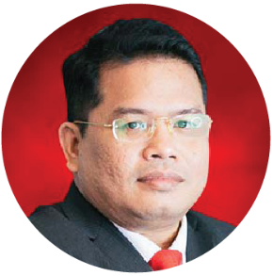
The Proposal
Engagement Team Leadership
Approved Company Auditor under Ministry of Finance (MoF)
Approved Tax Agent under Ministry of Finance (MoF)
Approved Cooperative Auditor under Malaysian Cooperative Commission
Chartered Accountant CA (M) with Malaysian Institute of Accountant (MIA)
Elected Council Member of the MIA
Member of MIA's Investigation Committee (Statutory)
Member of MIA's Taxation Practice Committee (Technical)
Member of MIA's Public Practice Committee
Member of MIA's Small & Medium Practice Committee (SMPC)
Elected President of Malaysia Accounting Firm’s Association (MAFA)
Fellow Member of Chartered Tax Institute of Malaysia (FCTIM)
Associate Member of Certified Public Accountant (CPA Australia)
Member of Malaysian Association of Certified Financial Planner (CFP)
Certified GST Agent and Trainer
Executive committee member of Malay Chartered Accountants Firms Malaysia
Executive committee of Malaysian Association of Tax Accountants
Bachelor and Master Degree holder in Accounting from International Islamic University Malaysia
Salihin Abang
Managing Partner
“Experienced/specialised in auditing & assurance services for the past 15 years” (Please edit according to the relevant engagement/project)
Notes:
Attention: Please edit accordingly.

Slide 45
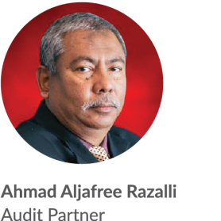
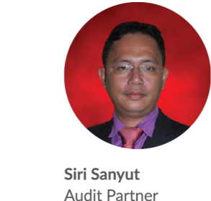
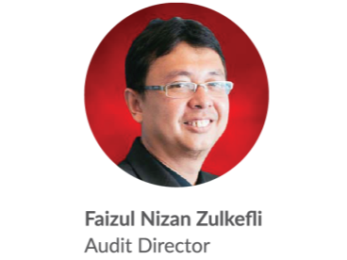
The Proposal
Engagement Team Leadership (Cont.)
Approved Company Auditor Under the Companies Act 1965
Approved Cooperative Auditor from Malaysian Cooperative Commission
Member of Malaysian Institute of Accountants (MIA)
Bachelor of Accounting from Universiti Teknologi MARA
Master Degree in Accounting and Finance from Stirling University, the UK
Approved Company Auditor Under the Companies Act 1965
Approved Cooperative Auditor from Malaysian Cooperative Commission
Member of Malaysian Institute of Accountants (MIA)
Associate with Chartered Tax Institute of Malaysia (CTIM)
Bachelor of Accounting from Universiti Malaysia Sabah (UMS)
Member of Malaysian Institute of Accountants (MIA)
Bachelor of Accounting from International Islamic University Malaysia (IIUM)
Notes:
Font Type: Open Sans Light
Font Size: Content (28)
Attention: Please insert the details of the project team members appropriately.
Directory: Pictures can be obtained from PUBLIC/SALIHINAlbum/ProposalPictures (Audry’s Action)

Slide 46
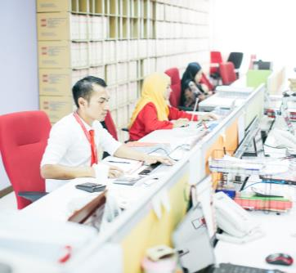

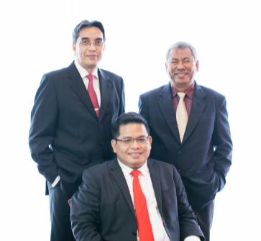
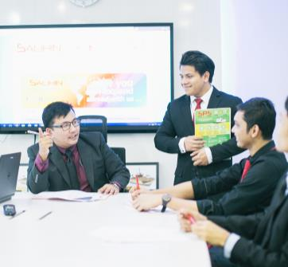
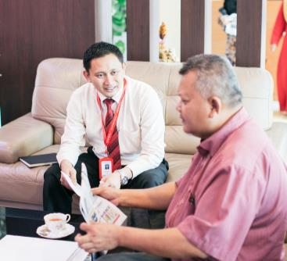
The Proposal
WHY SALIHIN ?
The following are key reasons why SALIHIN should be your firm’s preferred choice:
01.
Experienced Employees
We have the right ‘hands-on’ team with vast knowledge and relevant experience.
02.
Comprehensive Reports
We would be able to provide complete and comprehensive reports in tandem to your key areas of concern.
03.
Quality Service Delivery
Our Engagement Partner, Board of Advisors and Managers will be involved in closed co-operation for quality service delivery.
04.
Value for Money
We offer ‘value for money’ without compromising on the quality and timeliness of our services.
05.
Minimal Disruption
We will apply our considerable experience to ensure minimal disruption to clients’ daily operations.
Notes:
Attention: Please don’t change any content here. Thank you very much ☺

Slide 47
The Proposal
WHY SALIHIN ?
The following are key reasons why SALIHIN should be your firm’s preferred choice:
Commitment
Our mission emphasizes responsive personal attention to help you fulfill your mission and achieve your goals. Our team works with you in an integrated fashion, and we are committed to:
Performing the work within a timeframe mutually agreed upon between KKLW and SALIHIN.
Timely, prompt and responsive attention. We encourage the entire client service team to act proactively.
A strategic, organized approach to engagement management.
A job done efficiently and at a commensurate price - with minimal disruption to your staff and/or office procedures.
Philosophy
We hold ourselves accountable to a very high standard of behavior. We always focus on doing the right thing regardless of how it “sells”. Our accountability philosophy has been the cornerstone of SALIHIN, it has guided our growth for over 14 years and will continue to guide future growth and practice.
Notes:
Attention: Please change the name of the co accordingly.

Slide 48

Contact Us
Primary Contact Person
Name:
Position:
Contact No.:
Email:
Selangor
—
Headquarters
555, Jalan Samudra Utara,
Taman Samudra,
68100 Batu Caves,
Selangor Darul Ehsan.
Tel: +603-6185 9970 (Hunting Line)
Fax: +603-6184 2524
Email: info@salihin.com.my
Sarawak
—
Lot 506, Floor Section 1,
KTLD Jalan Kulas Tengah,
93400 Kuching, Sarawak.
Tel: +6082-240 378
Fax: +6082-240 359
Email: salihinkuching@salihin.com.my
Johor
—
No. 17-02, Jalan Kolam Air 1,
Taman Nong Chik Heights,
80100 Johor Bahru,
Johor Darul Takzim.
Tel: +607-207 1728
Fax: +607-207 1729
Email: info@salihin.com.my
Terengganu (TAF)
—
School of Maritime Business & Management,
Universiti Malaysia Terengganu (UMT),
21030 Kuala Terengganu,
Terengganu Darul Iman.
Tel: +609-668 3674
Fax: +609-668 3498
Email: taf.umt@salihin.com.my
Follow us on social media
Notes:
Please insert primary contact person accordingly.

Slide 49
www.salihin.com.my | www.salihinpremier.com
Careline: 1 300 88 5678
Notes:
Attention: Please don’t change any content here. Thank you very much ☺

