Slide 1



SPS E-Voting Proposal
Enabling Computerized Voting & Ballots Practice in the Information Edge
PREPARED BY:
SUBMITTED TO:
Salihin Business Management Sdn. Bhd.
Koperasi Tenaga Nasional Berhad
Notes:
Font Type: Open Sans
Font Size: Proposal Title (60), Proposal Details (40)
Business unit & Client logo: Small size

Slide 2
1.0 Executive Summary
There is a need to update voting and ballot business process and methodologies to improve trust, reliability, and convenience for cooperative bodies and other related organizations in the information edge. The objective of this proposal is to provide a computerized voting and ballot system, which would re-visualized the business process of conventional ballot. By the introduction of electronic voting system, we believe it would bring a major leaps and benefits as outlined below.
Privacy - Keeping an individual’s vote secret
Eligibility - Allowing only registered voters to vote, with each such voter voting only once
Hiding interim results - Partial results should not be released during the voting period
Verifiability - The ability to trust the vote tallying process
Receipt-Freeness - Voters should be unable to prove to a third party that they voted in a particular way. This is required to prevent coercion
Convenience - Voters must be able to vote easily, and everyone who is eligible must be able to vote
Notes:
Font Type: Open Sans
Font Size: Executive Summary Content (36)

Slide 3
Table of Contents
1.0
Executive Summary 2
2.0
About Us 4
3.0
The Proposal 12
4.0
Contact Us 32
Notes:
Font Type: Open Sans Light
Font Size: Table of Content (44)
Attention: Please change the table of content and page numbering accordingly. Thank you very much ☺

Slide 4
1.0 About Us
About Us
—
SALIHIN
1.0 About Us
Key Management Team
About Us
  Services
  Our Diverse Clients
Notes:
Font Type: Open Sans (Bold)
Font Size: About Us (60)

Slide 5



About Us
Founded in 2002, SALIHIN is the brand name of a group of independent and separate legal entities, deploying wide spectrum of capabilities to help clients see and tap opportunities in the areas of transaction and corporate finance, taxation (direct tax and GST), auditing and assurance, shariah auditing and advisory, corporate governance, IT consultancy and business accounting solution.
As one of the fastest growing home-nurtured and bumiputera firms, SALIHIN is having close to 200 competent professionals from different background with diverse thoughts, expertise and experience serving in 9 offices nationwide. In addition to relevant licenses/certifications for its capabilities, SALIHIN is having MSC Malaysia Status and 1-InnoCERT certification, Licensed Tax Agent and GST Tax Agent, Licensed Capital Market Services as well as Shariah Advisory by Securities Commission. SALIHIN is also a Registered Public Interest Entities Auditor by Audit Oversight Board (AOB), a Registered Auditor with PPK Accountants in the UK, an approved Cooperative Auditor with Suruhanjaya Koperasi Malaysia (SKM), an Approved Training Provider by Human Resources Development Fund (HRDF). Additionally, SALIHIN is a member of i2an, a global network of accountants based in Paris and has won Enterprise 50 (E50) Awards in 2010.
We have a proven track record credited to a sustained quality service delivery to our clients without compromising our professional integrity. SALIHIN continues to build on its successes. It became the first in the world to introduce Teaching Accountancy Firm (TAF) to bridge the gap between accountancy theory and practice.
Vision
To become the preferred national accountancy firm of Malaysia.
Mission
SALIHIN is dedicated to creating value by focusing on customer satisfaction and growth, excellent internal business process and superior human capital resource development.
Notes:
Attention: Please don’t change any content here. Thank you very much ☺

Slide 6
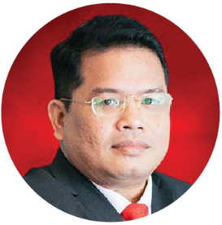
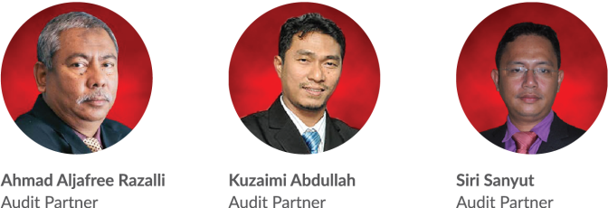
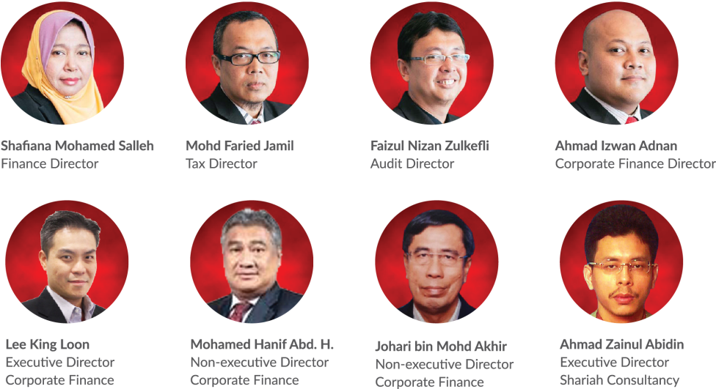
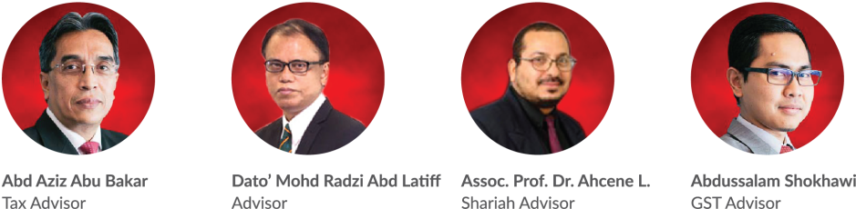
About Us
Key Management Team
Salihin Abang
Founder/Managing Partner/CEO
Notes:
Attention: Please don’t change any content here. Thank you very much ☺

Slide 7
About Us
Services
SALIHIN offers wide spectrum value for money services:
AUDIT & ASSURANCE
GST & BUSINESS
ACCOUNTING SOLUTION
GST ADVISORY
Statutory Financial Statement Audit
Review Engagements
Compilation Engagement
MPERS / MFRS Training
Agreed Upon Procedures
Preparation & Submission: GST-03
GST Accounting and Review for users of SPS
Preparation of Full Sets Accounts
Preparation of Management Account or Reports
Forensic Accounting
GST Strategic Planning
Cash Flow Planning & Pricing Strategy
GST Bad Debt Management
GST Record Keeping and Internal Control
GST Special Transaction
GST-IT Advisory
Transfer of Going Concern
GST Audit and Investigation
Advice on GST Ruling & Appeal
GST-03 Monthly Submission Review
Monitoring TAP System
GST Annual Adjustment
GST Training & Education Services
GST Accounting Software
DIRECT TAXATION
Mergers and Acquisition Tax Advisory
Corporate Tax Compliance and Planning
Transfer Pricing Advisory
Transfer Pricing Documentation
Tax Audit, Investigation & Appeal
International Tax Consulting
Real Property Gain Tax
Tax Accounting
Tax Risk Management
Notes:
Attention: Please don’t change any content here. Thank you very much ☺

Slide 8
About Us
Services (Cont.)
SALIHIN offers wide spectrum value for money services:
GOVERNANCE &
CORPORATE SECRETARIAL
IT CONSULTANCY
SHARIAH AUDIT & ADVISORY
Islamic Banking Product Structuring
Islamic Securities: Sukuk Issuance & Structure
Islamic Wealth Management Advisory
Islamic Private Equity Advisory
Establishment of Islamic Bank
Zakat & Waqf Accounting Software (SPS)
Shariah Compliance Training Program
Shariah Training & Education, Research & Development
Shariah Internal & External Audit, Review & Screening
Shariah Risk Management
Shariah Legal Advisory
Shariah Governance & Supervision
IT Audit & Due Diligence
IT Governance and Planning
IT Project Management
IT Risk Management
IT Strategy and Assessment
Business Intelligence
IT Sourcing/Outsourcing
Enterprise Resource Planning (ERP)
Software Development and Customization
TRANSACTION & CORPORATE FINANCE
Internal & Forensic Auditing
Enterprise Risk Management
Due Diligence & Business Valuation
Financial Statement Analysis
Raising Seed/Start-Up Capital
Agreed Upon Procedures
Management Buy-In(MBI) / Buy-Out (MBO)
Project and Infrastructure Finance
Pre and Post IPO Advisory
Raising and Restructuring of Debt
Governance and Compliance Advisory
Merges, Acquisition and Demergers
Notes:
Attention: Please don’t change any content here. Thank you very much ☺

Slide 9

About Us
Services (Cont.)
Notes:
Attention: Please don’t change any content here. Thank you very much ☺

Slide 10








































About Us
Our Diverse Clients
SALIHIN serves diverse clients including corporate companies, foundations / non-profit organisations, government bodies, government linked companies and educational institutions. Their diversity spans across different sectors of the economy.
Notes:
Attention: Please don’t change any content here. Thank you very much ☺

Slide 11




About Us
Our Local & International Networks
Buenos Aires
Mexico
Boston
Los Angeles
Miami
New York
San Francisco
Europe
MALAYSIA
Batu Caves
Johor Bahru
Kuching
Kuala Terengganu (TAF)
SALIHIN is a member firm of i2an,
a reputable global network of accountants which have presence in America, Asia and Europe as well as all the international financial centres.
Vienna
Brussels
Limassol
Paris
Frankfurt
Milan
Rrome
Luxemborg
Bucharest
Moscow
Barcelona
Madrid
Lausanne
Rotterdam
London
Kyiv
Asia
Shanghai
Hong Kong
Tokyo Kuala Lumpur
Singapore
Dubai
Sydney
New Delhi
Ramat Gan
Taiwan
America
Our Local Branches
Notes:
Attention: Please don’t change any content here. Thank you very much ☺

Slide 12
The Proposal
—
Rural Entrepreneur’s Financial Literacy Empowerment Proposal
2.0 The Proposal
Current Business Scenario
What We Offer
Competitive Benefits
How System Works – Admin’s Page View
How System Works – Voter’s Page View
Investment Consideration
Why SALIHIN?
Notes:
Font Type: Open Sans & Open Sans Light
Font Size: The Proposal (60), Content (36)
Proposal Title’s Example (at the right-top of the red box) : Audit Proposal (For Audit Dept.) or GST Proposal (For GST Dept.)

Slide 13


The Proposal
Current Business Scenario
Generally a voting system is one of the platform that normally being used by most countries, companies, agencies or associations when it comes to elections day.
From our observations, method of voting process mostly still used traditional way which is manual process. These method are acceptable but fall short in this age of Information and Technology, it will lead to slow process, fraud in the voting and the voting results are less accurate and unsafe.
The major problem with the current system process involve a lot of manual operations which prone to errors.
Notes:
Font Type: Open Sans Light
Font Size: Content (36)
Content suggestion: Client and proposal background.

Slide 14
The Proposal
Current Voting Process Loop Hole
01
SPOILED BALLOT
LONG WAITING
05
The manual vote counting process is very time consuming, long waiting and number of resources to count and check the bill one by one.
Faulty voting by voters due to error or last minute changes the selection of candidates.
02
EXPENSIVE
FRAUD VOTING
04
The preparation of traditional method are very expensive because using a lot of paper, ballot boxes and printing materials.
Voting environment can be set to close network only for pre-determined terminal to reduce access and avoid fraud voting
03
FAULT VOTING
Numbers of fault voting are due to small technical mistakes such as mark over the border, miss count the mark.
Notes:
Font Type: Open Sans Light
Font Size: Content (36)
Content suggestion: Client and proposal background.

Slide 15




The Proposal
Proposed Solutions
STANDALONE
SPS E-Voting system is a platform that developed to cast and count votes.
It is consists of set of rules and procedures that need to be followed by voters.
Our E-Voting system also designed for flexible platform either standalone, intranet or web based online.
E-VOTING
SYSTEM
CLOUD BASED
INTRANET
Notes:
Font Type: Open Sans Light
Font Size: Content (36)
Content suggestion: Client and proposal background.

Slide 16
The Proposal
SPS E-Voting Features
FEATURES
Flexible platform. Support Standalone, Web/ Cloud and Intranet
System can be used on touchscreen LCD monitor
Real-time processing
Interactive report generation
Notes:
Font Type: Open Sans Light
Font Size: Content (36)
Content suggestion: Client and proposal background.

Slide 17
The Proposal
Competitive Benefits
Auditable and Transparent
To help reduce human errors
Faster Result
People can get officially results within hours
Secure and Accurate
Increase Accessibility
Our system also protects the secrecy of the vote.
More easier and accessible
Increase Engagement and Turnout
Encourage and increase voter turnout
Notes:
Font Type: Open Sans Light
Font Size: Content (36)

Slide 18
The Proposal
Process Flow
The voter’s need to register at registration terminal
The voter's name will be called by the officer on duty
The voter’s go to ballot terminal and give ID for verification
Voter’s start for voting and choose selection
Auditors & Secretariat will close monitor during voting process
Balloting process end
Notes:
Font Type: Open Sans Light
Font Size: Content (36)

Slide 19
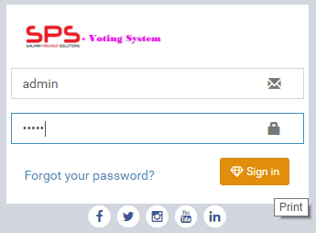
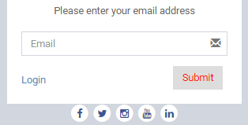
The Proposal
System Interface – Admin Page
Admin login can be access only by an authorized Administrator.
Super Administrator will provide the username and password.
If you are having problem to login, you may proceed to click the “Forgot your password?” link.
Notes:
Font Type: Open Sans Light
Font Size: Content (36)

Slide 20
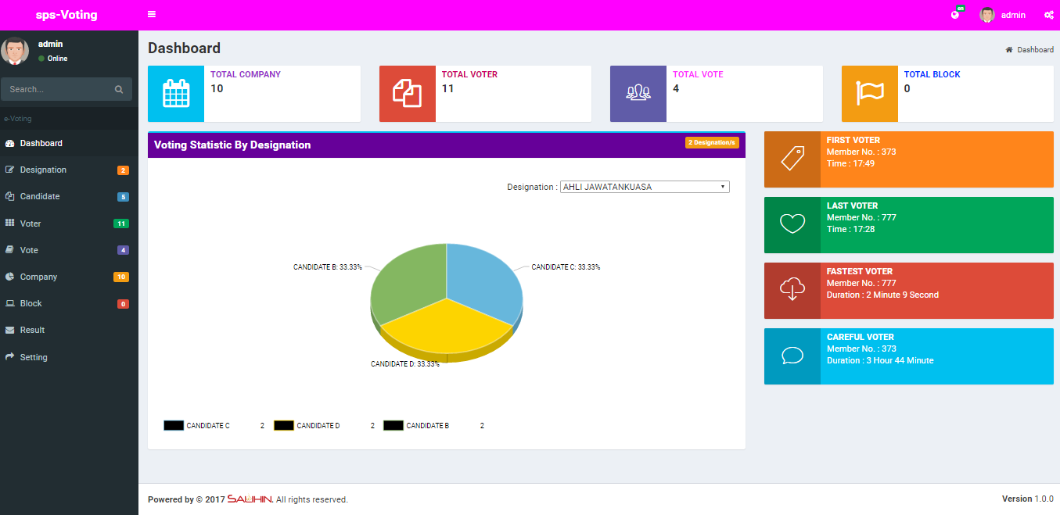
The Proposal
Main Dashboard – Admin Page
Main Dashboard will display:-
  Main Menu
  Numbers of voter, vote and user that has been block
  Voting Statistic by Designation
Notes:
Font Type: Open Sans Light
Font Size: Content (36)
Please insert the details (in red) accordingly.

Slide 21
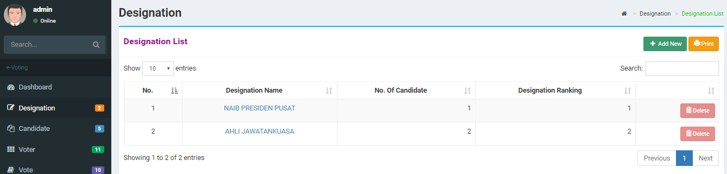
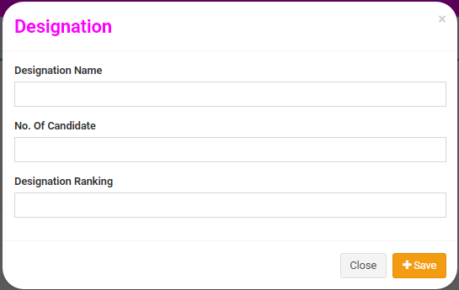
The Proposal
Designation page – Admin Page
Admin can pre-set the Designation Name and the No. Of Candidate.
The Pre-Set will follows the company rules and regulations.
To add new, admin can simply click the Add New button.
Notes:
Font Type: Open Sans Light
Font Size: Content (36)
Please insert the details (in red) accordingly.

Slide 22
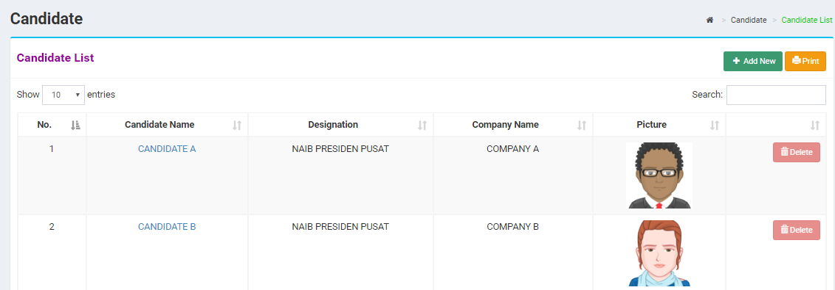
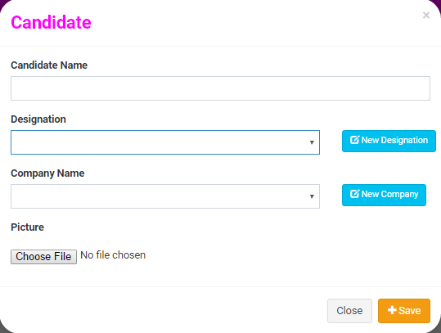
The Proposal
Add/ Edit Candidate – Admin Page
Page will display the list of candidates.
To insert new candidate information, simply click the Add New button.
Enter the Candidate Name, Designation and Company Name.
To upload candidate picture, simply click the Choose File button.
If the designation name and company not in the list, you may proceed to add new by click the blue button located in the same row of the field.
Click Save button to saved.
Notes:
Font Type: Open Sans Light
Font Size: Content (36)
Please insert the details (in red) accordingly.

Slide 23
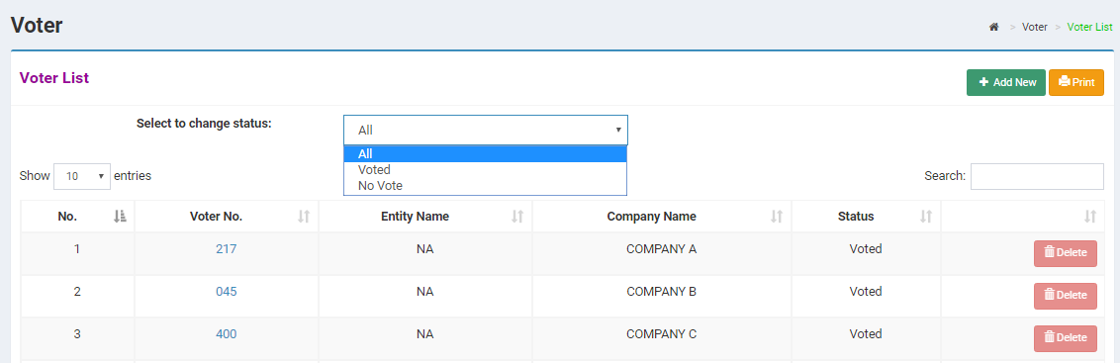
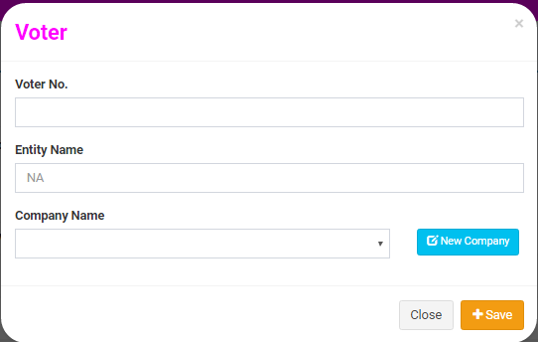
The Proposal
Add/ Edit Voter – Admin Page
Page will display the list of voters.
To insert new voter, simply click the Add New button.
If the company name not in the list, you may proceed to add new by click the blue button located in the same row of the field.
Click Save button to saved.
Admin can view the voters status by click the drop down menu.
Notes:
Font Type: Open Sans Light
Font Size: Content (36)

Slide 24
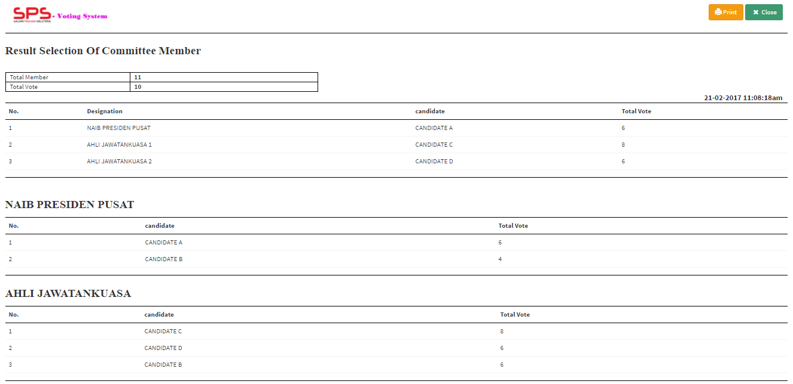
The Proposal
Result – Admin Page
Page will display the summary of the voting result.
Usually the results will be reviewed by the auditors .
Results are confidential
Notes:
Font Type: Open Sans Light
Font Size: Content (36)

Slide 25
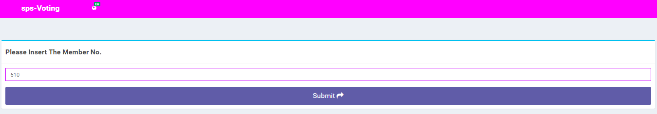
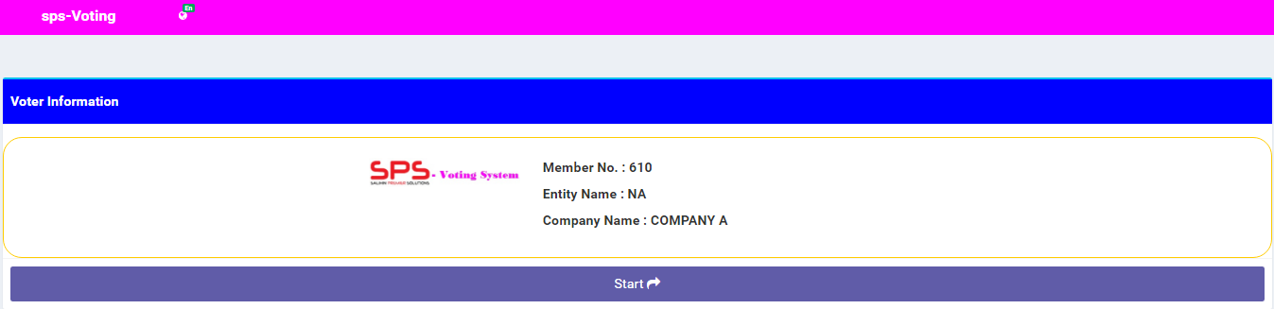
The Proposal
System Interface – Voters Page
Main interface for voters.
Voters need to read the instructions before proceed.
In this page, secretariat will enter the Membership No.
Once submitted, voter information interface will be display as shown below.
Notes:
Font Type: Open Sans Light
Font Size: Content (36)

Slide 26
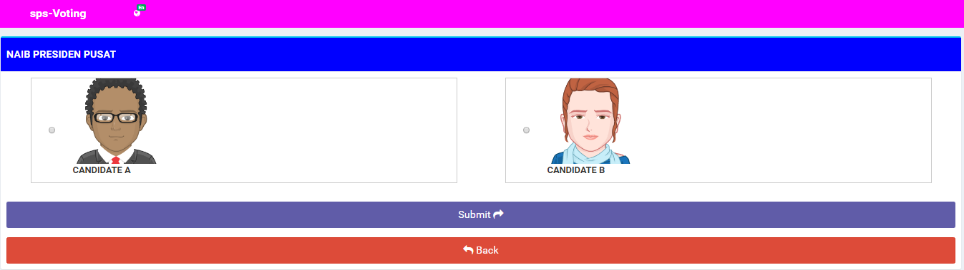
The Proposal
Candidates Listing – Voters Page
After verification of voter information has been made, click button Start to proceed.
Voters are allowed to start voting from a list of candidates.
Notes:
Font Type: Open Sans Light
Font Size: Content (36)

Slide 27
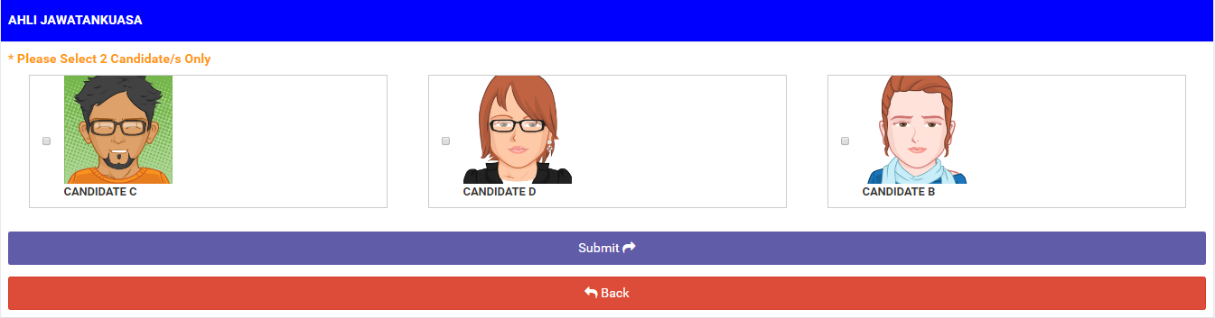
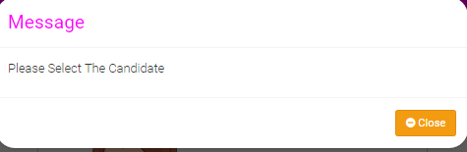
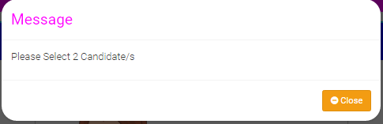
The Proposal
Candidate Listing – Voters Page
This message box will appears if voters try to skip the voting step by click Submit button.
This message box will appears when voters only select one of the candidates.
Voters need to read the instructions .
The instructions will depends on the company rules and regulations.
Notes:
Font Type: Open Sans Light
Font Size: Content (36), Date (32)
Please change red font accordingly.
Please insert the date and name of company (in red) accordingly

Slide 28
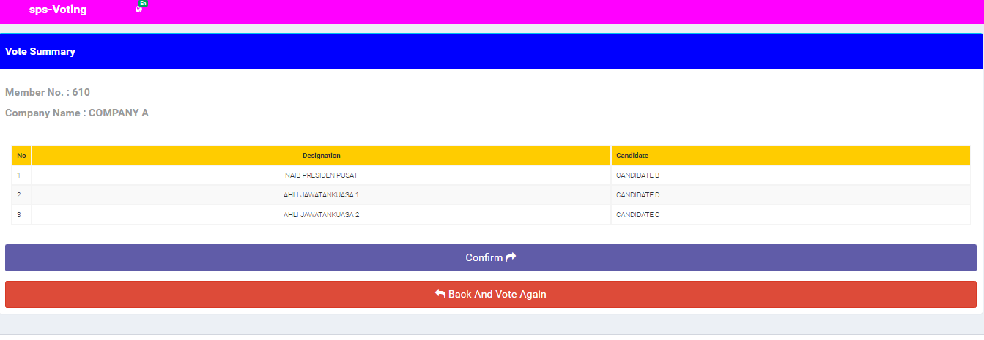
The Proposal
Voting Summary – Voters Page
This page will display the Vote Summary.
Voters can do the final review before Confirm.
If there is a mistakes, voters can click the Back and Vote Again button to start all over again.
If voters are satisfied with the results of the voting, proceed to click Confirm button.
Notes:
Font Type: Open Sans
Font Size: Engagement’s content (36)
Attention: You may add additional row/slide depending on your needs.
In the case of progress fee, you may use this phrase: *The fees are based on deliverables at each stage of advisory work.

Slide 29



The Proposal
Voting Set Up
REGISTRATION
VOTING COUNTER
1
2
3
4
5
6
7
8
9
10
Notes:
Font Type: Open Sans
Font Size: Engagement’s content (36)
Attention: You may add additional row/slide depending on your needs.
In the case of progress fee, you may use this phrase: *The fees are based on deliverables at each stage of advisory work.

Slide 30
The Proposal
Investment Consideration
INVESTMENT CONSIDERATION BY KOPERASI TENAGA NASIONAL BERHAD | RM 9,000.00
The financial considerations are includes an attractive value-for-money proposition to the KTNB which includes:-
Managed E-Voting Services
2 Staff
2 Terminal
Report (Endorsed by Auditors)
Data Entry/ Migration (TBD)
OPTIONAL INVESTMENT
RM2,500 for additional staff/ terminal
Notes:
Font Type: Open Sans
Font Size: Engagement’s content (36)
Attention: You may add additional row/slide depending on your needs.
In the case of progress fee, you may use this phrase: *The fees are based on deliverables at each stage of advisory work.

Slide 31





The Proposal
WHY SALIHIN ?
The following are key reasons why SALIHIN should be your firm’s preferred choice:
01.
Experienced Employees
We have the right ‘hands-on’ team with vast knowledge and relevant experience.
02.
Comprehensive Reports
We would be able to provide complete and comprehensive reports in tandem to your key areas of concern.
03.
Quality Service Delivery
Our Engagement Partner, Board of Advisors and Managers will be involved in closed co-operation for quality service delivery.
04.
Value for Money
We offer ‘value for money’ without compromising on the quality and timeliness of our services.
05.
Minimal Disruption
We will apply our considerable experience to ensure minimal disruption to clients’ daily operations.
Notes:
Attention: Please don’t change any content here. Thank you very much ☺

Slide 32

Contact Us
Primary Contact Person
Name:
Position:
Contact No.:
Email:
Selangor
—
Headquarters
555, Jalan Samudra Utara,
Taman Samudra,
68100 Batu Caves,
Selangor Darul Ehsan.
Tel: +603-6185 9970 (Hunting Line)
Fax: +603-6184 2524
Email: info@salihin.com.my
Sarawak
—
Lot 506, Floor Section 1,
KTLD Jalan Kulas Tengah,
93400 Kuching, Sarawak.
Tel: +6082-240 378
Fax: +6082-240 359
Email: salihinkuching@salihin.com.my
Johor
—
No. 17-02, Jalan Kolam Air 1,
Taman Nong Chik Heights,
80100 Johor Bahru,
Johor Darul Takzim.
Tel: +607-207 1728
Fax: +607-207 1729
Email: info@salihin.com.my
Terengganu (TAF)
—
School of Maritime Business & Management,
Universiti Malaysia Terengganu (UMT),
21030 Kuala Terengganu,
Terengganu Darul Iman.
Tel: +609-668 3674
Fax: +609-668 3498
Email: taf.umt@salihin.com.my
Follow us on social media
Notes:
Please insert primary contact person accordingly.

Slide 33
www.salihin.com.my | www.salihinpremier.com
Careline: 1 300 88 5678
Notes:
Attention: Please don’t change any content here. Thank you very much ☺

