Slide 1


COMPANY PROFILE

Slide 2

Summary
Name of company | HNJ Pictures Sdn Bhd
SSM Registration no | 609622-P
MOF License no | 357-02048145 (Bumiputera Status)
FINAS Licenses no | PF 04/01379 * DF 05/00839
Business Premis | No. 303-A Lrg Perak, Melawati Sq Business Centre, 53100 Kuala Lumpur.
Office Tel/Fax | Tel : +603-4108 8867 Fax: +603-4147 4022
Date Incorporated | 21ST March 2003
Authorized Capital | RM100,000.00
Paid-up Capital | RM50,000.00
Managing Director | Ahmad Al-Husna B. Abu Hassan H/P: 012-9199227 alhusna@gmail.com
Company Secretary | Khairul Ridha & Co. 238-2B Jalan Haruan 5/6, Pusat Komersial Oakland 2, 70300 Seremban, Negeri Sembilan. Tel : +606-631 2899

Slide 3


Business Activities
Types of Programmes – TV, Webtv & Video Production
 | · Capsule · Corporate Video · Documentary · Drama · Magazine Programme · News & Current Affairs · Reality TV · Talk Show · Telemovies · Training Videos · TV Commercial · Special Event

Slide 4
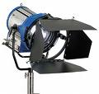
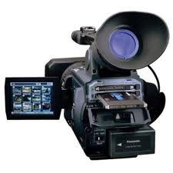
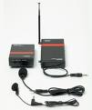




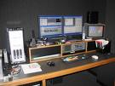

Equipment
Single Camera Production & Multiple Camera Production
 | SONY / PANASONIC HDV HD
Non-linear Editing System
 | FCP EDIUS 5

Slide 5

Clientele
Companies
ABX EXPRESS SDN BHD | LEF RECREATION
AL HIJRAH MEDIA CORPORATION | MIMOS BERHAD
ATLAS DEFENCE TECHNOLOGY SDN BHD | MYNETWORKS SDN BHD
ADA VISION COMMUNICATION SDN BHD | NUR HIKMAH MULTIMEDIA SDN BHD
AVMC SOLUTIONS | SISTEM TELEVISYEN MALAYSIA BERHAD (TV3)
BURSATRA SDN BHD | SKF BEARING INDUSTRIES (MALAYSIA) SDN BHD
CH-9 MEDIA SDN BHD (TV9) | THE NEW STRAITS TIMES PRESS (M) BHD
GLOBAL ATLAS RESOURCES SDN BHD | TIME ENGINEERING BHD
HVD TELEVISION PRODUCTION SDN BHD | WHITE & ORANGE SDN BHD
IKE SERVICES (M) SDN BHD | WIZ COMMUNICATIONS
IRIS NETWORK SDN BHD | ZEAL HI-TEC SOLUTIONS SDN BHD

Slide 6
Clientele
 | Government Agencies
 | INSTITUTE OF DIPLOMATIC & FOREIGN RELATIONS (IDFR)
 | KEMENTERIAN KOMUNIKASI & MULTIMEDIA – RTM (TV1, TV2, Tvi)
 | KEMENTERIAN KESIHATAN
 | PERBADANAN KEMAJUAN KRAFTANGAN MALAYSIA (Supplier/Contractor Co. Registration No. 091/09)
 | ROYAL MALAYSIAN AIR FORCE (RMAF)
 | UNIVERSITI TEKNOLOGI MARA (UiTM)
 | Non-govermental Organization (NGO)
 | PERGERAKAN WANITA UMNO MALAYSIA
 | MALAY RESEARCH & STRATEGIC FOUNDATION Yayasan Kajian & Strategi Melayu

Slide 7
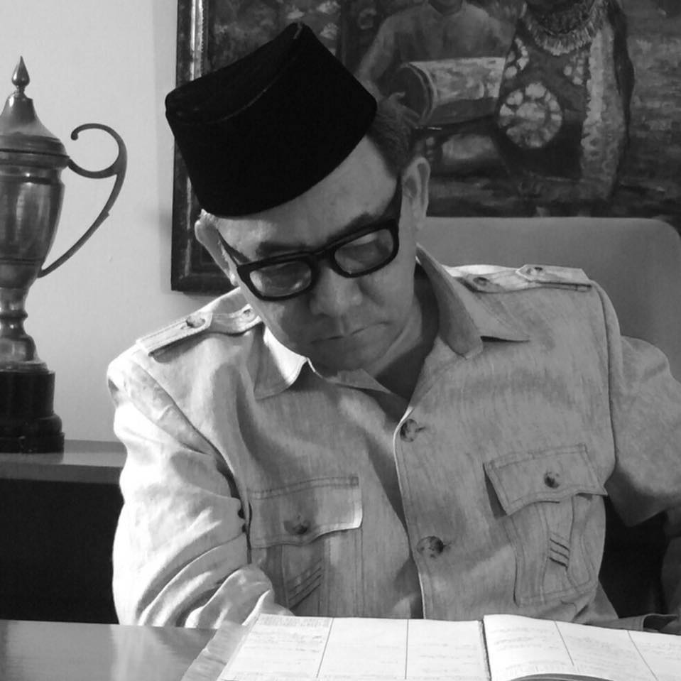

Track Record – Year 2014-2017
Title | Type / Duration | Language | Format | Client
Di Puncak Dunia – Special Merdeka Month 2017(Production Management) | Special Malaysia National Day Documentaries 6 eps x 60’ | Malay | HD | Red White Media / Astro
ECER ANNUAL REPORT 2016 (Copy Editing) | 1 Set | Malay | Print | pVm Comm / DNA Comm / Eastern Coast Economic Region, ECER
Gaduh-gaduh Sayang | Drama Series Novel Adaptation 26 eps x 60’ | Malay | HD | Medyavizyon / RTM TV1
PELABURAN HARTANAH BHD (Concept Creation) | Video Korporat 1 x 5min | Malay | HD | MA Pictures Sdn Bhd
(Prdn Management) TUN RAZAK 40 TAHUN DALAM KENANGAN KAMI ANAK MALAYSIA | Merdeka Special Documentary 2 X 60’ Merdeka Special Documentary 1 X 60’ | Malay/Eng Malay/Eng | HD HD | Medyavizyon Sdn Bhd (ASTRO)
DUNIAKU MALAYSIAKU (Editorial) | Majalah Remaja 13 x 30’ | Malay | HD | TV Alhijrah
F.I.K.R. (Editorial, Prdn) | Majalah Remaja RTM 13 x 30’ | Malay | Beta Digital | Adept Media (M) Sdn Bhd (RTM)
BAWALAH AKU PULANG | Telemovie, Umum 1 x 90m | Malay | Beta Digital | Radio & Televisyen M’sia (RTM)

Slide 8


Track Record – Year 2013
Title | Type / Duration | Language | Format | Client
BULUH, BAJU & BABA | Telemovie, Aidilfitri 2013 1 x 90m | Malay | Beta Digital | Radio & Televisyen M’sia (RTM)
PASPORT DUNIAWI | Telemovie Umum 1 x 90’ | Malay | Beta Digital | Al Hijrah Media Corporation (TV Al Hijrah)
SAYA SABAR | Telemovie, Umum 1 x 90m | Malay | Beta Digital | Al Hijrah Media Corporation (TV Al Hijrah)

Slide 9



Track Record – Year 2012
Title | Type / Duration | Language | Format | Client
GELOMBANG MERAH SRI KANDI UMNO | Corporate Video 2 Versions x 20m | Malay English | HD DVD | Pergerakan Wanita UMNO Malaysia
Majlis Antipemerdagangan Orang dan Antipenyeludupan Migran (MAPO) | Corporate Video 2 Versions x 10m | Malay English | DVD | Home Pictures Sdn Bhd MAPO-KDN
3 JANJI | Drama (Serial) Slot Lestary 13 x 60m TX Every Tues 9pm w.e.f. 20 Mar 2012 | Malay | Beta Digital DVD VHS | Sistem Televisyen Malaysia Bhd (TV3)
SENANDUNG CINTA SEMALAM | Telemovie Slot Cerekarama 1 x 82m (TX Sat 16 May 2012 10pm-12pm) | Malay | Beta Digital DVD VHS | Sistem Televisyen Malaysia Bhd (TV3)

Slide 10





Track Record – Year 2011
Title | Type / Duration | Language | Format | Client
BUNGA APRIL | Drama (Serial) Slot Samarinda 25 x 30m (TX Mon,Tue Wed !030pm 22 Nov 2011 – 10 Jan 2012) | Malay | Beta Digital DVD VHS | Sistem Televisyen Malaysia Bhd (TV3)
KEKASIHKU PUYU | Drama (Serial) Slot Lagenda 20 x 60m (TX Mon,Tue,WedThu 4pm 29 Aug – 29 Sep 2011) | Malay | Beta Digital DVD VHS | Sistem Televisyen Malaysia Bhd (TV3)
1000 CIPTA (INOVASI) | Magazine (Episodic) INOVASI 13 x 30m | Malay | Beta Digital DVD VHS | TV i Kementerian Penerangan, Komunikasi & Kebudayaan Malaysia
MAJLIS RUMAH TERBUKA MALAYSIA AIDILFITRI | MCP Location : Pulau Pinang | NA | Audio Video Signal for LED Screen Projection | Kementerian Penerangan, Komunikasi & Kebudayaan Malaysia
 | Integrated Learning Management System Video Wafer Fab Project | English Natural Sound | HDV HD | Mimos Berhad

Slide 11
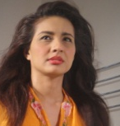
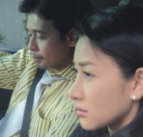
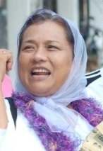
Track Record – Year 2010
Title | Type / Duration | Language | Format | Client
EDUWEBTV.COM | WEBTV Content Rencana 1Malaysia, 45 x 30m | Malay | 3CCD/ Data DVD | Zeal Hi-Tech Solutions, Ministry of Education (Aug-Dec 2010)
CIMA Cementing Nation Building | Corporate Video Script 1 x 7m | English | DVD Beta | Neo Reka / Cement Industries of M’sia Bhd
TELAPAK SYURGA | Telemovie 1 x 120m | Malay | Beta | Sistem Televisyen Malaysia Bhd (TV3)
 | SCP Events – Docu / Open Day / Agribazzar | NA | HDV | Mimos Berhad
SALJU DI HATI IBU | Telemovie Hari Ibu - Mei 2010 1 x 120m | Malay | Beta | Radio & Televisyen Malaysia (TV2)
EDUWEBTV.COM | WEBTV Content Documentary, 45 x 30m Akademik, 24 x 30m Interaktif, 39 x 10m | Malay / English | 3CCD/ Data DVD | Zeal Hi-Tech Solutions, Ministry of Education (Jan-Mac 2010)

Slide 12



Track Record – Year 2009
Title | Type / Duration | Language | Format | Client
 | SCP 5 days Indoor / Outdoor Mimos Activities | Natural Sound | MDV | MIMOS Berhad
EDUWEBTV.COM | WEBTV Content Rencana, 30 x 30m Documentary, 24 x 30m Akademik, 20 x30m | Malay / English | 3CCD/ Data DVD | Zeal Hi-Tech Solutions, Ministry of Education
TV1 & TV2 NEWSPAPER AD | 1 DAY | MALAY | PRESS AD | RTM
KEMENTERIAN KESIHATAN Prosedur Penyediaan Makanan Di Hospital | VIDEO GUIDE 1x10m | Malay | DVD | Kementerian Kesihatan

Slide 13


Track Record – Year 2008
Title | Type / Duration | Language | Format | Client
 | WEBTV Content Rencana, 70 x 30m Documentary, 35 x 30m | Malay / English | 3CCD/ Data DVD | Zeal Hi-Tech Solutions, Ministry of Education
MTDC | TVC, 30s | Malay | Digital Beta | CSG TV3, M’sian Tech. Dev. Corp.
DI SEBALIK BAYANG | Drama, 8 x 30m | Malay | Digital Beta | Ch-9 Media Sdn Bhd – TV9
MARKAS SISTEM ARMADA | Corporate Video, 10m | Malay | MDV | Global Atlas Resources, Royal Malaysian Navy
IKE SERVICES | Corporate Video, 10m | English | MDV | Ike Services
TORPEDO FIRING | Military Exercise, Lumut Naval Base, 8m | Natural Sound | MDV | IKE Services, Royal Malaysian Navy
SALAM CIKGU | Education TV Magazine, 11 x 30m | Malay | Digital Beta | Zeal Hi-Tec Solutions / TV3

Slide 14
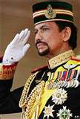



Track Record – Year 2007
Title | Type / Duration | Language | Format | Client
SYUKUR & MENJUNJUNG KASIH | Special Docu in conjunction of Sultan Brunei 61st Birthday, 11 x 10m | Malay | Beta | HVDTP, Radio & Televisyen Brunei
NSTP PRINTWORKS | Marketing Video, 7m | English | DVD | The New Straits Times Press (M) Bhd
Law Faculty | Interactive & Non-interactive Corporate Video, 2 x 15m | English, Malay | DVD, MDV | UiTM Law Faculty
Business Faculty | Video Launching, 15m | English | DVD, Beta | UiTM Business Faculty
SHIPBORNE MISSILE FIRING | Military Exercise, Lumut Naval Base, 8m | Natural Sound | DVD, MDV | Global Atlas Resources, Royal Malaysian Navy
AIRBORNE MISSILE FIRING | Military Exercise, Lumut Naval Base, 8m | Natural Sound | DVD, MDV | Global Atlas Resources, Royal Malaysian Navy
MARKAS SISTEM ARMADA | Corporate Video, 7m | Malay | DVD, MDV | Global Atlas Resources, Royal Malaysian Navy
KL FESTIVAL & MAKYONG | Event Compilation | Malay, English | Beta | Illusi Warna, KEKKWA
SENAMAN YG BETUL & SELAMAT | Video Guide, 15m | Malay, English | MDV, Beta | Ada Vision Communication, Kementerian Kesihatan
KALAMULLAH 30 JUZUK | Al-Quran Recital, Ramadan Special, 30 days | Malay, Arabic | Beta | Sistem Televisyen M’sia Bhd, TV3
NEWS SPECIAL REPORT | Selangor Special Report, 70 x 2m | Malay | MDV | K’jaan Negeri Selangor, Buletin Utama, TV3

Slide 15


Track Record – Year 2006
Title | Type / Duration | Language | Format | Client
KEMENTERIAN PENGANGKUTAN | Corporate Video, 15m | Malay, English | Beta | Ada Vision Communication, Ministry of Transport
HERBATIK | TV Magazine, Herbal, 13 x 30m | Malay | Digi Beta | Mynetworks, Radio & Televisyen M’sia
WIRA TAK DIDENDANG | TV Documentary Series, Patriotism, 13 x 30m | Malay | Digi Beta | Mynetworks, Radio & Televisyen M’sia
SPECIAL KEYNOTE BY FELDA CHAIRMAN, TAN SRI DR YUSOF NOR | Video Speech, 30m | Malay | MDV, DVD | AVMC Solutions, Felda
FELDA 50th ANNIVERSARY EVENT LAUNCHING, SEMARAK | Multiple Camera Production, 3hrs | Natural Sound | Multimedia Projection | AVMC Solutions, Felda
FELDA INTERNATIONAL CONVENTION, HILTON SENTRAL | Single Camera Production, 2 days | Natural Sound | MDV | AVMC Solutions, Felda
NERACA, KISAH BENAR | Drama, 26 x 30m Season 8 & 9 | Malay | Beta | Iris Network Sdn Bhd, TV3
SAYAP INFO, SELANGOR MAJU | Prototype Flash, Interactive, 5 min | Malay | DVD | HVD Television Production
PERTANDINGAN PANTUN KORPORAT | Multiple Camera Production, 3hrs | Malay | Multimedia Projection | Kementerian Kebudayaan, Kesenian & Warisan, KEKKWA
PROFIL ANUGERAH SENI NEGARA | Docu, 60 min | Malay | Beta | Kementerian Kebudayaan, Kesenian & Warisan, KEKKWA

Slide 16


Track Record – Year 2005
Title | Type / Duration | Language | Format | Client
HAMDOLOK | VCD Replication 10,000 copies x 60m | Malay | VCD | Kementerian Kebudayaan, Kesenian & Warisan, KEKKWA
KEKALKAN KEGEMILANGAN BANGSA MU | Video Campaign, 7m | Malay | VCD | Biro Keahlian & Latihan Umno
TIME WARISAN FAMILY DAY | Event, Port Dickson 300 copies x 60m | Malay | VCD | Lef Recreation, Time Engineering Bhd
SEMINAR ON FINANCIAL MARKET / ACCOUNTING FOR PLC’S | SCP, Istana Hotel, 1 day | Natural Sound | SCP & Video Projection | Bursatra Sdn Bhd
NERACA – KISAH BENAR | Drama, 26 x 30m Season 6 & 7 | Malay | Beta | Iris Network Sdn Bhd, TV3
DIGI TEAMBUILDING, PANGKOR ISLAND | Sports Event, 30m | Malay | VCD | Lef Recreation, Digi
MALAM KORPORAT PRIHATIN, SHANGRILA HOTEL | MCP, 3hrs | Natural Sound | Beta | Yayasan Kajian Strategi Melayu
RMN – NEW GENERATION PATROL VESSEL | SCP Aerial View, Onboard 3 days, Lumut Sea | Natural Sound | Beta | Atlas Defence Tech Sdn Bhd
SPECIAL KEYNOTE BY THE UMNO PRESIDENT | VCD Replication, 2000 x 60m | Malay | VCD | Yayasan Kajian Strategi Melayu
ACEH TSUNAMI FUND FOR THE ORPHAN | Fund raising video campaign, 10m | Malay | VCD | Yayasan Kajian Strategi Melayu

Slide 17




Track Record – Year 2004
Title | Type / Duration | Language | Format | Client
DETEKTIF | Drama – crime 13 x 30m | Malay | Beta | Sistem Televisyen M’sia Bhd, TV3
OH AYAH! OH IBU! | Reality TV, 8 x 30m | Malay | Beta
FOOTBALL & PLAYGROUND | Drypers Infomercial, 2 x 30s | Malay | Beta | Sistem Televisyen M’sia Bhd, TV3
NERACA – KISAH BENAR Season 4 & 5 | Drama, 26 x 30m | Malay | Beta | Iris Network Sdn Bhd, TV3
BANTUAN LOGISTIK PROGRAM LATIHAN KHIDMAT NEGARA | Event, 30m | Natural Sound | DVD | RMAF, Ministry of Defense
AFFIN 4x4 TEAMBUILDING | Event, 20m | Natural Sound | VCD | Lef Recreation, Affin Bank

Slide 18


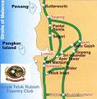
Track Record – Year 2003
Title | Type / Duration | Language | Format | Client
BISIKAN HATIKU, FAIR & LOVELY | Drama, 60m | Malay | Beta | CSG, Sistem Televisyen M’sia Bhd, TV3
NERACA – KISAH BENAR | Drama, 26 x 30m Season 2 & 3 | Malay | Beta | Iris Network Sdn Bhd, TV3
HARI PEKERJA SKF BEARING DGN PERDANA MENTERI | Event, 30m | Natural Sound | DVD | SKF Bearing Industries, Nilai
PANDUAN MENAIKI PESAWAT C130 TUDM | Video Guide, 10m | Malay, English | MDV, DVD | RMAF, Subang
ANUGERAH PANJI-PANJI SKUADRON TUDM – SULTAN PAHANG | Live Parade MCP, 3 hrs | Natural Sound | LED Panel Multimedia Projection | RMAF, Kuantan
4x4 TEAMBUILDING, RAUB | Event, 10m | Natural Sound | MDV | SKF Bearing Industries, Nilai
FERRARI & MASSERATTI TRACK DAY | Event, Sepang Circuit, 15m | Natural Sound | MDV | Next Car Sdn Bhd
RMAF LOGISTICS | Corporate Video, 20m | Malay | MDV,DVD | RMAF Logistics
KURSUS ASAS KOMANDO, BANTING | Training, Event, 30m | Natural Sound | MDV | RMAF
STERENG EMAS | Training Video, 20m | Malay | VCD, MDV | Pusat Latihan Pengurusan Logistik, RMAF Kinrara
PERISYTIHARAN MAJLIS PERBANDARAN MANJUNG | Corporate Video, 15m | Malay | MDV | Nur Hikmah Multimedia, Tiga Events

Slide 19
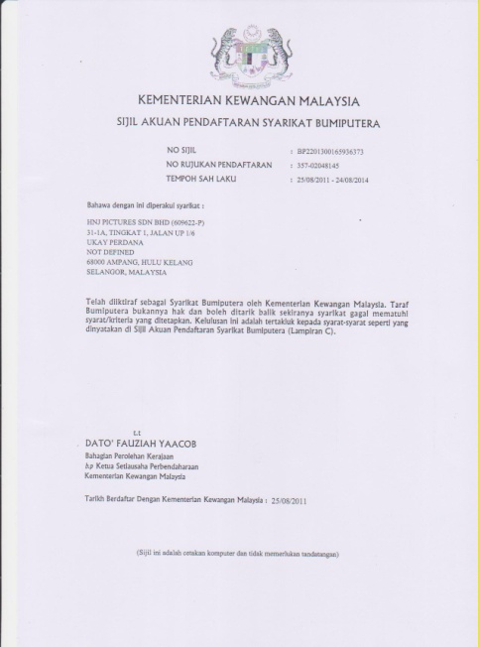
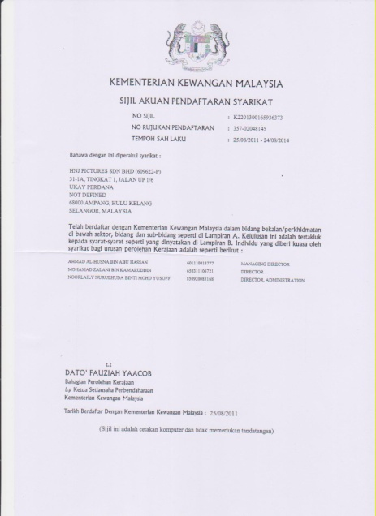
Lesen Bumiputera
Lesen Kewangan

Slide 20
Kod Bidang
060100 Kamera/Peralatan
060200 Filem Siap Untuk Tayangan
220701 Pengeluaran Filem-filem
220702 Rakaman
220704 Audio Visual
221501 Media Elektronik (Tidak Termasuk Kerja Percetakan)
220502 Media Cetak (Tidak Termasuk Kerja Percetakan)
221503 Billboard
221710 Penterjemahan

Slide 21
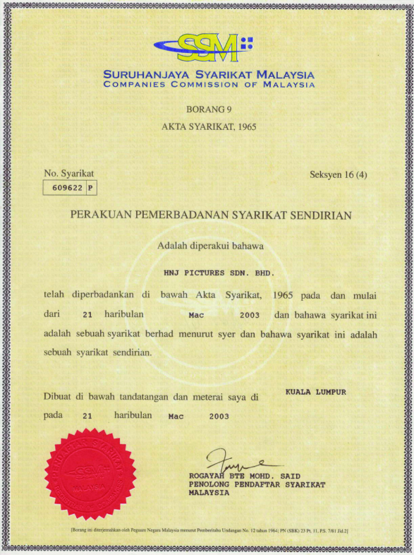
Lesen KKMM
Lesen Pendaftaran SSM

Slide 22
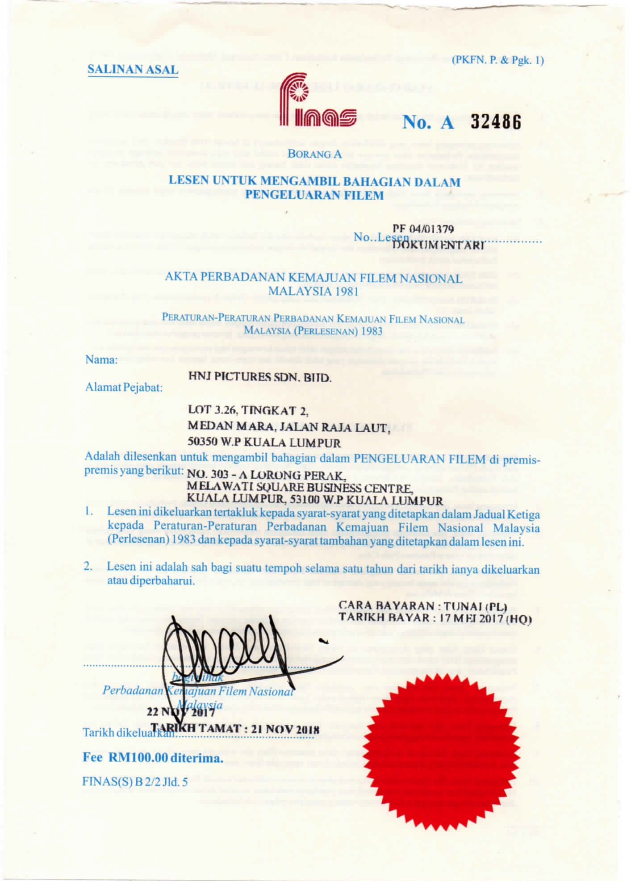
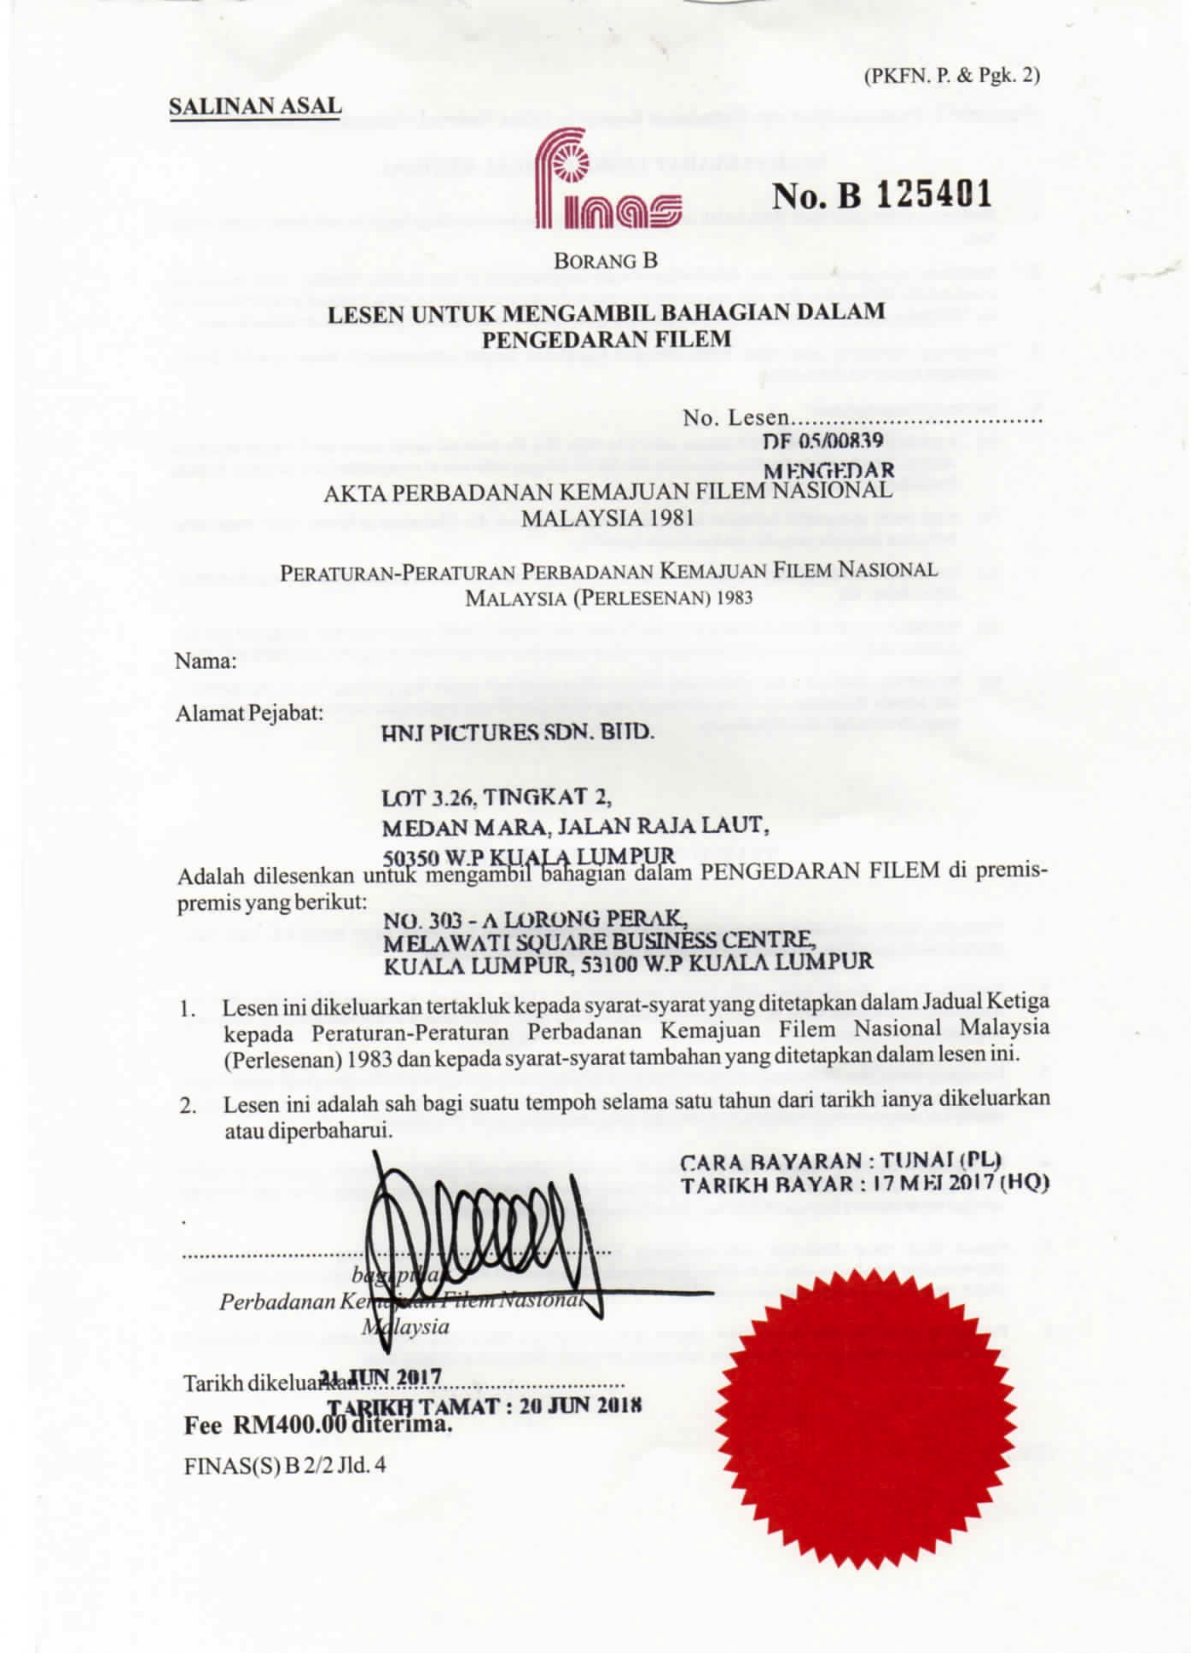
Lesen Finas : Pengeluaran
Tarikh Tamat : 21 Nov 2018
Lesen Finas : Pengedaran
Tarikh Tamat : 20 Jun 2018

Slide 23
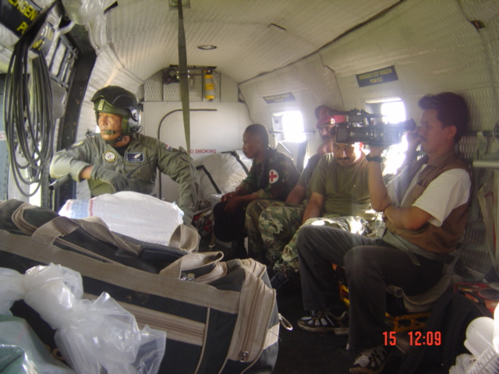
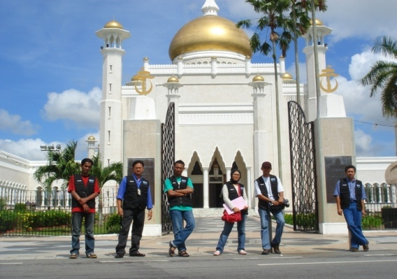
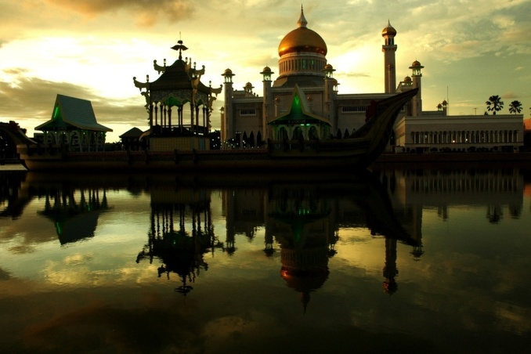
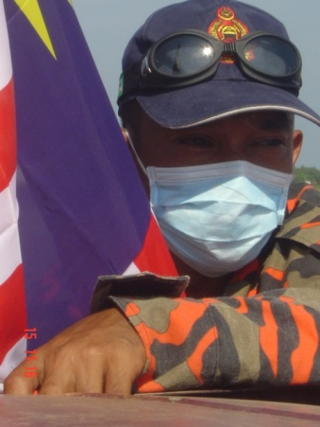
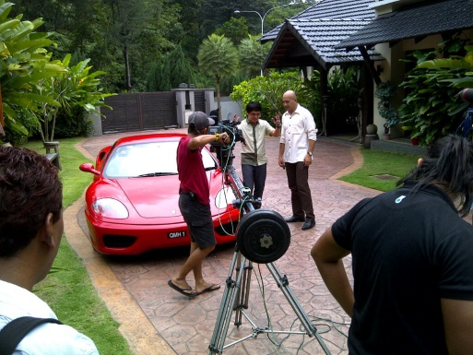
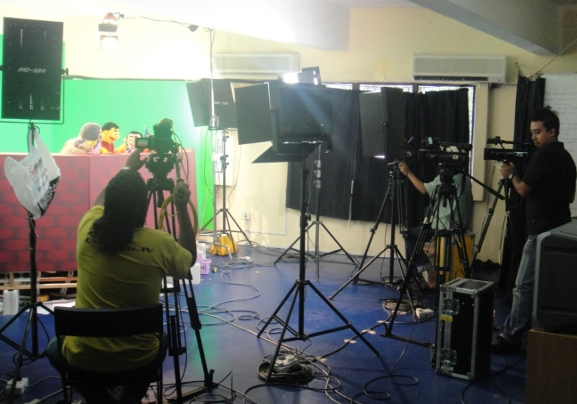
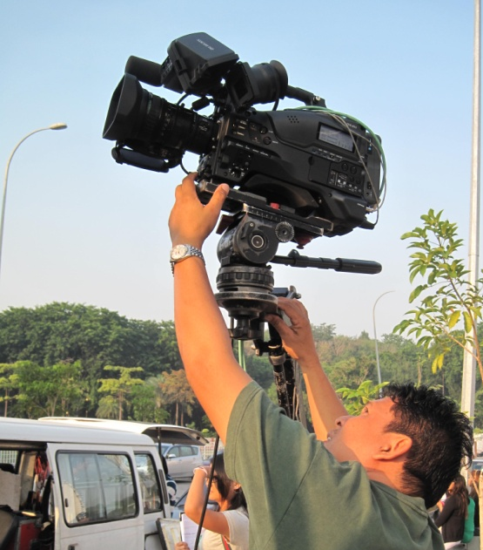

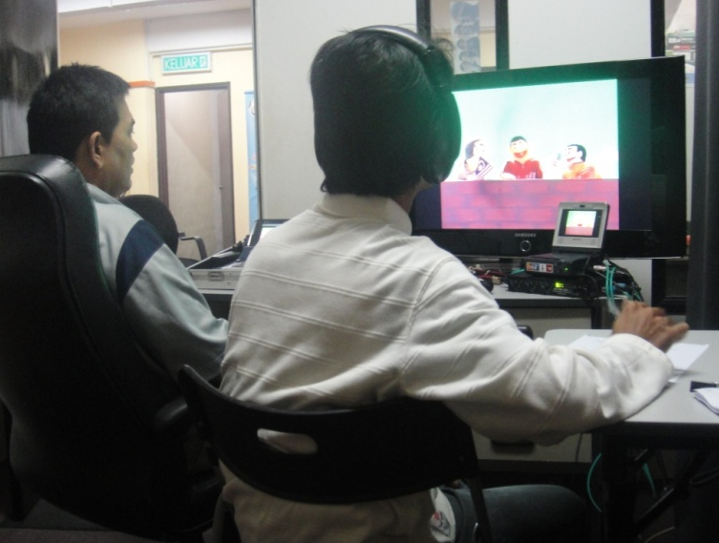

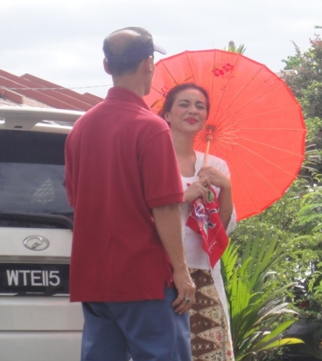
thank you...
HNJ PICTURES SDN BHD (609622-P)
No. 303-A Lrg Perak, Melawati Square Business Centre,
53100 Kuala Lumpur
Tel : +603-4108 8867 Fax: +603-4147 4022
Email : alhusna@gmail.com

