Slide 1





GST SEMINAR
FOR GOVERNMENT SECTOR
GOODS & SERVICES TAX (GST) :
REINVIGORATING UNDERSTANDING
In Collaboration with:
Supported by:
Presented by:
En Salihin Abang
Managing Partner of SALIHIN
23RD MARCH 2016

Slide 2
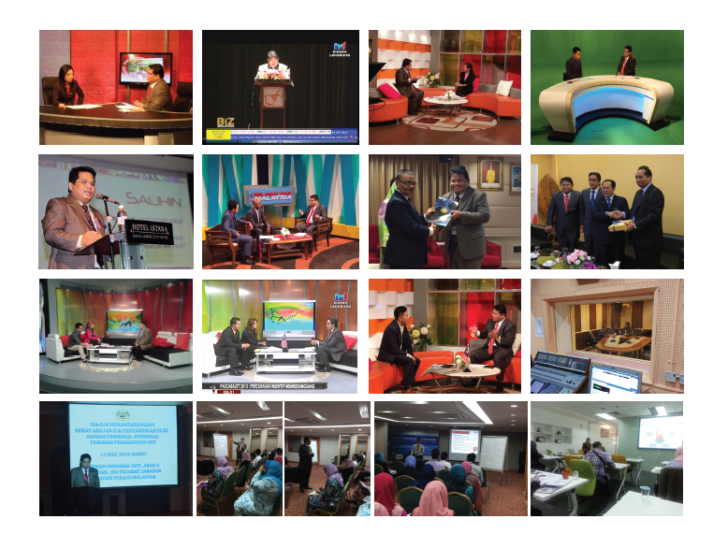
  ABOUT US
    SALIHIN EXPERIENCE IN GST TRAINING AND EDUCATION

Slide 3
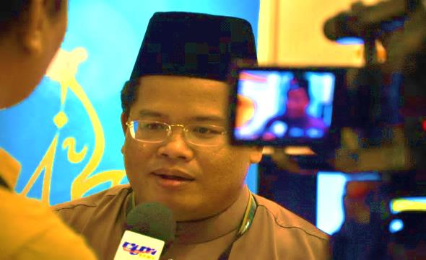
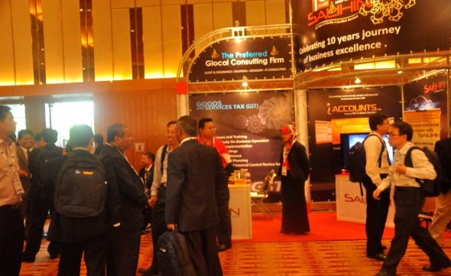
  ABOUT US
SALIHIN memulakan langkah pertamanya di dalam sektor perkhidmatan profesional negara pada Januari 2002. Tempoh 10 tahun di dalam industri ini telah berjaya mematangkan SALIHIN dan meletakkan SALIHIN di suatu kedudukan yang luar biasa berbanding para pesaing yang seangkatan dengannya.
Pencapaian serta pengiktirafan kualiti dan kecemerlangan yang diterima oleh SALIHIN adalah bukti bahawa aspirasi SALIHIN untuk meletakkan diri sebagai sebuah firma profesional Nasional bertaraf antarabangsa, telah berada di landasan yang betul. Ini ditambah lagi oleh sokongan padu daripada para pelanggan dan kakitangan yang bermotivasi tinggi yang bersedia mentransformasikan diri bersama-sama SALIHIN untuk ke fasa kejayaan seterusnya.

Slide 4

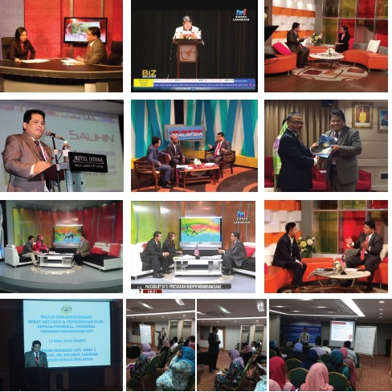



  ABOUT US
    SALIHIN SERVICES
Services
Auditing & Assurance
Taxation
Islamic Accounting & Auditing
Corporate Finance & Transaction Services
Corporate Secretarial Services
Financial Accounting Services
Goods & Services Tax (GST)
IT Consultancy
Zakat & Waqf
KUALA LUMPUR . JOHOR BAHRU . KUCHING

Slide 5

  ABOUT US
    PRACTICE AND ACADEMIA

Slide 6

  AGENDA
  Latest GST Updates
  2016 Budget Highlights on GST
  Overview of GST in Malaysia
  Scope of GST
  Type of Supply
  Summary of Governing Legislations
  Understanding Key Areas of GST
  Charging Output Tax
  Entitlement of Input Tax
  Tax Invoice and Record Keeping
  GST Audit Findings

Slide 7

  LATEST GST UPDATES

Slide 8

  LATEST GST UPDATES
  GST REGISTRATION
As at 5 Jan 2016 400,870
GST Registrant
RMCD aims to have 500,000 companies registered in 2016.
GST REGISTRATION
Sources : Edge Insider. January 7 2016. http://www.freemalaysiatoday.com/category/nation/2016/01/07/customs-aims-to-collect-rm39bil-in-gst-this-year/

Slide 9
  LATEST GST UPDATES
  GST REGISTRATION
GST REGISTRANTS BY STATES
Bil | State | Total Registration | Bil | State | Total Registration
1 | WPKL | 82,062 | 9 | PAHANG | 13,990
2 | SELANGOR | 74,775 | 10 | KEDAH | 13,663
3 | JOHOR | 51,899 | 11 | NEGERI SEMBILAN | 12,352
4 | PULAU PINANG | 28,610 | 12 | MELAKA | 10,848
5 | PERAK | 27,538 | 13 | KELANTAN | 7,362
6 | SARAWAK | 26,538 | 14 | TERENGGANU | 6,676
7 | SABAH | 21,719 | 15 | PERLIS | 1,595
8 | KLIA | 20,441 | 16 | LABUAN | 802
As at 05 January 2016

Slide 10
  LATEST GST UPDATES
  GST REGISTRATION
TOTAL REGISTERED SMEs
Manufacturing | Number of Registrants | Total Registrants
Medium | 3,196 | 47,187
Small | 39,615
Macro | 4,376
Non-Manufacturing | Number of Registrants | Total Registrants
Medium | 58,462 | 329,852
Small | 239,547
Macro | 31,843
Total SME |  | 377,039

Slide 11
  LATEST GST UPDATES
  GST REGISTRATION
GST REGISTRANTS BY TYPE OF ENTITIES
BIL | Type of Entities | Total
1 | Company | 222,882
2 | Sole Proprietor | 104,639
3 | Partnership | 56,915
4 | Professional | 6,785
5 | Individual | 4,005
6 | Association | 2,108
7 | Limited Liability Partnership | 1,650
8 | Other Entity | 1,218
9 | Statutory Body | 387
10 | Local Authority | 201
11 | Public Authority | 80
 | JUMLAH | 400,870

Slide 12
  LATEST GST UPDATES
BIL | SECTOR | Total Registration
1 | Wholesale, Retail Trade, Repair Motor Vehicles & Motorcycles | 141,860
2 | Construction | 71,786
3 | Manufacturing | 45,764
4 | Professional, Scientific and Technical Activities | 25,115
5 | Administrative and Support Service Activities | 16,805
6 | Accommodation and Support Service Activities | 16,763
7 | Transportation and Storage | 14,380
8 | Information and Communication | 11,933
9 | Agriculture, Forestry and Fishing | 11,800
10 | Real Estate Activities | 10,333
11 | Other Service Activities | 7,583
12 | Financial and Insurance/ Takaful Activities | 4,839
13 | Human Health and Social Work Activities | 3,472
14 | Water Supply, Sewerage Waste Management and Remediation | 2,683
15 | Mining and Quarrying | 2,587
16 | Education | 2,451
17. | Public Administration and Defence, Compulsory Social Security | 1,867
18. | Arts, Entertainment and Recreation | 1,338
19. | Electricity, Gas, Steam and Air Conditioning Supply | 1,151
20. | Others | 190
 | JUMLAH | 400,870

Slide 13



  LATEST GST UPDATES
  GST COMPLIANCE RATE
Average GST returns submission rate as at 2015
90%
Sources : http://www.thestar.com.my/business/business-news/2015/10/31/budget-2016-journey-continues-for-gst-compliance/

Slide 14



  LATEST GST UPDATES
  GST COLLECTION
RM30 billion April 2015 – October 2015
RM39 billion Forecast for 2016
Sources : Edge Insider. January 7 2016. http://www.freemalaysiatoday.com/category/nation/2016/01/07/customs-aims-to-collect-rm39bil-in-gst-this-year/

Slide 15
  LATEST GST UPDATES
  GST RETURNS
As at 5th JAN 2016
TAXABLE PERIOD | SUPPOSED TO RECEIVE TOTAL | RECEIVED TOTAL PERCENTAGE | NOT RECEIVED TOTAL PERCENTAGE
APRIL | 72,593 | 72,074 99.29% | 519 0.71%
MAY | 71,580 | 71,076 99.30% | 504 0.70%
JUNE | 58,050 | 57,727 99.44% | 323 0.56%
*APRIL-JUNE | 282,712 | 272,404 96.35% | 10,308 3.65%
JULY | 73,152 | 72,200 98.70% | 952 1.30%
AUGUST | 72,143 | 71,160 98.64% | 983 1.36%
SEPTEMBER | 57,402 | 56,791 98.94% | 611 1.06%
*JULY-SEPTEMBER | 288,240 | 271,171 94.08% | 17,069 5.92%
OCTOBER | 73,915 | 71,561 96.28% | 2,354 3.18%
NOVEMBER | 72,811 | 68,727 94.39% | 4,084 5.61%
DECEMBER | 349,330 | 3,678 1.05% | 345,652 98.95%

Slide 16
  LATEST GST UPDATES
  GST REFUND
(AS AT 6th January 2016 )
Days | APRIL |  | MAY |  | JUNE |  | JULY |  | AUGUST |  | SEPTEMBER |  | OCTOBER
 | No. | % | No. | % | No. | % | No. | % | No. | % | No. | % | No. | %
<14 | 3,313 | 8.99 | 4,703 | 28.38 | 9,736 | 21.62 | 5,243 | 51.68 | 15,428 | 59.42 | 29,016 | 71.22 | 8,152 | 58.99
15-30 | 6,148 | 33.11 | 6,697 | 40.41 | 24,322 | 54.00 | 4,656 | 45.89 | 7,317 | 28.18 | 4,148 | 10.18 | 3,407 | 24.65
>31 | 9,107 | 49.05 | 5,174 | 31.22 | 10,980 | 24.38 | 246 | 2.42 | 3,219 | 12.40 | 7,578 | 18.60 | 2,261 | 16.36
Total | 18,568 | 100 | 16,574 | 100 | 45,038 | 100 | 10,145 | 100 | 25,964 | 100 | 40,742 | 100 | 13,820 | 100
REFUND

Slide 17
  LATEST GST UPDATES
  GST SPECIAL REFUND
(AS AT 6th JANUARY 2016 )
MONTH | APRIL | MAY | JUNE | JULY | AUGUST | SEPTEMBER | TOTAL
Application | 17 | 62 | 79 | 101 | 159 | 2,093 | 2,511
Approved | 14 | 44 | 68 | 76 | 112 | 396 | 710
Rejected | 3 | 18 | 10 | 14 | 21 | 102 | 168
Reviewed | 0 | 0 | 1 | 11 | 26 | 1,595 | 1,633
Percentage (Approved + Rejected) | 100% | 100% | 98.73% | 89.11% | 83.65% | 23.79% | 34.97%
DUE DATE FOR SPECIAL REFUND SUBMISSION : 30 SEPTEMBER 2015

Slide 18
  LATEST GST UPDATES
  TOURIST REFUND SCHEME
(AS AT 06 JANUARI 2016 )
Filing Period | No. of Tourist Refund | Tourist Refund Amount | Refund Fee | Total Claim Amount
30-Apr-2015 | 2,416 | 472,401.50 | 83,363.88 | 555,765.38
31-May-2015 | 12,340 | 1,764,014.70 | 311,292.11 | 2,075,306.81
30-Jun-2015 | 7,001 | 810,542.50 | 143,040.18 | 953,582.68
31-Jul-2015 | 19,377 | 2,223,802.00 | 392,434.92 | 2,616,236.92
31-Aug-2015 | 49,116 | 5,386,838.90 | 950,607.02 | 6,337,445.92
30-Sept-2015 | 18,617 | 2,468,562.70 | 435,629.07 | 2,904,191.77
31-Oct-2015 | 49,620 | 5,287,583.50 | 933,091.27 | 6,220,674.77
30-Nov-2015 | 35,434 | 4,257,230.40 | 751,273.87 | 5,008,504.27
31-Dis-2015 | 18,589 | 2,487,635.30 | 438,995.05 | 2,926,630.35
TOTAL | 212,510 | 25,158,611.50 | 4,439,727.37 | 29,598,338.87
Approved outlet by RMCD = 4,911

Slide 19
  LATEST GST UPDATES
  TOURIST REFUND SCHEME
(AS AT 06 JANUARI 2016 )
Refund Location | No. of Tourist Refund | Tourist Refund Amount | Refund Fee | Total Claim Amount
KLIA 2 AIRSIDE | 50,859 | 3,113,642.10 | 549,444.07 | 3,663,086.17
KLIA C1 SATELLITE TERMINAL | 32,672 | 2,165,478.90 | 382,126.90 | 2,547,605.80
KLIA CP TERMINAL | 26,047 | 1,562,537.90 | 275,724.16 | 1,838,262.06
KOTA KINABALU T1 INTL AIRPORT | 1,603 | 90,720.40 | 16,009.18 | 106,729.58
KUCHING INTL AIRPORT | 209 | 12,863.90 | 2,270.56 | 15,134.46
non-cash | 66,960 | 16,494,014.90 | 2,910,739.39 | 19,404,754.29
PENANG INTL AIRPORT | 33,898 | 1,702,876.40 | 300,505.01 | 2,003,381.41
SENAI INTL AIRPORT | 86 | 4,938.50 | 871.68 | 5,810.18
SUBANG INTL AIRPORT | 176 | 11,538.50 | 2,036.42 | 13,574.92
 | 212,510 | 25,158,611.50 | 4,439,727.37 | 29,598,338.87
Approved outlet by RMCD = 4,911

Slide 20
  RISING PRICES AND PROFITEERING
Although traders can claim special refund to eliminate double taxation but not many have done so.
If special refund is not claimed, GST 6% will be charged on selling price with embedded sales tax until the old stock last.
RMCD is working with KPDNKK to avoid traders from taking advantage to continue charging the same price on new stock of goods
Due date for Special Refund application was 30 September 2015
MONTH | APRIL | MAY | JUNE | JULY | AUGUST | SEPTEMBER | TOTAL
Application | 17 | 62 | 79 | 101 | 159 | 2093 | 2511
Approved | 14 | 44 | 68 | 76 | 112 | 396 | 710
Rejected | 3 | 18 | 10 | 14 | 21 | 102 | 168
Review | 0 | 0 | 1 | 11 | 26 | 1595 | 1633
Percentage (Approved + Rejected) | 100% | 100% | 98.73% | 89.11% | 83.65% | 23.79% | 34.97%

Slide 21
2016 MALAYSIAN BUDGET HIGHLIGHTS ON GST

Slide 22
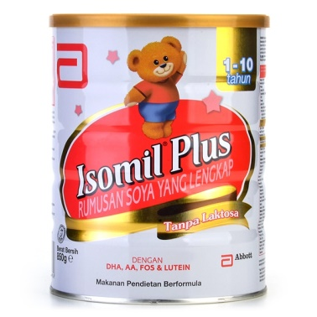
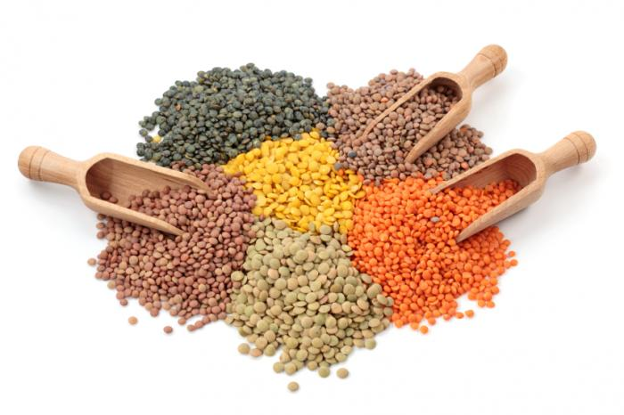
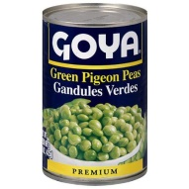
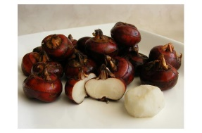
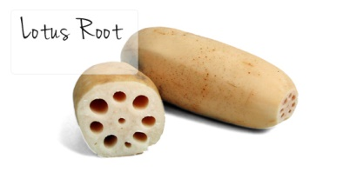
  2016 MALAYSIAN BUDGET HIGHLIGHTS
  ZERO-RATED FOOD PRODUCTS
Streamlining of Zero-Rated Food Products
1) Organic and soy base milk in powder form for feeding infant and young children (up to 36 months) which comply the requirement specified in the food regulation 1985 [P.U. (A) 437/1985] and put up in the form of packaging for retail sale only.
2) To include all types of dhal (pigeon peas, chickpeas garbanzos, vigna mungol, hepper/vigna radiate & lenthils)
3) Lotus roots and water chestnut

Slide 23

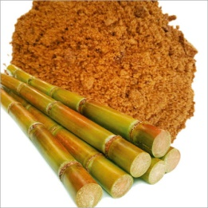
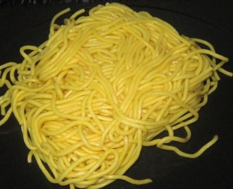
  2016 MALAYSIAN BUDGET HIGHLIGHTS
  ZERO-RATED FOOD PRODUCTS
Streamlining of Zero-Rated Food Products
4) Mustard seeds
5) Jaggery Powder
6) Noodles (wet yellow mee/mi kolok dried) –1902.19.400

Slide 24
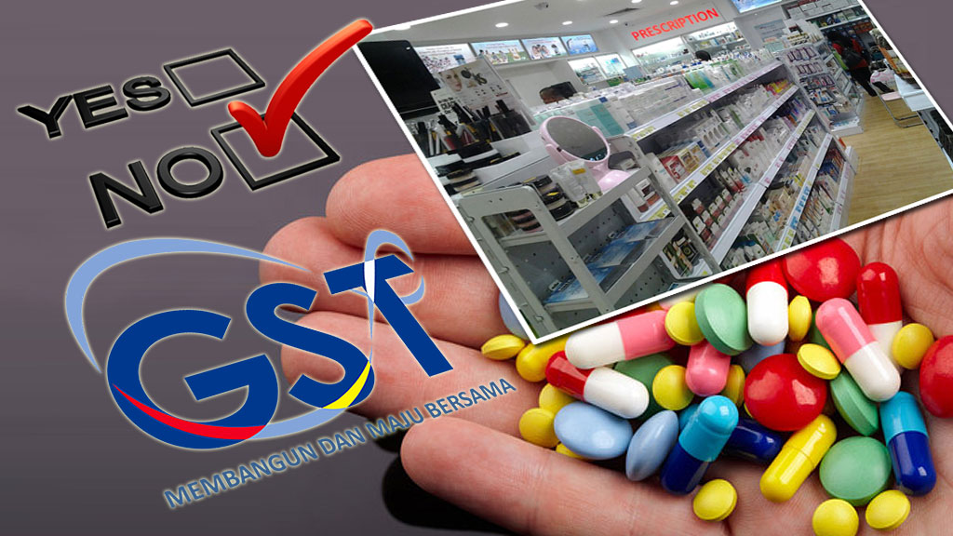
  2016 MALAYSIAN BUDGET HIGHLIGHTS
  EXPANSION OF SCOPE ZERO-RATED MEDICINES
Expansion of Scope of Zero-Rated Medicines
all types of controlled drugs in the Poisons Groups A, B, C, and D of the Poisons Act 1952;
over-the-counter medicines registered by the Drug Control Authority; and
drugs classified as medical devices under the National Essential Medicines List.

Slide 25
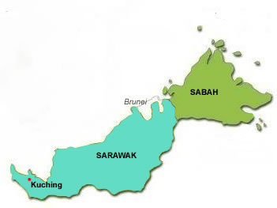
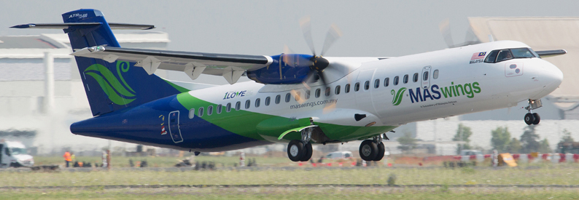
  2016 MALAYSIAN BUDGET HIGHLIGHTS
  EXEMPTION FOR AIR TRANSPORTATION SERVICES IN SABAH AND SARAWAK
GST (Exempt Supply)Order 2014
Exemption for Air Transportation Services in Sabah and Sarawak
Air passenger transport services for economy class on domestic flight within and between Sabah, Sarawak and Labuan

Slide 26
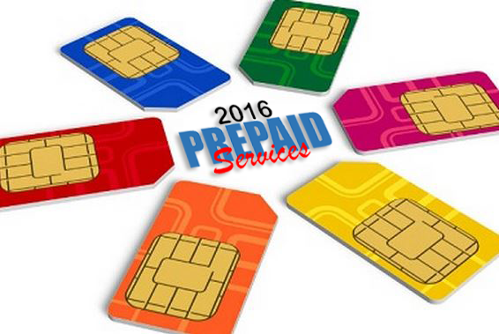
  2016 MALAYSIAN BUDGET HIGHLIGHTS
  PREPAID TELECOMMUNICATION SERVICES OR PREPAID CARDS
Prepaid Telecommunication Services or Prepaid Cards
It is proposed that Malaysian users of prepaid telecommunication services or prepaid cards will be given rebates which are equivalent to the amount of GST paid. The proposal is effective from 1 January 2016 to 31 December 2016.

Slide 27
OVERVIEW OF GST IN MALAYSIA

Slide 28

  INTRODUCTION
  A BROAD-BASED consumption tax in the form of value added tax
  MULTI STAGE TAX based on net value at each stage of business transaction up to the retail stage of distribution
  Also known as VALUE ADDED TAX (VAT) in certain countries
  Tax on final consumption – THE CONSUMER
  GST incurred on inputs is allowed as a credit to the registrant - OFFSET AGAINST OUTPUT TAX
WHAT IS GST?

Slide 29

SCOPE OF GST

Slide 30
  ELEMENT & SCOPE OF GST
  TYPE OF SUPPLY
  Standard Rated Supply
6%
  Zero Rated Supply
0%
  Exempt Supply
GST
  Out of Scope
GST
  Relief
GST

Slide 31


  ELEMENT & SCOPE OF GST
  TEST OF GST
  GST is charged on :
    The taxable supply of goods and services
    Made by a taxable person
    In the course or furtherance of business
    In Malaysia
  GST is charged on imported goods and services

Slide 32
  ELEMENT & SCOPE OF GST
  GST MECHANISM
INPUT TAX
OUTPUT TAX
ACQUISITION
SUPPLY
PURCHASES
SALES
PAYMENT
INCOME

Slide 33
  ELEMENT & SCOPE OF GST
  GST MECHANISM (CONTD.)
INPUT
OUTPUT
Goods
Raw Materials
Seller
Rental
Services
Telephone
GST on Input
= Input Tax
Claim
Input Tax
GST on Output
= Output Tax

Slide 34

  ELEMENT & SCOPE OF GST
  HOW GST WORKS?
  Standard-rated Supply
Illustration of tax computation on standard-rated supply
Business Entity | Cost of Sales (RM) | 6% Output Tax (RM) | 6% Input Tax (RM) | Net Tax Paid (RM)
Suppliers | 10.00 | 0.60 | - | 0.60
Manufacturers | 50.00 | 3.00 | 0.60 | 2.40
Wholesalers | 70.00 | 4.20 | 3.00 | 1.20
Retailers | 100.00 | 6.00 | 4.20 | 1.80
GST paid on Input Tax is refundable at each level of supply

Slide 35
  ELEMENT & SCOPE OF GST
  GST MECHANISM (CONTD.)
GST ON SUPPLY OF GOODS AND SERVICES
[OUTPUT TAX]
GST INCURRED IN BUSINESS PURCHASES
[INPUT TAX]
NET GST
PAYABLE TO RMCD
REFUNDABLE FROM RMCD

Slide 36

TYPE OF SUPPLY

Slide 37
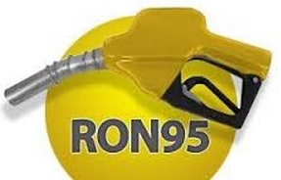
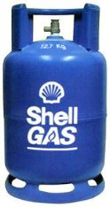

  ELEMENT & SCOPE OF GST
  STANDARD RATED AND GST RELIEF
STANDARD RATED SUPPLIES
For items that are not listed as GST Exempt or Zero-Rated Supplies
GST RELIEF
Petroleum products
Retail sales of Petrol RO95, diesel and RPG are granted relief from GST to consumers.

Slide 38
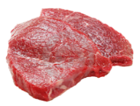
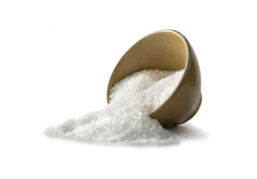





  ELEMENT & SCOPE OF GST
  ZERO RATED SUPPLIES
0%
ZERO RATED SUPPLIES
Livestock supplies (Fresh, chilled or frozen)
Cows, goats, buffalo, poultry (including eggs of chicken and duck)
Rice, Flour, Salt, etc.
Water and electricity
Rice, flour,sago and kacang dhal
Sugar and salt
Cooking oils (palm, coconut and peanuts)
White bread and wholemeal bread
Coffee powder, tea dust and cocoa powder
Yellow mee, kuey teow, laksa and meehoon
Spices
Infant formula
Seafood
Water supply (domestic)
Electricity supply for the first 300 unit (domestic)
Export
Goods and services exported
Reading materials
Agriculture Product
Exercise books and printed books
Dictionaries and encyclopaedia, text books
Reference books, religious text only
Newspaper (appearing at least four times a week)
Children picture, drawing and colouring books
Paddy
Fresh Vegetables and salads
Fruits

Slide 39

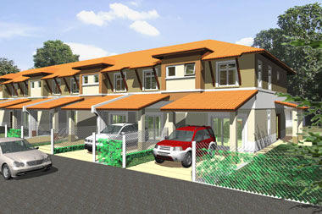

  ELEMENT & SCOPE OF GST
  EXEMPT SUPPLIES
SUPPLY OF GOODS DETERMINED AS AN EXEMPT SUPPLY
Any land intended to be used for residential or agricultural or general use
- including parking facilities
- agriculture – does not include land for hunting and fishing activities.
Any building or premises being used for residential purposed, designed or adapted for use or intended to be used as dwelling (excluding hotel, inn, boarding house or similar establishment sleeping accommodation)
Any supply of investment precious metal.
Eg: gold, silver, platinum, gold coin, silver coin (excluding collector coin)
**General use : burial ground, playground, religious building
**Similar establishment: premises provided with sleeping accommodation, with or without lodging or facilities for the preparation of foods for use of visitor or travellers.

Slide 40
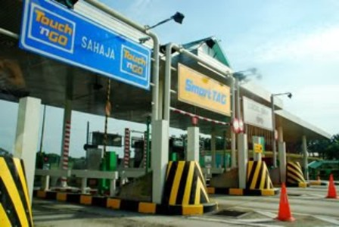
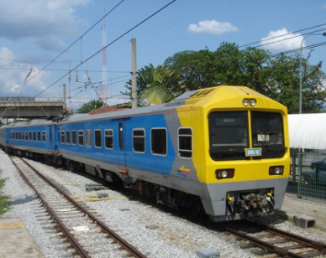
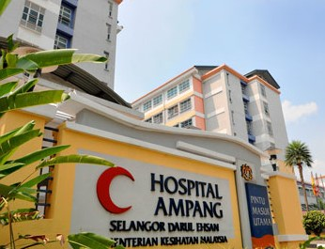
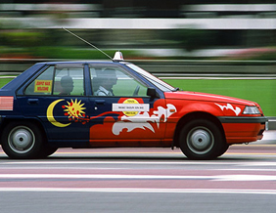
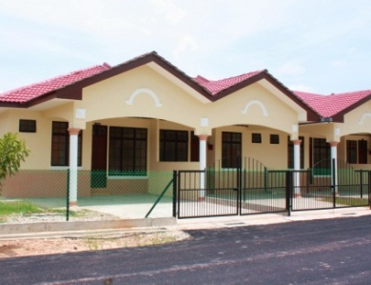
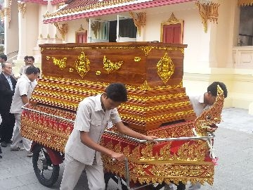
  ELEMENT & SCOPE OF GST
  EXEMPT SUPPLIES (CONTD.)
SUPPLY OF SERVICES DETERMINED AS AN EXEMPT SUPPLY
Public Transportation
Residential, Land For Residential, Agriculture And General Use
Highway and Toll Bridge
Funeral, Burial and Cremation Services
Healthcare Services
Education Services
Financial Services
Child Care Services

Slide 41
  ELEMENT & SCOPE OF GST
  GOVERNMENT SUPPLY
 | FEDERAL GOVERNMENT & STATE GOVERNMENT | LOCAL AUTHORITY & STATUTORY BODIES
OUT OF SCOPE | All supplies by Federal & State Government | Supplies made in the regulatory and enforcement (R&E) Functions e.g. assessment rate collection, issuance of license, penalty
SUBJECT TO GST | Supplies that have been directed by Minister in the GST (Government Taxable Supply) Order 2014 e.g. supply made by RTM, Prison Department | Non R&E functions, i.e. business activities e.g. Rental facilities
ACQUISITIONS | Need to pay GST on their acquisitions Relief on all goods excluding petroleum & imported motor cars | Need to pay GST on their acquisitions Need to register for GST and input tax claimable

Slide 42

SUMMARY OF GOVERNING LEGISLATIONS

Slide 43
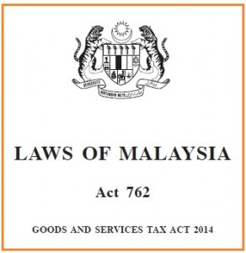
  OVERVIEW OF GST IN MALAYSIA
  GOVERNING LEGISLATIONS - GST ACT 2014
On 19th June 2014, the GST Act 2014 has been gazette

Slide 44
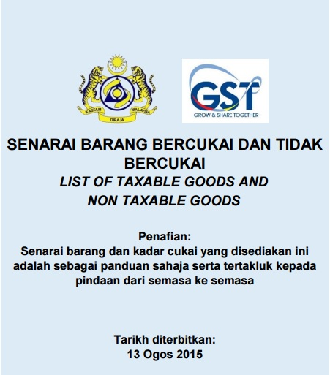
  OVERVIEW OF GST IN MALAYSIA
  LIST OF TAXABLE GOODS AND NON TAXABLE GOODS
List of Taxable Goods and Non Taxable Goods – SUNDRY GOODS
Sources : http://gst.customs.gov.my/en/cp/SiteAssets/List%20of%20SUNDRY%20GOODS%2013.8.2015.pdf

Slide 45
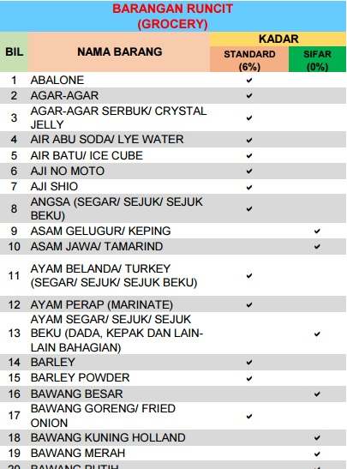
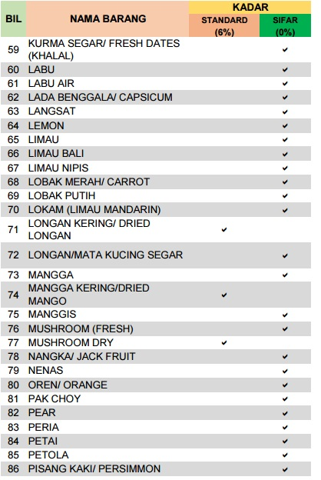
  OVERVIEW OF GST IN MALAYSIA
  LIST OF TAXABLE GOODS AND NON TAXABLE GOODS
Sources : http://gst.customs.gov.my/en/cp/SiteAssets/List%20of%20SUNDRY%20GOODS%2013.8.2015.pdf

Slide 46
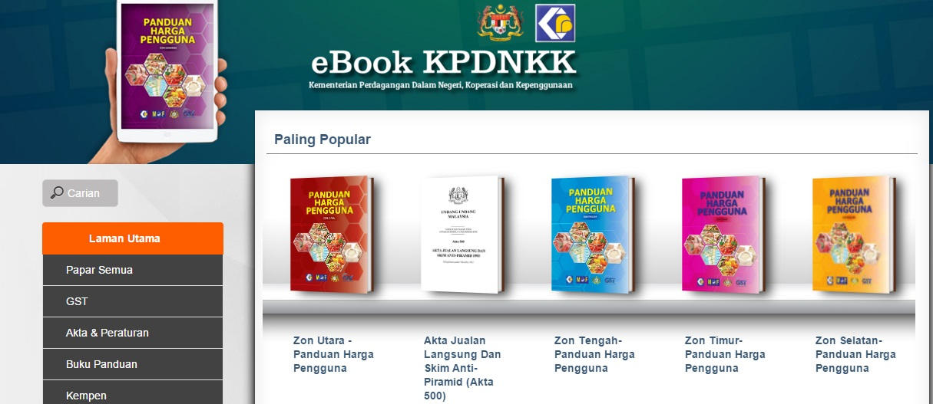
  OVERVIEW OF GST IN MALAYSIA
  SHOPPERS GUIDE
Shoppers Guide is available through Ministry of Domestic Trade, Co-Operatives and Consumerism (MTDCC) official portal.
Sources : http://ebook.kpdnkk.gov.my/ebook/

Slide 47
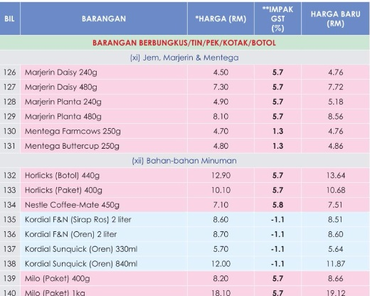

  OVERVIEW OF GST IN MALAYSIA
  SHOPPERS GUIDE
Illustrate comparisons of prices of goods and services before and after the implementation of GST
Sources : http://ebook.kpdnkk.gov.my/ebook/

Slide 48

  OVERVIEW OF GST IN MALAYSIA
  IMPORTANT LINK
Important information and update can be obtained from:
http://gst.customs.gov.my/
GST Act 2014 : http://gst.customs.gov.my/en/rg/Pages/rg_bill.aspx
GST Orders : http://gst.customs.gov.my/en/rg/Pages/re_odr.aspx
GST Regulations : http://gst.customs.gov.my/en/rg/Pages/rg_reg.aspx
GST Relief Order : http://gst.customs.gov.my/en/rg/Pages/rg_rog.aspx
GST General Guide : http://gst.customs.gov.my/en/rg/Pages/rg_gg.aspx
GST Industry Guide : http://gst.customs.gov.my/en/rg/Pages/rg_ig.aspx
GST Specific Guide : http://gst.customs.gov.my/en/rg/Pages/rg_sg.aspx

Slide 49
UNDERSTANDING KEY AREAS OF GST

Slide 50

CHARGING OUTPUT TAX

Slide 51

  ELEMENT & SCOPE OF GST
  WHAT IS SUPPLY?
Scope of Tax
Supply
Importation
Not subject to GST
No
Taxable Supply
Subject to GST
No
Taxable Person
No
For the purpose of business
No
Made in Malaysia
    GST is charged on imported goods and services

Slide 52


  ELEMENT & SCOPE OF GST
  SCOPE AND CHARGE
  OUTPUT TAX
  SCOPE AND CHARGE
Taxable supplies
Deemed supplies
  Disposal of business assets
  Private use of business asset
  Imported services
  Good sold in satisfactory of a debt
  Payment not paid to taxable person for purchases
  made after 6 month
  Gift costing more than RM500
GST charged on:

Slide 53
  OUTPUT TAX
  SCOPE AND CHARGE
Supplies which may not be subject to GST
Cash donation or grants where a person does not get benefits
Compensation or liquidated damages
Distribution, dividend, loan repayments or capital injection
Transfer of going concern
Contribution of pension, provident or social security fund
Supplies by any society or similar organisation
Supplies excluded from input tax credit
53

Slide 54

ENTITLEMENT OF INPUT TAX

Slide 55

  INPUT TAX CREDIT
  DEFINITION
  Definition
Any tax on any taxable supply of goods or services to a taxable person; or
Any tax paid or to be paid by a taxable person on any importation of goods
  Condition
Goods or services must be used for business purposes and carried by taxable person

Slide 56
  INPUT TAX CREDIT
  INPUT TAX CREDIT - LIABILITY
  Imported Services
Services made by a supplier outside Malaysia to a recipient who belongs in Malaysia.
Services consumed in Malaysia.
Example: Intangible and intellectual properties such as trademarks, rights, patents, licence, good will, etc.
  Tax Liability
Recipient is liable to account GST on the supply made for the purpose of any business carried by him.

Slide 57
  INPUT TAX CREDIT
  ENTITLEMENT TO CLAIM INPUT TAX
Entitlement to claim input tax
Input tax has been incurred
Input tax is allowable
Taxable person
Good or services acquired in the furtherance of business
Good and services made in Malaysia or supply made outside Malaysia which would taxable supply if made in Malaysia

Slide 58
  INPUT TAX CREDIT
  ENTITLEMENT TO CLAIM INPUT TAX
Particular | Critical Area
Managing Acquisition and Procurement | Possession of a valid Tax Invoice for claiming input tax credit To develop a procedure to emphasize/encourage purchases from GST registrant. Speedy collection of Tax Invoice from suppliers
Standard Operating Procedure | To include standard operating procedure (SOP) of GST relates to your business in every each business unit. GST is not just the duty of finance or account department, it requires collaboration from all division of the entity.
GST in Human Resource | Employee Benefit Contract of Employment Gift Rule Blocked Input Tax Goods and Services Provided for Free

Slide 59
  INPUT TAX CREDIT
  ENTITLEMENT TO CLAIM INPUT TAX
Particular | Critical Area
Administrative | To keep full and true records of all transactions occurred in business transaction Proper documentation and record keeping Available in Bahasa Malaysia or English Keep for 7 year Can be kept in soft or hard copy To be kept in principal place of business
Legal | Inclusion of GST Clause Contracts with opportunity to review Non-reviewable contract:
Accounting System – GST Compliance | The issuance of Tax Invoice as well as credit/debit note Reporting facility for the generation of information for GST return submission (GST 03 form) Generation of GST Audit File (GAF) Adequate audit trail

Slide 60

RECORD KEEPING

Slide 61
  RECORD KEEPING
  WHAT ARE RECORDS?
All books of account or relevant computer print-outs (if a computer is used), as well as supporting documents. If the record is in an electronically readable form, a manual to the software must be available.
If the record is in an electronically readable form, the record shall be kept in such manner as to enable the record to be readily accessible and convertible into writing.
For those who intend to keep their records overseas, they must seek approval from the Director General, subject to the conditions as he deems fit. Still, made available when required by the GST officers for verification or audit purposes.

Slide 62



  RECORD KEEPING
  WHAT ARE RECORDS? - STANDARD OPERATING PROCEDURE (SOP)
GST is not just the duty of finance or account department, it requires collaboration from all division of the entity.
To include standard operating procedure (SOP) of GST relates to your business.
Important
Preparation of standard operating procedure to ensure company wide operating policy and documentation need in preparation for future GST audit.

Slide 63

  RECORD KEEPING
  ADMINISTRATIVE
ADMINISTRATIVE
Section 36 of the GSTA requires every taxable person and certain non-taxable person to keep full and true records of all transactions which affect or may affect his liability to tax.
  Bahasa Malaysia or English
  7 years
  Can be kept in soft or hard copy
  To be kept in principal place of business

Slide 64

  RECORD KEEPING
  ADMINISTRATIVE
Records relating to registration
  SSM records – Form A, B, C, 8,9 and etc.
Records relating business activities
  tax invoices, invoices, receipts,
  debit note, credit note
  delivery order, purchase order
  Bank slip, bank statement, voucher and etc.
  Contract, agreement
Records relating to accounting (hard copy)
  Financial statement – Profit & Loss, Balance Sheet, Trial Balance
  Account payable, account receivable, General ledger, Sales, Purchase, stock, cash and etc.

Slide 65
  RECORD KEEPING
  ADMINISTRATIVE
Records relating to taxation
  Customs forms – K1, K2, K9 and etc
  GST – GST returns, registration and etc
  GST adjustment sheet
  Income tax declaration
Records relating to electronic form
  Accounting software manual
  Accounts chart, access code, program documentation
  Audit trail
  Purchase, Sales, GL Listing (e.g standard, exempt, disregard, out of scope, deemed supply etc)
  GAF File (GST Accounting Software)
  Management Information Report (MIS) report
  Other data / records keep in accounting / business software

Slide 66


  RECORD KEEPING
  ADMINISTRATIVE
  The taxable person must keep the original documentation.
  Where the record is in an electronic form, the record shall be kept in such a manner as to enable the record be readily accessible and convertible into writing.
  Such records shall be admissible as evidence in any proceedings
TAXABLE PERSON

Slide 67


  RECORD KEEPING
  FAIL TO KEEP RECORD
“Any person, who contravenes Sec. 36, commits an offence and shall, on conviction, be liable to a fine not exceeding RM 50,000 or imprisonment for a term not exceed 3 years; or both”
Goods and Services Tax Act (GST Act 2014)

Slide 68
  GST Audit Findings
  Payments and Invoices before Effective Date
  Input Tax
  Claiming Input Tax Using Non Valid Document
  Double Claim
  Disallowance of Input Tax
  Unregistered Taxable Persons
  Tax Invoice
  Issuance of Tax Invoice
  False Tax Invoice
  Other Issues
  GST Audit Findings in Singapore
  Case Studies – Singapore & Australia

Slide 69
  PAYMENTS AND INVOICES BEFORE EFFECTIVE DATE

Slide 70
  PAYMENTS AND INVOICES BEFORE EFFECTIVE DATE
SECTION 183(2) of GST ACT 2014 :
Where, before the effective date-
any payment is received in connection with a supply of goods or services that will be made on or after the effective date; or
an invoice is issued relating to a supply of goods or services that will be made on or after the effective date,
for the purposes of determining the taxable period to which output tax or input tax is attributable, the payment is taken to have been received or the invoice is taken to have been issued on the effective date.
SECTION 183(3) of GST ACT 2014 :
the payment received or any amount stated in the invoice issued shall be deemed to be INCLUSIVE of tax.

Slide 71
  PAYMENTS AND INVOICES BEFORE EFFECTIVE DATE
AUDIT FINDINGS :
Scenario:
Receive advanced payment or invoice issued from customer before effective date where supply of services are to be made after the effective date.
Solution:
GST registrant must declare GST 6% inclusive from the payment received or any amount stated in the invoice issued.

Slide 72
  INPUT TAX

Slide 73
  INPUT TAX
AUDIT FINDINGS :
  Claiming Input Tax Using Non Valid Document
Scenario:
Claiming input tax without proper tax invoice.
Solution:
GST registrant must hold a valid tax invoice in order to claim input tax credit on purchases of taxable goods or services.

Slide 74
  INPUT TAX
AUDIT FINDINGS :
  Double Claim
Scenario:
GST registrant was found double claiming input tax by using the same purchase tax invoice.
Solution:
GST registrant must not counter check all transactions to avoid this issue.

Slide 75
  INPUT TAX
AUDIT FINDINGS :
  Disallowance of Input Tax
Scenario:
GST registrant was found to claim input tax on disallowed recovery of input tax credit or blocked input tax credit items.
Solution:
Input tax incurred by the registrant shall be excluded from any credit under Section 38 GST Act 2014.

Slide 76
  UNREGISTERED TAXABLE PERSONS

Slide 77
  UNREGISTERED TAXABLE PERSONS
AUDIT FINDINGS :
Scenarios:
Trader who deliberately does not register.
Make falsified accounting records.
Potential Fraudsters :
Sole proprietor
Business in borderline scenario (almost reach threshold for mandatory registration)
Retail/ Cash based business e.g. Retailer, restaurants, vehicle service centre.

Slide 78
  TAX INVOICE

Slide 79
  TAX INVOICE
AUDIT FINDINGS :
  Issuance of Tax Invoice
Scenario:
GST registrant was found to claim input tax on disallowed recovery of input tax credit or blocked input tax credit items.
Solution:
Input tax incurred by the registrant shall be excluded from any credit under Section 38 GST Act 2014.

Slide 80
  TAX INVOICE
AUDIT FINDINGS :
  False Tax Invoice
Scenario:
GST registrant was found to claim input tax on disallowed recovery of input tax credit or blocked input tax credit items.
Solution:
Input tax incurred by the registrant shall be excluded from any credit under Section 38 GST Act 2014.

Slide 81
  OTHER ISSUES

Slide 82
  OTHER ISSUES
AUDIT FINDINGS :
  Other Income, Payment Basis and Wrong Tax Code
Scenario:
Other income not charge with GST 6% e.g. Scrap
Declare output tax and input tax based on payment basis without approval from DG
Choose wrong tax code in accounting system

Slide 83
  GST AUDIT FINDINGS IN SINGAPORE

Slide 84
  GST Audits Findings In Singapore
  Inland Revenue Authority Of Singapore
What to Expect During an Audit?
To verify that GST has been properly accounted for in your business transactions, and to ensure that the information is correctly reported in your GST returns
By checking if your supplies are classified correctly, if GST was properly charged and accounted for, if input tax was claimed correctly, and if the values of supplies, purchases and taxes reported are complete
Purposes of Audit
Ensure your business tax returns are in compliance with the tax laws;
Educate your business on your tax obligations and assist you to comply; and
Identify tax laws, policies and processes where we can simplify or clarify.
Audit Selection
For each industry, we generally adopt a risk-based approach in selecting businesses for audits. We also periodically conduct audits on businesses to check the general level of compliance
We does not assume that a business selected for audit has made GST errors and review will be made fairly
Source :https://www.iras.gov.sg/irashome/GST/GST-registered-businesses/Getting-it-right/GST-Registered-Businesses-Audits-by-IRAS/

Slide 85
  GST Audits Findings In Singapore
  Inland Revenue Authority Of Singapore
Audit Method | Requirement
Conducted via emails, letters, faxes and telephone interviews. | Information on business operations Information the person in charge
Visit premise request to meet your key personnel and/or employees. | To review the related documents Interview the employees for more information
Information on your business | Information on business arrangements, running of business
Supporting documents for your business transactions | Invoices, Export documents
Completed self-review checklists | Self-review form for pre-registration input tax claims, Bad debt relief.

Slide 86
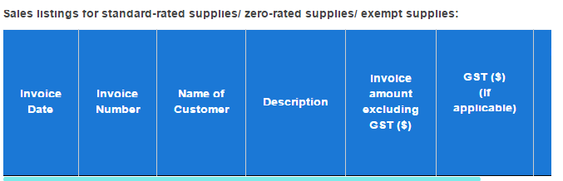
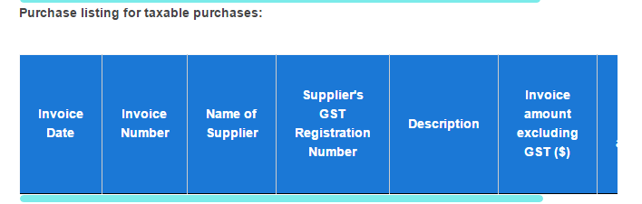
  GST Audits Findings In Singapore
  Inland Revenue Authority Of Singapore
Sales and Purchases Listings
You should maintain sales and purchases listings to support the figures reported in your GST returns.
During an audit, the listings are to be provided in the form of an IRAS Audit File (IAF).
What is IRAS Audit File (IAF)
An IRAS Audit File (IAF) is a data file containing standardised accounting information required for audit purposes. Accounting software capable of producing IAF ensure that the information transmitted is in a format that is readable by us.
REMINDER!!!!
If you are not using accounting software capable of generating an IAF, you should ensure that the listings are provided in Microsoft Excel file type with the following information. An image reproduction of your listings (e.g. in PDF file type) is not acceptable.

Slide 87
  Case Studies – Singapore & Australia

Slide 88
  Case Studies in Singapore
No. | Issue(s) | Situation | Result
1 | Unlawful GST collection | The sole-proprietor is not GST registered However, they had unlawfully collected GST. | Penalty is three times of GST unlawfully collected and fine. 50 days of imprisonment.
2 |  | The Company and the company’s manager are not GST registered. The company’s manager was issuing of invoice and charged GST to customer. | The Company face a fine and penalty of three times of GST unlawfully collected and fine. The Company’s manager face a fine and penalty of three times of GST unlawfully collected and fine.
3 | Not account for GST output tax | The director of Company, who is responsible for GST filing did not account for GST collected as an output tax in the company's GST return. | The Company and the company’s director have to pay a penalty of two times the amount of GST evaded and fine.

Slide 89
  Case Studies in Singapore
No. | Issue(s) | Situation | Result
4 | Fraudulent GST Refund Claims | The mastermind had made use of the names of several acquaintances and her husband to set up various shell businesses with the intention of defrauding the government of the GST refund. She then assisted these shell businesses to make false declarations on their respective GST returns. Through these shell businesses, she had fraudulently claimed in GST refund. | 8 weeks in jail and penalty of three times the amount of GST refund fraudulently claimed.
5 |  | The mastermind had fabricated purchases and sales records, and declared the fictitious figures as taxable purchases and supplies in the GST returns in order to claim GST refunds. Then, he was altered invoices were included in the Company purchase listings which were then used as supporting documents for fictitious GST refund claims. He had also conspired with another Company (AC), to claim fictitious GST refunds from IRAS in the GST returns of AC. He had issued invoices of Company to AC to enable the latter to claim the GST amount as input tax in its GST returns, even though there were no transactions made. | The mastermind was jailed for 54 months and ordered to pay a penalty of three times the total amount of tax undercharged. AC was charged and convicted for their part in the fraud, and was sentenced to 14 months’ imprisonment and penalty.

Slide 90
  Tribunal Appeal Cases in Australia
Cases | Result
Crown Estates (Sales) Pty Ltd and Commissioner of Taxation [2015] AATA 949 The applicant was not entitled to claim input tax credits in respect of acquisitions made in providing property management services to owner-clients. The applicant was acting as the agent of those owner-clients. | The Commissioner decided the shortfall arose because the taxpayers were reckless with regard to the operation of the taxation laws. That meant a base penalty amount of 50% was appropriate.

Slide 91
  Tribunal Appeal Cases in Australia
Cases | Result
Lansell House Pty Ltd & Anor v FC of T4 The taxpayers sold an imported food product called Mini Ciabatte, which was describe as Italian Flat Bread. They claimed it was bread and not biscuit which means it is GST free. | A supplier cannot by a label govern the classification of a product for the purpose of the GST Act. The Italian Flat Bread is charged with GST.

Slide 92

T
H
A
N
K
Y
O
U
www.salihin.com.my | www.mysalihin.com
1 300 88 5678
Copyright Controlled 2016 @ SALIHIN

