Slide 1




GOODS AND SERVICES TAX (GST) AND ACCOUNTING SYSTEM OF COMPANIES
Accounting & Financial Reporting
En. Salihin Abang
21 September 2015
Hotel Grand Bluewave, Shah Alam.
Copyright © 2015 SALIHIN

Slide 2

Agenda
Introduction: Financial Reporting Ecosystem
Regulatory Requirements
  Companies Act 1965
  Financial Reporting Act 1997
  Accounting Standards- Financial Reporting Standards
  MASB: MFRS & MPERS
  IASB: IFRS, IFRS for SMEs & Structure
The Business Entity
Financial Statements
  Income Statement, Balance Sheet, Statement of Changes in Equity, Cash Flow Statement & Notes
Exercise & Case Study
GST & Financial Reporting

Slide 3
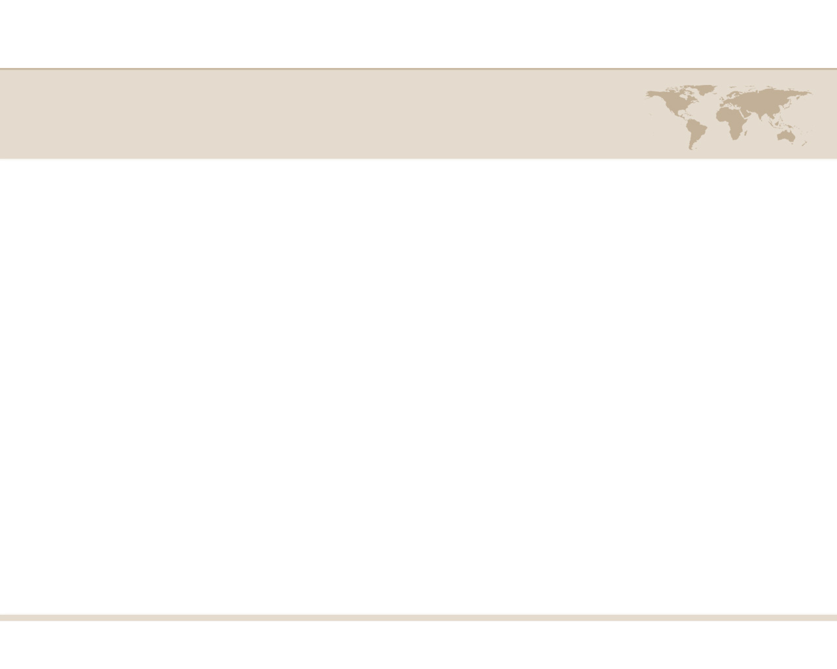
Definition of Accounting
Narrowly,
it is the art of recording, classifying, and summarizing in a significant manner and in terms of money, transactions and events which are in part at least, of a financial character and interpreting the result thereof.
Broadly,
It is the process of identifying, measuring, and communicating economic information to permit informed judgements and decisions by users of the information

Slide 4
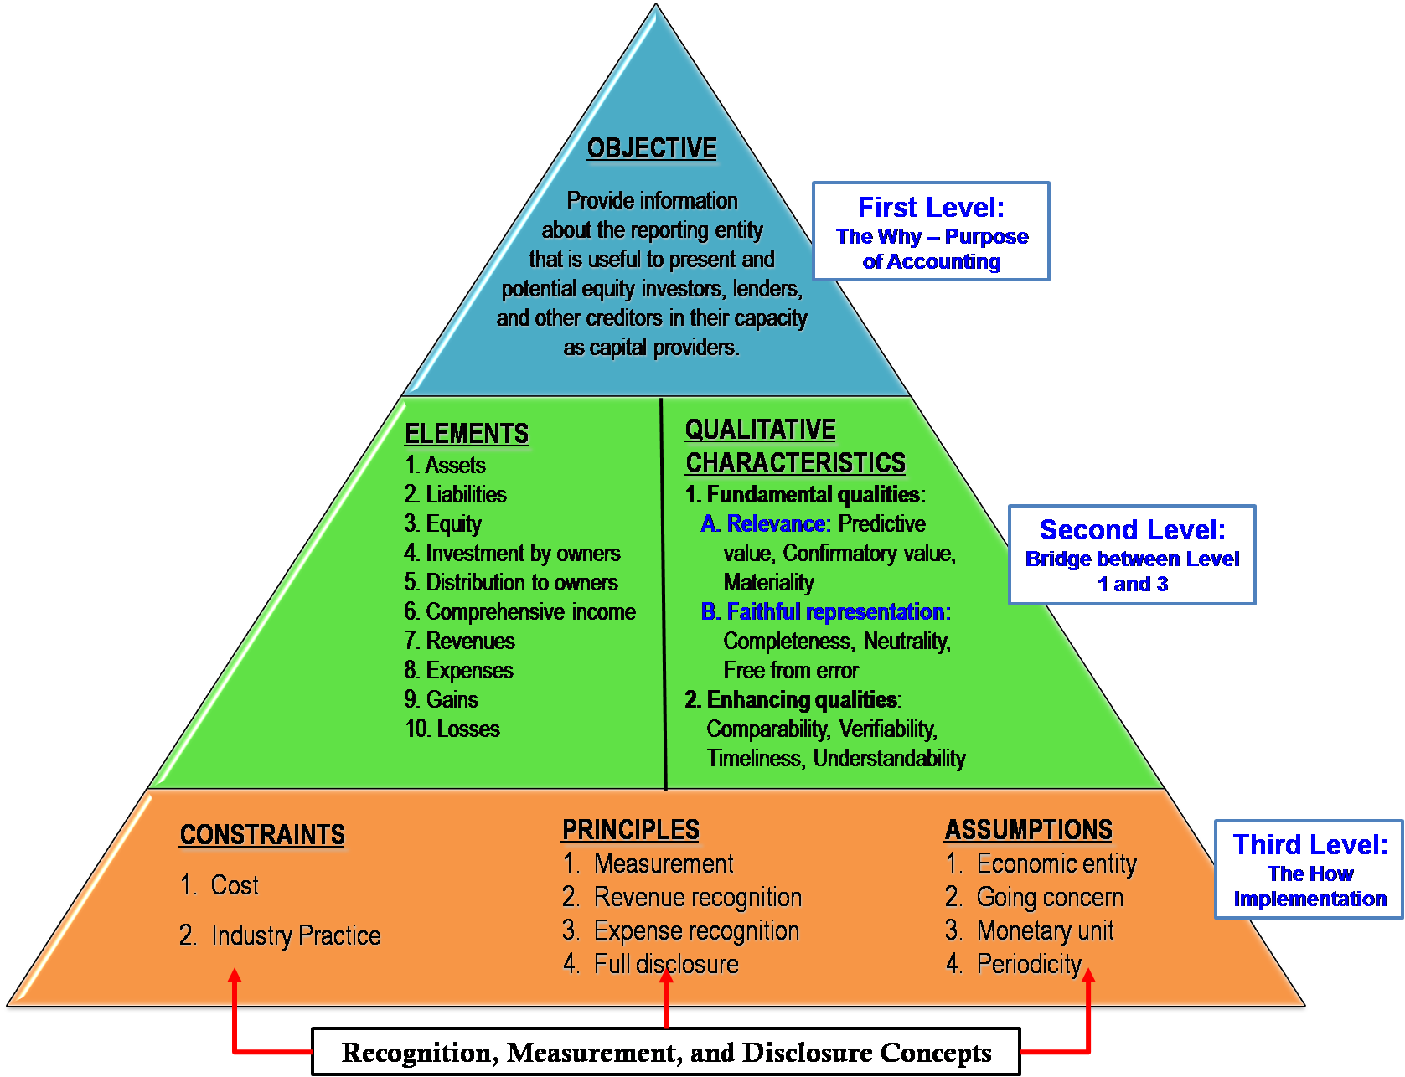
Conceptual Framework for FR

Slide 5
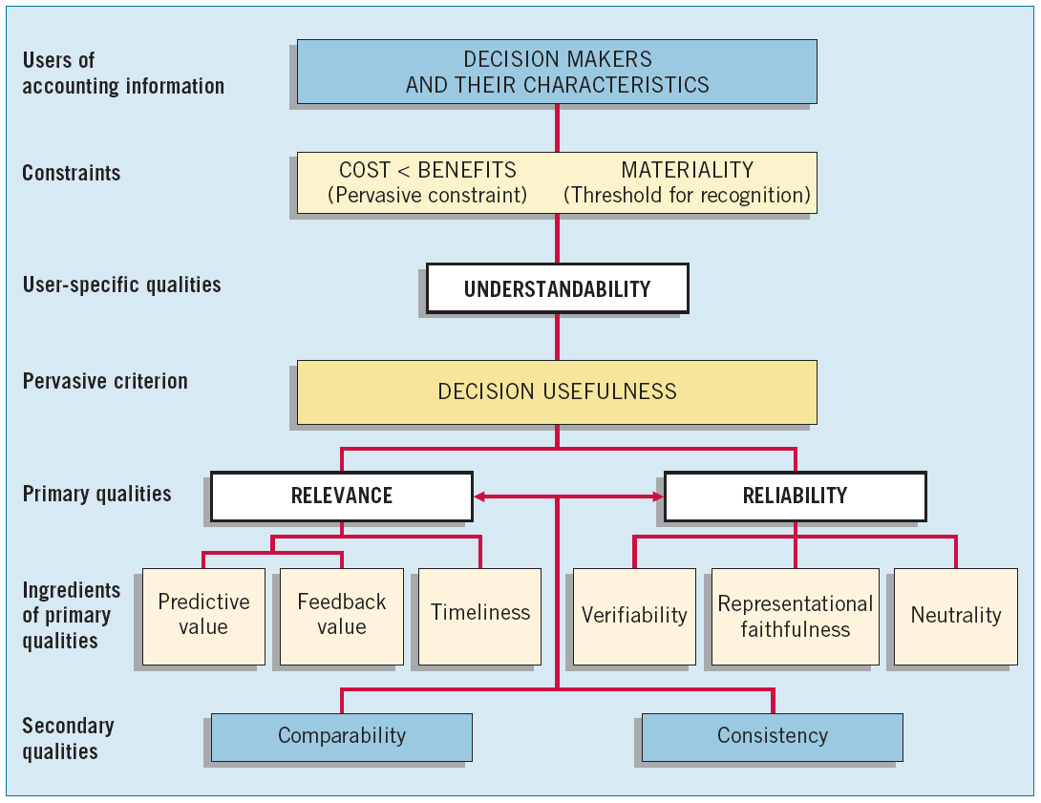
Qualities of Accounting Information

Slide 6
The Financial Reporting Ecosystem
Companies
Regulators
Securities Commission
Bank Negara
Bursa Malaysia
Company Commission
Others- AOB
Auditors
Annual
Reports
Standard Setters
FRF, MASB
IASB
Users &
Other stakeholders

Slide 7
Regulatory Requirements
In preparing and presenting financial statements, companies in Malaysia are to comply with the following:
Companies Act 1965
Financial Reporting Act 1997
Accounting Standards
Income Tax Act 1967
The Securities Commission Guidelines 1995
KLSE Listing Requirement
Bank Negara Malaysia Guidelines

Slide 8
Companies Act 1965
Is the main legislation governing the formation and operation of companies in Malaysia.
It provides the rules on accounting and requirement for true and fair view reporting.
Section 167;
  Every company must keep proper accounting and other records to sufficiently explain the transactions and financial position of the company and to enable true and fair profit and loss accounts and balance sheets and related documents to be prepared from time to time
Disclosure requirements are set out in the 9th Schedule

Slide 9
Companies Act 1965
Section 167
The accounts must be recorded and kept in such manner as to enable them to be conveniently and properly audited;
Entered in the accounting records within 60 days of the completion of transactions to which they relate;
Retained for 7 years after the completion of the related transactions or operations; at the registered office, or at such other place as the directors think fit.
Accounts be prepared in English or national language(s360)

Slide 10
Companies Act 1965
Section 169;
Annual reports shall be presented at the AGM of the company.
The 1st AGM of shareholders should be held not later than 18 months after the date of incorporation of the company
Subsequent AGM shall be held at least once every calendar year, and at intervals not more than 15 months from the last general meeting

Slide 11
Companies Act 1965
Section 169
Laying of accounts (s169); audited, approved and adopted by board of directors:
  Profit and Loss account
  Balance Sheet
  Directors report
  Statements of Directors
  Statutory declaration made by directors
  Auditors report
  Consolidated Profit and Loss account and Balance Sheet where applicable

Slide 12
Companies Act 1965
Section 166A w.e.f. 1.9.1998,
Compliance with approved accounting standards in accordance with S27 of FRA 1997
Directors to ensure that accounts are made out in accordance with applicable approved accounting standards
Disclosure by way of a note if compliance would not give a true and fair view of the results of the business and the state of affairs of the company or group (true and fair view over-ride of approved accounting standards)
Conflict or inconsistency arises between approved accounting standards and 9th Schedule, applicable approved accounting standard shall prevail.

Slide 13
Financial Reporting Act 1997
The bodies responsible for stetting accounting standards in Malaysia are:
  Financial Reporting Foundation (FRF) and
  Malaysian Accounting Standards Board (MASB)
  FRF is established under the Financial Reporting Act 1997.
  The FRF comprises representation from all relevant parties in the standard setting process, including preparers, users, regulators and the accountancy profession.
  The FRF oversights MASB's performance, financial and funding arrangements

Slide 14
Financial Reporting Act 1997
  The FRF serves an initial source of views for the MASB on proposed standards and pronouncements.
  It has no direct responsibility with regard to standard setting.
  Section 2 (amendment to s166A of Company Act 1965A);
    compliance with approved accounting standards
    enforcement authority to the standards issued by MASB.

Slide 15
Financial Reporting Act 1997
  Section 26;
  Compliance with FRS
  Section 27;
  Compliance with approved accounting standards for accounts to be prepared and lodged under any law administered by Securities Commission, Bank Negara Malaysia and the Company Commission of Malaysia.

Slide 16
Financial Reporting Standards
  Financial Reporting Standards (FRS) issued by MASB - ended 2011.
  Fully converged with the International Financial Reporting Standards (IFRS) from 1 January 2012.
  The Malaysian version of the IFRS is MFRS which is word to word of the IFRS.
  The required effective date for transitioning entities to migrate to MFRS is 1 January 2017

Slide 17
Financial Reporting Standards
  MASB’s Private Entities Reporting Standards (PERS) is applicable to private entities – ends December 2015,
  Private entities are to apply MPERS (Malaysian Private Entities Reporting Standard) effective 1 January 2016.
  Just like MFRS, the MPERS is word-for-word the IFRS for Small and Medium Enterprises, except for the requirements on income tax and property development activities as well as some terminology changes.

Slide 18
Financial Reporting Standards
  A private entity is a private company, incorporated under the Companies Act 1965, that -
  is not itself required to prepare or lodge any financial statements under any law administered by the Securities Commission or the Bank Negara Malaysia; and
  is not a subsidiary or associate of, or jointly controlled by, an entity which is required to prepare or lodge any financial statements under any law administered by the Securities Commission or the Bank Negara Malaysia.

Slide 19
Financial Reporting Standards
  Section 15(1) of the Companies Act 1965, a company having a share capital may be incorporated as a private company if its memorandum or articles-
  restricts the right to transfer its shares;
  limits to not more than fifty the number of its members;
  prohibits any invitation to the public to subscribe for any shares in or debentures of the company; and
  prohibits any invitation to the public to deposit money with the company for fixed periods or payable at call, whether bearing or not bearing interest.

Slide 20
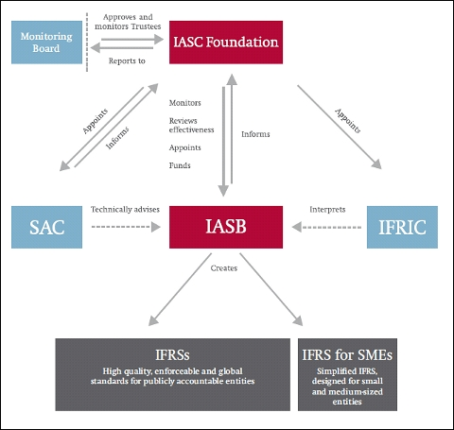
Financial Reporting Standards
MFRS
MPERS

Slide 21
Financial Reporting Standards
  The idea of IFRS was conceived in 1960
  IFRS required by European Union on all European companies trading in the European Securities Market in 2005 and all non-European companies in 2007.
  So far 140 jurisdictions, representing all parts of the globe, have adopted or planned to adopt.
  130 are committed to a single set of high quality global accounting standards.

Slide 22
Financial Reporting Standards
  132 jurisdictions have made a public commitment to IFRS as the single set of global accounting standards.
  IFRS is mandatory in 116 countries.
  Thailand is in the process of full adoption,
  Indonesia is in the process of substantially (though not entirely) converging its national standards with IFRS.
  Bhutan is to start using IFRS in 2021
  IFRS is yet to be adopted by the US.

Slide 23
List of MFRS/IFRS
MFRS | IFRS
MFRS 1 | IFRS 1 | First-time Adoption of International Financial Reporting Standards
MFRS 2 | IFRS 2 | Share-based Payment
MFRS 3 | IFRS 3 | Business Combinations
MFRS 4 | IFRS 4 | Insurance Contracts
MFRS 5 | IFRS 5 | Non-current Assets Held for Sale and Discontinued Operations
MFRS 6 | IFRS 6 | Exploration for and Evaluation of Mineral Assets
MFRS 7 | IFRS 7 | Financial Instruments: Disclosures
MFRS 8 | IFRS 8 | Operating Segments
MFRS 9 | IFRS 9 | Financial Instruments

Slide 24
List of MFRS/IFRS
MFRS | IFRS
MFRS 10 | IFRS 10 | Consolidated Financial Statements
MFRS 11 | IFRS 11 | Joint Arrangements
MFRS 12 | IFRS 12 | Disclosure of Interests in Other Entities
MFRS 13 | IFRS 13 | Fair Value Measurement
MFRS 14 | IFRS 14 | Regulatory Deferral Accounts
MFRS 15 | IFRS 15 | Revenue from Contracts with Customers
MFRS 101 | IAS 1 | Presentation of Financial Statements
MFRS 102 | IAS 2 | Inventories
MFRS 107 | IAS 7 | Statement of Cash Flows
MFRS 108 | IAS 8 | Accounting Policies, Changes in Accounting Estimates and Errors

Slide 25
List of MFRS/IFRS
MFRS | IFRS
MFRS 110 | IAS 10 | Events After the Reporting Period
MFRS 111 | IAS 11 | Construction Contracts
MFRS 112 | IAS 12 | Income Taxes
MFRS 116 | IAS 16 | Property, Plant and Equipment
MFRS 117 | IAS 17 | Leases
MFRS 118 | IAS 18 | Revenue
MFRS 119 | IAS 19 | Employee Benefits
MFRS 120 | IAS 20 | Accounting for Government Grants and Disclosure of Government Assistance
MFRS 121 | IAS 21 | The Effects of Changes in Foreign Exchange Rates
MFRS 123 | IAS 23 | Borrowing Costs

Slide 26
List of MFRS/IFRS
MFRS | IFRS
MFRS 124 | IAS 24 | Related Party Disclosures
MFRS 126 | IAS 26 | Accounting and Reporting by Retirement Benefit Plans
MFRS 127 | IAS 27 | Separate Financial Statements
MFRS 128 | IAS 28 | Investments in Associates and Joint Ventures
MFRS 129 | IAS 29 | Financial Reporting in Hyperinflationary Economies
MFRS 132 | IAS 32 | Financial Instruments - Presentation
MFRS 133 | IAS 33 | Earnings per Share
MFRS 134 | IAS 34 | Interim Financial Reporting
MFRS 136 | IAS 36 | Impairment of Assets
MFRS 137 | IAS 37 | Provisions, Contingent Liabilities and Contingent Assets

Slide 27
List of MFRS/IFRS
MFRS | IFRS | Title
MFRS 138 | IAS 38 | Intangible Assets
MFRS 139 | IAS 39 | Financial Instruments - Recognition and Measurement
MFRS 140 | IAS 40 | Investment Property
MFRS 141 | IAS41 | Agriculture

Slide 28
The Business Entity
3 General Types of Business Activities
Financing Activities
Investing Activities
Operating Activities
ABC Sdn Bhd
A business entity is separate from the personal affairs of its owner.

Slide 29
The Business Concept
Sole Proprietorship
Business
Sdn. Bhd.
Artificial Person
(Going Concern)
Companies Act 1965
Partnership
Business
Bhd.
Raise Capital
OPBIT
Revenue
Expense
Shareholders
Power To:
Invest
Sue/Be Sued
Interest
Goods
Services
BoD
NPBIT
Purchase Asset
Raise Capital
Gov’t Tax
Shareholder
Equity
Borrowing
Debtholder
NPAIT
Dividend
Fixed Interest

Slide 30
Financial Statements
Statement of comprehensive income
(Profit & Loss Account)
Statement of financial position
(Balance Sheet)
Statement of changes in equity
Statement of cash flows
Notes to accounts

Slide 31
Financial Statements
Beginning of period
End of period
Time
Balance Sheet
Balance Sheet
Income Statement
Statement of Cash Flows

Slide 32
Income Statement
Summarizes revenues and expenses for a designated period of time: month, quarter, or year.
If revenue > expense = Net Income.
Reports operating success or failure for a period.
Debtholders
Income Tax Act 1967-Government
The Accrual and Matching Principles

Slide 33
Income Statement
Dated for a specific period
Reconciles beginning and ending balances of the stockholders’ equity accounts
  Common Stock
  Retained Earnings, etc.
Links the income statement and the balance sheet
Shareholders

Slide 34
Balance Sheet
Depicts financial position as at a specific date
Reports assets and claims to assets.
Claims of creditors, liabilities.
Claims of owners, stockholders’ equity.
Assets = Liabilities + Stockholders’ Equity
Assets = Liabilities + Owners’ Equity

Slide 35
The main elements
Asset
resource controlled by the entity
result of past event
expected inflow of economic benefits
Liability
present obligation
arising from past event
expected outflow of economic benefits
Income
recognised increase in asset/decrease in liability in current reporting period
that result in increased equity
Expense
recognised decrease in asset/increase in liability in current reporting period
that result in decreased equity

Slide 36
Cash flow statement
Business Activities
Operating Activities
Investing Activities
Financing Activities
How much capital raised?
How much invested?
How much generated from operation?

Slide 37
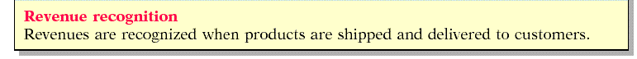
Notes to the accounts
Explanatory notes and supplementary schedules
Clarifies information in financial statements
Expands with additional detail
Describes accounting policies
Explains uncertainties and contingencies
An integral part of the financial statements

Slide 38
Exercise- EFG Sdn. Bhd.
EFG begins on Jan. 1, 2013
For the year ended Dec. 31, 2013, prepare
  Income statement
  Statement of changes in equity
  Balance sheet
  Cash flow statement

Slide 39
Exercise- EFG Sdn. Bhd.

Slide 40
Exercise- EFG Sdn. Bhd.

Slide 41
Exercise- EFG Sdn. Bhd.

Slide 42
Exercise- EFG Sdn. Bhd.

Slide 43
Case Study

Slide 44
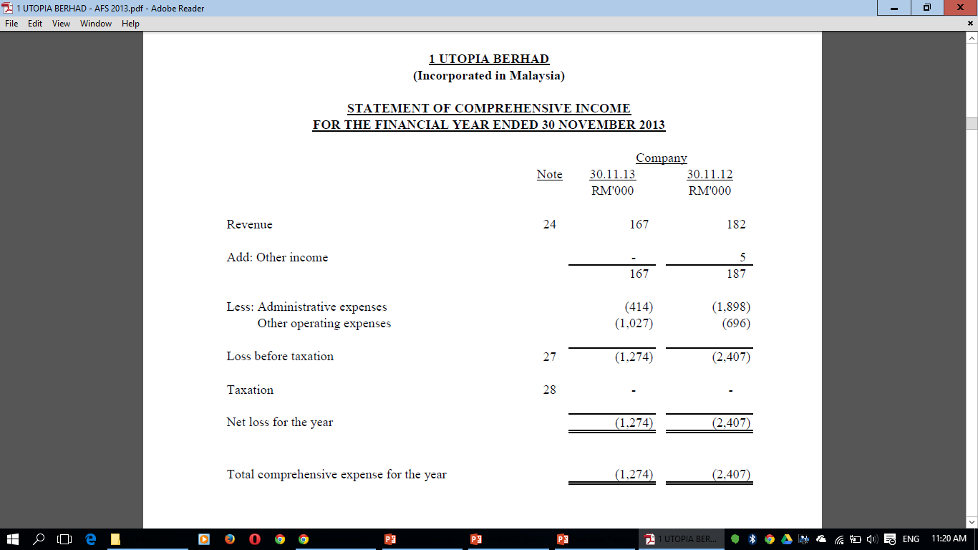

Slide 45
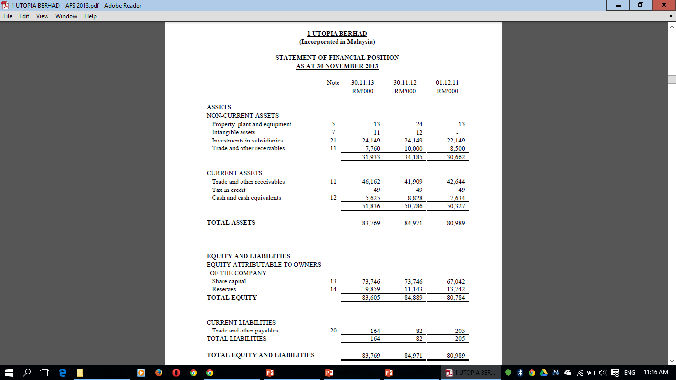

Slide 46
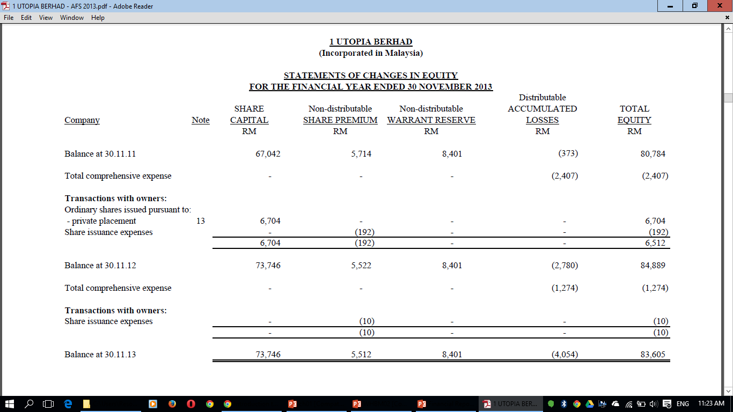

Slide 47
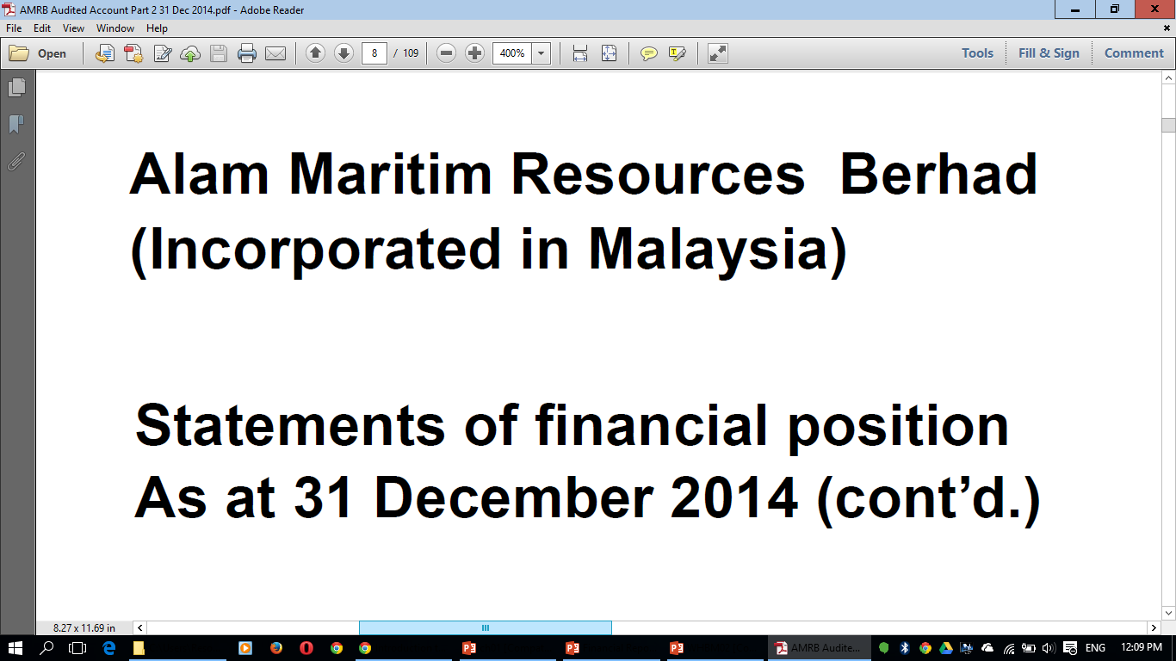

Slide 48
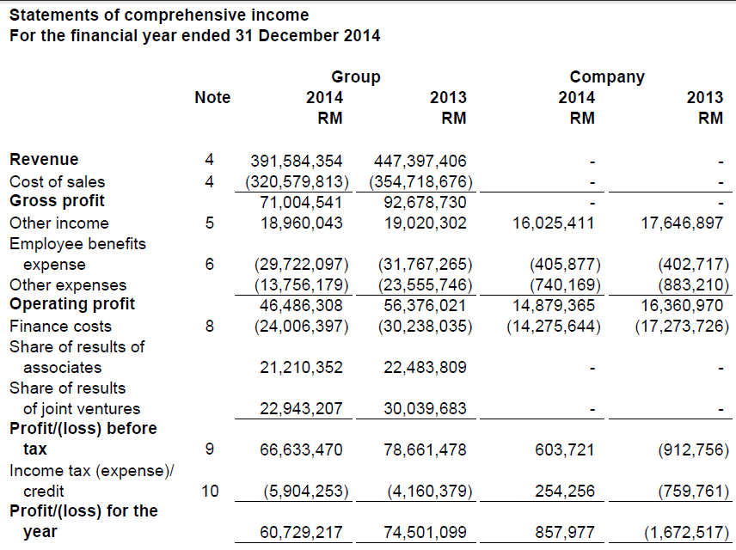

Slide 49
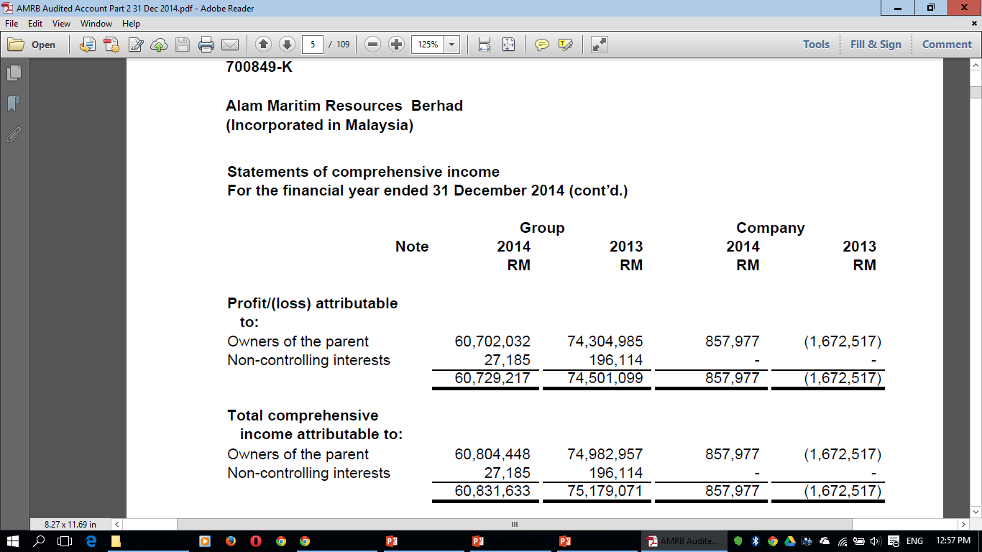

Slide 50
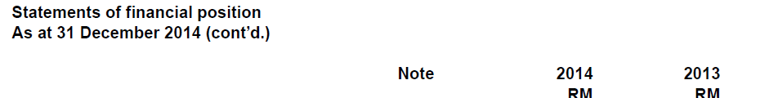
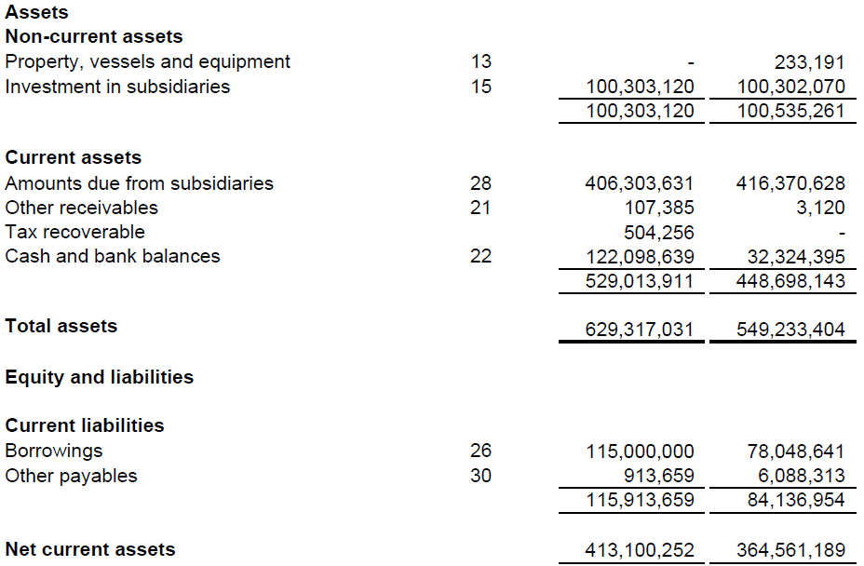

Slide 51
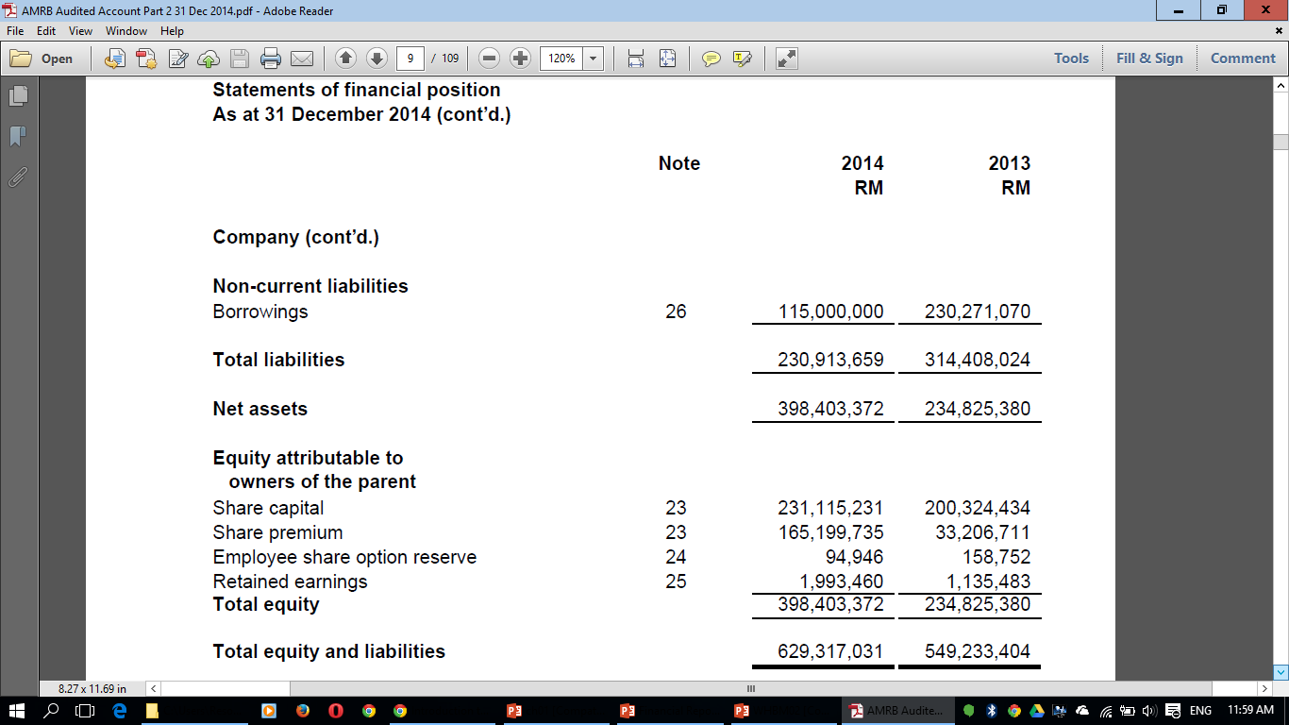

Slide 52
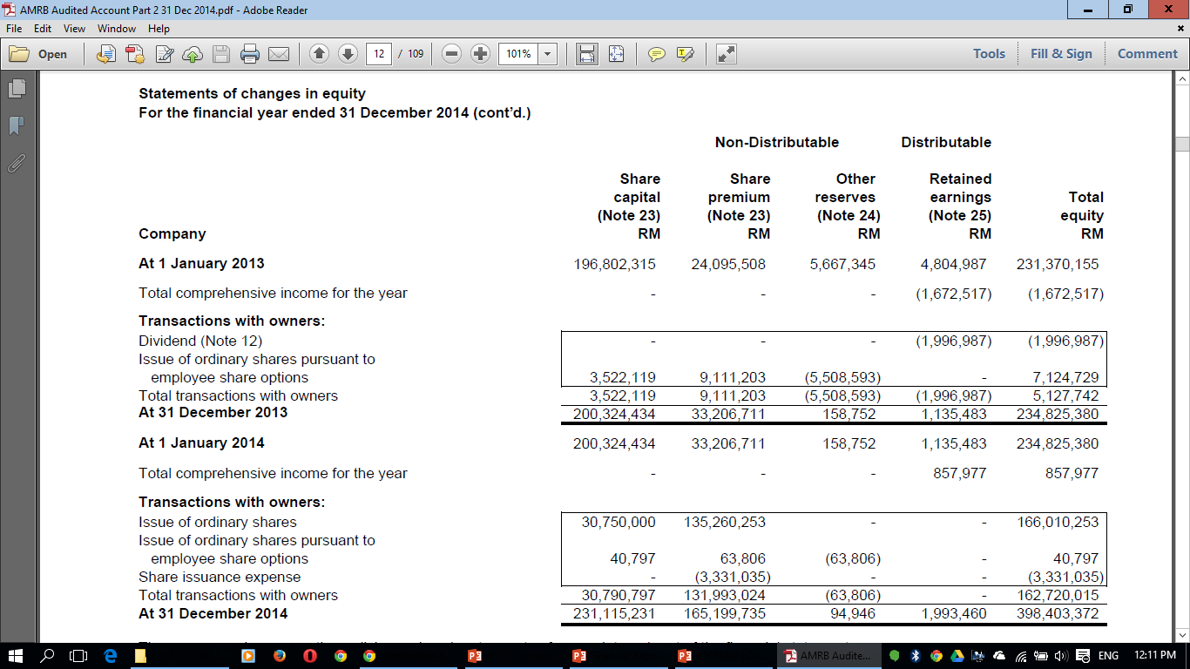

Slide 53
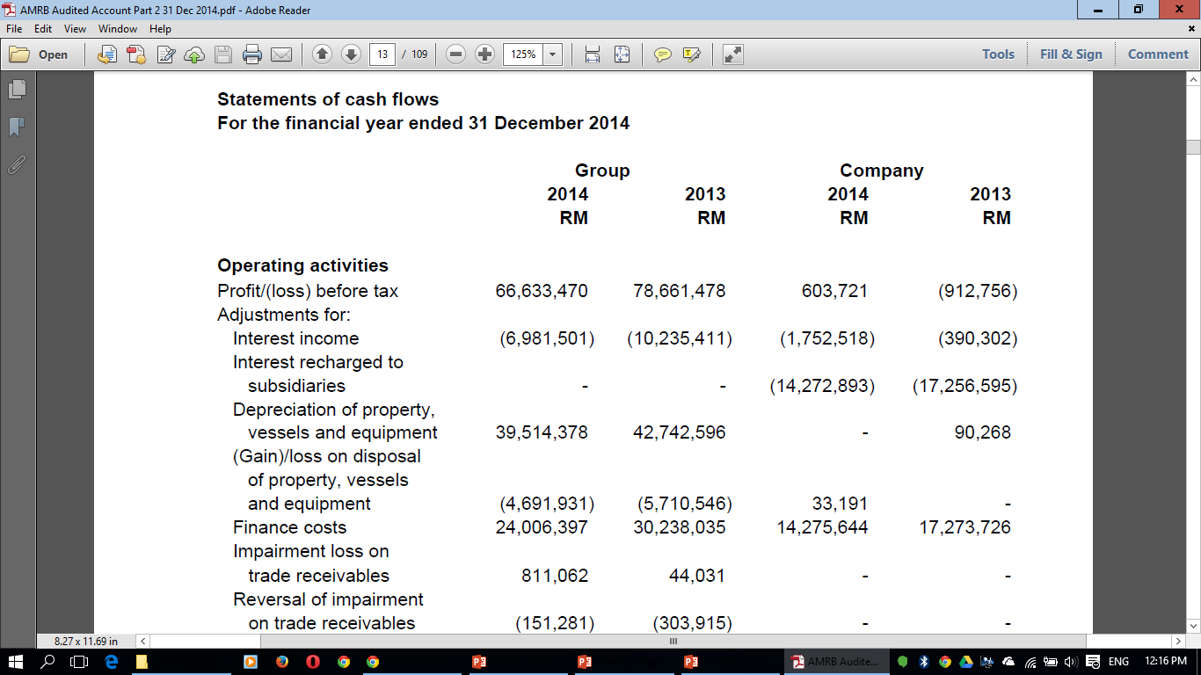
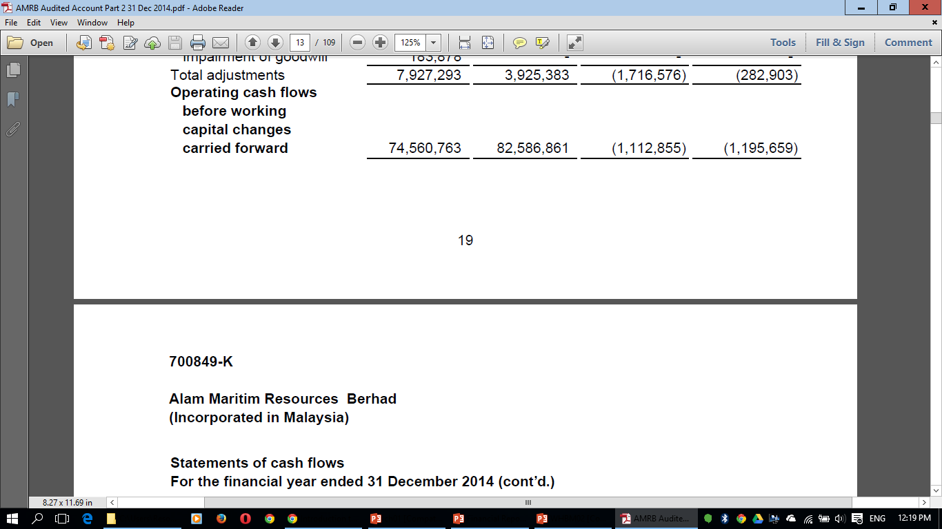

Slide 54
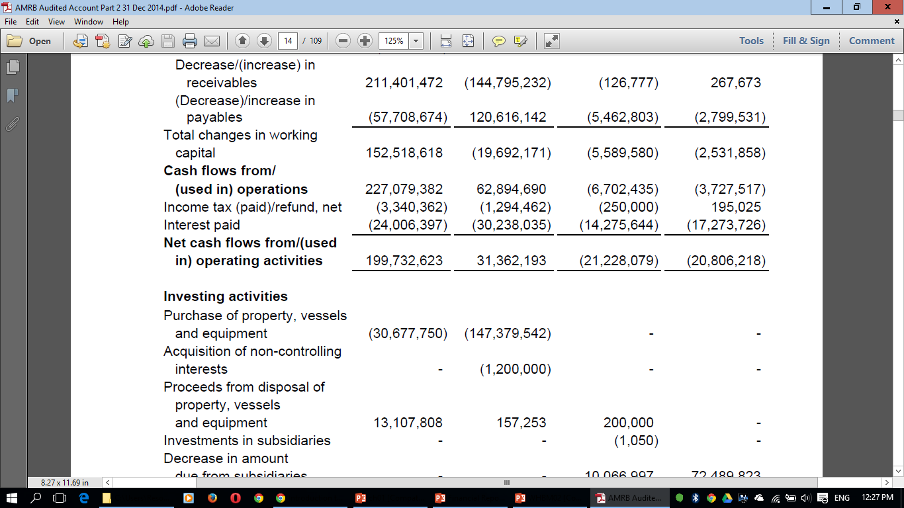
Cont’d

Slide 55
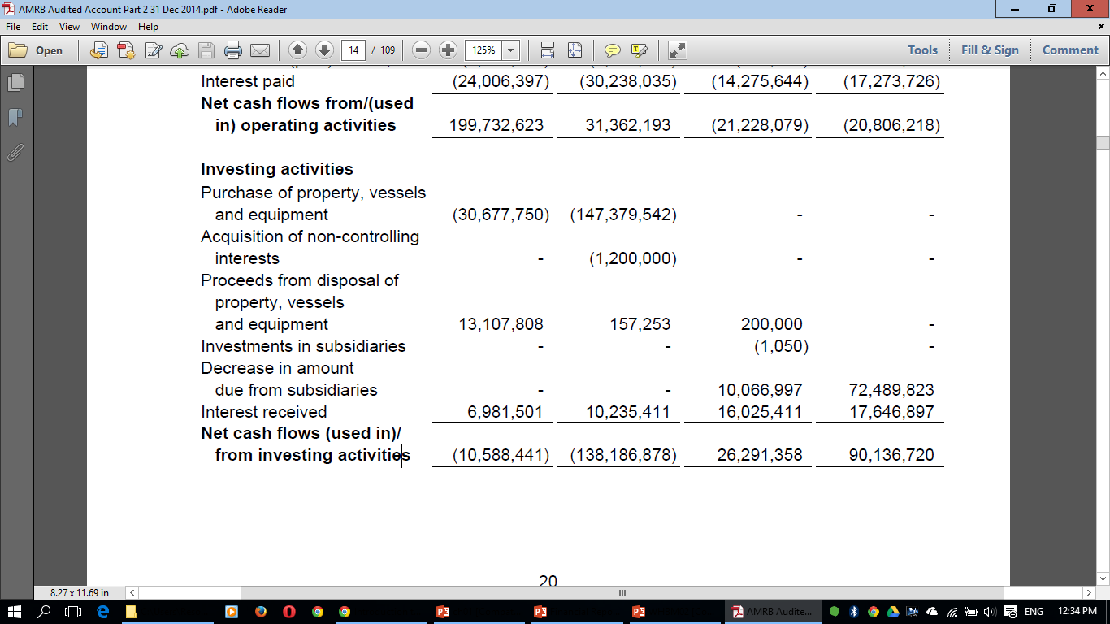
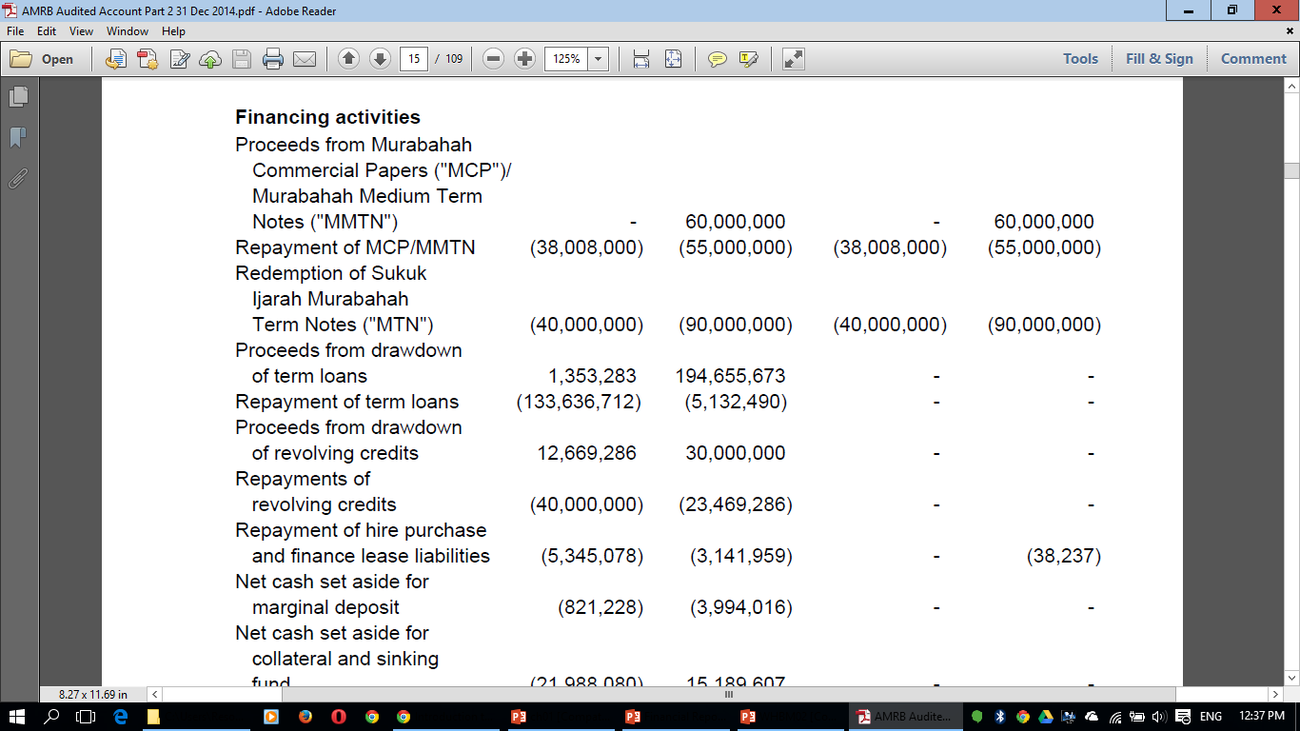
Cont’d
Cont’d

Slide 56
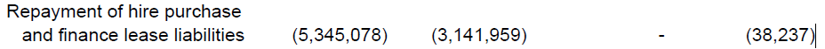
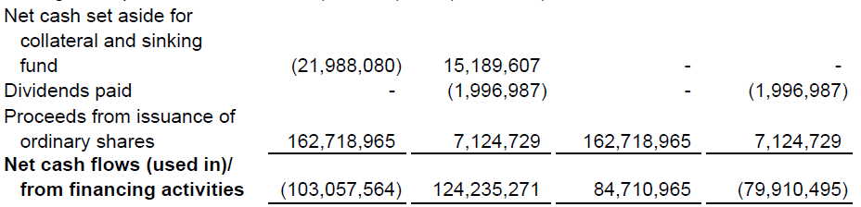
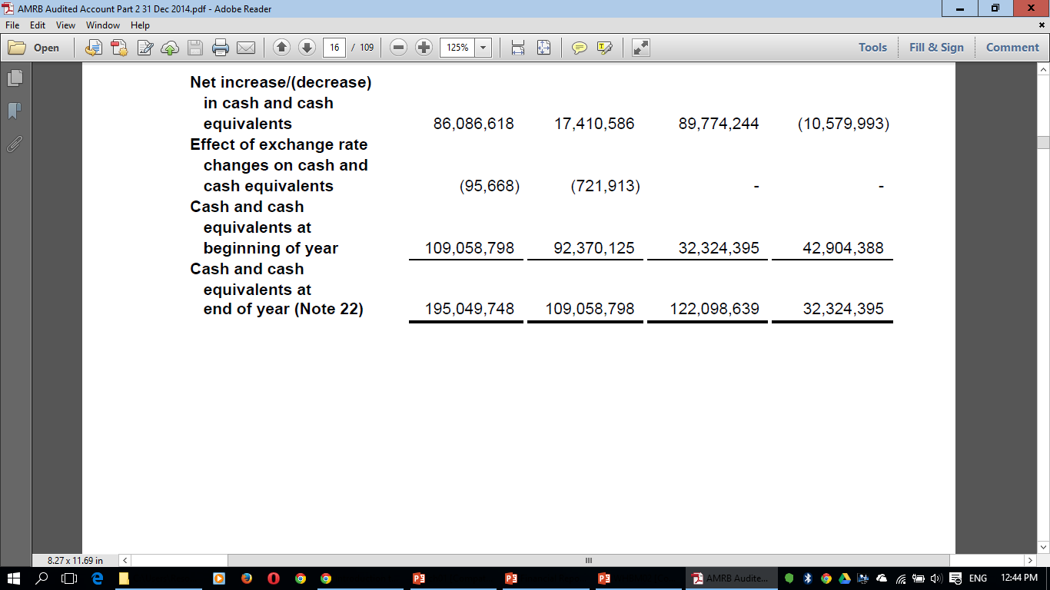
(Cont’d)

Slide 57
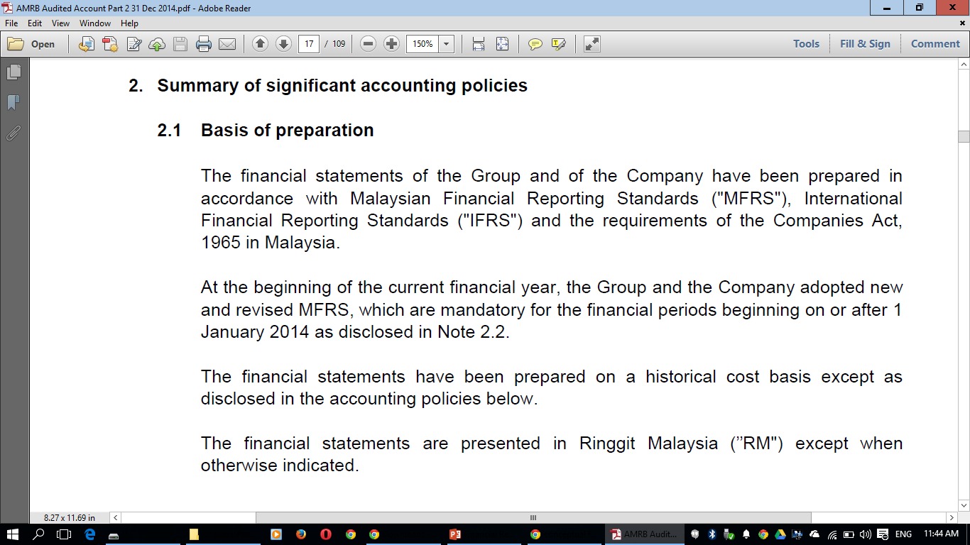
SAMPLE NOTES TO THE ACCOUNTS

Slide 58
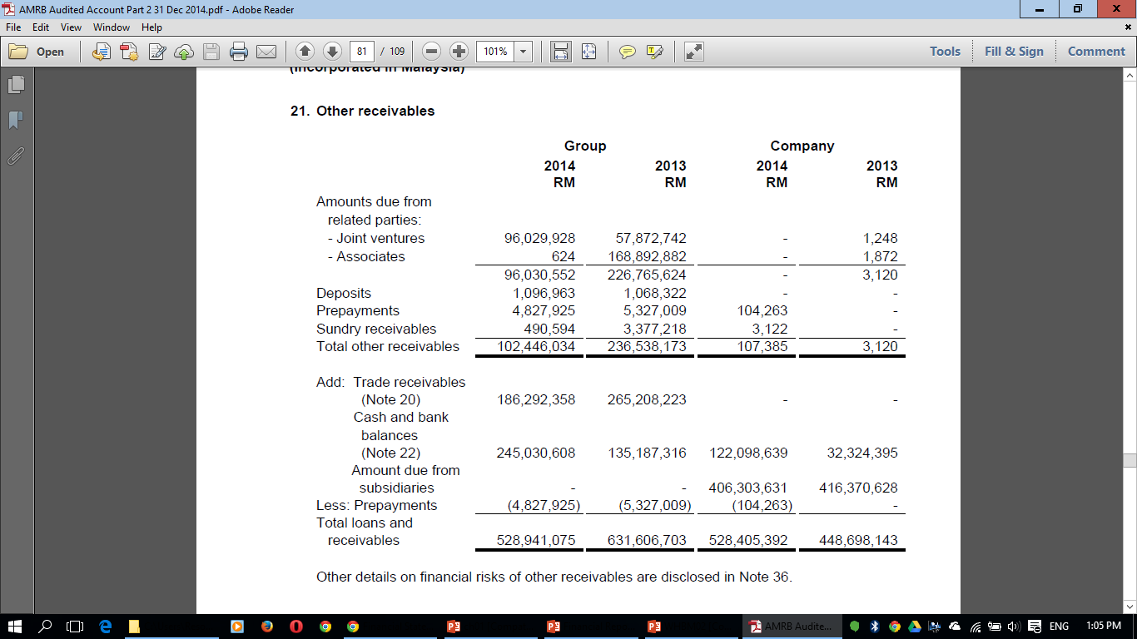
SAMPLE NOTES TO THE ACCOUNTS

Slide 59
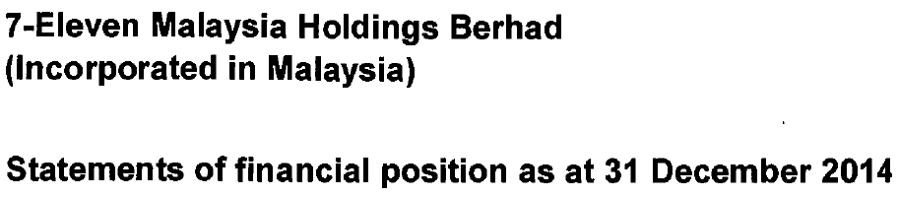

Slide 60
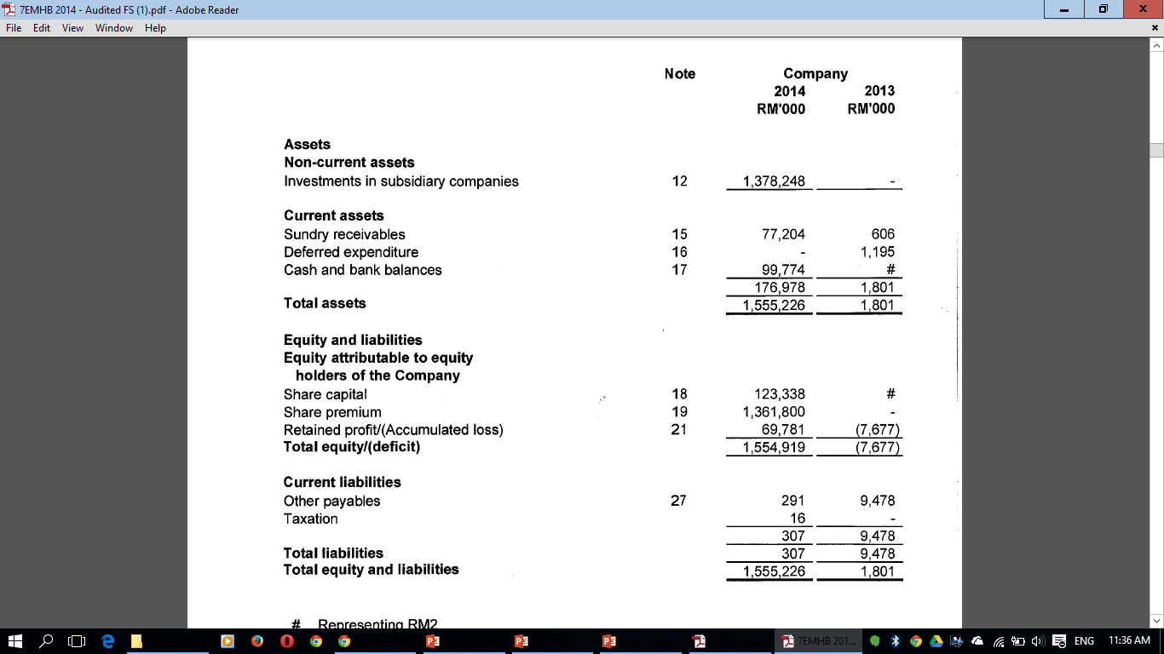

Slide 61
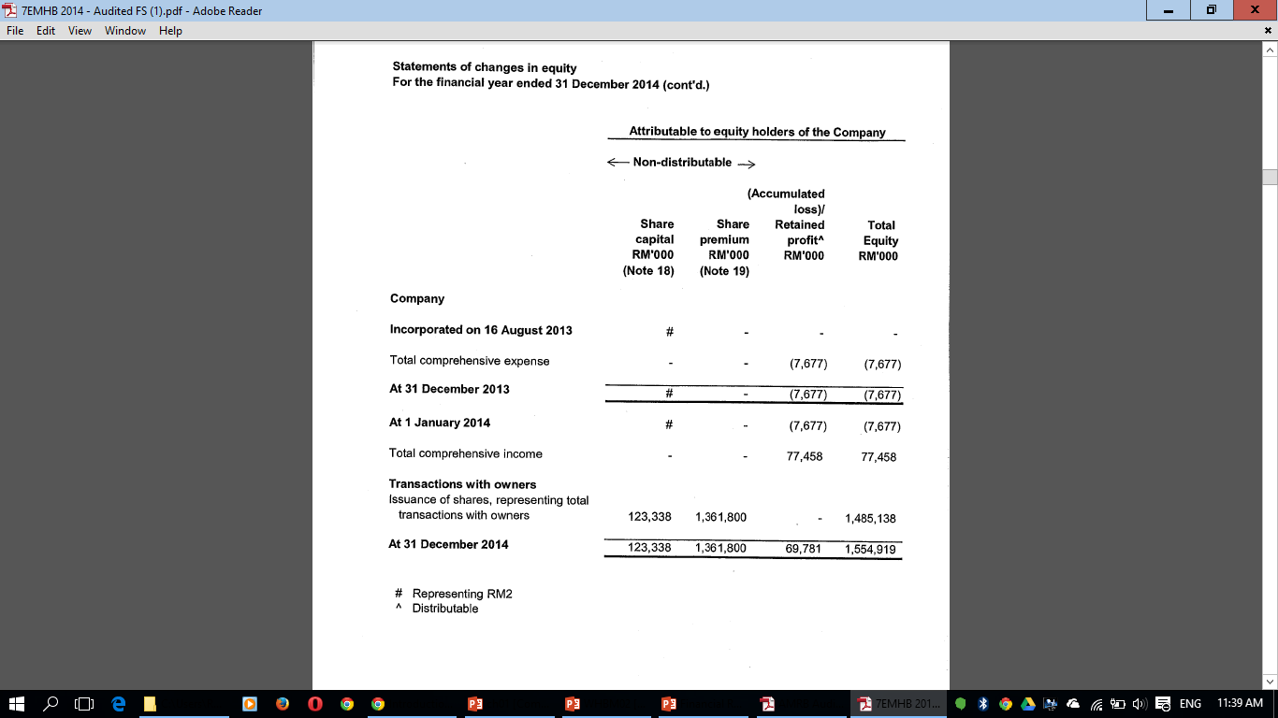

Slide 62
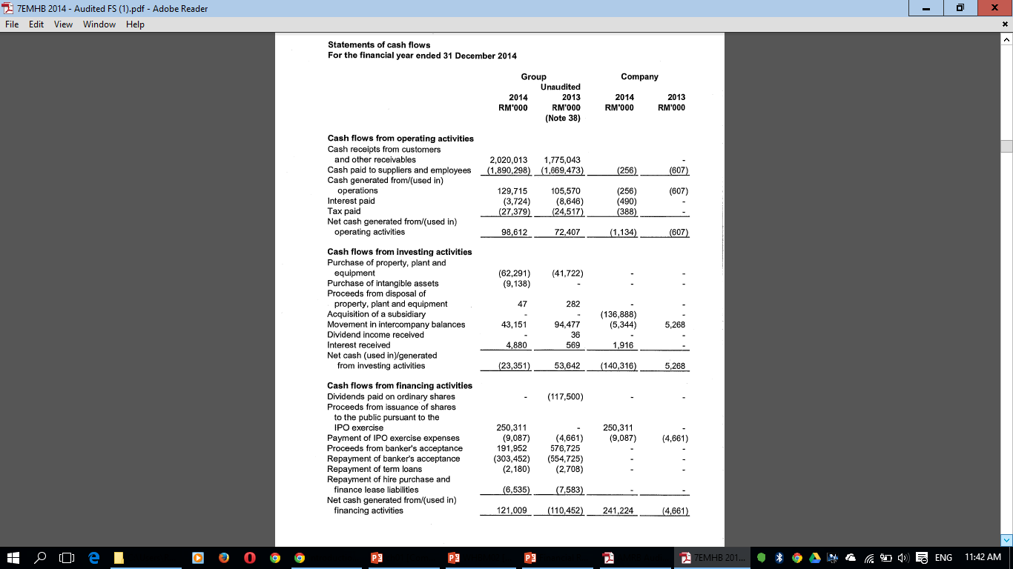

Slide 63
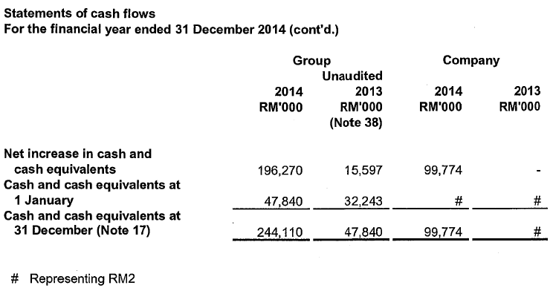

Slide 64
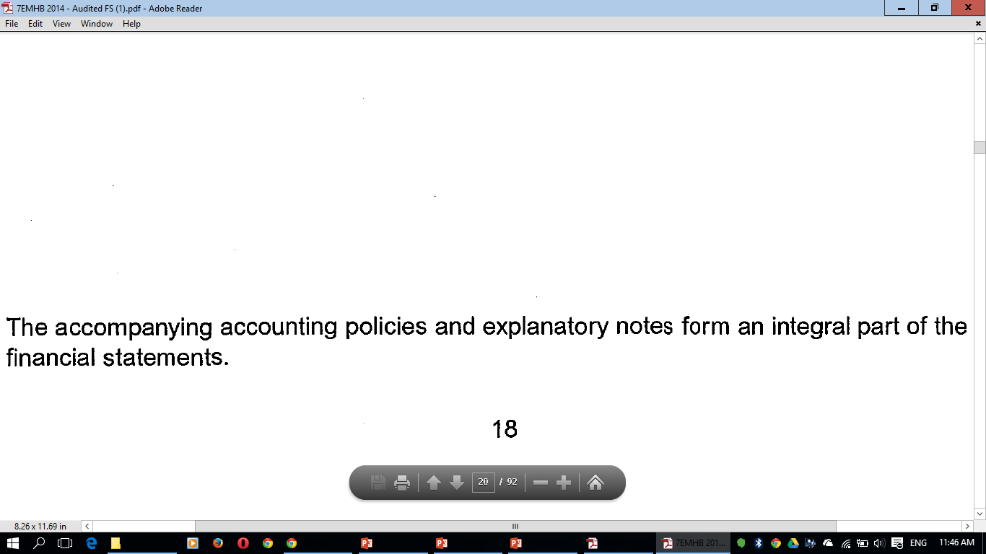
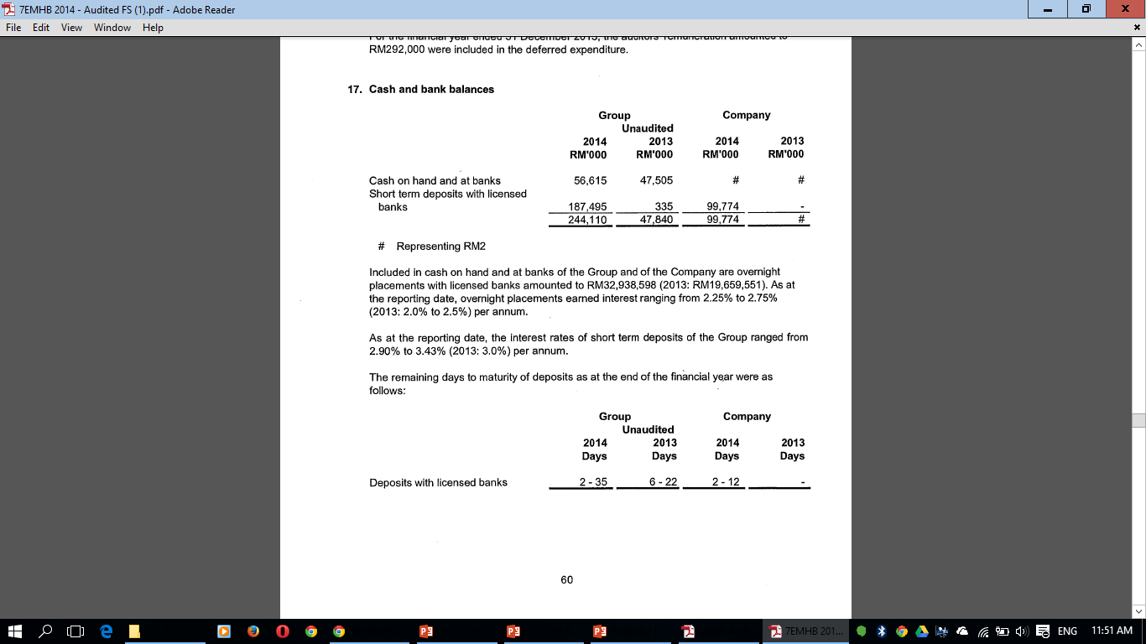

Slide 65
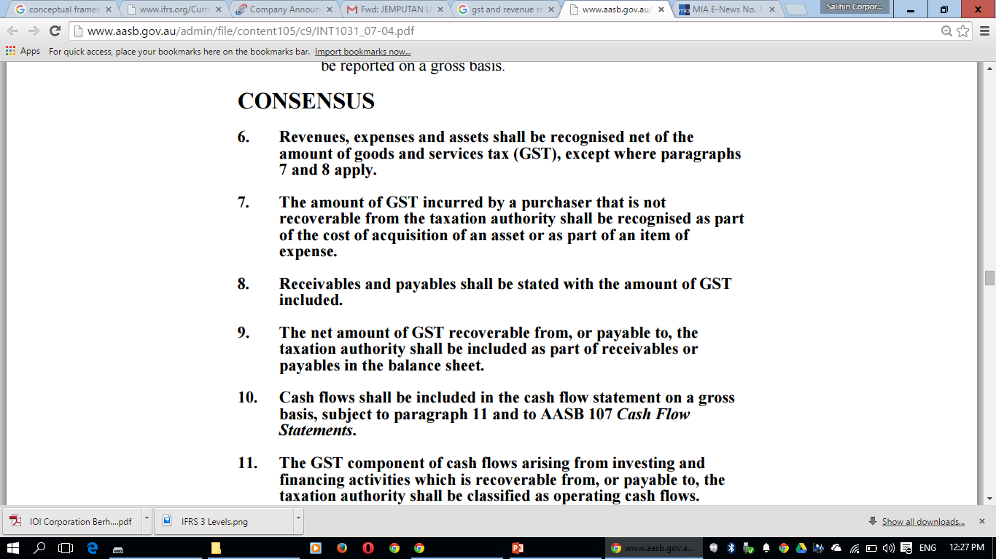
GST AND FINANCIAL REPORTING
Source: Australian Accounting Standards Board, 2004

Slide 66

THANK YOU

Slide 67


Unit 2A-1, Level 1 , Tower 2A, Plaza Sentral
Jalan Stesen Sentral 5, KL Sentral, 50470, Kuala Lumpur.
+603-2261 4180 | info@salihin.com.my | www.salihin.com.my

