Slide 1


SALIHIN PREMIER SOLUTIONS
Prepared for:
Prepared by:

Slide 2
TABLE OF CONTENTS
SPS OVERVIEW 3
  WHY CHOOSE SPS 5
  CLIENTELE OVERVIEW 6
  SPS Modules 7
  SPS CORE FEATURES 8
  SPS SYSTEM REQUIREMENT 9
  SPS FUTURE ENHANCEMENT
AFTER SALES SUPPORT 10
  TYPES OF SUPPORT 11
SPS PRODUCT PRICING 12
CONTACT US 14
© SPS 2015. Strictly Private & Confidential

Slide 3
Sps overview

Slide 4


SPS OVERVIEW
SALIHIN PREMIER SOLUTIONS also known as SPS SOFTWARE , the intelligent software in the world that can manage numerous aspects of financial accounting including Goods and Services Tax (GST) and Zakat calculation, customized especially for Small and Medium Enterprises (SMEs).
GST
MSC
SYSTEM
ACCOUNTING
DEVELOPMENT
SME’S
TECHNOLOGY
MALAY
ENTREPRENUER
SOLUTIONS
INTELLIGENT
SPS SOFTWARE is an efficient and effective accounting software that accommodate invoicing and billing system of business process. The software is powered by the latest security features to secure data for optimal integrity and confidentiality. It is tailor made for small and medium industries by professional accountants.
© SPS 2015. Strictly Private & Confidential

Slide 5


WHY CHOOSE SPS?
100% DEVELOPED & OWNED BY MALAY BUMIPUTERA
BY ACCOUNTANTS FOR ACCOUNTANTS
CERTIFIED AND COMPLIED WITH RMCD’S REQUIREMENT
TAILOR MADE FOR SME’S
GST COMPLIANT
1st IN THE WORLD THAT OFFER ZAKAT & WAQF MODULE

Slide 6









CLIENTELE OVERVIEW
© SPS 2015. Strictly Private & Confidential

Slide 7
SPS MODULES
There is 5 main modules that makes the SPS Accounting software like no other’s.
Financial Module
Inventory Module
GST Module
Zakat Module
Waqf / Endowment Module

Slide 8
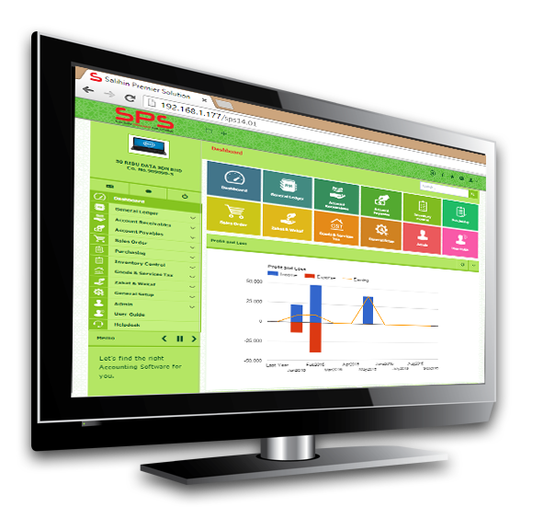
SPS CORE FEATURES
SPS Installer Faster & Easier
Predefined
Accounting Chart
Default GST Setup
Biz Dashboard
Regulate User Access
GST-03 Online
Submission
Dynamic Graph
Propagation
Void Unconfirmed
Transaction
Auto Notification of
Any New Update
Zakat Calculation
Enhancement
Simplified Tax Invoice
Auto Calculation Wakaf
Self Billed Tax Invoice

Slide 9
SPS SYSTEM REQUIREMENT
INTERNET
HARDWARE
SOFTWARE
Win 7 and above
Important note: Win XP & Win 2003 are not supported
Microsoft Office 2010 and above
A broadband internet connection will be required only for WAN environment and usage within an office will require a basic LAN configuration
1 GHz processor or faster
1 GB of RAM
10 GB of hard disk space
OPERATING SYSTEM

Slide 10
After sales support

Slide 11
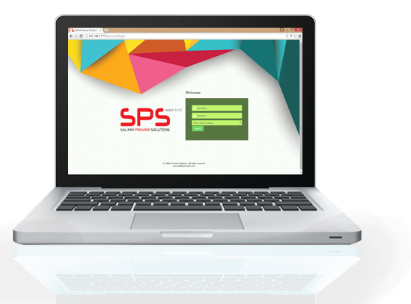
TYPES OF SUPPORT?
On-Site Support
TeamViewer
Helpdesk Support

Slide 12
Sps product pricing

Slide 13
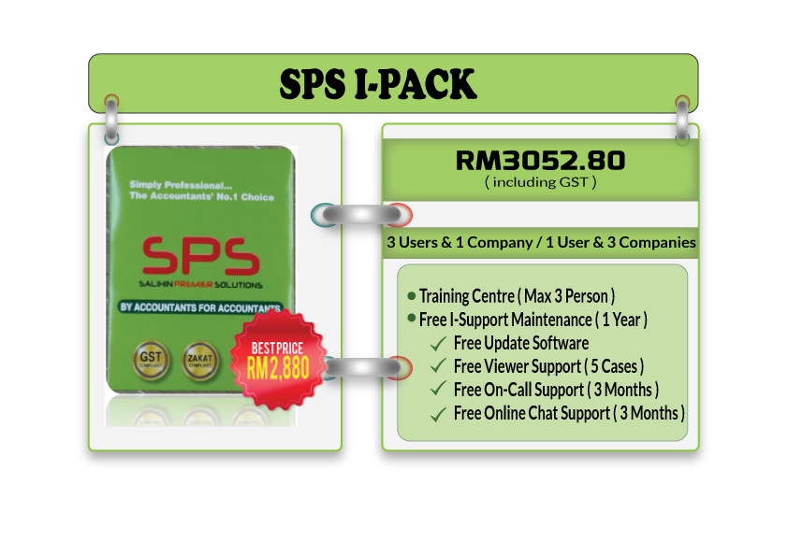

SPS I-PACK PRICING

Slide 14

CONTACT US
CORPORATE CENTRE:
KL Sentral Office
Unit 2A-1, Level 1
Tower 2A, Plaza Sentral
Jalan Stesen Sentral 5
KL Sentral
50470, Kuala Lumpur
Tel: +603 2261 4180
Fax: +603 2261 4182
CONSULTANT: FARHANA BT ZAHARI
EMAIL: farhana@salihin.com.my
Official Website : www.salihin.com.my
Customer Service : www.salihinpremier.com
E-mail : sales@salihinpremier.com
Careline : 1 300 88 5678

Slide 15

Official Website : www.salihin.com.my
Customer Service : www.salihinpremier.com
E-mail : sales@salihinpremier.com

