Slide 1



Taklimat Operasi Luar
Banci Ekonomi 2016
GOODS & SERVICES TAX (GST) :
  LATEST GST UPDATES
Prepared for:
Presented by:
En Salihin Abang
Managing Partner of SALIHIN
4th April 2016

Slide 2
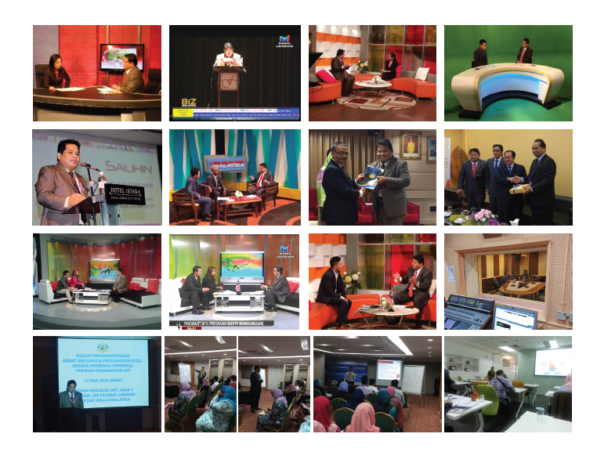
  ABOUT US
    SALIHIN EXPERIENCE IN GST TRAINING AND EDUCATION

Slide 3
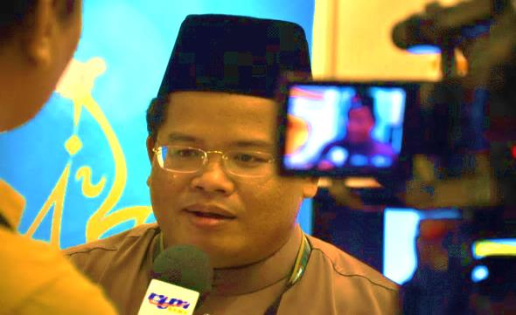
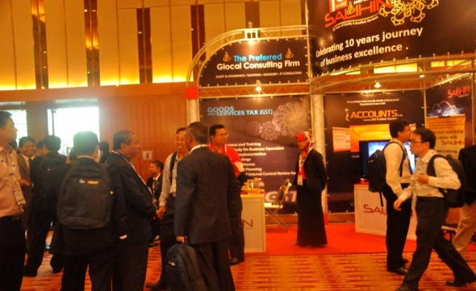
  ABOUT US
SALIHIN memulakan langkah pertamanya di dalam sektor perkhidmatan profesional negara pada Januari 2002. Tempoh 10 tahun di dalam industri ini telah berjaya mematangkan SALIHIN dan meletakkan SALIHIN di suatu kedudukan yang luar biasa berbanding para pesaing yang seangkatan dengannya.
Pencapaian serta pengiktirafan kualiti dan kecemerlangan yang diterima oleh SALIHIN adalah bukti bahawa aspirasi SALIHIN untuk meletakkan diri sebagai sebuah firma profesional Nasional bertaraf antarabangsa, telah berada di landasan yang betul. Ini ditambah lagi oleh sokongan padu daripada para pelanggan dan kakitangan yang bermotivasi tinggi yang bersedia mentransformasikan diri bersama-sama SALIHIN untuk ke fasa kejayaan seterusnya.

Slide 4

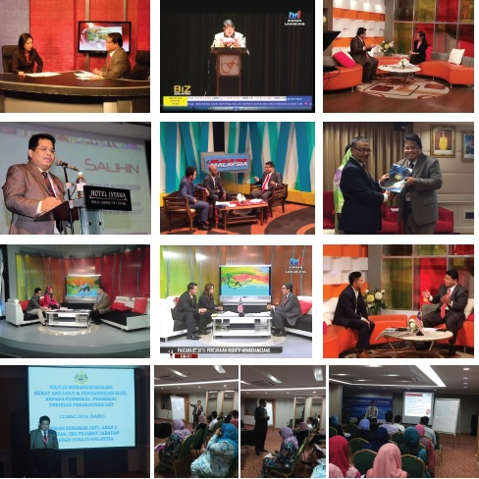



  ABOUT US
    SALIHIN SERVICES
Services
Auditing & Assurance
Taxation
Islamic Accounting & Auditing
Corporate Finance & Transaction Services
Corporate Secretarial Services
Financial Accounting Services
Goods & Services Tax (GST)
IT Consultancy
Zakat & Waqf
KUALA LUMPUR . JOHOR BAHRU . KUCHING

Slide 5

  ABOUT US
    PRACTICE AND ACADEMIA

Slide 6

  AGENDA
  2016 Budget Highlights on GST
  Overview of GST in Malaysia
  Scope of GST
  Type of Supply

Slide 7

OVERVIEW OF GST IN MALAYSIA

Slide 8

  INTRODUCTION
  A BROAD-BASED consumption tax in the form of value added tax
  MULTI STAGE TAX based on net value at each stage of business transaction up to the retail stage of distribution
  Also known as VALUE ADDED TAX (VAT) in certain countries
  Tax on final consumption – THE CONSUMER
  GST incurred on inputs is allowed as a credit to the registrant - OFFSET AGAINST OUTPUT TAX
WHAT IS GST?

Slide 9

SCOPE OF GST

Slide 10
  ELEMENT & SCOPE OF GST
  TYPE OF SUPPLY
  Standard Rated Supply
6%
  Zero Rated Supply
0%
  Exempt Supply
GST
  Out of Scope
GST
  Relief
GST

Slide 11


  ELEMENT & SCOPE OF GST
  TEST OF GST
  GST is charged on :
    The taxable supply of goods and services
    Made by a taxable person
    In the course or furtherance of business
    In Malaysia
  GST is charged on imported goods and services

Slide 12
  ELEMENT & SCOPE OF GST
  GST MECHANISM
INPUT TAX
OUTPUT TAX
ACQUISITION
SUPPLY
PURCHASES
SALES
PAYMENT
INCOME

Slide 13
  ELEMENT & SCOPE OF GST
  GST MECHANISM (CONTD.)
INPUT
OUTPUT
Goods
Raw Materials
Seller
Rental
Services
Telephone
GST on Input
= Input Tax
Claim
Input Tax
GST on Output
= Output Tax

Slide 14

  ELEMENT & SCOPE OF GST
  HOW GST WORKS?
  Standard-rated Supply
Illustration of tax computation on standard-rated supply
Business Entity | Cost of Sales (RM) | 6% Output Tax (RM) | 6% Input Tax (RM) | Net Tax Paid (RM)
Suppliers | 10.00 | 0.60 | - | 0.60
Manufacturers | 50.00 | 3.00 | 0.60 | 2.40
Wholesalers | 70.00 | 4.20 | 3.00 | 1.20
Retailers | 100.00 | 6.00 | 4.20 | 1.80
GST paid on Input Tax is refundable at each level of supply

Slide 15
  ELEMENT & SCOPE OF GST
  GST MECHANISM (CONTD.)
GST ON SUPPLY OF GOODS AND SERVICES
[OUTPUT TAX]
GST INCURRED IN BUSINESS PURCHASES
[INPUT TAX]
NET GST
PAYABLE TO RMCD
REFUNDABLE FROM RMCD

Slide 16

TYPE OF SUPPLY

Slide 17
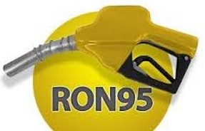
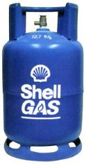
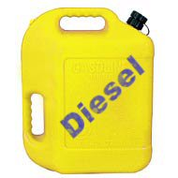
  ELEMENT & SCOPE OF GST
  STANDARD RATED AND GST RELIEF
STANDARD RATED SUPPLIES
For items that are not listed as GST Exempt or Zero-Rated Supplies
GST RELIEF
Petroleum products
Retail sales of Petrol RO95, diesel and RPG are granted relief from GST to consumers.

Slide 18
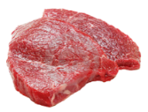
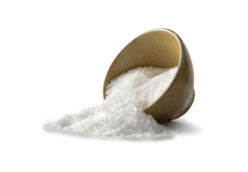





  ELEMENT & SCOPE OF GST
  ZERO RATED SUPPLIES
0%
ZERO RATED SUPPLIES
Livestock supplies (Fresh, chilled or frozen)
Cows, goats, buffalo, poultry (including eggs of chicken and duck)
Rice, Flour, Salt, etc.
Water and electricity
Rice, flour,sago and kacang dhal
Sugar and salt
Cooking oils (palm, coconut and peanuts)
White bread and wholemeal bread
Coffee powder, tea dust and cocoa powder
Yellow mee, kuey teow, laksa and meehoon
Spices
Infant formula
Seafood
Water supply (domestic)
Electricity supply for the first 300 unit (domestic)
Export
Goods and services exported
Reading materials
Agriculture Product
Exercise books and printed books
Dictionaries and encyclopaedia, text books
Reference books, religious text only
Newspaper (appearing at least four times a week)
Children picture, drawing and colouring books
Paddy
Fresh Vegetables and salads
Fruits

Slide 19

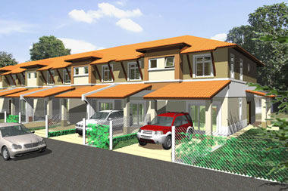

  ELEMENT & SCOPE OF GST
  EXEMPT SUPPLIES
SUPPLY OF GOODS DETERMINED AS AN EXEMPT SUPPLY
Any land intended to be used for residential or agricultural or general use
- including parking facilities
- agriculture – does not include land for hunting and fishing activities.
Any building or premises being used for residential purposed, designed or adapted for use or intended to be used as dwelling (excluding hotel, inn, boarding house or similar establishment sleeping accommodation)
Any supply of investment precious metal.
Eg: gold, silver, platinum, gold coin, silver coin (excluding collector coin)
**General use : burial ground, playground, religious building
**Similar establishment: premises provided with sleeping accommodation, with or without lodging or facilities for the preparation of foods for use of visitor or travellers.

Slide 20
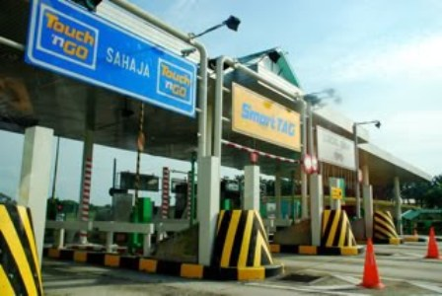
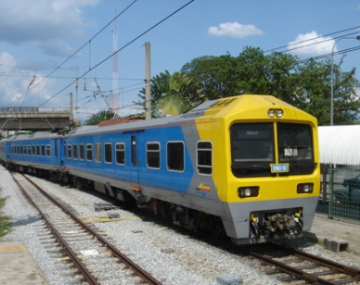
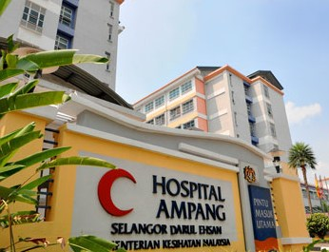
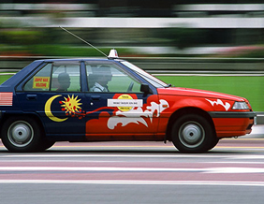
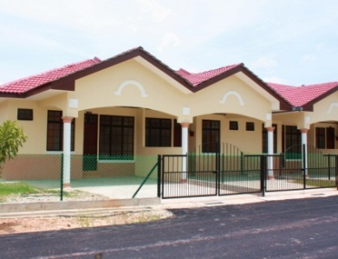
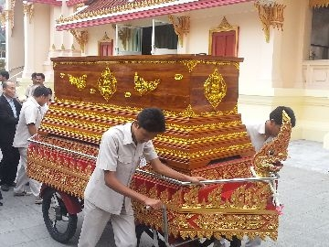
  ELEMENT & SCOPE OF GST
  EXEMPT SUPPLIES (CONTD.)
SUPPLY OF SERVICES DETERMINED AS AN EXEMPT SUPPLY
Public Transportation
Residential, Land For Residential, Agriculture And General Use
Highway and Toll Bridge
Funeral, Burial and Cremation Services
Healthcare Services
Education Services
Financial Services
Child Care Services

Slide 21
  ELEMENT & SCOPE OF GST
  GOVERNMENT SUPPLY
 | FEDERAL GOVERNMENT & STATE GOVERNMENT | LOCAL AUTHORITY & STATUTORY BODIES
OUT OF SCOPE | All supplies by Federal & State Government | Supplies made in the regulatory and enforcement (R&E) Functions e.g. assessment rate collection, issuance of license, penalty
SUBJECT TO GST | Supplies that have been directed by Minister in the GST (Government Taxable Supply) Order 2014 e.g. supply made by RTM, Prison Department | Non R&E functions, i.e. business activities e.g. Rental facilities
ACQUISITIONS | Need to pay GST on their acquisitions Relief on all goods excluding petroleum & imported motor cars | Need to pay GST on their acquisitions Need to register for GST and input tax claimable

Slide 22

T
H
A
N
K
Y
O
U
www.salihin.com.my | www.mysalihin.com
1 300 88 5678
Copyright Controlled 2016 @ SALIHIN

