Slide 1



Taklimat Operasi Luar
Banci Ekonomi 2016
GOODS & SERVICES TAX (GST) :
  LATEST GST UPDATES
Prepared for:
Presented by:
En Salihin Abang
Managing Partner of SALIHIN
4th April 2016

Slide 2
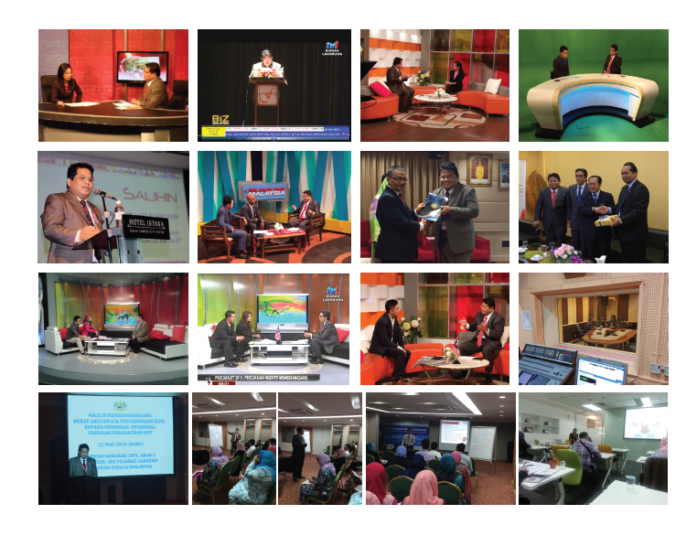
  ABOUT US
    SALIHIN EXPERIENCE IN GST TRAINING AND EDUCATION

Slide 3
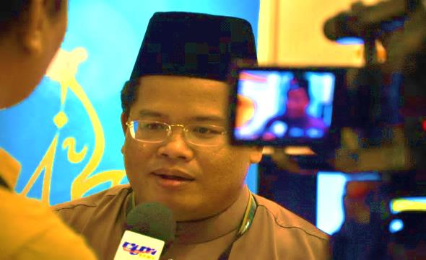
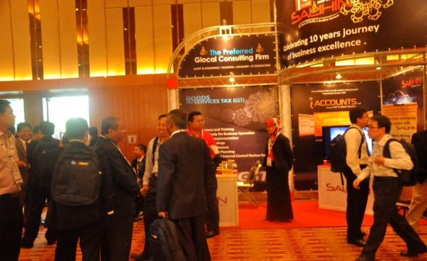
  ABOUT US
SALIHIN memulakan langkah pertamanya di dalam sektor perkhidmatan profesional negara pada Januari 2002. Tempoh 10 tahun di dalam industri ini telah berjaya mematangkan SALIHIN dan meletakkan SALIHIN di suatu kedudukan yang luar biasa berbanding para pesaing yang seangkatan dengannya.
Pencapaian serta pengiktirafan kualiti dan kecemerlangan yang diterima oleh SALIHIN adalah bukti bahawa aspirasi SALIHIN untuk meletakkan diri sebagai sebuah firma profesional Nasional bertaraf antarabangsa, telah berada di landasan yang betul. Ini ditambah lagi oleh sokongan padu daripada para pelanggan dan kakitangan yang bermotivasi tinggi yang bersedia mentransformasikan diri bersama-sama SALIHIN untuk ke fasa kejayaan seterusnya.

Slide 4

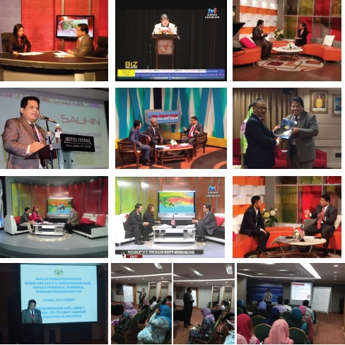



  ABOUT US
    SALIHIN SERVICES
Services
Auditing & Assurance
Taxation
Islamic Accounting & Auditing
Corporate Finance & Transaction Services
Corporate Secretarial Services
Financial Accounting Services
Goods & Services Tax (GST)
IT Consultancy
Zakat & Waqf
KUALA LUMPUR . JOHOR BAHRU . KUCHING

Slide 5

  ABOUT US
    PRACTICE AND ACADEMIA

Slide 6

  AGENDA
  Latest GST Updates
  2016 Budget Highlights on GST
  Overview of GST in Malaysia
  Scope of GST
  Type of Supply

Slide 7

  LATEST GST UPDATES

Slide 8

  LATEST GST UPDATES
  GST REGISTRATION
As at 5 Jan 2016 400,870
GST Registrant
RMCD aims to have 500,000 companies registered in 2016.
GST REGISTRATION
Sources : Edge Insider. January 7 2016. http://www.freemalaysiatoday.com/category/nation/2016/01/07/customs-aims-to-collect-rm39bil-in-gst-this-year/

Slide 9
  LATEST GST UPDATES
  GST REGISTRATION
GST REGISTRANTS BY STATES
Bil | State | Total Registration | Bil | State | Total Registration
1 | WPKL | 82,062 | 9 | PAHANG | 13,990
2 | SELANGOR | 74,775 | 10 | KEDAH | 13,663
3 | JOHOR | 51,899 | 11 | NEGERI SEMBILAN | 12,352
4 | PULAU PINANG | 28,610 | 12 | MELAKA | 10,848
5 | PERAK | 27,538 | 13 | KELANTAN | 7,362
6 | SARAWAK | 26,538 | 14 | TERENGGANU | 6,676
7 | SABAH | 21,719 | 15 | PERLIS | 1,595
8 | KLIA | 20,441 | 16 | LABUAN | 802
As at 05 January 2016

Slide 10
  LATEST GST UPDATES
  GST REGISTRATION
TOTAL REGISTERED SMEs
Manufacturing | Number of Registrants | Total Registrants
Medium | 3,196 | 47,187
Small | 39,615
Macro | 4,376
Non-Manufacturing | Number of Registrants | Total Registrants
Medium | 58,462 | 329,852
Small | 239,547
Macro | 31,843
Total SME |  | 377,039

Slide 11
  LATEST GST UPDATES
  GST REGISTRATION
GST REGISTRANTS BY TYPE OF ENTITIES
BIL | Type of Entities | Total
1 | Company | 222,882
2 | Sole Proprietor | 104,639
3 | Partnership | 56,915
4 | Professional | 6,785
5 | Individual | 4,005
6 | Association | 2,108
7 | Limited Liability Partnership | 1,650
8 | Other Entity | 1,218
9 | Statutory Body | 387
10 | Local Authority | 201
11 | Public Authority | 80
 | JUMLAH | 400,870

Slide 12
  LATEST GST UPDATES
BIL | SECTOR | Total Registration
1 | Wholesale, Retail Trade, Repair Motor Vehicles & Motorcycles | 141,860
2 | Construction | 71,786
3 | Manufacturing | 45,764
4 | Professional, Scientific and Technical Activities | 25,115
5 | Administrative and Support Service Activities | 16,805
6 | Accommodation and Support Service Activities | 16,763
7 | Transportation and Storage | 14,380
8 | Information and Communication | 11,933
9 | Agriculture, Forestry and Fishing | 11,800
10 | Real Estate Activities | 10,333
11 | Other Service Activities | 7,583
12 | Financial and Insurance/ Takaful Activities | 4,839
13 | Human Health and Social Work Activities | 3,472
14 | Water Supply, Sewerage Waste Management and Remediation | 2,683
15 | Mining and Quarrying | 2,587
16 | Education | 2,451
17. | Public Administration and Defence, Compulsory Social Security | 1,867
18. | Arts, Entertainment and Recreation | 1,338
19. | Electricity, Gas, Steam and Air Conditioning Supply | 1,151
20. | Others | 190
 | JUMLAH | 400,870

Slide 13



  LATEST GST UPDATES
  GST COMPLIANCE RATE
Average GST returns submission rate as at 2015
90%
Sources : http://www.thestar.com.my/business/business-news/2015/10/31/budget-2016-journey-continues-for-gst-compliance/

Slide 14



  LATEST GST UPDATES
  GST COLLECTION
RM30 billion April 2015 – October 2015
RM39 billion Forecast for 2016
Sources : Edge Insider. January 7 2016. http://www.freemalaysiatoday.com/category/nation/2016/01/07/customs-aims-to-collect-rm39bil-in-gst-this-year/

Slide 15
  LATEST GST UPDATES
  GST RETURNS
As at 5th JAN 2016
TAXABLE PERIOD | SUPPOSED TO RECEIVE TOTAL | RECEIVED TOTAL PERCENTAGE | NOT RECEIVED TOTAL PERCENTAGE
APRIL | 72,593 | 72,074 99.29% | 519 0.71%
MAY | 71,580 | 71,076 99.30% | 504 0.70%
JUNE | 58,050 | 57,727 99.44% | 323 0.56%
*APRIL-JUNE | 282,712 | 272,404 96.35% | 10,308 3.65%
JULY | 73,152 | 72,200 98.70% | 952 1.30%
AUGUST | 72,143 | 71,160 98.64% | 983 1.36%
SEPTEMBER | 57,402 | 56,791 98.94% | 611 1.06%
*JULY-SEPTEMBER | 288,240 | 271,171 94.08% | 17,069 5.92%
OCTOBER | 73,915 | 71,561 96.28% | 2,354 3.18%
NOVEMBER | 72,811 | 68,727 94.39% | 4,084 5.61%
DECEMBER | 349,330 | 3,678 1.05% | 345,652 98.95%

Slide 16
  LATEST GST UPDATES
  GST REFUND
(AS AT 6th January 2016 )
Days | APRIL |  | MAY |  | JUNE |  | JULY |  | AUGUST |  | SEPTEMBER |  | OCTOBER
 | No. | % | No. | % | No. | % | No. | % | No. | % | No. | % | No. | %
<14 | 3,313 | 8.99 | 4,703 | 28.38 | 9,736 | 21.62 | 5,243 | 51.68 | 15,428 | 59.42 | 29,016 | 71.22 | 8,152 | 58.99
15-30 | 6,148 | 33.11 | 6,697 | 40.41 | 24,322 | 54.00 | 4,656 | 45.89 | 7,317 | 28.18 | 4,148 | 10.18 | 3,407 | 24.65
>31 | 9,107 | 49.05 | 5,174 | 31.22 | 10,980 | 24.38 | 246 | 2.42 | 3,219 | 12.40 | 7,578 | 18.60 | 2,261 | 16.36
Total | 18,568 | 100 | 16,574 | 100 | 45,038 | 100 | 10,145 | 100 | 25,964 | 100 | 40,742 | 100 | 13,820 | 100
REFUND

Slide 17
  LATEST GST UPDATES
  GST SPECIAL REFUND
(AS AT 6th JANUARY 2016 )
MONTH | APRIL | MAY | JUNE | JULY | AUGUST | SEPTEMBER | TOTAL
Application | 17 | 62 | 79 | 101 | 159 | 2,093 | 2,511
Approved | 14 | 44 | 68 | 76 | 112 | 396 | 710
Rejected | 3 | 18 | 10 | 14 | 21 | 102 | 168
Reviewed | 0 | 0 | 1 | 11 | 26 | 1,595 | 1,633
Percentage (Approved + Rejected) | 100% | 100% | 98.73% | 89.11% | 83.65% | 23.79% | 34.97%
DUE DATE FOR SPECIAL REFUND SUBMISSION : 30 SEPTEMBER 2015

Slide 18
  LATEST GST UPDATES
  TOURIST REFUND SCHEME
(AS AT 06 JANUARI 2016 )
Filing Period | No. of Tourist Refund | Tourist Refund Amount | Refund Fee | Total Claim Amount
30-Apr-2015 | 2,416 | 472,401.50 | 83,363.88 | 555,765.38
31-May-2015 | 12,340 | 1,764,014.70 | 311,292.11 | 2,075,306.81
30-Jun-2015 | 7,001 | 810,542.50 | 143,040.18 | 953,582.68
31-Jul-2015 | 19,377 | 2,223,802.00 | 392,434.92 | 2,616,236.92
31-Aug-2015 | 49,116 | 5,386,838.90 | 950,607.02 | 6,337,445.92
30-Sept-2015 | 18,617 | 2,468,562.70 | 435,629.07 | 2,904,191.77
31-Oct-2015 | 49,620 | 5,287,583.50 | 933,091.27 | 6,220,674.77
30-Nov-2015 | 35,434 | 4,257,230.40 | 751,273.87 | 5,008,504.27
31-Dis-2015 | 18,589 | 2,487,635.30 | 438,995.05 | 2,926,630.35
TOTAL | 212,510 | 25,158,611.50 | 4,439,727.37 | 29,598,338.87
Approved outlet by RMCD = 4,911

Slide 19
  LATEST GST UPDATES
  TOURIST REFUND SCHEME
(AS AT 06 JANUARI 2016 )
Refund Location | No. of Tourist Refund | Tourist Refund Amount | Refund Fee | Total Claim Amount
KLIA 2 AIRSIDE | 50,859 | 3,113,642.10 | 549,444.07 | 3,663,086.17
KLIA C1 SATELLITE TERMINAL | 32,672 | 2,165,478.90 | 382,126.90 | 2,547,605.80
KLIA CP TERMINAL | 26,047 | 1,562,537.90 | 275,724.16 | 1,838,262.06
KOTA KINABALU T1 INTL AIRPORT | 1,603 | 90,720.40 | 16,009.18 | 106,729.58
KUCHING INTL AIRPORT | 209 | 12,863.90 | 2,270.56 | 15,134.46
non-cash | 66,960 | 16,494,014.90 | 2,910,739.39 | 19,404,754.29
PENANG INTL AIRPORT | 33,898 | 1,702,876.40 | 300,505.01 | 2,003,381.41
SENAI INTL AIRPORT | 86 | 4,938.50 | 871.68 | 5,810.18
SUBANG INTL AIRPORT | 176 | 11,538.50 | 2,036.42 | 13,574.92
 | 212,510 | 25,158,611.50 | 4,439,727.37 | 29,598,338.87
Approved outlet by RMCD = 4,911

Slide 20
  RISING PRICES AND PROFITEERING
Although traders can claim special refund to eliminate double taxation but not many have done so.
If special refund is not claimed, GST 6% will be charged on selling price with embedded sales tax until the old stock last.
RMCD is working with KPDNKK to avoid traders from taking advantage to continue charging the same price on new stock of goods
Due date for Special Refund application was 30 September 2015
MONTH | APRIL | MAY | JUNE | JULY | AUGUST | SEPTEMBER | TOTAL
Application | 17 | 62 | 79 | 101 | 159 | 2093 | 2511
Approved | 14 | 44 | 68 | 76 | 112 | 396 | 710
Rejected | 3 | 18 | 10 | 14 | 21 | 102 | 168
Review | 0 | 0 | 1 | 11 | 26 | 1595 | 1633
Percentage (Approved + Rejected) | 100% | 100% | 98.73% | 89.11% | 83.65% | 23.79% | 34.97%

Slide 21
2016 MALAYSIAN BUDGET HIGHLIGHTS ON GST

Slide 22
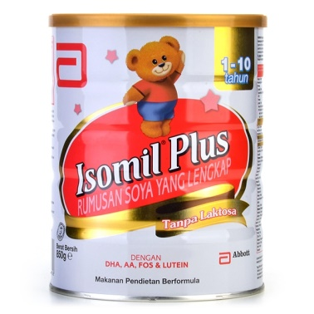
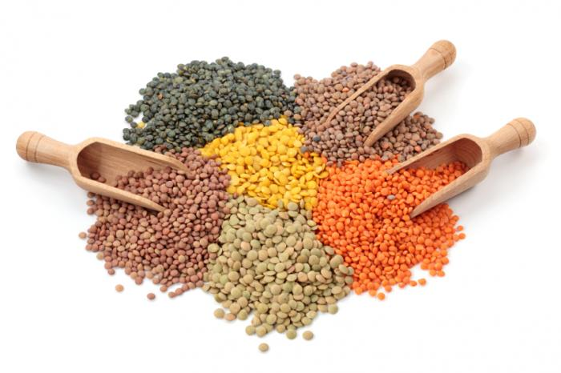
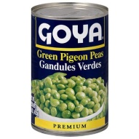
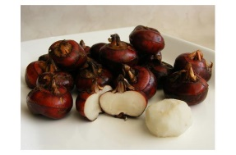
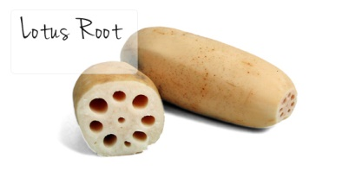
  2016 MALAYSIAN BUDGET HIGHLIGHTS
  ZERO-RATED FOOD PRODUCTS
Streamlining of Zero-Rated Food Products
1) Organic and soy base milk in powder form for feeding infant and young children (up to 36 months) which comply the requirement specified in the food regulation 1985 [P.U. (A) 437/1985] and put up in the form of packaging for retail sale only.
2) To include all types of dhal (pigeon peas, chickpeas garbanzos, vigna mungol, hepper/vigna radiate & lenthils)
3) Lotus roots and water chestnut

Slide 23
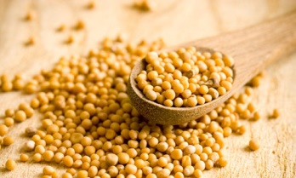
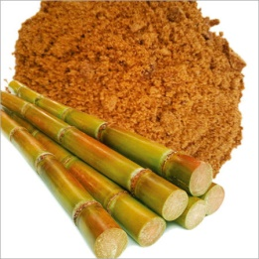
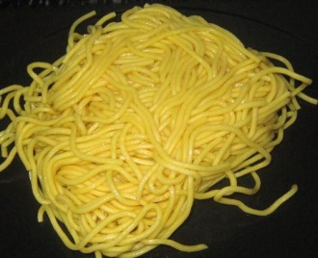
  2016 MALAYSIAN BUDGET HIGHLIGHTS
  ZERO-RATED FOOD PRODUCTS
Streamlining of Zero-Rated Food Products
4) Mustard seeds
5) Jaggery Powder
6) Noodles (wet yellow mee/mi kolok dried) –1902.19.400

Slide 24
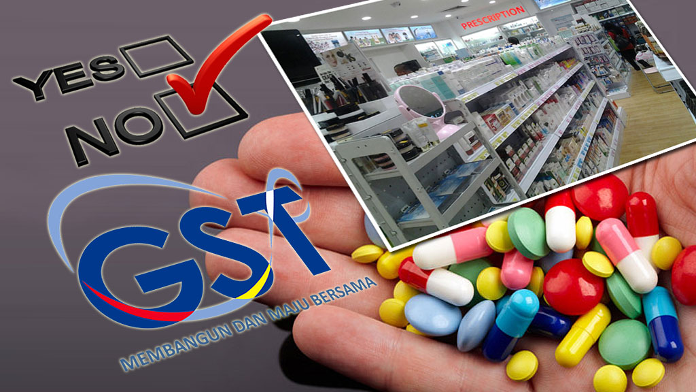
  2016 MALAYSIAN BUDGET HIGHLIGHTS
  EXPANSION OF SCOPE ZERO-RATED MEDICINES
Expansion of Scope of Zero-Rated Medicines
all types of controlled drugs in the Poisons Groups A, B, C, and D of the Poisons Act 1952;
over-the-counter medicines registered by the Drug Control Authority; and
drugs classified as medical devices under the National Essential Medicines List.

Slide 25
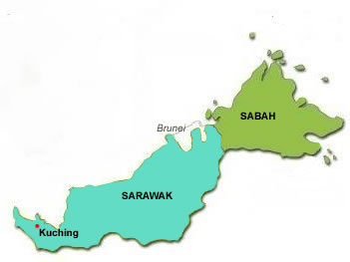
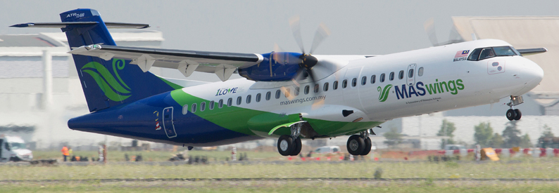
  2016 MALAYSIAN BUDGET HIGHLIGHTS
  EXEMPTION FOR AIR TRANSPORTATION SERVICES IN SABAH AND SARAWAK
GST (Exempt Supply)Order 2014
Exemption for Air Transportation Services in Sabah and Sarawak
Air passenger transport services for economy class on domestic flight within and between Sabah, Sarawak and Labuan

Slide 26
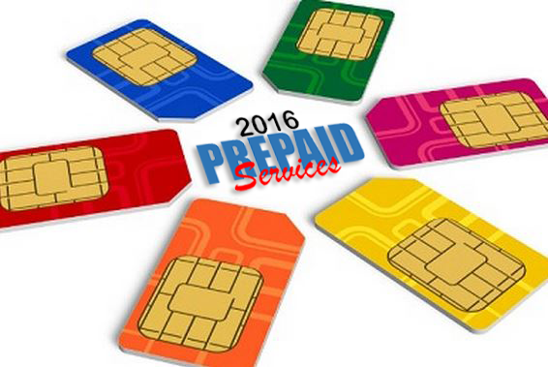
  2016 MALAYSIAN BUDGET HIGHLIGHTS
  PREPAID TELECOMMUNICATION SERVICES OR PREPAID CARDS
Prepaid Telecommunication Services or Prepaid Cards
It is proposed that Malaysian users of prepaid telecommunication services or prepaid cards will be given rebates which are equivalent to the amount of GST paid. The proposal is effective from 1 January 2016 to 31 December 2016.

Slide 27
OVERVIEW OF GST IN MALAYSIA

Slide 28

  INTRODUCTION
  A BROAD-BASED consumption tax in the form of value added tax
  MULTI STAGE TAX based on net value at each stage of business transaction up to the retail stage of distribution
  Also known as VALUE ADDED TAX (VAT) in certain countries
  Tax on final consumption – THE CONSUMER
  GST incurred on inputs is allowed as a credit to the registrant - OFFSET AGAINST OUTPUT TAX
WHAT IS GST?

Slide 29

SCOPE OF GST

Slide 30
  ELEMENT & SCOPE OF GST
  TYPE OF SUPPLY
  Standard Rated Supply
6%
  Zero Rated Supply
0%
  Exempt Supply
GST
  Out of Scope
GST
  Relief
GST

Slide 31


  ELEMENT & SCOPE OF GST
  TEST OF GST
  GST is charged on :
    The taxable supply of goods and services
    Made by a taxable person
    In the course or furtherance of business
    In Malaysia
  GST is charged on imported goods and services

Slide 32
  ELEMENT & SCOPE OF GST
  GST MECHANISM
INPUT TAX
OUTPUT TAX
ACQUISITION
SUPPLY
PURCHASES
SALES
PAYMENT
INCOME

Slide 33
  ELEMENT & SCOPE OF GST
  GST MECHANISM (CONTD.)
INPUT
OUTPUT
Goods
Raw Materials
Seller
Rental
Services
Telephone
GST on Input
= Input Tax
Claim
Input Tax
GST on Output
= Output Tax

Slide 34

  ELEMENT & SCOPE OF GST
  HOW GST WORKS?
  Standard-rated Supply
Illustration of tax computation on standard-rated supply
Business Entity | Cost of Sales (RM) | 6% Output Tax (RM) | 6% Input Tax (RM) | Net Tax Paid (RM)
Suppliers | 10.00 | 0.60 | - | 0.60
Manufacturers | 50.00 | 3.00 | 0.60 | 2.40
Wholesalers | 70.00 | 4.20 | 3.00 | 1.20
Retailers | 100.00 | 6.00 | 4.20 | 1.80
GST paid on Input Tax is refundable at each level of supply

Slide 35
  ELEMENT & SCOPE OF GST
  GST MECHANISM (CONTD.)
GST ON SUPPLY OF GOODS AND SERVICES
[OUTPUT TAX]
GST INCURRED IN BUSINESS PURCHASES
[INPUT TAX]
NET GST
PAYABLE TO RMCD
REFUNDABLE FROM RMCD

Slide 36

TYPE OF SUPPLY

Slide 37
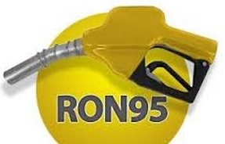
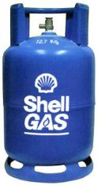
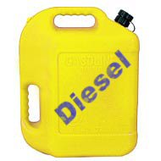
  ELEMENT & SCOPE OF GST
  STANDARD RATED AND GST RELIEF
STANDARD RATED SUPPLIES
For items that are not listed as GST Exempt or Zero-Rated Supplies
GST RELIEF
Petroleum products
Retail sales of Petrol RO95, diesel and RPG are granted relief from GST to consumers.

Slide 38
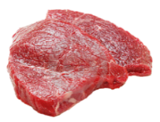
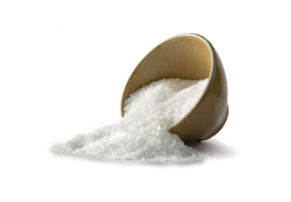




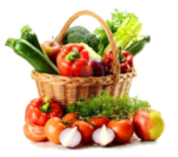
  ELEMENT & SCOPE OF GST
  ZERO RATED SUPPLIES
0%
ZERO RATED SUPPLIES
Livestock supplies (Fresh, chilled or frozen)
Cows, goats, buffalo, poultry (including eggs of chicken and duck)
Rice, Flour, Salt, etc.
Water and electricity
Rice, flour,sago and kacang dhal
Sugar and salt
Cooking oils (palm, coconut and peanuts)
White bread and wholemeal bread
Coffee powder, tea dust and cocoa powder
Yellow mee, kuey teow, laksa and meehoon
Spices
Infant formula
Seafood
Water supply (domestic)
Electricity supply for the first 300 unit (domestic)
Export
Goods and services exported
Reading materials
Agriculture Product
Exercise books and printed books
Dictionaries and encyclopaedia, text books
Reference books, religious text only
Newspaper (appearing at least four times a week)
Children picture, drawing and colouring books
Paddy
Fresh Vegetables and salads
Fruits

Slide 39

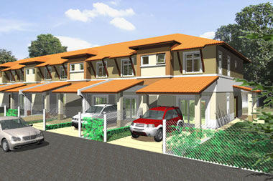

  ELEMENT & SCOPE OF GST
  EXEMPT SUPPLIES
SUPPLY OF GOODS DETERMINED AS AN EXEMPT SUPPLY
Any land intended to be used for residential or agricultural or general use
- including parking facilities
- agriculture – does not include land for hunting and fishing activities.
Any building or premises being used for residential purposed, designed or adapted for use or intended to be used as dwelling (excluding hotel, inn, boarding house or similar establishment sleeping accommodation)
Any supply of investment precious metal.
Eg: gold, silver, platinum, gold coin, silver coin (excluding collector coin)
**General use : burial ground, playground, religious building
**Similar establishment: premises provided with sleeping accommodation, with or without lodging or facilities for the preparation of foods for use of visitor or travellers.

Slide 40
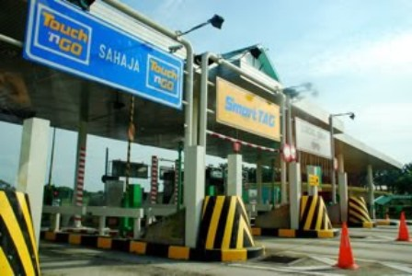
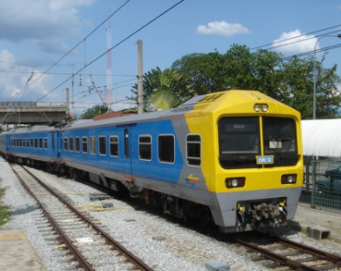
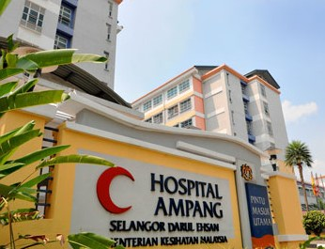
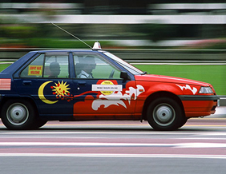
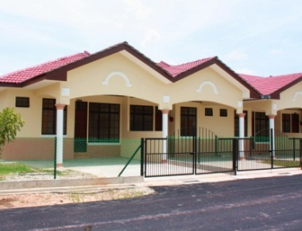
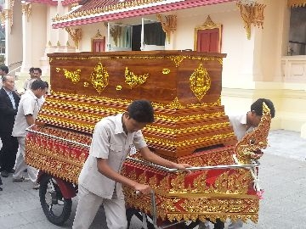
  ELEMENT & SCOPE OF GST
  EXEMPT SUPPLIES (CONTD.)
SUPPLY OF SERVICES DETERMINED AS AN EXEMPT SUPPLY
Public Transportation
Residential, Land For Residential, Agriculture And General Use
Highway and Toll Bridge
Funeral, Burial and Cremation Services
Healthcare Services
Education Services
Financial Services
Child Care Services

Slide 41
  ELEMENT & SCOPE OF GST
  GOVERNMENT SUPPLY
 | FEDERAL GOVERNMENT & STATE GOVERNMENT | LOCAL AUTHORITY & STATUTORY BODIES
OUT OF SCOPE | All supplies by Federal & State Government | Supplies made in the regulatory and enforcement (R&E) Functions e.g. assessment rate collection, issuance of license, penalty
SUBJECT TO GST | Supplies that have been directed by Minister in the GST (Government Taxable Supply) Order 2014 e.g. supply made by RTM, Prison Department | Non R&E functions, i.e. business activities e.g. Rental facilities
ACQUISITIONS | Need to pay GST on their acquisitions Relief on all goods excluding petroleum & imported motor cars | Need to pay GST on their acquisitions Need to register for GST and input tax claimable

Slide 42

T
H
A
N
K
Y
O
U
www.salihin.com.my | www.mysalihin.com
1 300 88 5678
Copyright Controlled 2016 @ SALIHIN

