Slide 1

ACCOUNTING FOR GST

Slide 2
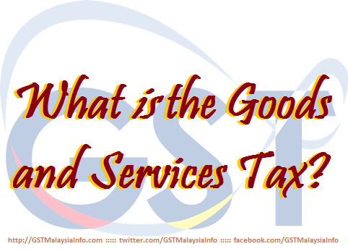
  AGENDA
TAX INVOICE
DEBIT NOTE & CREDIT NOTE
BAD DEBT
RECORD KEEPING
GST CODE & GST-03
GST TAX RETURN

Slide 3
TAX INVOICE

Slide 4



  OUTPUT TAX
  SCOPE AND CHARGE
Taxable supplies
Deemed supplies
  Disposal of business assets
  Private use of business asset
  Imported services
  Good sold in satisfactory of a debt
  Payment not paid to taxable person for purchases
  made after 6 month
  Gift costing more than RM500
GST charged on:

Slide 5
  OUTPUT TAX
  SCOPE AND CHARGE
Supplies which may not be subject to GST
Cash donation or grants where a person does not get benefits
Compensation or liquidated damages
Distribution, dividend, loan repayments or capital injection
Transfer of going concern
Contribution of pension, provident or social security fund
Supplies by any society or similar organisation
Supplies excluded from input tax credit

Slide 6

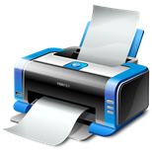

  GST TAX INVOICE
  DIAGRAM
Tax Invoice
Hard Copy
Electronic
Must be issued within 21 days
Full
Simplified
Self-billed
(Full or Simplified)
Pre-determined format
If amount payable including GST lower than RM 500
Price is unknown by supplier during transaction
Recipient and supplier are both registered
Supplier agreed no tax invoice will be issued by him
A copy of tax invoice should be provided to supplier
UPON DG’s APPROVAL!

Slide 7

  GST TAX INVOICE
  ITEMS
No. | Items | Full Tax Invoice | Simplified Tax Invoice
1 | The words “tax invoice” in a prominent place
2 | Serially tax invoice number
3 | Date of issuance of the invoice
4 | Name, address and identification number of the supplier
5 | Name and address of the person to whom the goods or services are supplied
6 | A description sufficient to identify the goods or services supplied
7 | For each description, the quantity of the goods or the extent of the services and the amount payable, excluding tax
8 | Any discount offered
9 | The total amount payable excluding tax, the rate of tax and the total tax chargeable shown as a separate amount
10 | The total amount payable including the total tax chargeable

Slide 8
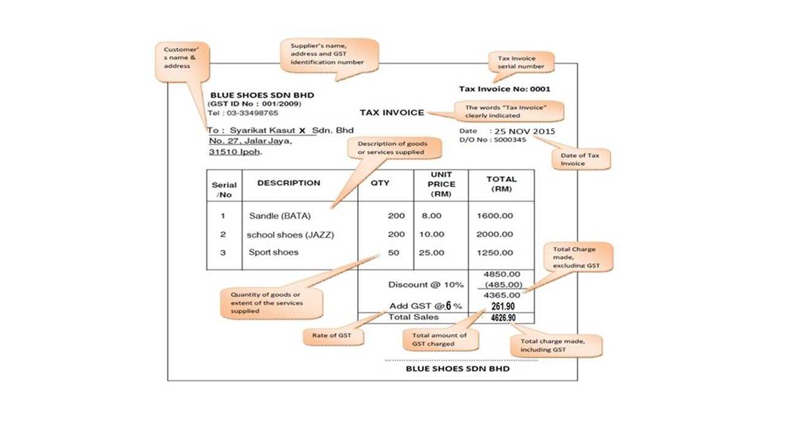
  GST TAX INVOICE
  FULL TAX INVOICE - SAMPLE

Slide 9
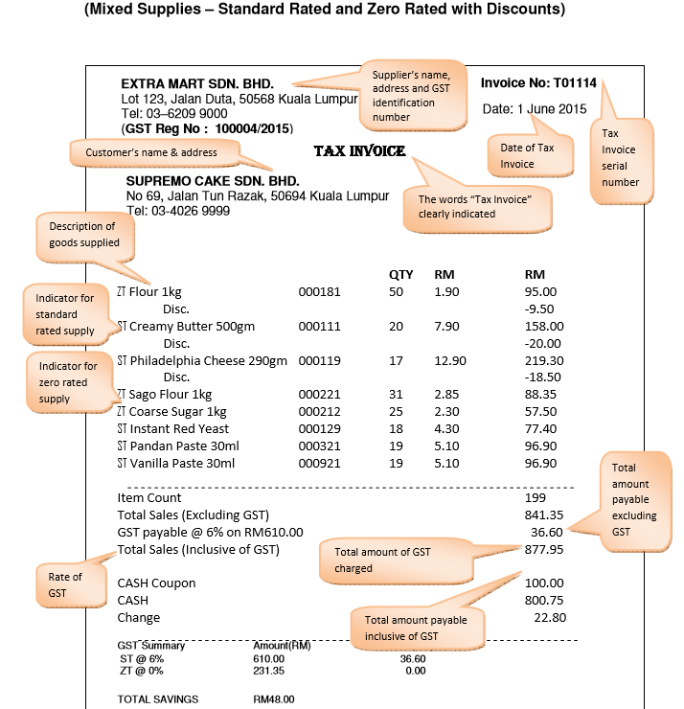
  GST TAX INVOICE
  MIXED SUPPLIES TAX INVOICE – SAMPLE 1

Slide 10
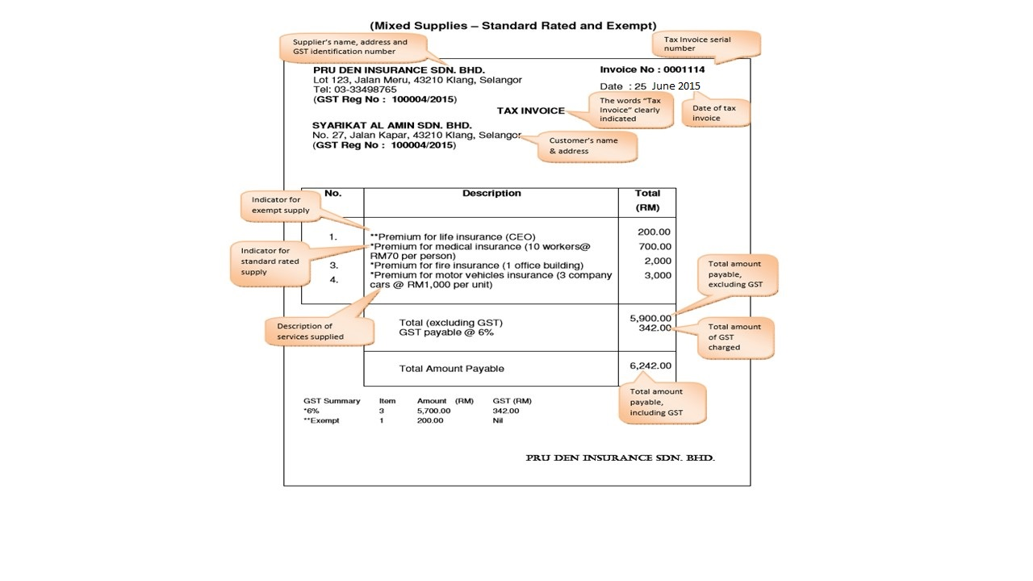
  GST TAX INVOICE
  MIXED SUPPLIES TAX INVOICE – SAMPLE 2
GST TAX INVOICE
MIXED SUPPLIES TAX INVOICE - SAMPLE 2

Slide 11
  GST TAX INVOICE
  SIMPLIFIED TAX INVOICE – SAMPLE
Supplier’s name, address and GST identification number
BESAR MALL SDN. BHD.
NO 3, Ampang Point Centre,
Jalan Gembira, 41100 Ampang,
Selangor.
(GST ID No : 346722220102)
Tel : 03-33498654
Tax Inv No : A00295
Date : 15.4.2015
Serialised “Tax Invoice” number
Date of Tax Invoice
Description | Total (RM)
3 in 1 coffee Ali | 15.65
Rounding Adj. | 0.05
TOTAL | *15.70
Description of goods or services supplied
Total amount payable including GST
The words “Price Payable includes GST amount and rate of tax” clearly indicated
* Price payable includes GST RM0.89 @ 6%

Slide 12
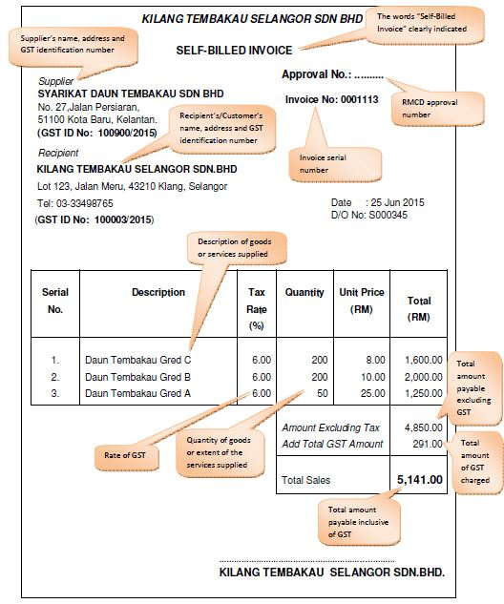
  GST TAX INVOICE
  SELF-BILLED TAX INVOICE - SAMPLE

Slide 13

  GST TAX INVOICE
  SELF BILLED TAX INVOICE – EXAMPLE
Example
Tobacco manufacturers issue tax invoice to growers who supply tobacco leaves. Since the recipient/buyers knows the open market value of the tobacco leaves, thus they are best able to provide the necessary information on the value of the product and will therefore issue ‘Self Billed Invoice’.

Slide 14
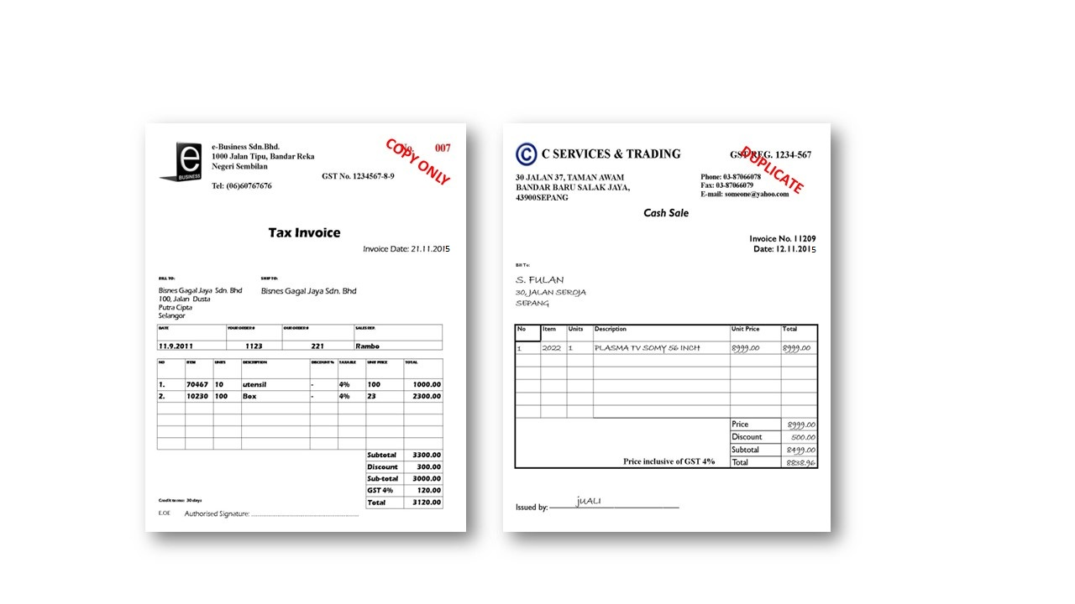
  GST TAX INVOICE
  LOST/MISPLACED TAX INVOICE - SAMPLE
What if user lost/the tax invoice?
request for replacement copy
marked as “COPY ONLY” or “DUPLICATE”

Slide 15
  GST TAX INVOICE
  FOREIGN CURRENCY
Invoice in Foreign Currency
Particulars in foreign currency need to be converted into RM using the open market rate of exchange for GST purposes included:
Amount payable before GST
Total GST chargeable
Total amount payable
In the case of importation, taxable person can use the exchange rate published by Customs

Slide 16
ENTITLEMENT INPUT TAX

Slide 17
  INPUT TAX CREDIT
  ENTITLEMENT TO CLAIM INPUT TAX
Entitlement to claim input tax
Input tax has been incurred
Input tax is allowable
Taxable person
Goods or services acquired in the furtherance of business
Goods and services made in Malaysia or supply made outside Malaysia which would taxable supply if made in Malaysia

Slide 18


  INPUT TAX CREDIT
  CLAIMING INPUT TAX
To be able for claiming Input Tax, taxable person MUST hold valid documents;
Tax Invoice
Custom No. 1 - Imported Goods
Custom No. 9 - Goods removed from
bonded warehouse
Documents on imported services

Slide 19
  INPUT TAX CREDIT
  CLAIMING INPUT TAX (CONTD.)
Input tax can be claimed on supplies bought or received regardless if the supplies:
Paid on credit
Cannot be sold through the taxable period (no matching of input-
output)
Claim can be made within the period of 6 years from the date GST return is made

Slide 20
  INPUT TAX CREDIT
  CLAIMING INPUT TAX
OUTPUT TAX
(-) Less
INPUT TAX
(=) Equals
NET TAXABLE
Negative
Amount
Positive
Amount
REDEEMABLE
PAYABLE
Input Tax claimable
= INPUT TAX CREDIT

Slide 21

  INPUT TAX CREDIT
  ALLOWABLE INPUT TAX
Allowable on taxable supplies:
Standard rated or zero rated supplies
Disregarded supplies
Within group
Within or between designated areas (Langkawi, Labuan etc)
Made in warehouse
Allowable on supplies made outside Malaysia which would be taxable supplies if made in Malaysia
Allowable on any other prescribed supply (Fixed Input Tax Recovery)

Slide 22


  INPUT TAX CREDIT
  ALLOWABLE INPUT TAX
  Supplies within group
Inputs tax will be accounted and group representative will submit GST return along with the payment to authority
Group
Member
Supplies between members are treated as supplies to representative member
Supplies within group are disregarded
Group
Representative
Group
Member

Slide 23



  INPUT TAX CREDIT
  ALLOWABLE INPUT TAX
  Supplies made outside Malaysia
Factory (China)
Supplies of Clothes
Instruct to supply to Australia
Inputs : Office rental, utilities, office furniture
Issue Invoices
Customer
(Australia)
Operational Headquarters
(Malaysia)

Slide 24
  INPUT TAX CREDIT
  INCIDENTAL FINANCIAL SUPPLIES
Deposit of money
Exchange of currency
Holding of bonds or other debt securities
Transfer of ownership of securities
Provision of loans, advance or credit to employees or connected persons
Assignment of provision of trade receivable
Holding or transfer of trust unit
Hedging of interest, commodity, utility or freight risk

Slide 25



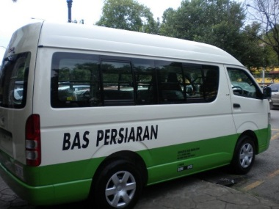
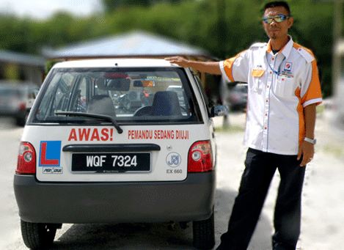
  INPUT TAX CREDIT
  BLOCKED INPUT TAX
Blocked supplies:
Passenger motor cars including hiring of car
Family benefits
Club subscription fee
Medical and personal accident insurance
Medical expenses
Entertainment expenses for family members and potential clients

Slide 26

DEBIT NOTE, CREDIT NOTE & GST BAD DEBTS
26

Slide 27
ISSUANCE OF DEBIT AND CREDIT NOTE
27

Slide 28


DEBIT AND CREDIT NOTE
CONTENTS
Debit Note and Credit Note must contains:
1) Words “Credit Note” or “Debit Note” in a prominent place
2) Serial Number and date of issue
3) Name, address and GST identification number of the supplier
4) Name and address of customer
5) Reason of issuance
6) Description of goods or services
7) Quantity and amount of each supply
8) Total amount excluding GST
9) Rate and amount of GST
10) Number and date of the original tax invoice
28

Slide 29
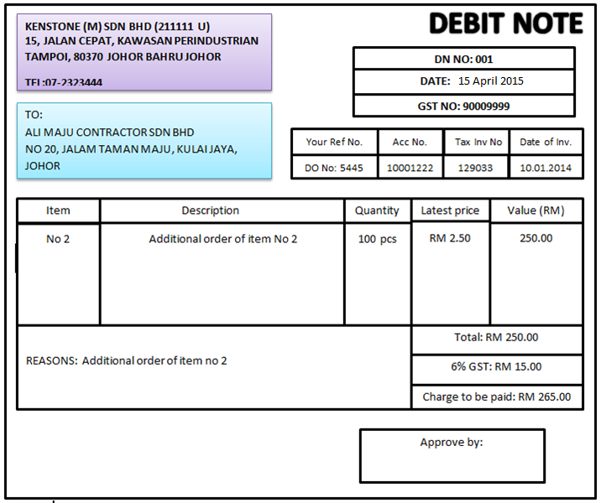
DEBIT NOTE
SAMPLE OF DEBIT NOTE
29

Slide 30
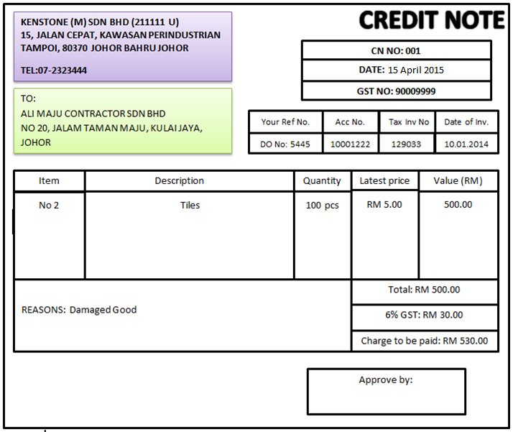
CREDIT NOTE
SAMPLE OF CREDIT NOTE

Slide 31

ISSUANCE OF DEBIT NOTE
SITUATIONS
Below is among the situations where Debit Note is applicable:
Change in consideration (addition) for the supply
Standard Rated supply mistakenly stated as Exempt or Zero Rated
Goods or supplies delivered are under priced
Oversupply to the customer
Supply of uncertain consideration
31

Slide 32

ISSUANCE OF DEBIT NOTE
ADJUSTMENT
  Adjustments Due to Debit Notes
    When a debit note is issued, the supplier/seller (registered person ) must increase his output tax in the return for amount stated in debit note
    The customer/buyer who is a registered person on the other hand, must increase his input tax in the return for the taxable period in which he received the debit note.
32

Slide 33



DEBIT NOTE
EXAMPLE ON ADJUSTMENT
Service provided by Company A to B, amount RM 1,000. Additional services provided amount RM 100 and debit note was issued within 21days
Company A
Debit Note
Company B
Adjustment by Company A to increase Output Tax
Current Output Tax charged,
RM 1,000 x 6% = RM 60
Increased in Output Tax,
RM 100 x 6% = RM 6
Actual GST paid to JKDM
= RM 66 (RM 60 + RM 6)
Adjustment by Company B to increase Input Tax
Current Input Tax charged,
RM 1,000 x 6% = RM 60
Increased in Input Tax,
RM 100 x 6% = RM 6
Actual GST claimed to JKDM
= RM 66 (RM 60 + RM 6)
33

Slide 34
DEBIT NOTE
ACCOUNTING ENTRY
Company A
Debit Note
Company B
Adjustment by Company A to increase Output Tax
Dr Debtor 106
Cr Sales RM100
Cr output tax RM 6
Adjustment by Company B to increase Input Tax
Dr Purchases RM100
Dr Input tax RM 6
Cr Trade payable RM106
34

Slide 35
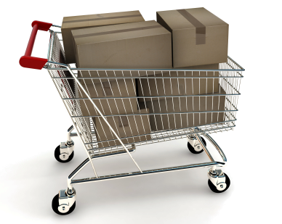
ISSUANCE OF CREDIT NOTE
SITUATIONS
Below is among the situations where Credit Note is applicable:
Exempt or Zero Rated supply mistakenly stated as Standard Rated
Consideration waived fully or partly
Supply of uncertain consideration
Cancellation of supply
Discounts given
Goods returned or supplies that is
not accepted
35

Slide 36
ISSUANCE OF CREDIT NOTE
ADJUSTMENT
Adjustments Due to Credit Notes Issued
    When a credit note is issued, the supplier/seller (registered person ) must reduce his output tax in the return for amount stated in credit note
    The customer/buyer who is a registered person on the other hand, must reduce his input tax in the return for the taxable period in which he received credit note.

Slide 37
CREDIT NOTE
EXAMPLE ON ADJUSTMENT
Goods were sold by Company A to B, amount RM 1,000. Goods were returned amount RM 100 and credit note was issued within 21days
Company A
Credit Note
Company B
Adjustment by Company A to reduce Output Tax
Current Output Tax charged,
RM 1,000 x 6% = RM 60
Reduce in Output Tax,
RM 100 x 6% = RM 6
Actual GST paid to JKDM
= RM 54 (RM 60 - RM 6)
Adjustment by Company B to reduce Input Tax
Current Input Tax charged,
RM 1,000 x 6% = RM 60
Reduce in Input Tax,
RM 100 x 6% = RM 6
Actual GST claimed to JKDM
= RM 54 (RM 60 - RM 6)
37

Slide 38
CREDIT NOTE
ACCOUNTING ENTRY
Company A
Credit Note
Company B
Adjustment by Company A to decrease Output Tax
Dr Sales Return – RM100
Dr Output tax – RM 6
Cr Trade debtors – RM 106
Adjustment by Company B to decrease Input Tax
Dr Trade payable – RM106
Cr Purchase return – RM 100
Cr Input tax – RM 6
38

Slide 39


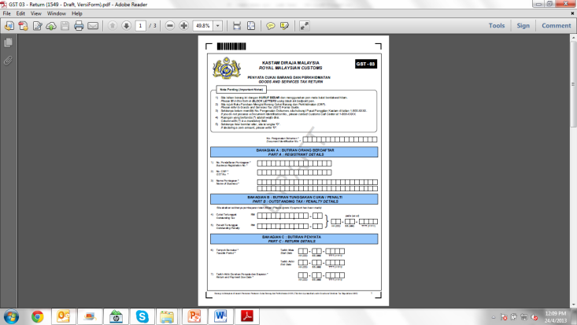
DEBIT AND CREDIT NOTE
CHANGES IN INPUT AND OUTPUT TAX
Supplier
Debit Note/
Credit Note
Customer
Form
GST 03
Form
GST 03
Both supplier and customer (if registered) need to adjust their input and output tax within the taxable period according to the date in Credit Note/Debit Note
39

Slide 40
BAD DEBT
40

Slide 41
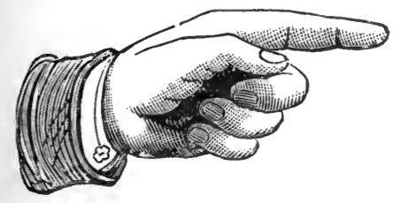
BAD DEBT
  Adjustments need to be made on the following situations:
    Bad debt due to non-payment
    Bad debt due to insolvency
    Recovery of payment with regards to bad debt
41

Slide 42

BAD DEBT RELIEF
ELIGIBILITY
A taxable person is entitled to a relief for bad debt on the whole or any part of the tax paid by him in respect of a taxable supply if:
  GST has been paid
  No payment has been received in 6 months from the date of supply
  The debtor has become insolvent before the period of 6 month has elapsed
  Sufficient efforts have been made by him to recover the debt.
42

Slide 43
BAD DEBT RELIEF
FORMULA
The seller has not received any payment
Claim for the whole of the tax paid
Seller received part payment for taxable supply
Claim for an amount calculated accordance to this formula
$$\frac{A1}{B}×C$$
Where A1 is payment not received for the taxable supply;
B is consideration for the taxable supply; and
C is the tax due and payable on the taxable supply.
43

Slide 44
BAD DEBT RELIEF
ADJUSTMENT – EXAMPLE
MONTHLY TAXABLE PERIOD
Invoice issued at 10th January 2016. The sixth month expires at the end of Jun and the bad debt relief must be claimed immediately in July monthly taxable period.
1
2
3
4
5
6
7
10/1/16
February
March
April
May
June
(expired)
July
(claim)

Slide 45


ADJUSTMENT-BAD DEBT
If company fails to pay GST after six month from date of supply :
If he has claimed input tax on that supply :
Pay back the input tax by accounting an amount equal to the input tax as his output tax.
Account the output tax in his taxable period immediately after six month period
45

Slide 46
RECORD KEEPING

Slide 47
  RECORD KEEPING
  LIABILITY TO KEEP RECORDS
The records MUST be:
in Bahasa Malaysia or English Language
kept in possession for a period not less than 7 years
made available upon request
readily accessible and convertible into writing if it is electronic
records
*Section 36

Slide 48

  RECORDS KEEPING
  TYPES OF BUSINESS RECORDS
Business Entity Records
SSM Records – Form A, B, C, 8, 9, 24, 49 and etc.
Business Transactions Records
Tax Invoices, invoices, receipts
Debit note, credit note
Delivery order, purchase order
Bank statement, slip, voucher etc
Contract, agreement
Accounting Records
(Hard Copy)
Financial statement
Account payable, receivable, GL, fixed asset register and etc
Taxation Records
Custom forms – K1, K2 and etc
Inland revenue declaration forms
GST adjustment working sheet
GST – GST returns, payment slips and receipts
Electronic
Accounting software manual
Audit trail
.GAF file
Others

Slide 49

  RECORDS KEEPING
  FAIL TO KEEP RECORDS
“Any person, who contravenes Sec. 36, commits an offence and shall, on conviction, be liable to a fine not exceeding RM 50,000 or imprisonment for a term not exceed 3 years; or both”

Slide 50
ACCOUNTING BASIS

Slide 51
  ACCOUNTING BASIS
  INVOICE BASIS
Invoice
Basis
Accounting
Basis
Payment
Basis
Invoice Basis
Generally, EVERY taxable person shall account for GST on an invoice basis
Under invoice basis, a taxable person shall:
Account for output tax on the date in which tax becomes due (time of
supply);
Claim input tax on the date in which he holds a valid tax invoice

Slide 52
RECORD KEEPING

Slide 53


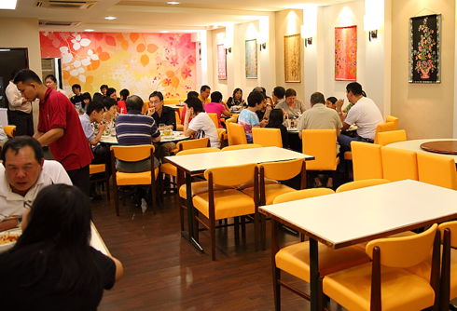
  RECORD KEEPING
  LIMITATION OF PAYMENT BASIS
Payment basis is NOT applicable for professional services
Applicable ONLY to:
Public body
Certain group of registered person who due to the nature of business and the nature of the accounting system employed by that person, is appropriate to account for the tax payable on a payment basis
Example: Retailers, grocery shops, hair salons and restaurant operators
Must get approval and under payment basis is effective for a period of 3 years only and is subject to renewal by the Director General.

Slide 54
GST TAX CODE & GST-03

Slide 55

GST TAX CODE
AGENDA
    GST TAX CODE FOR PURCHASE
    GST TAX CODE FOR SUPPLY
    GST - 03

Slide 56
GST TAX CODE FOR PURCHASE

Slide 57
GST TAX CODE FOR PURCHASE
Tax Type | Description | Tax Code | Tax Rate | Description | Ref. no. modul system GST | GST-03 Field
GST | Goods And Services Tax (Malaysia) | TX | 6% | Purchases with GST incurred at 6% and directly attributable to taxable supplies. | 1,2,4,5,7 | 6a, 6b
GST | Goods And Services Tax (Malaysia) | IM | 6% | Import of goods with GST incurred. | 3 | 6a, 6b
GST | Goods And Services Tax (Malaysia) | IS | 0% | Imports under special scheme with no GST incurred (e.g. Approved Trader Scheme, ATMS Scheme). | 12,13 | 14, 15

Slide 58
GST TAX CODE FOR PURCHASE
Tax Type | Description | Tax Code | Tax Rate | Description | Ref. no. modul system GST | GST-03 Field
GST | Goods And Services Tax (Malaysia) | BL | 6 % | Purchases with GST incurred but not claimable (Disallowance of Input Tax) (e.g. medical expenses for staff). | 14
GST | Goods And Services Tax (Malaysia) | NR | 0% | Purchase from non GST-registered supplier with no GST incurred. | 15
GST | Goods And Services Tax (Malaysia) | ZP | 0% | Purchase from GST-registered supplier with no GST incurred. (e.g. supplier provides transportation of goods that qualify as international services). | 16, 19

Slide 59
GST TAX CODE FOR PURCHASE
Tax Type | Description | Tax Code | Tax Rate | Description | Ref. no. modul system GST | GST-03 Field
GST | Goods And Services Tax (Malaysia) | EP | 0% | Purchases exempted from GST. E.g. purchase of residential property or financial services | 18,20
GST | Goods And Services Tax (Malaysia) | OP | 0% | Purchase transactions which is out of the scope of GST legislation (e.g. purchase of goods overseas). | 17,21,22
GST | Goods And Services Tax (Malaysia) | TX-E43 | 6% | Purchase with GST incurred directly attributable to incidental exempt supplies. | 6 | 6a, 6b

Slide 60
GST TAX CODE FOR PURCHASE
Tax Type | Description | Tax Code | Tax Rate | Description | Ref. no. modul system GST | GST-03 Field
GST* | Goods And Services Tax (Malaysia) | TX-N43 | 6% | Purchase with GST incurred directly attributable to non-incidental exempt supplies. | 20
GST* | Goods And Services Tax (Malaysia) | TX-RE | 6% | Purchase with GST incurred that is not directly attributable to taxable or exempt supplies. | 20 | 6a, 6b (taxable only)
GST | Goods And Services Tax (Malaysia) | GP | 0% | Purchase transactions which disregarded under GST legislation (e.g. purchase within GST group registration). | 22

Slide 61
GST TAX CODE FOR PURCHASE
Tax Type | Description | Tax Code | Tax Rate | Description | Ref. no. modul system GST | GST-03 Field
GST | Goods And Services Tax (Malaysia) | AJP | 6% | Any adjustment made to Input Tax e.g.: Bad Debt Relief, Debit Note & other input tax adjustment. | 8,9,10 | 6b only
*Applicable to GST-registered businesses that makes both taxable and exempt supplies. For more information, please refer to GST guide "Partially Exempt Traders and Input Tax Recovery" available at http://gst.customs.gov.my

Slide 62
GST TAX CODE FOR SUPPLY

Slide 63
GST TAX CODE FOR SUPPLY
Tax Type | Description | Tax Code | Tax Rate | Description | Ref. no. modul system GST | GST-03 Field
GST | Goods And Services Tax (Malaysia) | SR | 6% | Standard-rated supplies with GST Charged. | 1,2,3,8 | 5a, 5b
GST | Goods And Services Tax (Malaysia) | ZRL | 0% | Local supply of zero rated supplies. | 11 | 10
GST | Goods And Services Tax (Malaysia) | ZRE | 0% | Exportation of goods or services which are subject to zero rated supplies. | 12 | 11
GST | Goods And Services Tax (Malaysia) | ES43 | 0% | Incidental Exempt supplies. | 15 | 12

Slide 64
GST TAX CODE FOR SUPPLY
Tax Type | Description | Tax Code | Tax Rate | Description | Ref. no. modul system GST | GST-03 Field
GST | Goods And Services Tax (Malaysia) | DS | 6% | Deemed supplies (e.g. transfer or disposal of business assets without consideration). | 7 | 5a, 5b
GST | Goods And Services Tax (Malaysia) | OS | 0% | Out-of-scope supplies. | 17,18
GST | Goods And Services Tax (Malaysia) | ES | 0% | Exempt supplies under GST. | 15,16 | 12
GST | Goods And Services Tax (Malaysia) | RS | 0% | Relief supply under GST. | 13 | 13

Slide 65
GST TAX CODE FOR SUPPLY
Tax Type | Description | Tax Code | Tax Rate | Description | Ref. no. modul system GST | GST-03 Field
GST | Goods And Services Tax (Malaysia) | GS | 0% | Disregarded supplies. | 14
GST | Goods And Services Tax (Malaysia) | AJS | 6% | Any adjustment made to Output Tax e.g.: Longer period adjustment, Bad Debt recover, outstanding invoice > 6 months& other output tax adjustments. | 4,5,6,9 | 5b only
Notes: The tax codes listed are recommendations to allow proper classifications of typical purchase and sales scenarios encountered by GST-registered businesses for the purpose of GST. The list is not intended to be prescriptive nor comprehensive.

Slide 66
GST - 03

Slide 67
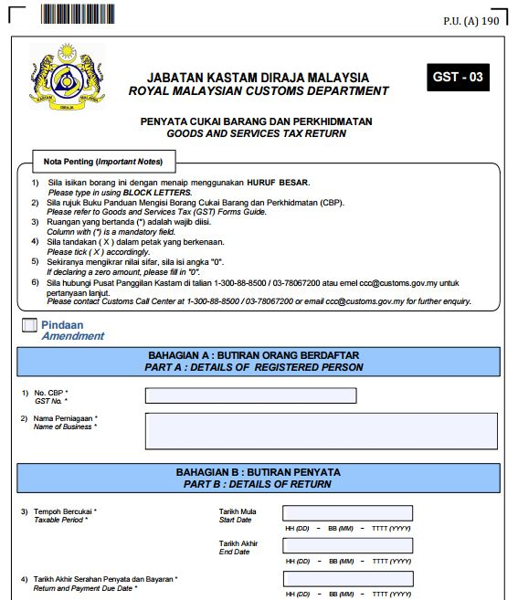
GST - 03
GST Number
Name of Business
Start Date : etc, 1 August 2015
End Date : etc, 31 August 2015
Due Date : etc, 30 Sept 2015

Slide 68
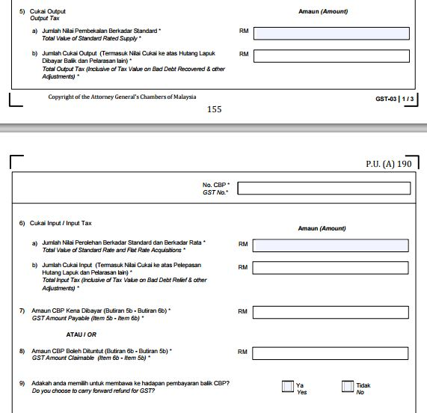
GST - 03
SR, DS
SR, DS, AJS
TX, TX-CG IM, TX-E43
TX, TX-CG, IM, TX-E43 , TX-RE, AJP
5b – 6b (Payable)
6b – 5b (Claimable)

Slide 69
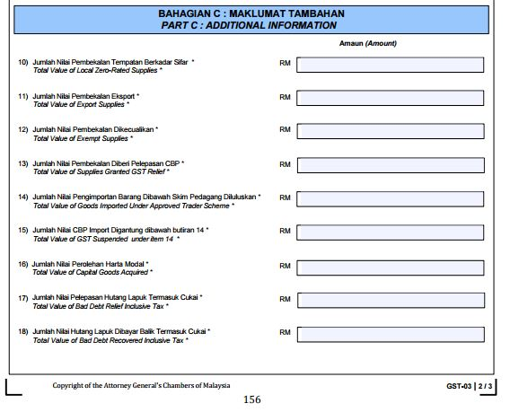
GST - 03
ZRL
ZRE
ES43 , ES
RS
IS
6% OF ITEM 14
TX-CG
AJP
AJS

Slide 70
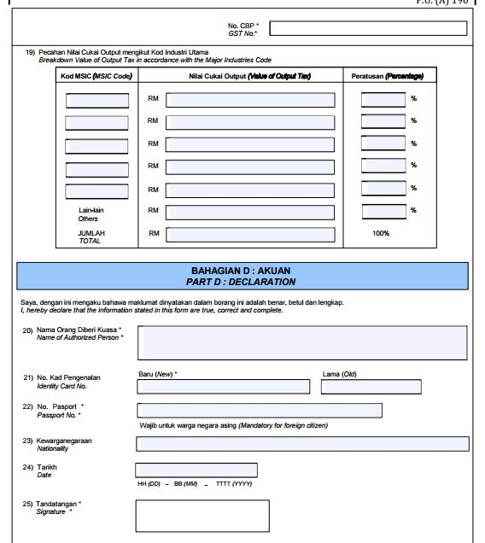
GST - 03
MSIC CODE
GST OUTPUT

Slide 71
GST TAX RETURN

Slide 72
  GST TAX RETURN PERIOD
Every taxable person will be assigned a taxable period which will end on the last day of the month of any calendar year unless a varied taxable period has been assigned
e.g. end on 31st January, 28th February, 31st March, …….
The category of a taxable period will depend on the amount of annual sales
Category | Taxable Supply | Taxable Period
A | RM 5 million and above | Monthly
B | Less than RM 5 million | Quarterly

Slide 73
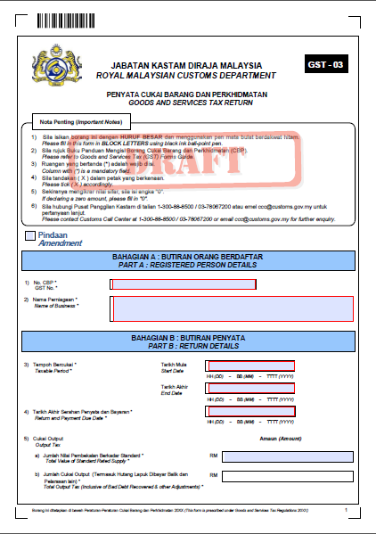

  GST TAX RETURN PERIOD
  FILING TAX RETURN
  GST returns and payment must be submitted not later than the last day of the following month of the taxable period
  Electronic filing is encouraged

Slide 74
  GST TAX RETURN PERIOD
  MONTHLY TAXABLE PERIOD
When to submit GST return
Monthly taxable period
Last date of submission :
DEC
JAN
FEB
MAC
31 Jan
28 Feb
31 Mac
Submission Date

Slide 75
  GST TAX RETURN PERIOD
  QUARTERLY TAXABLE PERIOD
When to submit GST return
      Quarterly taxable period
Last date of submission :
January - March
April - June
JAN
FEB
MAC
APR
MAY
JUN
JUL
30 April
31 July
Submission Date

Slide 76

T
H
A
N
K
Y
O
U
www.salihin.com.my | www.mysalihin.com
1 300 88 5678
Copyright Controlled 2014 @ SALIHIN

