Slide 1

EMPLOYEE BENEFITS

Slide 2

  EMPLOYEE BENEFITS
What do Employee Benefits mean?
Employee benefits include any right, privilege, service or facility provided free of charge to employees
Examples
Goods given free of charge to employees, interest free loan, leave passage, provision of accommodation and provision of transport

Slide 3

  EMPLOYEE BENEFITS
All goods provided free to the employees:
  subject to GST (subject to gift rule of RM 500) except those exempted,
  blocked input tax and zero rated goods
  ITC claimable
  Value of employee benefits (goods) given to be based on open market value

Slide 4
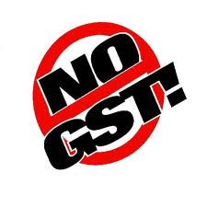
  EMPLOYEE BENEFITS
Services supplied free
Not a supply
No GST
Input tax is CLAIMABLE
4

Slide 5

  EMPLOYEE BENEFITS
Gift rule
Goods worth not more than RM 500 given free to the same person in the same year
Not a supply
Not subject to GST
Input tax is CLAIMABLE
[Provision – subparagraph 4(2)(a) of the First Schedule, GST Act]

Slide 6
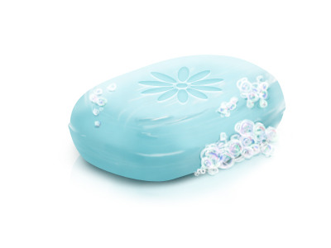
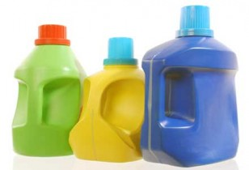

  EMPLOYEE BENEFITS
soap
Goods given free company’s products
detergent
glassware

Slide 7
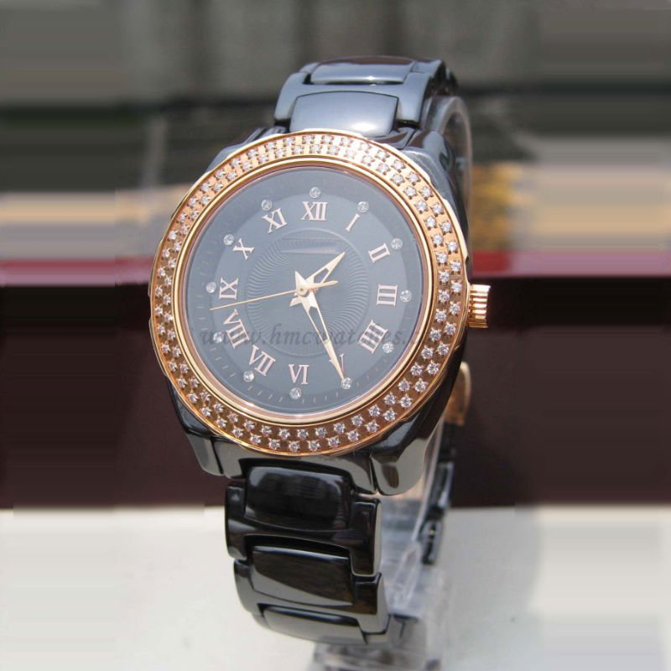
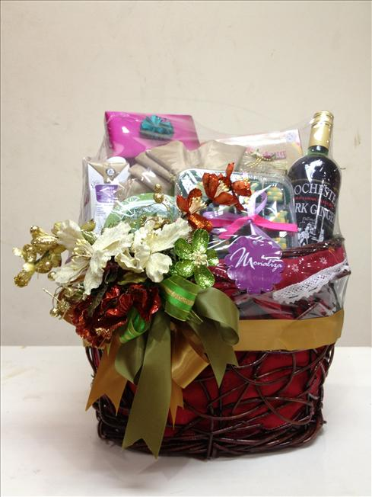
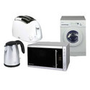
  EMPLOYEE BENEFITS
Purchased goods
watch
hampers
electrical goods

Slide 8
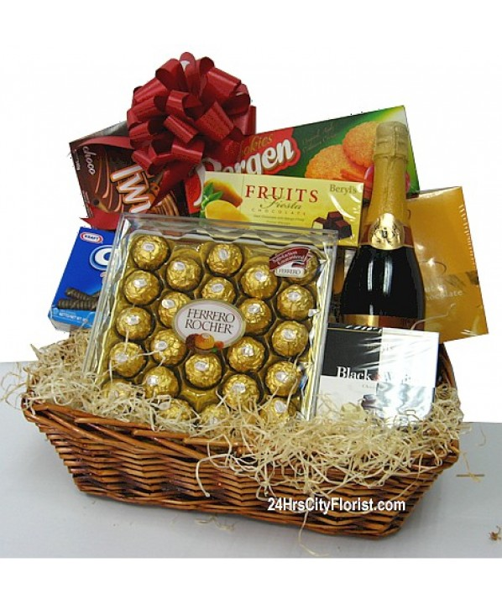

  EMPLOYEE BENEFITS
Example 1
Company A purchased 15 hampers for his employees worth RM200/hamper
Every employee will get one hamper FOC
No need to account for output tax
Input tax on 15 hampers
= RM 180.00 (6% x RM 3,000) is CLAIMABLE

Slide 9


  EMPLOYEE BENEFITS
Example 2
Company B purchased 2 non-monetary vouchers for 3 days and 2 nights stay in Pulau Redang worth RM1,000/voucher for his employees.
supply of services given free
No need to account for output tax
Input tax on 2 vouchers upon sale
= RM 120.00 (6% x RM2,000) is CLAIMABLE

Slide 10
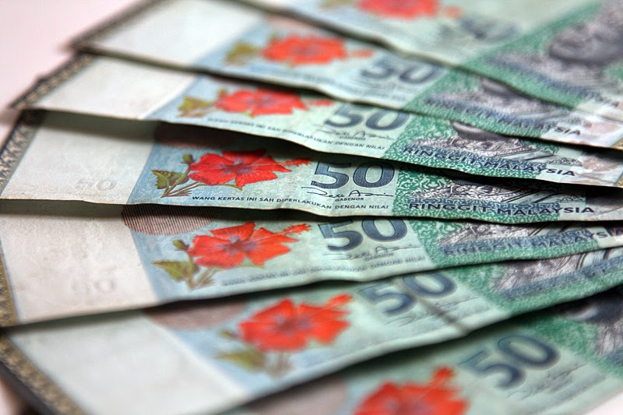

  EMPLOYEE BENEFITS
Example 3
Company C rewarded RM 5,000 to his best employee of the year
Not subject to GST
(Money is neither goods nor services)
[Provision-Section 2 of the GST Act]

Slide 11

  EMPLOYEE BENEFIT
  CHARGING OUTPUT TAX
No. | Employee Benefit | Charging Output Tax
 |  | YES | NO
1. | Services provided free to employees
2. | Services provided free to a connected person
3. | Gift given to same person in the same years, if more than RM500.00.
4. | Non-registered person given free goods to employees, the value of goods is more than RM500.00.
5. | Business goods used for non-business purposes
6. | Gift given to same person in the same years, if less than RM500 .00
7. | Given gift to employee but in monetary
8. | Goods given free as stated in the contract of employee

Slide 12

T
H
A
N
K
Y
O
U
www.salihin.com.my | www.mysalihin.com
1 300 88 5678
Copyright Controlled 2014 @ SALIHIN

