Slide 1


AWARENESS TRAINING
21 September 2015
©2014 SALIHIN GST Services. All Rights Reserved.

Slide 2
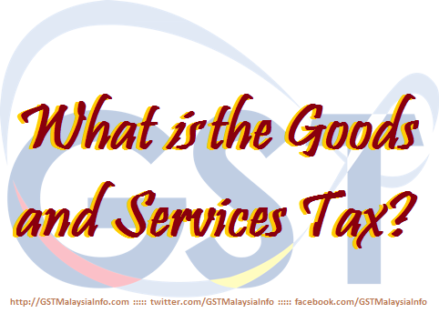
  AGENDA
TAX SYSTEM IN MALAYSIA
INTRODUCTION OF GST IN MALAYSIA
WHAT IS GST?
BASIC CONCEPT AND GST MODEL
GST REGISTRATION

Slide 3

TAX SYSTEM IN MALAYSIA

Slide 4

  CURRENT TAX SYSTEM IN MALAYSIA
Direct Tax
Indirect Tax
Corporate Tax
Import Duty
Individual Income Tax
Export Duty
Real Property Gains Tax
Excise Duty
Stamp Duty
Sales Tax
Service Tax
Consumption
Tax

Slide 5
  CURRENT TAX SYSTEM
  SALES AND SERVICE TAX
 | Sales Tax | Service Tax
Year introduced | 1972 | 1975
Scope | Selected items at manufacturing stage and imports | Selected taxable services
Rate | 5%, 10%, specific rate for petroleum | 6%, specific rate for credit card
Advantage | Supply of raw materials/components are non-taxable | -
Threshold | RM 100,000.00 | Up to RM 3mil

Slide 6
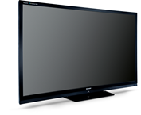

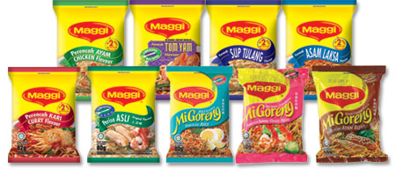
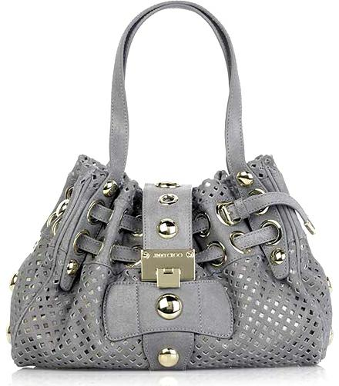



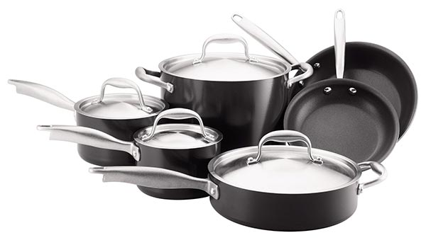
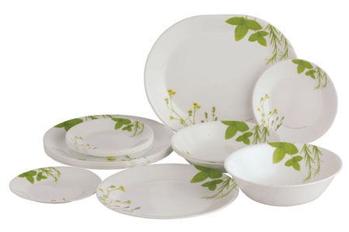
  CURRENT TAX SYSTEM
  GOODS SUBJECT TO SALES TAX
5%
10%

Slide 7







  CURRENT TAX SYSTEM
  SERVICES SUBJECT TO TAX AT 6%
6%
Hotel
Restaurant
Parking
Professional Service
Security Services
Service Centre

Slide 8
INTRODUCTION OF GST IN MALAYSIA

Slide 9



  WHAT IS GST?
  WHAT IS GST ?
What is
Goods and Services Tax

Slide 10
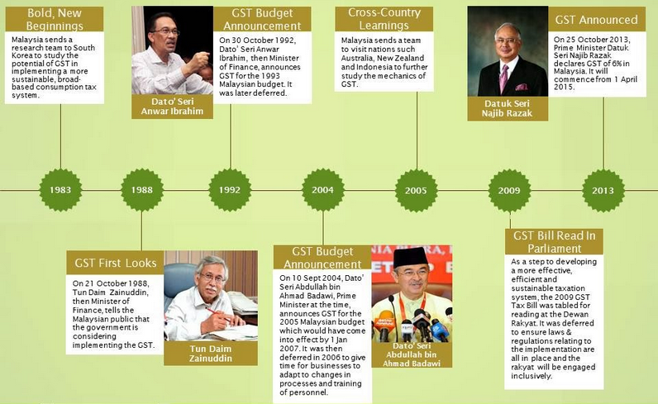
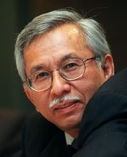
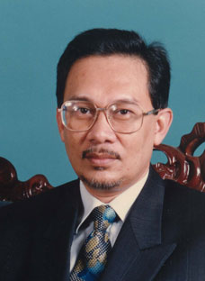
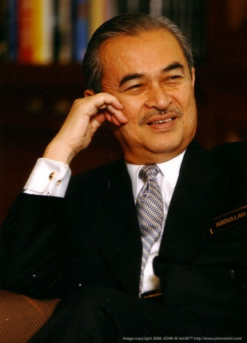
  HISTORY OF GST IN MALAYSIA
  HISTORY OF GST IN MALAYSIA
GST has been discussed in Malaysia since….
Value Added Tax
1989 Budget Presentation
By Tun Daim Zainuddin
Consolidated Sales and Services Tax
1993 Budget Presentation
By Dato’ Seri Anwar Ibrahim
Goods and Services Tax (GST)
2005 Budget Presentation
By Tun Abdullah Ahmad Badawi

Slide 11
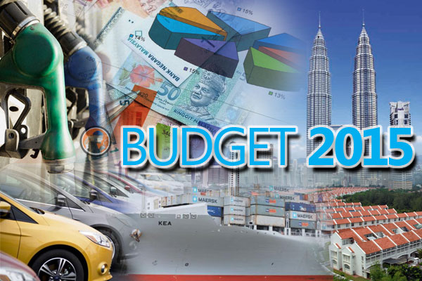
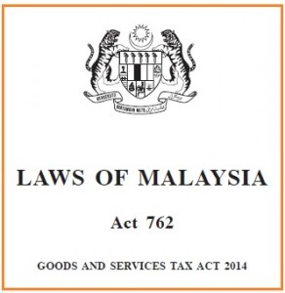
On 19th June 2014, the GST Act 2014 has been gazetted

Slide 12
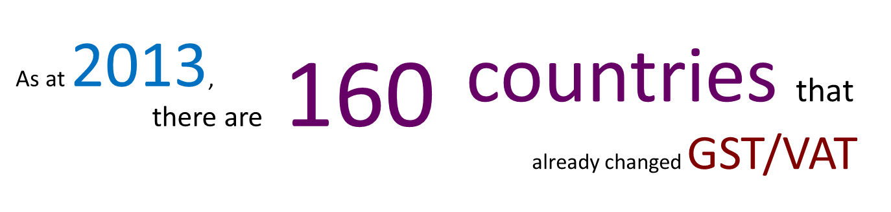
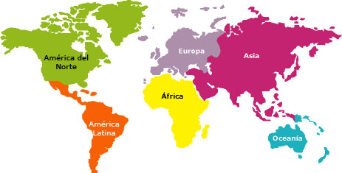
  GST/VAT WITHIN THE REGION
Region | Number of countries
ASEAN | 7
ASIA | 19
EUROPE | 53
OCEANIA | 7
AFRICA | 44
SOUTH AMERICA | 11
CARRIBEAN, CENTRAL & NORTH AMERICA | 19
TOTAL | 160

Slide 13
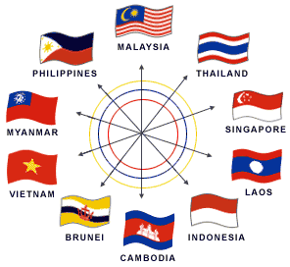
  GST/VAT IN ASEAN COUNTRIES
Country | Year of Implementation | Initial Rate(%) | Current Rate(%)
Indonesia | 1984 | 10 | 10
Thailand | 1992 | 7 | 7
Singapore | 1994 | 3 | 7
Filipina | 1998 | 10 | 12
Cambodia | 1999 | 10 | 10
Vietnam | 1999 | 10 | 10
Laos | 2009 | 10 | 10

Slide 14

  GST/VAT WORLDWIDE
Country | Year of Implementation | Initial Rate(%) | Current Rate(%)
UK | 1973 | 10 | 20
Australia | 2000 | 10 | 10
New Zealand | 1986 | 10 | 15
Norway | 1970 | 20 | 25
Turkey | 1984 | 10 | 18
Morocco | 1986 | 19 | 20

Slide 15
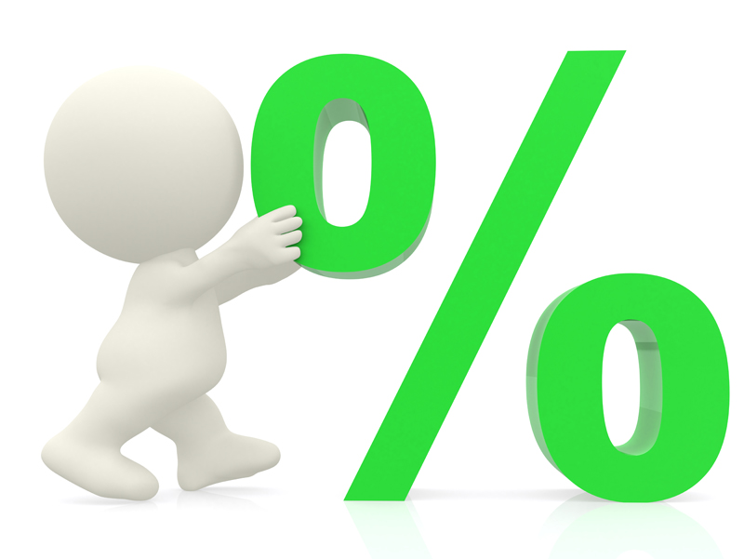

  GST/VAT WORLDWIDE
RATE ?
YEAR OF IMPLEMENTATION ?
HIGHEST
Hungary (European Union) – 27%
FIRST COUNTRY
France, 1954
LOWEST
Nigeria
Canada
Taiwan
Iran
Jersey
LATEST COUNTRY
Gambia, Africa - 2013
5%
Sources : http://gst.customs.gov.my/en/gst/Pages/gst_ci.aspx

Slide 16
WHAT IS GST?

Slide 17


  WHAT IS GST?
  A BROAD-BASED consumption tax in the form of value added tax
  MULTI STAGE TAX based on net value at each stage of business transaction up to the retail stage of distribution
  Also known as VALUE ADDED TAX (VAT) in certain countries
  Tax on final consumption – THE CONSUMER
  GST incurred on inputs is allowed as a credit to the registrant - OFFSET AGAINST OUTPUT TAX

Slide 18


  TYPE OF SUPPLY (GOODS OR SERVICES)
6%
0%
GST
GST
Standard Rated Supply
TAXABLE
SUPPLY
Zero Rated Supply
Exempt Supply
NON-
TAXABLE
SUPPLY
Out of Scope

Slide 19


  SCOPE OF GST / TEST OF GST
  GST is charged on
    The taxable supply of goods and services
    Made by a taxable person
    In the course or furtherance of business
    In Malaysia
  GST is charged on imported goods

Slide 20
BASIC CONCEPTS AND PROPOSED GST MODEL

Slide 21

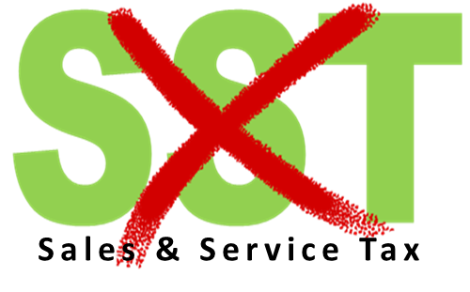
  ABOLISHMENT OF SST
Current Tax System
Effective on
1st April 2015
5%, 6%, 10%, 20%
& specific rate
6%
GST is a REPLACEMENT TAX

Slide 22
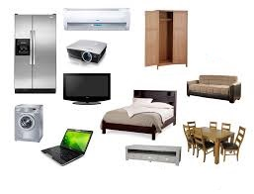
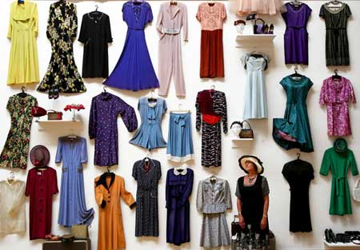
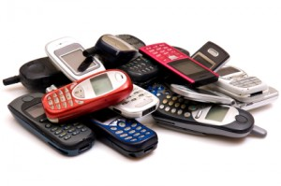




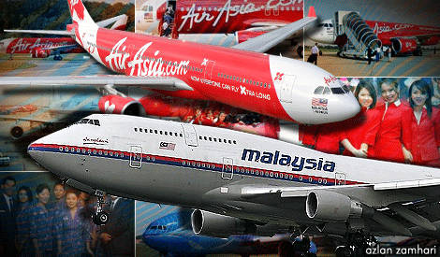
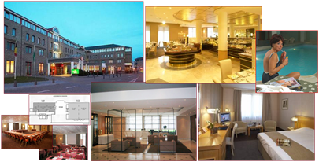
  GST MODEL - STANDARD RATED
6%
Standard rate

Slide 23



  GST MODEL - ZERO RATED
Water usage to domestic users
Export
First 300 units of electricity to domestic users
Excludes distilled water, de-ionised water, oxygenised water and mineral water.
Exported Goods and Services
Supply of first 300 units of electricity to domestic user (Current Tariff : RM 77)
0%

Slide 24
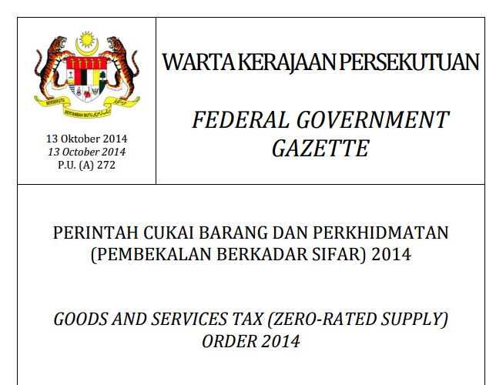
  GST MODEL - ZERO RATED
0%
http://gst.customs.gov.my/en/rg/Pages/re_odr.aspx

Slide 25
  GST MODEL - EXEMPTED
SUPPLY OF GOODS DETERMINED AS AN EXEMPT SUPPLY
Any building or premises being used for residential purposed, designed or adapted for use or intended to be used as dwelling (excluding hotel, inn, boarding house or similar establishment sleeping accommodation)
Any supply of investment precious metal.
Eg: gold, silver, platinum, gold coin, silver coin (excluding collector coin)
Any land intended to be used for residential or agricultural or general use
- including parking facilities
- agriculture – does not include land for hunting and fishing activities.
**General use : burial ground, playground, religious building
**Similar establishment: premises provided with sleeping accommodation, with or without lodging or facilities for the preparation of foods for use of visitor or travellers.
25

Slide 26
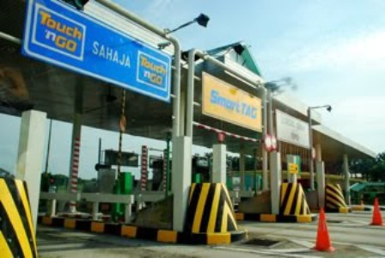
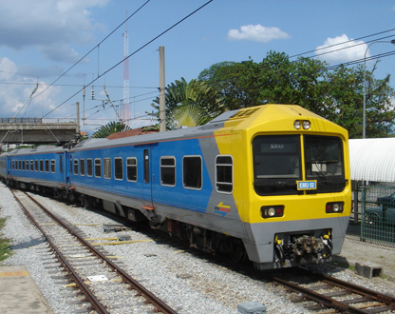
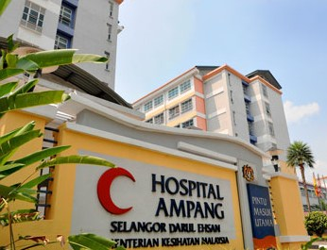
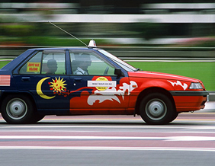
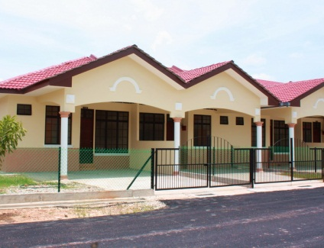
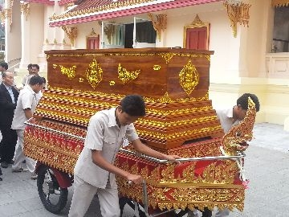
  GST MODEL - EXEMPTED
SUPPLY OF SERVICES DETERMINED AS AN EXEMPT SUPPLY
Public Transportation
Land For Residential, Agriculture And General Use
Highway and Toll Bridge
Funeral, Burial and Cremation Services
Healthcare Services
Education Services
Financial Services
Child Care Services
26

Slide 27
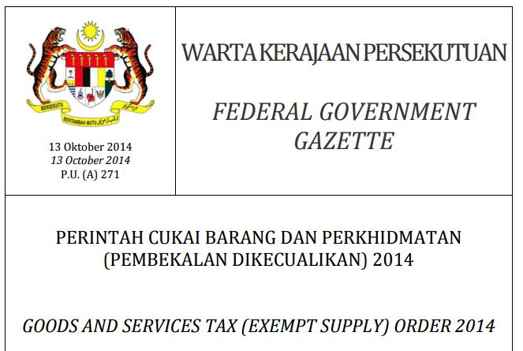
  GST MODEL - EXEMPTED
http://gst.customs.gov.my/en/rg/Pages/re_odr.aspx

Slide 28
  PROPOSED GST MODEL
  GOVERNMENT SUPPLY
 | FEDERAL GOVERNMENT & STATE GOVERNMENT | LOCAL AUTHORITY & STATUTORY BODIES
OUT OF SCOPE | All supplies by Federal & State Government | Supplies made in the regulatory and enforcement (R&E) Functions e.g. assessment rate collection, issuance of license, penalty
SUBJECT TO GST | Supplies that have been directed by Minister in the GST (Government Taxable Supply Order) e.g. supply made by RTM, Prison Department | Non R&E functions, i.e. business activities e.g. Rental facilities

Slide 29
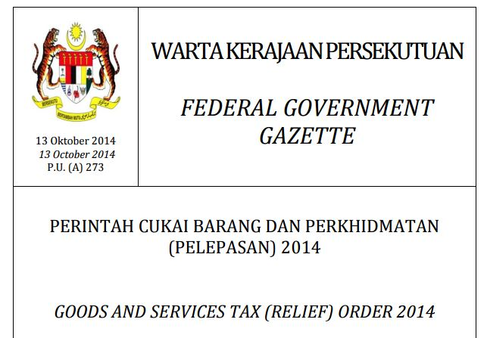
  PROPOSED GST MODEL
  RELIEF
http://gst.customs.gov.my/en/rg/Pages/re_odr.aspx

Slide 30
  GST MECHANISM
INPUT TAX
OUTPUT TAX
ACQUISITION
SUPPLY
PURCHASES
SALES
PAYMENT
INCOME

Slide 31
  GST MECHANISM (CONTD)
INPUT
OUTPUT
Goods
Raw Materials
Seller
Rental
Services
Telephone
GST on Input
= Input Tax
Claim
Input Tax
GST on Output
= Output Tax

Slide 32
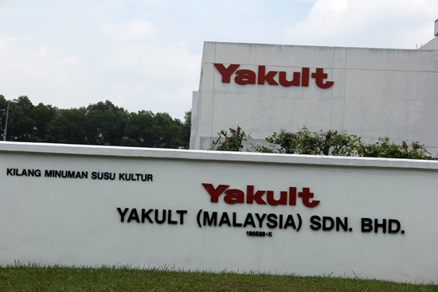
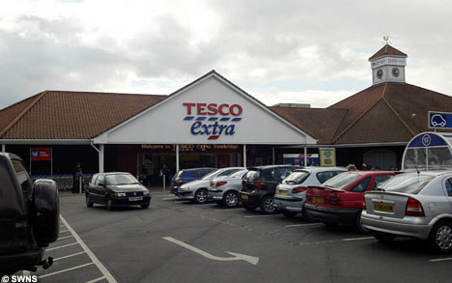
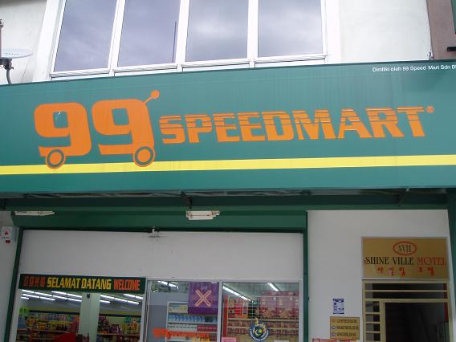

  HOW GST WORKS ?
  STANDARD RATED 6%
GST AT STANDARD RATE 6%
6%
6%
6%
Manufacturer
Wholesaler
Retailer
Consumer
GST input tax claimable

Slide 33


  HOW GST WORKS ?
  STANDARD RATED (CONTD)
Manufacturer
Tax Remitted to Government
Price :RM100
GST:RM6.00
Output Tax =
RM 6.00
Wholesaler
Output Tax = RM 7.50
Input Tax = RM 6.00
Price :RM125
GST:RM7.50
RM 1.50
Retailer
Output Tax = RM 9.00
Input Tax = RM 7.50
Price :RM150
GST:RM9.00
RM 1.50
Consumer
Total amount remitted to Custom:
= RM 9.00
GST 6%

Slide 34
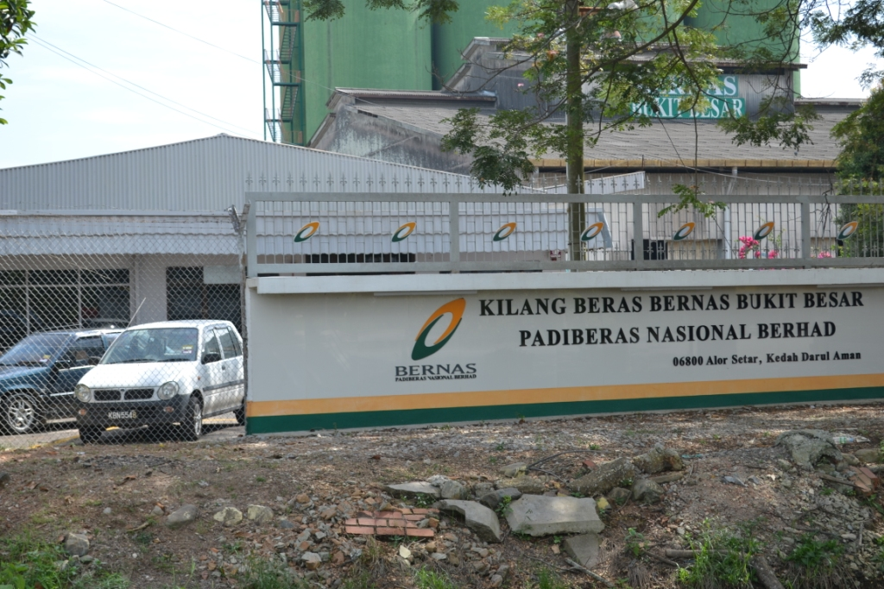


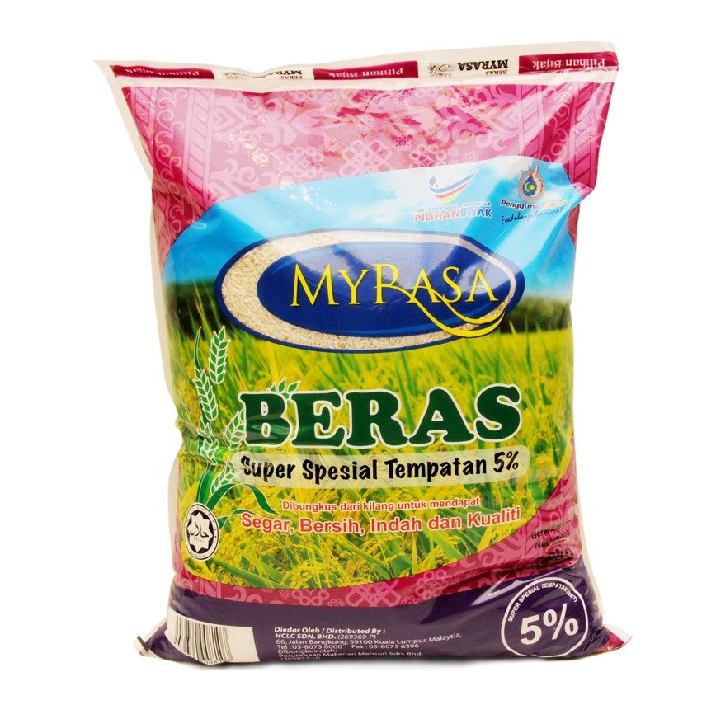
  HOW GST WORKS ?
  ZERO RATED
GST AT ZERO RATE 0%
Manufacturer
(Kilang Beras Bernas)
Wholesaler
(Syarikat Faiza Sdn Bhd)
Retailer
(Speedmart)
Consumer
Consumer
does not
pay any
GST
GST input tax claimable

Slide 35
  HOW GST WORKS ?
  ZERO RATED (CONTD)
0%
0%
0%
Manufacturer
(Beras Bernas)
WHOLESALER
(Syarikat Faiza Sdn Bhd)
Retailer
(99 Speedmart)
Consumer
Value Added Activity
Purchase Cost: RM100
GST* : RM0
Purchase Price:RM100
Selling Price: RM125
GST : RM0
Total Selling Price: RM125
Added Value: RM25
(+ GST : No GST )
No GST will be paid to Customs
*Note: claim input tax

Slide 36
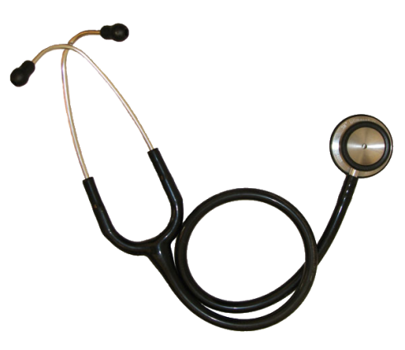
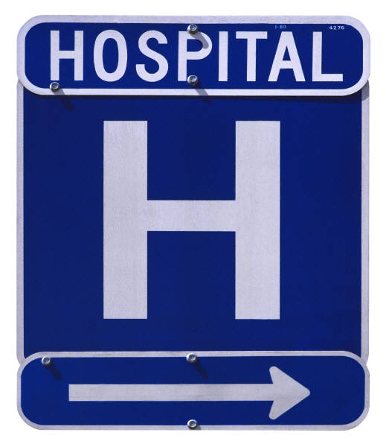

  HOW GST WORKS?
  EXEMPTED
GST AT 6%
NO GST
Supplier
Private Hospital
Consumer
Consumer
does not
pay any
GST
CANNOT claim back the GST paid

Slide 37
  HOW GST WORKS?
  EXEMPTED (CONTD)
Private Hospital
Supplier
Consumer
Value Added Activity
Purchase Cost: RM100
GST : RM6
Purchase Price:RM106
Selling Price: RM131
GST : RM0
Total Selling Price: RM131
Added Value: RM25
(+ GST : No GST )

Slide 38
GST REGISTRATION

Slide 39


GST REGISTRATION
Business
Non-Business
Taxable Supply
Non-Taxable Supply
Taxable Turnover exceed RM500,000
Taxable Turnover RM500,000 and below
Mandatory
Voluntary
Liable to notify within 28 days

Slide 40

MANDATORY REGISTRATION

Slide 41


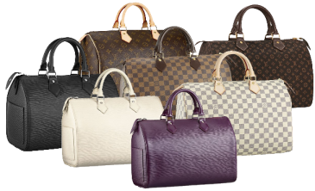

GST REGISTRATION
MANDATORY REGISTRATION
Carrying on a business in
Malaysia
The ‘PERSON’ should notify to register within 28 days from the end of taxable period
Makes taxable supplies
Taxable turnover exceed RM 500,000

Slide 42
MANDATORY REGISTRATION
THE DETERMINATION OF THRESHOLD
INCLUDES
Standard Rated Supplies
Zero Rated Supplies
Deemed Supplies such as private use, business gift > RM500.
Disregarded supply (supply between members of group)
EXCLUDES
Disposal of Capital Assets
Imported Services
Designated Areas
Out of scope supplies
Imported within warehouse (Warehousing Scheme)
Supplies made by a foreign principal (Approved Toll Manufacturer Scheme)
Historical Method
Future Method
Net taxable turnover
MANDATORY
REGISTRATION
Exceeds threshold RM500,000

Slide 43

GST REGISTRATION
MANDATORY REGISTRATION
Notification of liability & registration :
To apply for registration 28 days from end of the month where taxable turnover exceeds or expect to exceed RM 500,000
Effective date of registration will be on the 1st day of the following month after the 28th day period
Pre-registration before implementation of GST
IMPLEMENTATION DATE : 1 APRIL 2015
PRE-REGISTRATION BEGINS : JUNE 2014
LAST DATE REGISTRATION : DEC 2014
(MANDATORY)

Slide 44
SCOPE OF SUPPLY
(THE DETERMINATION OF THRESHOLD)
Method of assessment :
Historical Method
Value of taxable supplies in current month and previous consecutive 11 month is more than RM 500,000
Future Method
Value of taxable supplies in current month and 11 months to the future is EXPECTED more than RM 500,000

Slide 45
GST REGISTRATION
METHOD OF ASSESSMENT
Example - Historical Method
31/08/13
30/07/14
31/08/14
30/09/14
31/10/14
01/10/14
(Date of Registration/ Effective date)
11 Months backward
Total value of taxable supply
RM400,001
Value of taxable supply:
RM100,000
Preceeding
11 months
+
Current month
(01-28/09/14)
28 days period to notify RMCD

Slide 46
GST REGISTRATION
METHOD OF ASSESSMENT
Example - Future Method
11 Months forward
Total value of taxable supply
RM400,001
31/07/14
31/08/14
30/09/14
30/07/15
16/08/14
Value of taxable supply:
RM100,000
01/10/14
(Date of Registration/ Effective date)
(01-28/09/14)
28 days period to notify RMCD
Current Month
+
Next 11 months

Slide 47

VOLUNTARY REGISTRATION

Slide 48

VOLUNTARY REGISTRATION
(SECTION 24)
Business which do not liable for mandatory registration may register voluntarily if it satisfies any of these criteria:
Makes taxable supplies
VOLUNTEER!
Intends to make taxable supplies
Makes supplies outside Malaysia, which would be taxable if made in Malaysia
*Note: Business must remain registered for a period at least 2 years!
Intends to makes supplies outside Malaysia, which would be taxable if made in Malaysia

Slide 49

VOLUNTARY REGISTRATION
(SECTION 24)
Why business chooses for voluntary registration?
To recover input tax for start-up costs
To attract potential clients (GST input cannot be claimed if the invoice is issued by non-registered person)
To prepare for mandatory registration
To avoid giving the impression of small business operation

Slide 50
EXEMPTED FROM REGISTRATION

Slide 51

EXEMPTED FROM REGISTRATION
(Section 32)
Who is NOT required to register?
Any person who is:
Making exempt supply; or
Making out of scope supply
  Making supply in Designated Area for example in Labuan, Langkawi and Tioman

Slide 52
EXEMPTED FROM REGISTRATION
(Section 32)
Any person who makes or intends to make a taxable supplies can apply to be exempted from registration
The exempted person shall notify in writing when there is changes in his nature of supply within 30 days on which it occurred.

Slide 53

TYPE OF REGISTRATION

Slide 54

GST REGISTRATION
TYPE OF REGISTRATION
Partnership
Single Taxable Person
Branch / Division
Single Entity
Joint Venture
Group of Companies
Sole proprietorship
TOGC
Societies /
Club

Slide 55
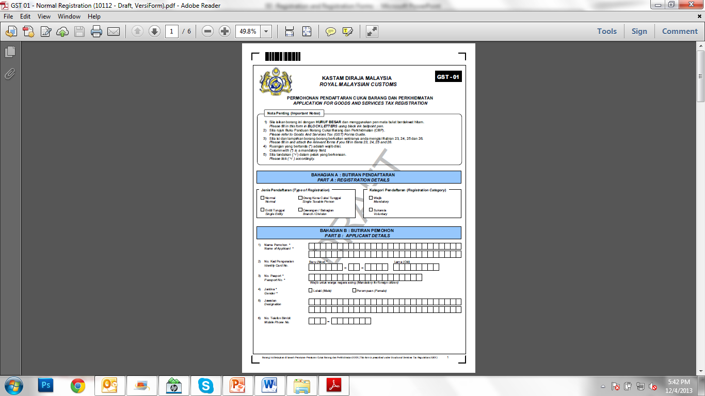
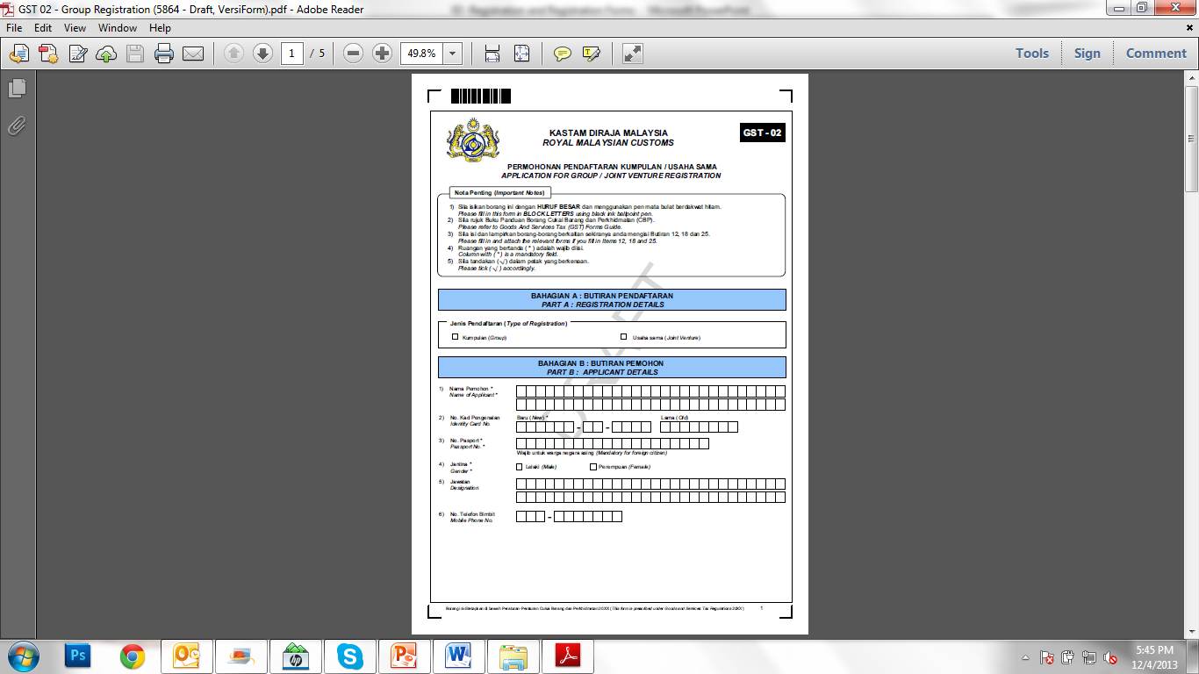
REGISTRATION FORM
FORM GST -01 & GST-02

Slide 56

T
H
A
N
K
Y
O
U
www.salihin.com.my | www.mysalihin.com
1 300 88 5678
Copyright Controlled 2014 @ SALIHIN

