Slide 1


AWARENESS TRAINING
13 JANUARY 2015
©2014 SALIHIN GST Services. All Rights Reserved.

Slide 2
GST AWARENESS TRAINING
13^{H} OF JANUARY 2015
TIME | PROGRAM
08.45 am – 09.00 am | Registration
09.00 am – 10.30 am | Salient Features of GST
10.30 am – 11.00 am | Break
11.00 am – 12.30 pm | GST Readiness
12.30 pm – 1.00 pm | Q & A / Closing

Slide 3
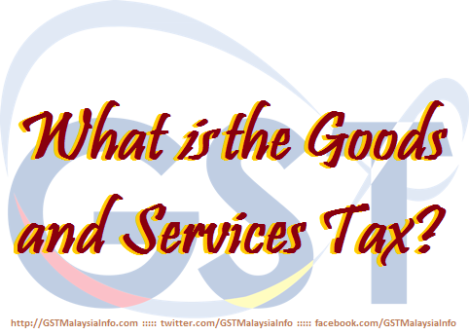
  AGENDA
ABOUT SALIHIN
TAX SYSTEM IN MALAYSIA
INTRODUCTION OF GST IN MALAYSIA
WHAT IS GST?
BASIC CONCEPT AND PROPOSED GST MODEL
SST vs GST
GST IMPACT TO CONSUMER
GST READINESS

Slide 4

ABOUT SALIHIN

Slide 5
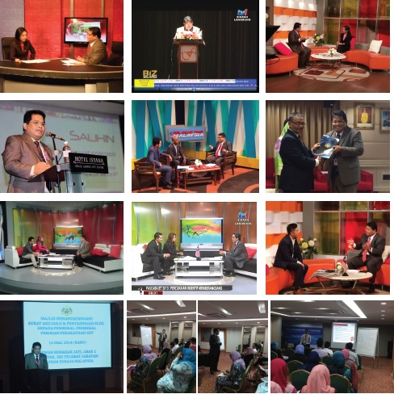

    ABOUT SALIHIN
    SALIHIN EXPERIENCE IN GST TRAINING AND EDUCATION
Services
Auditing & Assurance
Taxation
Islamic Accounting & Auditing
Corporate Finance & Transaction Services
Corporate Secretarial Services
Financial Accounting Services
Goods & Services Tax (GST)
IT Consultancy
Zakat & Waqf

Slide 6
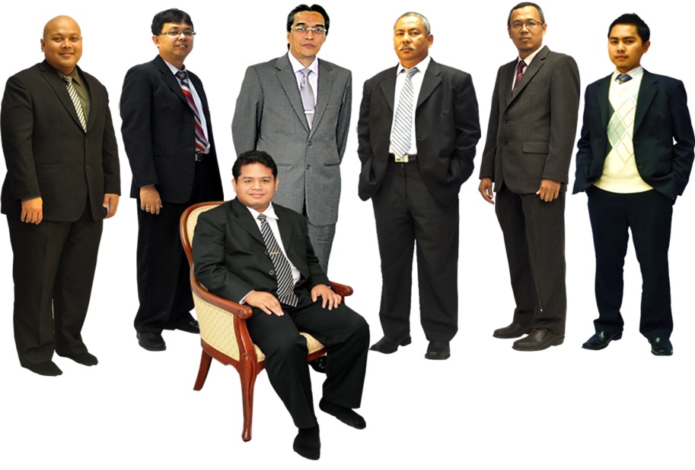
    ABOUT SALIHIN
    KEY PERSONNEL
In Front: Salihin Abang
L-R: Ahmad Izwan Adnan, Faizul Nizan Zulkefli ,
Tuan Haji Abd. Aziz Abu Bakar, Ahmad Aljafree Razalli,
Mohd Faried Jamil, Abdussalam Shokhawi

Slide 7
TAX SYSTEM IN MALAYSIA

Slide 8

  CURRENT TAX SYSTEM IN MALAYSIA
Direct Tax
Indirect Tax
Corporate Tax
Import Duty
Individual Income Tax
Export Duty
Real Property Gains Tax
Excise Duty
Stamp Duty
Sales Tax
Service Tax
Consumption
Tax

Slide 9
  CURRENT TAX SYSTEM
  SALES AND SERVICE TAX
 | Sales Tax | Service Tax
Year introduced | 1972 | 1975
Scope | Selected items at manufacturing stage and imports | Selected taxable services
Rate | 5%, 10%, specific rate for petroleum | 6%, specific rate for credit card
Advantage | Supply of raw materials/components are non-taxable | -
Threshold | RM 100,000.00 | Up to RM 3mil

Slide 10
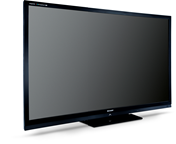

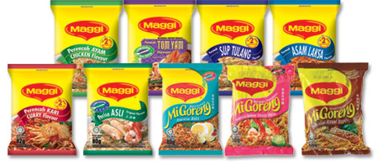
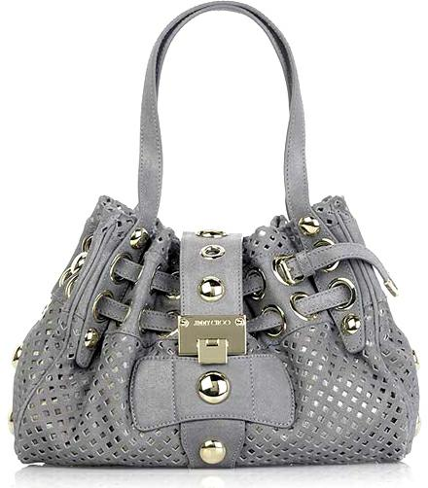



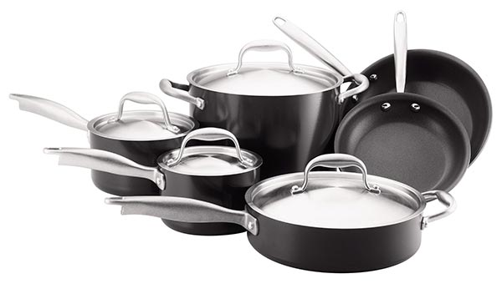
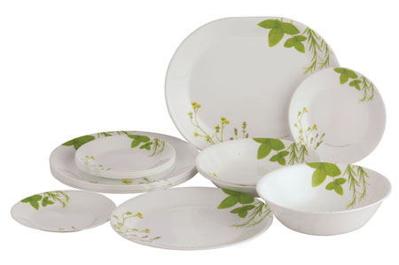
  CURRENT TAX SYSTEM
  GOODS SUBJECT TO SALES TAX
5%
10%

Slide 11







  CURRENT TAX SYSTEM
  SERVICES SUBJECT TO TAX AT 6%
6%
Hotel
Restaurant
Parking
Professional Service
Security Services
Service Centre

Slide 12
INTRODUCTION OF GST IN MALAYSIA

Slide 13


Slide 14



  WHAT IS GST?
  WHAT IS GST ?
What is
Goods and Services Tax

Slide 15
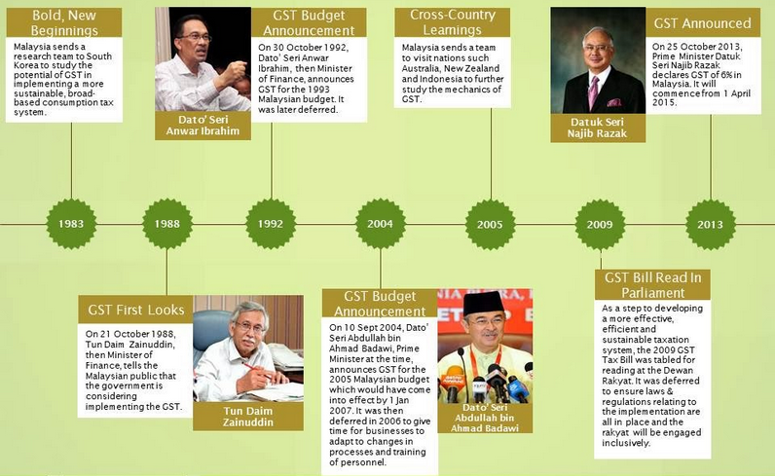
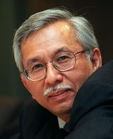
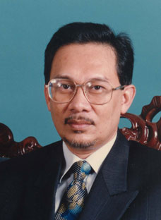
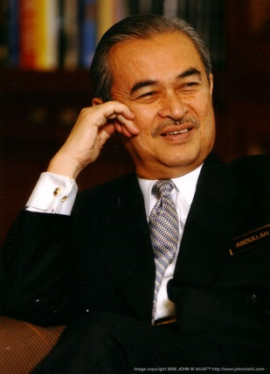
  HISTORY OF GST IN MALAYSIA
  HISTORY OF GST IN MALAYSIA
GST has been discussed in Malaysia since….
Value Added Tax
1989 Budget Presentation
By Tun Daim Zainuddin
Consolidated Sales and Services Tax
1993 Budget Presentation
By Dato’ Seri Anwar Ibrahim
Goods and Services Tax (GST)
2005 Budget Presentation
By Tun Abdullah Ahmad Badawi

Slide 16
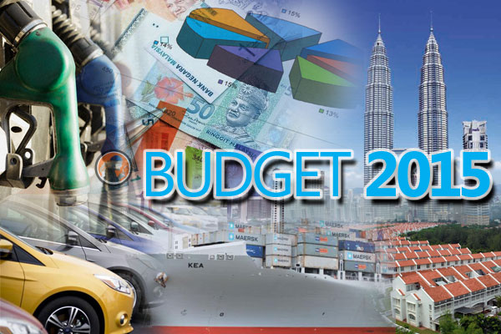
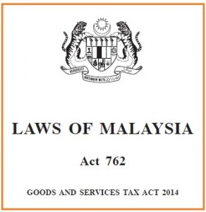
On 19th June 2014, the GST Act 2014 has been gazetted

Slide 17
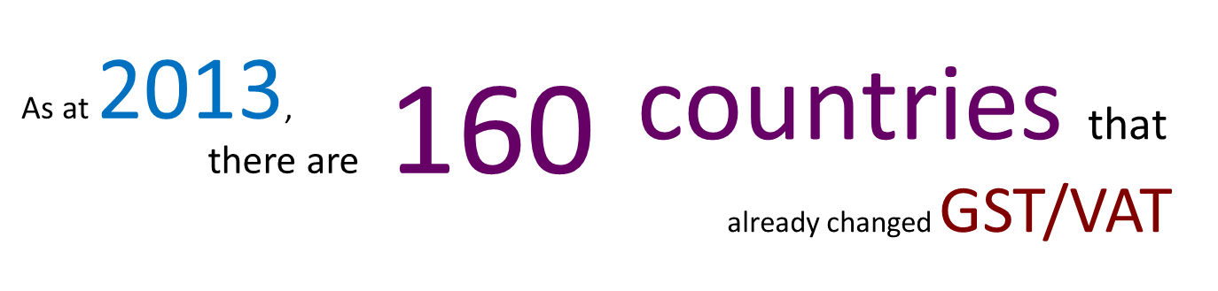
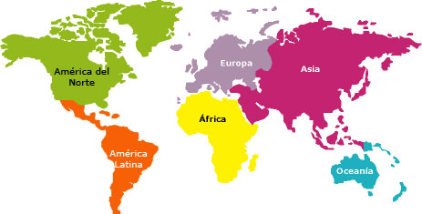
  GST/VAT WITHIN THE REGION
Region | Number of countries
ASEAN | 7
ASIA | 19
EUROPE | 53
OCEANIA | 7
AFRICA | 44
SOUTH AMERICA | 11
CARRIBEAN, CENTRAL & NORTH AMERICA | 19
TOTAL | 160

Slide 18
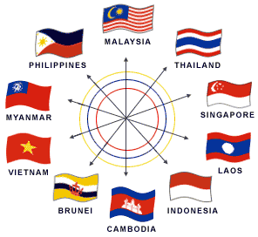
  GST/VAT IN ASEAN COUNTRIES
Country | Year of Implementation | Initial Rate(%) | Current Rate(%)
Indonesia | 1984 | 10 | 10
Thailand | 1992 | 7 | 7
Singapore | 1994 | 3 | 7
Filipina | 1998 | 10 | 12
Cambodia | 1999 | 10 | 10
Vietnam | 1999 | 10 | 10
Laos | 2009 | 10 | 10

Slide 19

  GST/VAT WORLDWIDE
Country | Year of Implementation | Initial Rate(%) | Current Rate(%)
UK | 1973 | 10 | 20
Australia | 2000 | 10 | 10
New Zealand | 1986 | 10 | 15
Norway | 1970 | 20 | 25
Turkey | 1984 | 10 | 18
Morocco | 1986 | 19 | 20

Slide 20
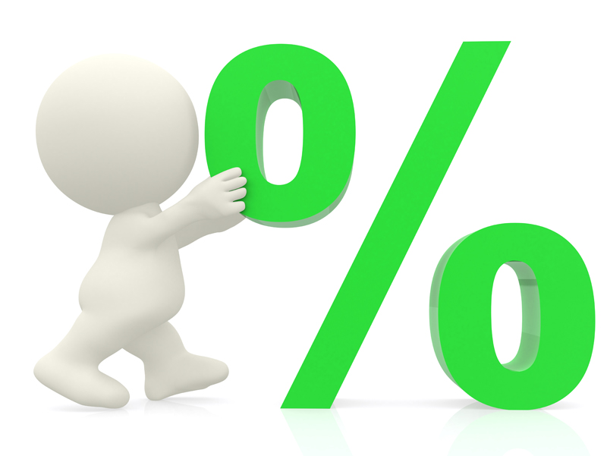

  GST/VAT WORLDWIDE
RATE ?
YEAR OF IMPLEMENTATION ?
HIGHEST
Hungary (European Union) – 27%
FIRST COUNTRY
France, 1954
LOWEST
Nigeria
Canada
Taiwan
Iran
Jersey
LATEST COUNTRY
Gambia, Africa - 2013
5%
Sources : http://gst.customs.gov.my/en/gst/Pages/gst_ci.aspx

Slide 21
WHAT IS GST?

Slide 22


Slide 23


  WHAT IS GST?
  A BROAD-BASED consumption tax in the form of value added tax
  MULTI STAGE TAX based on net value at each stage of business transaction up to the retail stage of distribution
  Also known as VALUE ADDED TAX (VAT) in certain countries
  Tax on final consumption – THE CONSUMER
  GST incurred on inputs is allowed as a credit to the registrant - OFFSET AGAINST OUTPUT TAX

Slide 24


  TYPE OF SUPPLY (GOODS OR SERVICES)
6%
0%
GST
GST
Standard Rated Supply
TAXABLE
SUPPLY
Zero Rated Supply
Exempt Supply
NON-
TAXABLE
SUPPLY
Out of Scope

Slide 25


  SCOPE OF GST / TEST OF GST
  GST is charged on
    The taxable supply of goods and services
    Made by a taxable person
    In the course or furtherance of business
    In Malaysia
  GST is charged on imported goods

Slide 26
BASIC CONCEPTS AND PROPOSED GST MODEL

Slide 27

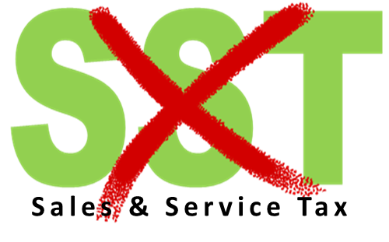
  ABOLISHMENT OF SST
Current Tax System
Effective on
1st April 2015
5%, 6%, 10%, 20%
& specific rate
6%
GST is a REPLACEMENT TAX

Slide 28
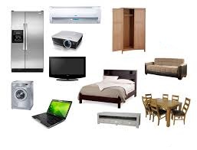
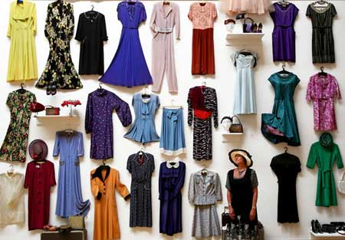
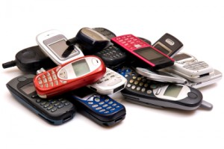



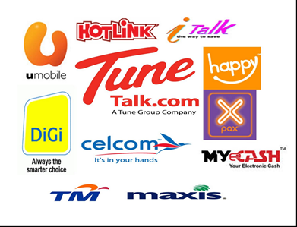
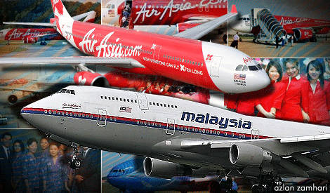
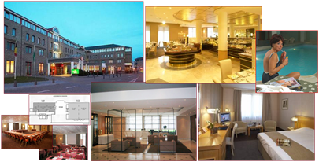
  PROPOSED GST MODEL - STANDARD RATED
6%
Standard rate

Slide 29



  PROPOSED GST MODEL - ZERO RATED
Water usage to domestic users
Export
First 300 units of electricity to domestic users
Excludes distilled water, de-ionised water, oxygenised water and mineral water.
Exported Goods and Services
Supply of first 300 units of electricity to domestic user (Current Tariff : RM 77)
0%

Slide 30
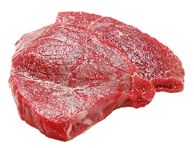


  PROPOSED GST MODEL - ZERO RATED
Livestock supplies (Fresh, chilled or frozen)
Fish, Crab, Oyster, etc.
Cattle
Buffalo
Swine
Sheep & goats
Ducks
Geese
Turkeys
Fish (including dried,salted)
Etc
Fish (including dried,salted)
Lobster
Oyster
Mussels
Octopus
Snails
Sea cucumbers
Jellyfish
Anchovies (ikan bilis)
Etc
0%

Slide 31
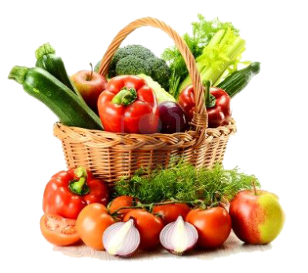
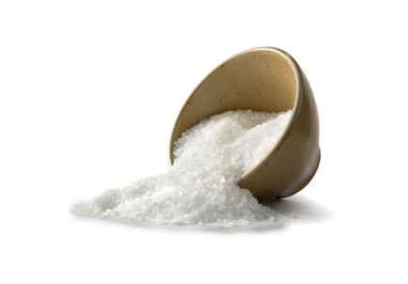
  PROPOSED GST MODEL - ZERO RATED
Agriculture Product
Rice, Flour, Salt, etc.
Potatoes
Tomatoes
Onion, garlic
Cabbage & lettuce
Carrots
Cucumbers
Celery
Mushrooms
Asparagus
Spinach
Olives
Yams
Banana (fresh only)
Etc
Rice
Flour
Palm oil
Coconut oil
Ground nut oil
Margarine
Cencaluk
Sugar
Pasta
White bread and wholemeal
Sauces
Salt
Spices
Milk powder (baby)
0%

Slide 32


  PROPOSED GST MODEL - ZERO RATED
Poultry & Eggs
Books and newspaper
Chicken
Duck
Chicken eggs
Duck eggs
* Include egg in shell, fresh, preserved or cooked
Exercise books and printed books
Dictionaries and encyclopaedia
Student text books
Reference books
Work books
Religious text only
Newspaper (appearing at least four times a week)
Children picture, drawing and colouring books
0%

Slide 33
  PROPOSED GST MODEL - EXEMPTED
SUPPLY OF GOODS DETERMINED AS AN EXEMPT SUPPLY
Any building or premises being used for residential purposed, designed or adapted for use or intended to be used as dwelling (excluding hotel, inn, boarding house or similar establishment sleeping accommodation)
Any supply of investment precious metal.
Eg: gold, silver, platinum, gold coin, silver coin (excluding collector coin)
Any land intended to be used for residential or agricultural or general use
- including parking facilities
- agriculture – does not include land for hunting and fishing activities.
**General use : burial ground,playground, religious building
**Similar establishment: premises provided with sleeping accommodation, with or without lodging or facilities for the preparation of foods for use of visitor or travellers.
33

Slide 34
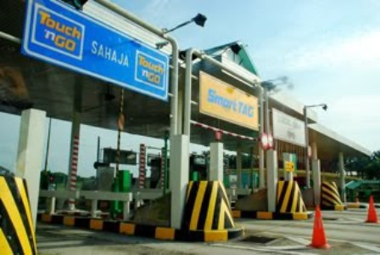
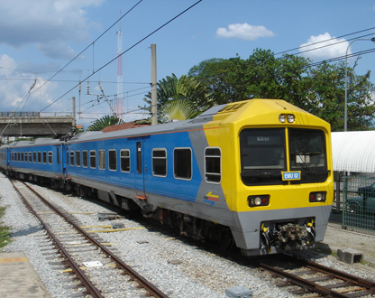
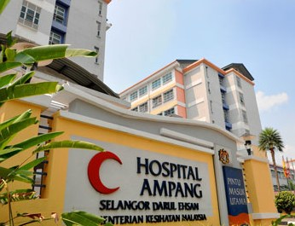
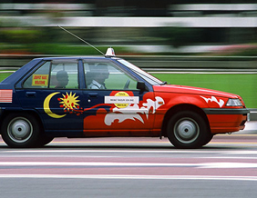
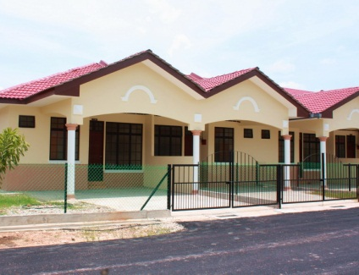
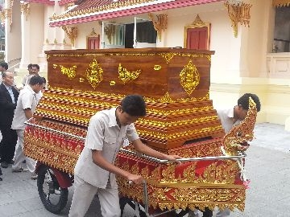
  PROPOSED GST MODEL - EXEMPTED
SUPPLY OF SERVICES DETERMINED AS AN EXEMPT SUPPLY
Public Transportation
Land For Residential, Agriculture And General Use
Highway and Toll Bridge
Funeral, Burial and Cremation Services
Healthcare Services
Education Services
Financial Services
Child Care Services
34

Slide 35
  PROPOSED GST MODEL
  GOVERNMENT SUPPLY
 | FEDERAL GOVERNMENT & STATE GOVERNMENT | LOCAL AUTHORITY & STATUTORY BODIES
OUT OF SCOPE | All supplies by Federal & State Government | Supplies made in the regulatory and enforcement (R&E) Functions e.g. assessment rate collection, issuance of license, penalty
SUBJECT TO GST | Supplies that have been directed by Minister in the GST (Government Taxable Supply Order) e.g. supply made by RTM, Prison Department | Non R&E functions, i.e. business activities e.g. Rental facilities

Slide 36
  GST MECHANISM
INPUT TAX
OUTPUT TAX
ACQUISITION
SUPPLY
PURCHASES
SALES
PAYMENT
INCOME

Slide 37
  GST MECHANISM (CONTD)
INPUT
OUTPUT
Goods
Raw Materials
Seller
Rental
Services
Telephone
GST on Input
= Input Tax
Claim
Input Tax
GST on Output
= Output Tax

Slide 38
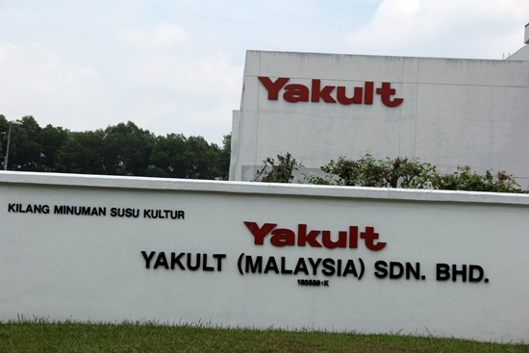
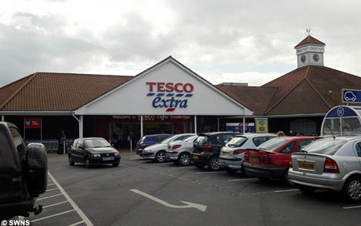
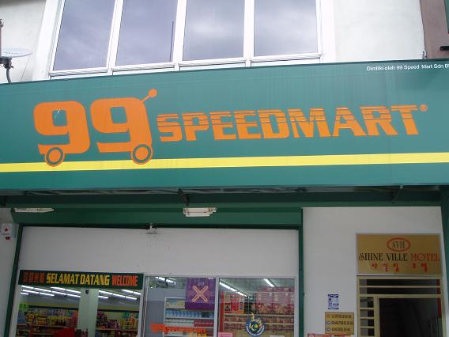

  HOW GST WORKS ?
  STANDARD RATED 6%
GST AT STANDARD RATE 6%
6%
6%
6%
Manufacturer
Wholesaler
Retailer
Consumer
GST input tax claimable

Slide 39

  HOW GST WORKS ?
  STANDARD RATED (CONTD)
6%
6%
6%
Manufacturer
WHOLESALER
Retailer
Consumer
Value Added Activity
Purchase Cost: RM100
GST* : RM6
Purchase Price:RM106
Selling Price: RM125
GST : RM7.50
Total Selling Price: RM132.50
Added Value: RM25
(+ GST : RM1.50)
*RM1.50 will be paid to Customs
*Note: claim input tax

Slide 40


  HOW GST WORKS ?
  STANDARD RATED (CONTD)
Manufacturer
Tax Remitted to Government
Price :RM100
GST:RM6.00
Output Tax =
RM 6.00
Wholesaler
Output Tax = RM 7.50
Input Tax = RM 6.00
Price :RM125
GST:RM7.50
RM 1.50
Retailer
Output Tax = RM 9.00
Input Tax = RM 7.50
Price :RM150
GST:RM9.00
RM 1.50
Consumer
Total amount remitted to Custom:
= RM 9.00
GST 6%

Slide 41
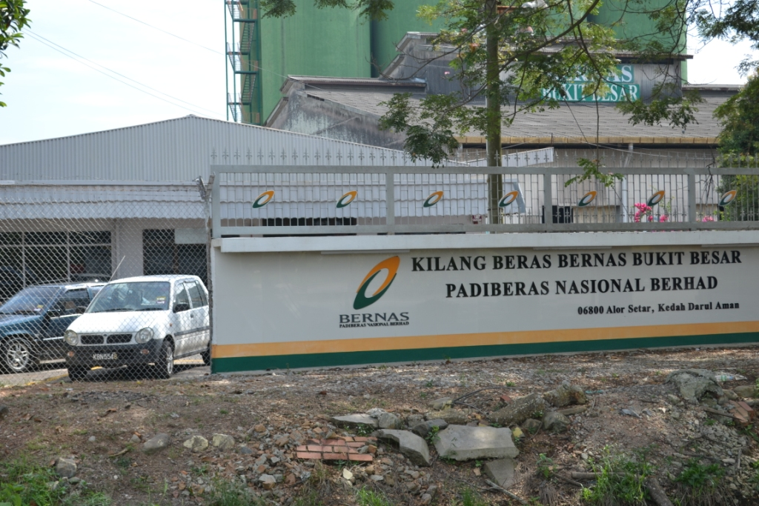


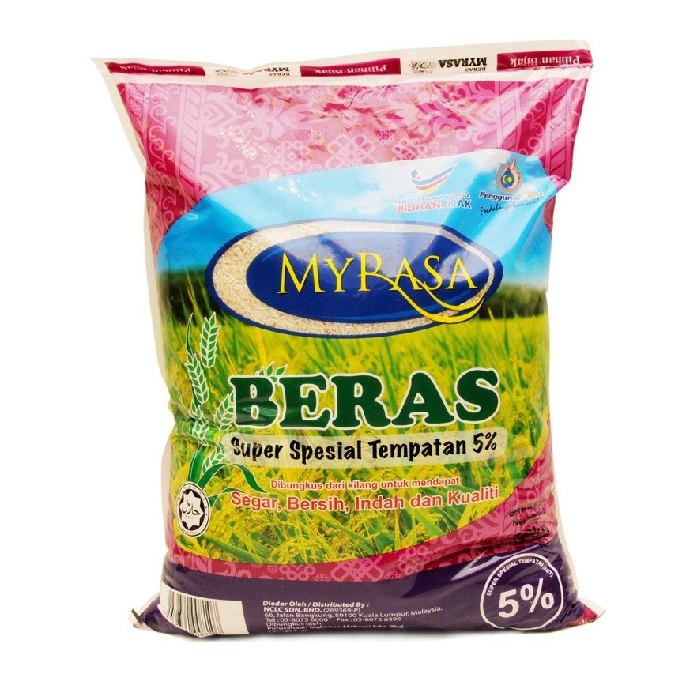
  HOW GST WORKS ?
  ZERO RATED
GST AT ZERO RATE 0%
Manufacturer
(Kilang Beras Bernas)
Wholesaler
(Syarikat Faiza Sdn Bhd)
Retailer
(Speedmart)
Consumer
Consumer
does not
pay any
GST
GST input tax claimable

Slide 42
  HOW GST WORKS ?
  ZERO RATED (CONTD)
0%
0%
0%
Manufacturer
(Beras Bernas)
WHOLESALER
(Syarikat Faiza Sdn Bhd)
Retailer
(99 Speedmart)
Consumer
Value Added Activity
Purchase Cost: RM100
GST* : RM0
Purchase Price:RM100
Selling Price: RM125
GST : RM0
Total Selling Price: RM125
Added Value: RM25
(+ GST : No GST )
No GST will be paid to Customs
*Note: claim input tax

Slide 43
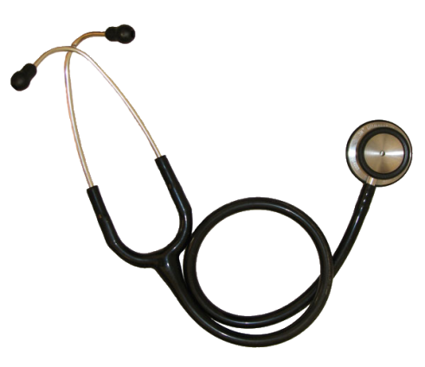
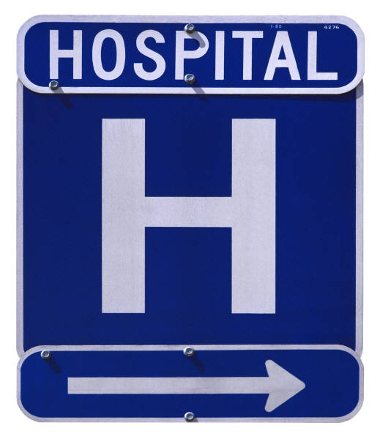

  HOW GST WORKS?
  EXEMPTED
GST AT 6%
NO GST
Supplier
Private Hospital
Consumer
Consumer
does not
pay any
GST
CANNOT claim back the GST paid

Slide 44
  HOW GST WORKS?
  EXEMPTED (CONTD)
Private Hospital
Supplier
Consumer
Value Added Activity
Purchase Cost: RM100
GST : RM6
Purchase Price:RM106
Selling Price: RM131
GST : RM0
Total Selling Price: RM131
Added Value: RM25
(+ GST : No GST )

Slide 45
SST vs GST

Slide 46


  WHY GST?
GST is proven to be a better tax system as it is more EFFECTIVE, EFFICIENT, TRANSPARENT and BUSINESS FRIENDLY and could spur economic growth as well as increase competitiveness in the global market.
GST is capable of generating a more STABLE SOURCE OF REVENUE to the nation because it is less susceptible to economic fluctuations.

Slide 47


GST ADVANTAGES (CONTD.)
  BENEFITS OF GST (CONTD)
Under declaring
Imported goods
1 ) Eliminating hidden activity
Transfer pricing
Manufacturing goods
GST will be shown on the invoice
Consumers will know exactly whether
the goods they consume are subject
to tax and the amount they pay for.
2) Greater Transparency

Slide 48
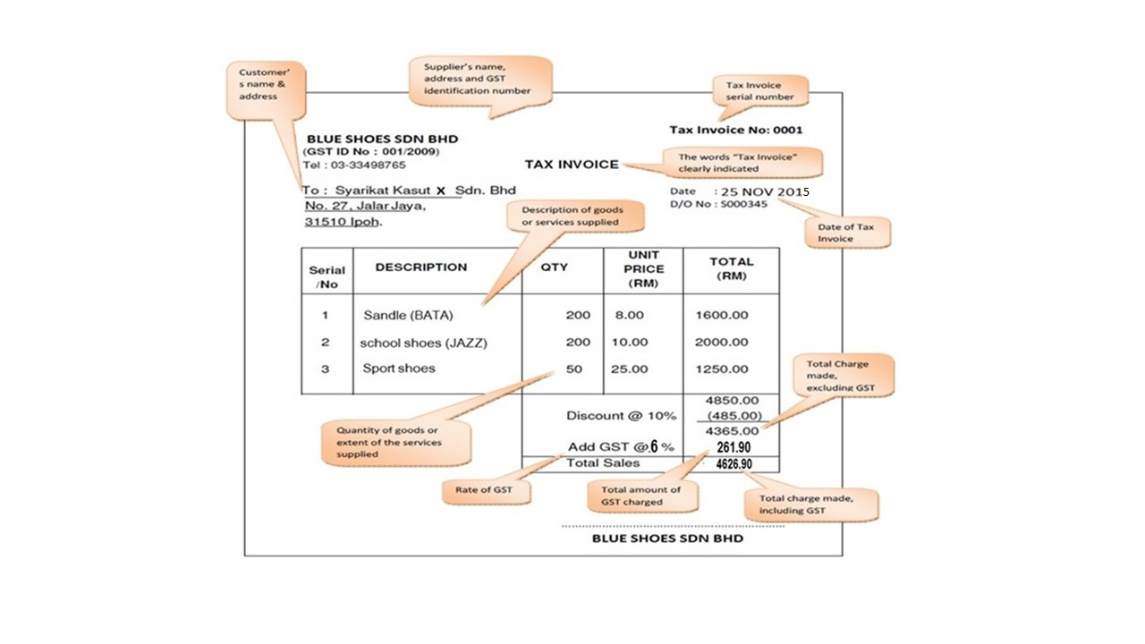
GST ADVANTAGES (CONTD.)
  BENEFITS OF GST (CONTD)
GST SHOWN IN TAX INVOICE

Slide 49


GST ADVANTAGES (CONTD.)
  BENEFITS OF GST (CONTD)
GST registered company will manage their
own accounting for tax.
They can claim any input tax paid without
undergoing any bureaucracy process.
Electronic / Online
      Registration
      GST Statement Submission
      Claiming input tax
3) Less Bureaucracy

Slide 50

  BENEFITS OF GST (CONTD)
4) Fair Tax System and Business Friendly
  Fair Tax System – GST will be charged at every stage of supply chain. (manufacturer, wholesale, retailer) on value added activity.
  Business friendly
  - Availability of various scheme provide such as Approved Trader Scheme, Warehousing Scheme

Slide 51
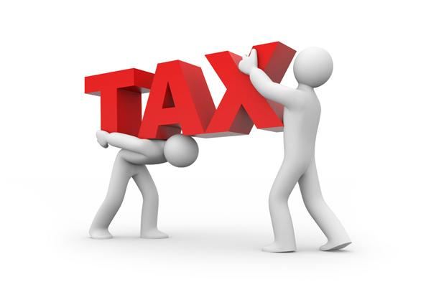
  BENEFITS OF GST (CONTD)
5) GST can overcome weaknesses of sales and service tax in terms of :
Double taxation
  Tax embedded in goods sold particularly in exports

Slide 52
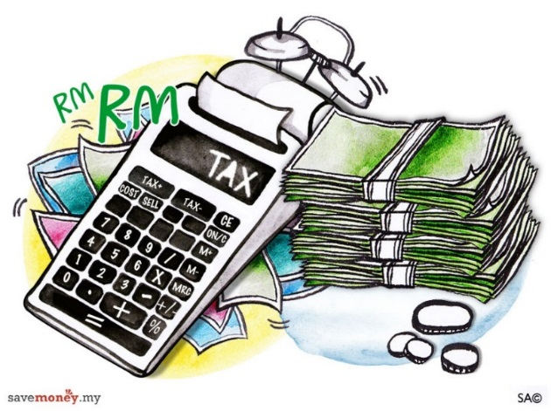

  BENEFITS OF GST (CONTD)
  Need to reduce reliance on:
  Direct tax
  Petroleum revenue
6) Need to reduce
reliance on
existing revenue
in Malaysia

Slide 53
GST IMPACT TO CONSUMER

Slide 54



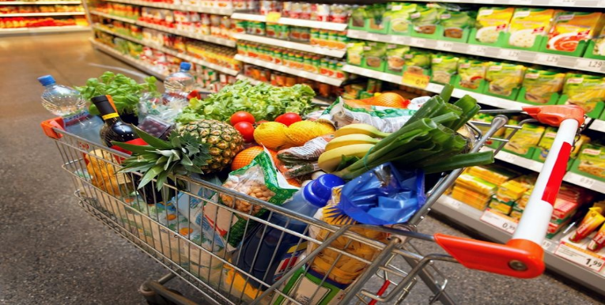
  GST IMPACT TO CONSUMER
  PRICE CONTROL AND ANTI PROFITEERING ACT 2011
Effective on 1 April 2011
Governed by KPDNKK
To make sure that trader/dealer does not increase price arbitrarily
1 - Price Control and Anti Profiteering Act 2011
Special Committee to combat profiteering (Price Monitoring Council)

Slide 55
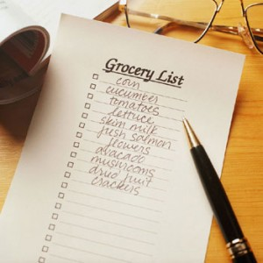
  GST IMPACT TO CONSUMER
  SHOPPERS GUIDE
Illustrate comparisons of prices of goods and services before and after the implementation of GST
  Issued before GST implementation date
  Price were monitored for 1 year after GST implementation date
  Will be publish 3 months before the implementation of GST date.
2 - Shoppers Guide

Slide 56


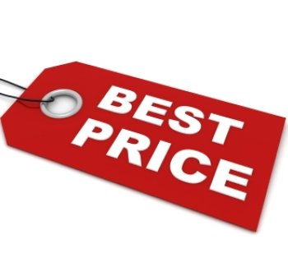
  GST IMPACT TO CONSUMER
  PRICE SETTER
The Government will get the assistance from the hypermarket to be the price setter for the benefit of the consumers
3 – PRICE SETTER

Slide 57

  GST IMPACT TO CONSUMER
  GST RELIEF PACKAGE FOR BUSINESSES
 | Description | Effective
Reduce cost of doing business | Reduction in corporate tax rate by 1%. Reduction in cooperative tax rate by 1% to 2%. Secretarial fee and tax filing fee tax deductible up to RM 5,000 & RM 10,000 respectively. Accelerated Capital Allowances (ACA) for ICT equipment and software is extended. Expenses for GST- related training in accounting & ICT given further deduction. | YA 2016 YA 2015 YA 2015 YAs 2014 to 2016 YAs 2014 & YA 2015
Financial assistance | RM 150 million allocation for purchase of accounting software by SMEs Training Grant of RM 100 million for GST Training | 2014 & 2015 2013 & 2014

Slide 58
  GST IMPACT TO CONSUMER
  GST RELIEF PACKAGE FOR BUSINESSES (CONTD)
 | Description | Effective
Increase disposable income | Personal tax rate reduction across tax bands by 1% to 3% Highest marginal tax rate reduced from 26% to 25% Restructuring of income tax band s by increasing chargeable income subject to maximum rate from above RM 100,000 to above RM 400,000 | YA 2015
Financial assistance | One-off cash assistance of RM 300 to households who are BR1M recipients. | 2015

Slide 59
GST READINESS

Slide 60
  GST READINESS
GST READINESS
EDUCATION AND TRAINING
TAX REGULATORY COMPLIANCE
TRANSITIONAL ISSUE
ACCOUNTING FOR GST
SUPPLIER AND CUSTOMER COMMUNICATION
SYSTEM AND TECHNOLOGY

Slide 61



  GST READINESS
GST Implication on Cash Flow
Need to analyse cash flow impact
  Cash recover from customer before GST is due.
  Assess the need to provide for one time fund to cater for GST payment upfront.
Review credit term to customers.
Review requirement to apply for special schemes.
Big impact to export and import business.

Slide 62
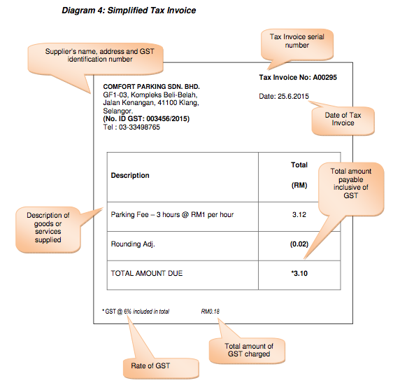
  GST READINESS
GST Implication on Invoicing
Identify each transaction whether standard rate, exempt, zero rate or out of scope supply.
Issuance of full or simplified tax invoice.
Requirement not issue tax invoice for imported services and second hand goods under margin scheme.
21 days rule.

Slide 63
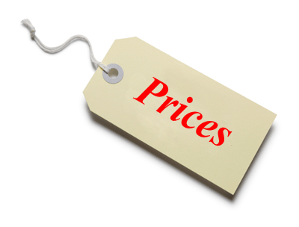

  GST READINESS
GST Implication on Price
Identify existing supplier
  Talk to small supplier to get them registered.
  Review procurement policy to avoid tax cascading.
  Negotiate prices with suppliers to pass on saving.
Review sales price
  Pass on saving
  Absorption of GST
  Price Control and Anti Profiteering Act 2011
Price???

Slide 64


  GST READINESS
GST Implication on Contract
Avoid long term contract without legal review
Absorption of GST
Pricing strategy to pass on saving
GST Implication on Human Resources
Enhance staff understanding of GST
Avoid unnecessary mistake
False info may open to audit case
Review policy on fringe benefit

Slide 65
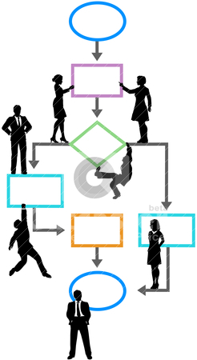
  GST READINESS
GST Implication on System
GST liability on every transaction
GST
???
Use of online submission to tax custom
???
Review system and processes
???
???
???
???
Perform complete mapping of transactions to identify required changes
Computerised system
  Ready made software
  Upgrading present system

Slide 66


  GST READINESS
GST Implication on Input Tax
Not all purchases are claimable, e.g. Blocked Input Tax.
Apportionment of input tax.
Input tax claim upon receiving simplified tax invoice is restricted to RM30.
Implication on Input Tax
INPUT TAX
???

Slide 67
  GST READINESS
GST Implication on Output Tax
Deemed supply eg. Private use and disposal of business assets subject to GST
Gift > RM 500 subject to GST
Implication on Output Tax
Commercial samples in a form not ordinarily available for sale to the public not subject to GST
Supplies to connected persons

Slide 68


  GST READINESS
GST Implication on Bad debts
Bad debt relief can be claim back after 6 months from the date of supply.
Bad debt claims – need to understand evidence of ‘reasonable efforts’ to recover the debt.

Slide 69


  GST READINESS
GST Implication on Stock Management
Monitor business stock
  Conduct stock take on transition date
  Procurement policy
  Registration and deregistration
Special refund
Proof sales tax has been paid (Documents)
Audit certificate

Slide 70

  GST READINESS CHECKLIST
Register for GST with the Royal Malaysian Customs Department (RMCD) through the GST Portal at www.gst.custom.gov.my before 31st December 2014.
GST TRAINING (MAX 3 PARTICIPANTS)
Train the Finance/Accounts department’s staff for GST
Ensure your accounting software is GST-compliant
Review your suppliers’ list (are they GST registered and non-registered?)
Review your long term contracts (implication before and after GST?)
Transitional period issues (from Sales and Services Tax (SST) to GST?)

Slide 71
  GST READINESS CHECKLIST (CONTD.)
Provide a plan for inventory towards GST implementation
Train the Finance/Accounts department’s staffs for GST
Check the list of Output Tax and Input Tax in the organization
Review your business processes (policy and procedures) – can your existing business processes accommodate the added administrative tasks?)
Review your pricing strategies
Check the GST registered and non-registered suppliers list
Review your employment policies (allowances, incentives, etc.)
Make announcements/notice on “Organization Ready for GST” to the concerned parties include the shareholders, investors, customers and suppliers

Slide 72

  ROYAL MALAYSIAN CUSTOMS PORTAL
  www.gst.customs.gov.my

Slide 73

T
H
A
N
K
Y
O
U
www.salihin.com.my | www.mysalihin.com
1 300 88 5678
Copyright Controlled 2014 @ SALIHIN

