Slide 1
Contact

Slide 2








Type*
Customer
Phone
03-6185 9970 , 03-6185 9932
Company*
ABC Sdn Bhd
Fax
03-61842524
ROC No.
12345-T
Email
info@abc.com.my
Address 1
No. 555, Jalan Samudra Utara 2
Web Address
www.info.com.my
Address 2
Taman Samudra
Gred
A
Postal Code
68100
Status
Active
City
Batu Caves
State
Business
Activities
Business Consultant
Selangor Darul Ehsan
Country
Malaysia
Year End
Click to select date
Contact
Director & Shareholder
Other Address
Services
Account
Audit
Taxation
Co.Sec
CF
GST
IT
Shariah
Other
Add New
Print
search
 | First Name | Last Name | Work Phone | Mobile Phone | Email | City
 | Mohammad Ali | Ja’afar | 03-6188 5241 | 012-5225621 | ali@abc.com.my | Shah Alam
 | Azarina | Ramdhan | 03-6188 5242 | 019-8221256 | azarina@abc.com.my | Klang
 | Abu | Razak | 03-6188 5242 | 017-2256321 | abu@abc.com.my | Miri

Slide 3

First Name*
Address 1
Last Name*
Address 2
I.C Number
Postal Code
Co. Name
City
Title
State
Work Phone
Country
Mobile Phone
Shareholder
Yes
No
Fax
Share (RM)
Email
Effective date
Click to select date
Director
Yes
No
Effective date
Effective date
Click to select date
Details
Login Panel
Home Phone
Home City
Home Address 1
Home Sate
Home Address 2
Home Country
Home Postal Code
Birth Date
Click to select date

Slide 4
First Name*
Address 1
Last Name*
Address 2
I.C Number
Postal Code
Co. Name
City
Title
State
Work Phone
Country
Mobile Phone
Shareholder
Yes
No
Fax
Share (RM)
Email
Effective date
Click to select date
Director
Yes
No
Effective date
Click to select date
Details
Login Panel
User Login
Set Password
Confirm Password
Admin

Slide 5
Director & Shareholder

Slide 6
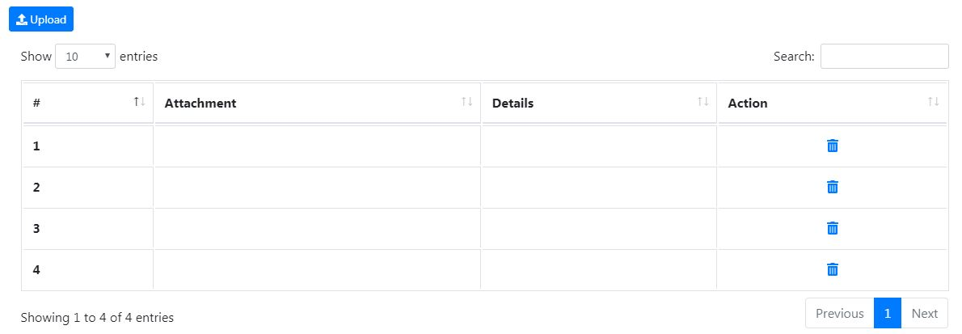
Contact
Director & Shareholder
Other Address
Services
Account
Audit
Taxation
Co.Sec
CF
GST
IT
Shariah
Other
Add New
Print
search
 | First Name | Last Name | Director | Effective | Shareholder | Share Per Unit | Effective Date
 | Mohammad Ali | Ja’afar | Yes |  | Yes | 10,000.00 | 13/01/2017
 | Abu | Raza | Yes |  | Yes | 20,000.00 | 13/01/2017
Attachements

Slide 7
Other Address

Slide 8
Contact
Director & Shareholder
Other Address
Services
Account
Audit
Taxation
Co.Sec
CF
GST
IT
Shariah
Other
Add New
Print
search
 | Description | Address | State | Country | Phone | Fax
 | Branch Kedah | Lot 27, Jalan KPAA 1 Kompleks Perniagaan Al-Azim 75150 Bukit Baru | Kedah Darul Aman | Malaysia | 04-2256325 | 04-2256325
 | Branch Johor | No. 741 , Jalan Angsana Bukit Katil 45000 Segamat | Johor Darul Takzim | Malaysia | 07-5223652 | 07-5225211

Slide 9
Pop up for Other Address
Description
Branch Kedah
Phone
04-2256325
Address 1
Lot 27, Jalan KPAA 1
Fax
04-2256325
Address 2
Kompleks Perniagaan Al-Azim
Note
Postal Code
75150
City
Bukit Baru
State
Kedah Darul Aman
Country
Malaysia
Save
Closed

Slide 10
Services

Slide 11
Contact
Director & Shareholder
Other Address
Services
Account
Audit
Taxation
Co.Sec
CF
GST
IT
Shariah
Other
Add New
Print
search
 | Services | Type of Job | Description | Start Date | End Date
 | Audit | Financial Statement Audit | Preparing Audit 2017 | 12/02/2017 | 20/04/2017
 | Taxation | Tax Compliance | Tax Compliance 2017 | 12/04/2017 | 24/07/2017
 | Account | Accounting & Bookkeeping | Preparing annual financial statement 2017 | 03/01/2017 | 28/01/2017
 | Company Sec. | Annual return | Annual return 2017 | 04/01/2017 | Current
 | GST | GST Compliance | Preparing GST return | 03/03/2017 | Current

Slide 12
Pop up for Services
Services
Taxation
Type of Job
Tax Compliance
Start date
Click to select date
Description
Tax Compliance 2017
End date
Current
Click to select date
Save
Closed
***End date : hanya pilih salah satu sahaja. Samaada piih current of masukkan date.

Slide 13
ACCOUNT info

Slide 14
AUDIT Info

Slide 15
THIS SECTION SAME AS SLIDE 1
Contact
Director & Shareholder
Other Address
Services
Account
Audit
Taxation
Cosec
CF
GST
IT
Shariah
Other
z
Attachment/Document
Upload
# | Attachment | Details | Action
1 |  | Borang 9

Slide 16
ADD NEW COMPANY SECRETARY
COMPANY SECRETARY INFORMATION
Company Name*
State
Company No*
Person In Charge
Address 1
Status
Address 2
Postal Code
City

Slide 17
Taxation info

Slide 18
THIS SECTION SAME AS SLIDE 1
Contact
Director & Shareholder
Other Address
Services
Account
Audit
Taxation
Cosec
CF
GST
IT
Shariah
Other
TAXATION INFORMATION
Tax No*
LHDN Branch*
Submission Date
Attachment/Document
Upload
# | Attachment | Details | Action
1 |  | Borang 9

Slide 19

UPLOAD FILE
Details/Description
Upload Files
Format for upload files : jpg/jpeg/png/bmp/pdf/doc/docx/xls/xlsx

Slide 20
COSEC Info

Slide 21
THIS SECTION SAME AS SLIDE 1
Contact
Director & Shareholder
Other Address
Services
Account
Audit
Taxation
Co.Sec
CF
GST
IT
Shariah
Other
Incorporated Date*
Bank List:
Add New
 | Bank | Branch | Account No
 | Maybank | Sri Gombak | 1643543452
 | CIMB | Damansara | 403902248
Attachment/Document
Upload
# | Attachment | Details | Action
1 |  | Borang 9
COMPANY SECRETARY INFORMATION
Add New
# | Company Secretary | Year | Action
1 | MYSA | 2018
2 | KK COMPANY SECRETARY | 2017

Slide 22
Add New Bank Setup
BANK MASTER INFORMATION
Bank Name*
Bank Acct No.*
ADDRESS INFORMATION
Address 1
State
Address 2
Country
Postal Code
City

Slide 23
UPLOAD FILE
Details/Description
Upload Files
Format for upload files : jpg/jpeg/png/bmp/pdf/doc/docx/xls/xlsx

Slide 24
GST Info

Slide 25
THIS SECTION SAME AS SLIDE 1
Contact
Director & Shareholder
Other Address
Services
Account
Audit
Taxation
Cosec
CF
GST
IT
Shariah
Other
GST INFORMATION
GST Registration No*
Taxable Period*
Branch
Attachment/Document
Upload
# | Attachment | Details | Action
1 |  | Borang 9

Slide 26
UPLOAD FILE
Details/Description
Upload Files
Format for upload files : jpg/jpeg/png/bmp/pdf/doc/docx/xls/xlsx

